Slide 1
BAAR System Administration Training – Phase 3
September 2015

Slide 2
Table of Contents
Segment | Topic
1 | Pegasys General BAAR Reference Tables
2 | Detail Billing Record Related Reference Tables
3 | Referral Reference Table
4 | Debt Account Reference Tables
5 | Allowance For Loss Reference Table
6 | VCSS Reference Table Management
7 | VCSS Security Authorization Framework and Principal Management
8 | VCSS Systems Settings Table
9 | Online VCSS Vendor Registration Process
10 | Online VCSS New User Access Process

Slide 3
Segment 1:
Pegasys General BAAR
Reference Tables

Slide 4
Segment Outline
Segment 1: Pegasys General BAAR Reference Tables
Receivable Type
Accounts Receivable Options
Write-Off Reason
Write-Off Type
Segment 2: Detail Billing Record Reference Table
Segment 3: Referral Reference Table
Segment 4: Debt Account Reference Tables
Segment 5: Allowance For Loss Reference Table
Segment 6: VCSS Reference Table Management
Segment 7: VCSS Security Authorization Framework & Principal Management
Segment 8: VCSS System Settings Table
Segment 9: Online VCSS Vendor Registration Process
Segment 10: Online VCSS New User Access Process

Slide 5
General BAAR Reference Tables
Updated Reference Tables in Phase 3
Receivable Type
Accounts Receivable Options
New Phase 3 Reference Tables
Write-Off Reason
Write-Off Type

Slide 6
Dunning
Receivable Type

Slide 7
Receivable Type Reference Table
Name Receivable Type
Purpose Defines valid Receivable Types that can be used in the system, allowing transactions to be classified into groups for downstream processes
Navigation Reference > Accounts Receivable > Receivable Types
Related Items Transaction Type Defaults
Dunning
Referral
Write-Off

Slide 8
Receivable Type
Receivable Types are based on Business Line as needed for each billing method
Separate Receivable Types are required when dunning is configured differently for these vendors
Phase 3 Receivable Types - BILLING:
Business Line | Code | Uses
AAS-ITS | AASITSADV | AAS-ITS Advance
AASFEDSIM | FSIP | AAS FedSim IPAC
 | FSNI | AAS FedSim Non-IPAC
AASREGIT | RITIP | AAS Regional IT IPAC
 | RITNI | AAS Regional IT Non-IPAC
IWAC | IWACIP | IWAC IPAC
 | IWACNI | IWAC Non-IPAC
ITSEXPSER | ESIP | ITS Expanded Services IPAC
 | ESNI | ITS Expanded Services Non-IPAC
ITSWAN | WANIP | ITS WAN IPAC
 | WANNI | ITS WAN Non-IPAC
ITSREGTEL | RTLCOMIP | ITS Regional Telecom IPAC
 | RTLCOMNI | ITS Regional Telecom Non-IPAC
ITSNATITCM | NITIP | ITS National IT IPAC
 | NITNI | ITS National IT Non-IPAC
ITSHSPD12 | HSPD12IP | ITS HSPD-12 IPAC
 | HSPD12NI | ITS HSPD-12 Non-IPAC
Business Line | Code | Uses
OUTLEASE | OUTLS | Outlease
EXTERNAL SERVICES | EXTSERVI | Region 6 External Services MBP IPAC
 | EXTSERVNI | Region 6 External Services MBP Non-IPAC
R6 MANUAL | MNLI | Manual BP IPAC
 | MNLNI | Manual BP Non-IPAC
R7 MANUAL | R7MANLNI | Region 7 Manual BP Non-IPAC
 | R7MANLI | Region 7 Manual BP IPAC

Slide 9
Receivable Type
Phase 3 Receivable Types - CLAIMS:
Business Line | Code | Uses
R6 CLAIMS | ADCLAIMR6 | Region 6 Aggregate Discount Claims
 | APCLAIMR6 | Region 6 Autopay Claims
 | AUCLAIMR6 | Region 6 Audit Related Claims
 | ECCLAIMR6 | Region 6 Excess Cost Claims
 | FICLAIMR6 | Region 6 FOIA Claims
 | FPCLAIMR6 | Region 6 Fedpay Claims
 | IFCLAIMR6 | Region 6 IFF Claims
 | LDCLAIMR6 | Region 6 Liquidated Damages Claims
 | NCCLAIMR6 | Region 6 Non Compliance Payments Claims Collections
 | PRCLAIMR6 | Region 6 Payroll Claims
 | RPCLAIMR6 | Region 6 Restitution Payments Claims Collections
 | TACLAIMR6 | Region 6 TAPS Claims
 | VEHCLAIM | Region 6 Vehicle Claims
 | VNCLAIMR6 | Region 6 Vendor Claims
 | WSCLAIMR6 | Region 6 Waste Paper/Scrap Claims
 | NCCLAIMR6 | Region 6 Non Compliance Payments Claims Collections
Business Line | Code | Uses
R7 CLAIMS | CDCLAIMR7 | Region 7 Contract Dispute Claims
 | DPCLAIMR7 | Region 7 Duplicate Payment Claims
 | EPCLAIMR7 | Region 7 Erroneous Payment Claims
 | ETCLAIMR7 | Region 7 Early Termination Claims
 | FRCLAIMR7 | Region 7 Fraud Claims
 | LDCLAIMR7 | Region 7 Liquidated Damages Claims
 | LTCLAIMR7 | Region 7 Litigation Claims
 | PRCLAIMR7 | Region 7 Property Damages Claims
 | RSCLAIMR7 | Region 7 Restitution Claims
 | STCLAIMR7 | Region 7 Settlement Claims
 | UCCLAIMR7 | Region 7 Utility Credit Claims

Slide 10
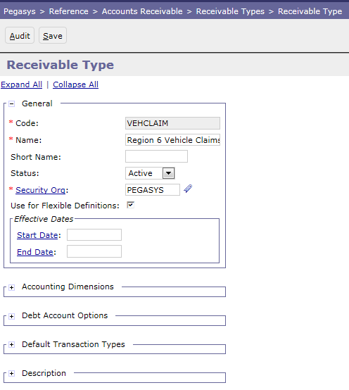
Receivable Type Reference Table
Reference > Accounts Receivable > Receivable Types

Slide 11
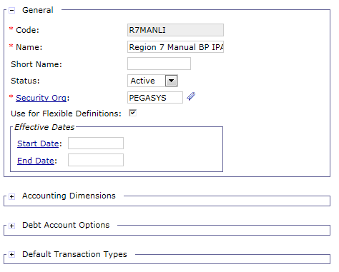
Receivable Type Reference Table
General: Includes information that uniquely identifies
each Receivable Type (Code, Name)
Not used in GSA’s
configuration

Slide 12
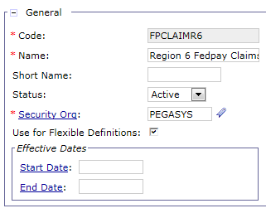
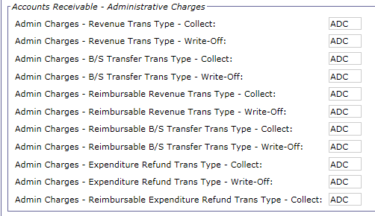
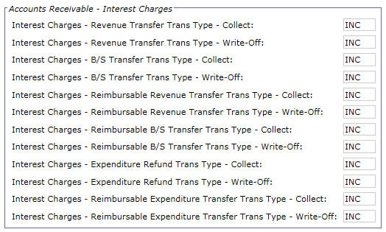
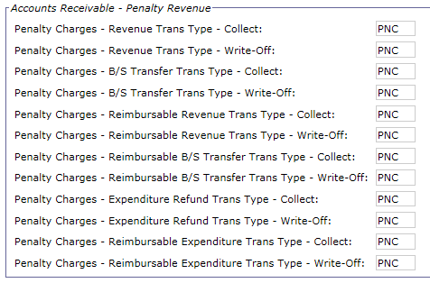
Receivable Type Reference Table – Default Transaction Types
Default Transaction Types: For Receivable
Type Codes related to Debt Accounts (Claims),
this table also stores the default Transaction
Types for Interest, Penalty, and Administrative
Charges

Slide 13
Dunning
Accounts Receivable Options

Slide 14
Accounts Receivable Options Reference Table
Name Accounts Receivable Options
Purpose Defines the options for Accounts Receivable processing for each Fiscal Year, Receivable Type, Vendor Type combination
Navigation Reference > Accounts Receivable > Accounts Receivable Options
Related Items Dunning Notice Generation Criteria
Overdue Interest, Penalty, Admin Charge Assessment
Write-off Generation
Treasury Referral Selection Criteria

Slide 15
Accounts Receivable Options Usage
The Accounts Receivable Options reference table is used by various processes throughout the receivables lifecycle, including:
Dunning Notice Generation Criteria
Overdue Interest, Penalty, and Administrative Charge
Assessment
Write-Off Generation
Treasury Referral Selection Criteria
Generate Receivable and Earned Revenue
Bill Customer
Accruals
Track Receivable & Record Overdue Charges
ARDUNNING
AROVERDUE
Record Collection
Disputes -
Chargebacks
Write off/ Adjustment/ Treasury Referral
ARREFERSEL
Notes:
This is the generic lifecycle that does not take into account the billing vehicle

Slide 16
Accounts Receivable Options Reference Table
Defines the options for Accounts Receivable processing for each Fiscal Year, Receivable Type, Vendor Type combination
Ex. Dunning creation and administrative/interest/penalty charges application against overdue receivables
Vendor Type
Fiscal Year
Receivable Type
Primary key
Defines how transactions should be treated in downstream processes
Configured for each Business Line
Billing Receivable Types: unique values for IPAC vs non-IPAC
Examples:
Count/frequency of dunning
Overdue charge assessment
Referral Selection criteria
Identifies the type of vendor:
Federal Government
Commercial
DC Government
Employee
Commercial
State & Local Government
Foreign Commercial
Note: The “Primary Key” is the combination of Rec Type, Fiscal Year, and Vendor Type that make each record unique but there is no field called “Primary Key” in the AR Options Reference Table.

Slide 17
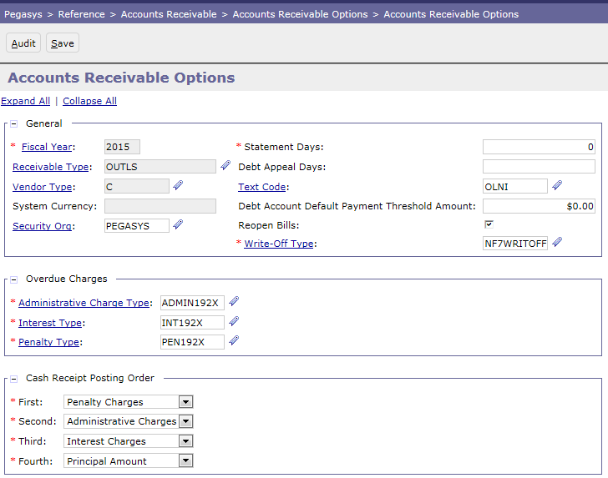
Accounts Receivable Options Reference Table
Reference > Accounts Receivable > Accounts Receivable Options

Slide 18
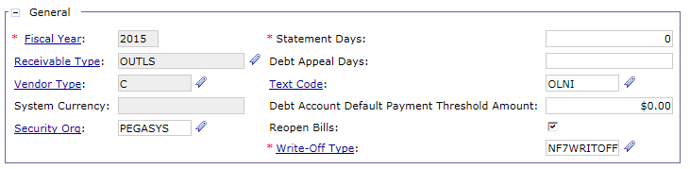
Accounts Receivable Options Reference Table
General Section: Includes information that uniquely identifies the AR Option:
Fiscal Year
Receivable Type
Vendor Type
Security Org
Text Code: Pre-defined text to be included on the printed bill (configured value defaults on BDs)
Write-off Type to be associated with billings using the Receivable Type /Vendor Type (configured valued defaults on BDs)
Reopen Bills: Determines whether a referenced bill should be reopened by a referencing transaction
Note: The Statement Days, Debt Appeal Days, and Debt Account Default Payment Threshold Amount fields are not used in BAAR Phase 3
Notes:
Note: The Text code defines some standard printed bill information, but there are also other configurable messages/layout settings that are in the "Bill Gen Text Code" on the batch job parameters.
Note: GSA has chosen not to use the automated Pegasys write-off functionality. However, since the Write-Off Type is a required field on the AR Options table, it will be populated with a “dummy” code (not configured for use).

Slide 19
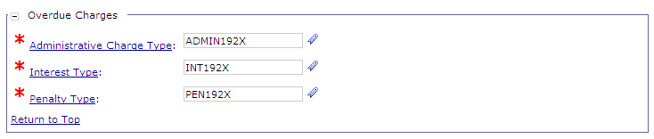
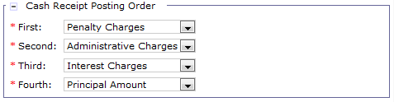
Accounts Receivable Options Reference Table
Overdue Charges: Defines how overdue charges should be
applied by referencing valid Administrative, Interest, and Penalty
overdue charge types (configured values default on BDs)
Cash Receipt Posting Order: Defines the order which a Cash
Receipt should liquidate the different line types of BDs
Cash posting order is dictated by Treasury
Note: Overdue Charges are only automatically calculated and assessed for non-Federal customers
Notes:
Note: GSA may manually charge certain Federal customers (those that have repayment issues) with administration fees, interest, and penalty overdue charges.

Slide 20
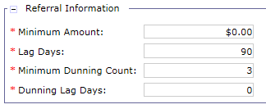
Accounts Receivable Options Reference Table
Referral Information: Defines the options used to determine
when and for what amount a debt can be referred to Treasury for collection
Note: Pegasys Referral functionality will be used by Outlease and Claims
Minimum Amount: Minimum dollar amount for BD/DAs to be eligible for referral
Lag Days: Minimum number of days that must pass for BD/DAs to be eligible for referral
Based on Collection Due Date for BDs
Based on First Demand Letter Generated Date for DAs
Minimum Dunning Count: Minimum number of dunning notices that must be sent to a debtor before the receivable is eligible for referral
Dunning Lag Days: Minimum number of days after the last dunning notice was sent before the receivable is eligible for referral

Slide 21
Accounts Receivable Options Reference Table
Referral Information: Defines the options used to determine
when and for what amount a debt can be referred to Treasury for collection
 | Region 6 Program Office Claims | Region 6 Non-Program Office Claims | Region 7 Claims | Region 7 Outlease
Minimum Amount | 0 | 0 | 0 | 0
Lag Days | 90 | 90 | 90 | 90
Minimum Dunning Count | 2 | 3 | 3 | 3
Dunning Lag Days | 0 | 0 | 0 | 0
Minimum Dunning Count: Pegasys only creates 2 dunning letters for R6 PO Claims because 1st dunning letter is generated by Program Office and not recorded in Pegasys

Slide 22
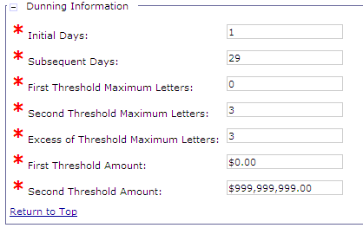
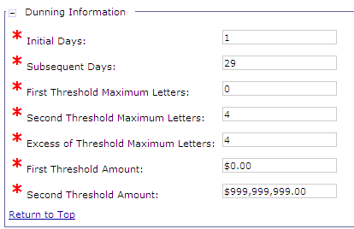
Accounts Receivable Options Reference Table
Dunning Information: Defines the options used to determine when dunning
should be created for Billing Documents
Dunning Criteria: Non-Federal Customers
Dunning Criteria: Federal Customers
Initial Days: Number of days after the collection due date on which the 1st dunning letter should be generated [The Collection Due Date is set to 30 days after the bill print date for non-Federal customers]
Subsequent Days: Number of days used to determine the frequency for generating dunning notices after the 1st dunning notice is generated
First/Second Threshold Maximum Letters: Maximum number of dunning letters that should be produced for receivables with a principal total less than or equal to the First/Second Threshold Amount
Excess of Threshold Maximum Letters: Maximum number of dunning letters that should be produced for receivables with a principal total greater than the Second Threshold Amount
First/Second Threshold Amount: Amount used to determine the maximum number of dunning notices generated for receivables with principal totals less than or equal to the threshold amount.
Notes:
Note: Dunning notices generated in Pegasys are transmitted to VCSS for the customer to view. Like PDF billing statements, dunning notices are not emailed to the customer.
First/Second Threshold Amount used in conjunction with the First/Second Threshold Maximum Letters to determine the maximum number of letters to be sent based on principal amount.

Slide 23
Accounts Receivable Options Reference Table
Dunning Information: Defines the options used to determine when dunning
should be created for Debt Accounts
 | Region 6 Program Office Claims | Region 6 Non-Program Office Claims | Region 7 Claims
Initial Days | 30 | 0 | 0
Subsequent Days | 30 | 30 | 30
1st Threshold Maximum Letters | 0 | 0 | 0
2nd Threshold Maximum Letters | 2 | 3 | 3
Excess of Threshold Maximum Letters | 2 | 3 | 3
1st Threshold Amount | 0 | 0 | 0
2nd Threshold Amount | $999,999,999 | $999,999,999 | $999,999,999
Initial Days: 1st dunning letter for R6 PO claims is generated by Program Office, not Peg
Pegasys waits 30 days to create the 2nd dunning letter
1st/2nd Threshold Max Letters: Pegasys only creates 2 dunning letters for R6 PO Claims because 1st dunning letter is generated by Program Office and not recorded in Pegasys
Notes:
Note: Dunning notices generated in Pegasys are transmitted to VCSS for the customer to view. Like PDF billing statements, dunning notices are not emailed to the customer.

Slide 24
Dunning
Write-Off Reason

Slide 25
Write-Offs – Overview
Receivables with outstanding amounts may be written-off if the bill/claim is deemed uncollectible by GSA
Write-offs are processed in Pegasys using a Cash Receipt document
Processing Write-Off CRs triggers workflow approval
Require workflow approvals prior to processing
Approval Routing is based on:
Write-off transaction amount
GSA Policy Write-Off Thresholds for Federal and Non-Federal receivables
Write-Off Selection batch job:
Identifies outstanding debts eligible to be written-off
Eligibility determined by Write-Off Types defaulted from AR Options
Notes:
Approvals and Thresholds are maintained in the Write-Off tables

Slide 26
Write-Offs – Federal Approvals
Approval routing of write-off documents is based on the write-off amount and GSA policy write-off thresholds
All R6/7 Federal Write-Off Approvers:
Min ($) | Max ($) | Approval 1 | Approval 2 | Approval 3 | Approval 4 | Approval 5
50.01 | 1,000 | Technical Matter Expert
1,000.01 | 5,000 | “ | Manager
5,000.01 | 10,000 | “ | “ | Branch Chief
10,000.01 | 20,000 | “ | “ | “ “ | Division Director
20,000.01 |  | “ | “ | “ “ | “ “ | Director Financial Policy and Operations
‹#›

Slide 27
Write-Offs – Non-Federal Approvals
Approval routing of write-off documents is based on the write-off amount and GSA policy write-off thresholds
All R6/7 Non-Federal Write-Off Approvers:
Min ($) | Max ($) | Approval 1 | Approval 2 | Approval 3 | Approval 4 | Approval 5
50.01 | 1,000 | Technical Matter Expert
1,000.01 | 10,000 | “ | Manager
10,000.01 | 50,000 | “ | “ | Branch Chief
50,000.01 | 100,000 | “ | “ | “ “ | Division Director
100,000.01 |  | “ | “ | “ “ | “ “ | Director Financial Policy and Operations
‹#›

Slide 28
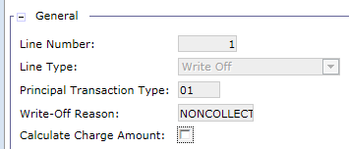
Write-Off Reason Reference Table
Name Write-Off Reason
Purpose Defines valid Write-Off Reasons to be recorded on Pegasys Write-Off documents
Navigation Pegasys > Reference > Accounts Receivable > Write-Offs > Write-Off Reasons
Related Items Write-Off Documents
Write-Off Entry Query

Slide 29
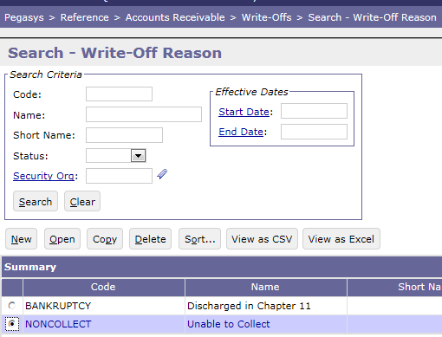
Write-Off Reason Reference Table
Reference > Accounts Receivable > Write-Offs > Write-Off Reasons

Slide 30
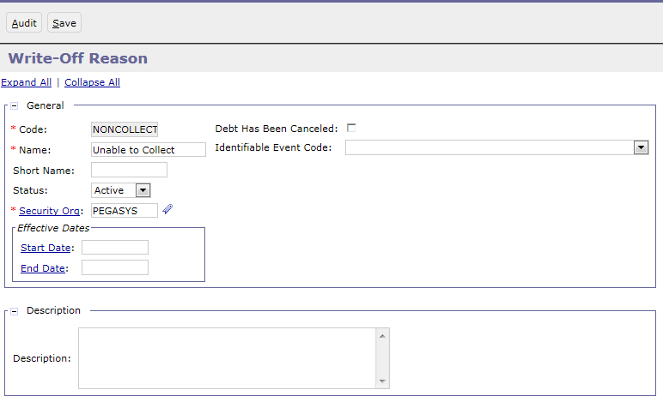
Write-Off Reason Reference Table
General: Includes information that uniquely identifies
each Reason (Code, Name)

Slide 31
Dunning
Write-Off Type

Slide 32
Write-Off Type Reference Table
Name Write-Off Type
Purpose Maintains the Write-Off types defaulted on Debt Accounts.
Define eligibility criteria for Debt Accounts to be identified for write-off by Write-Off Selection batch job.
Define default Write-Off Doc Type, Write-Off Reason, and Write-Off transaction line description.
New Phase 3 values include:
R6CWRITOFF (Region 6 Claims) R7CWRITOFF (Region 7 Claims)
Navigation Pegasys > Reference > Accounts Receivable > Write-Offs > Write-Off Types
Related Items Write-Off Selection Write-Off Generation

Slide 33
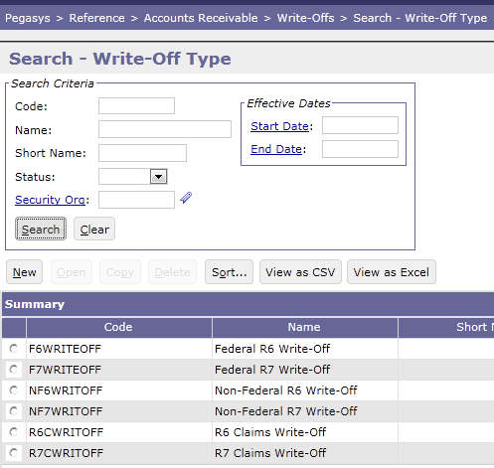
Write-Off Type Reference Table
Reference > Accounts Receivable > Write-Offs > Write-Off Types

Slide 34
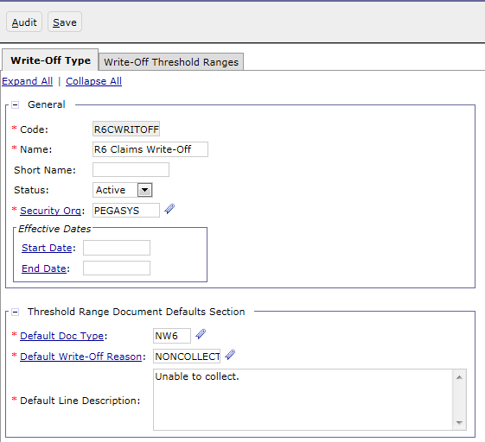
Write-Off Type Reference Table
General: Includes information that uniquely identifies
each Reason (Code, Name)
Default Doc Type: Determines the write-off Cash
Receipt Document Type to be generated via the
Write-Off Generation batch job
Default Write-Off Reason: Determines the Write-Off
Reason code to be recorded on the write-off Cash
Receipt created by the Write-Off Generation batch job
Default Line Description: Determines the
text explaining the write-off to be recorded
on the write-off Cash Receipt created by
the Write-Off Generation batch job

Slide 35
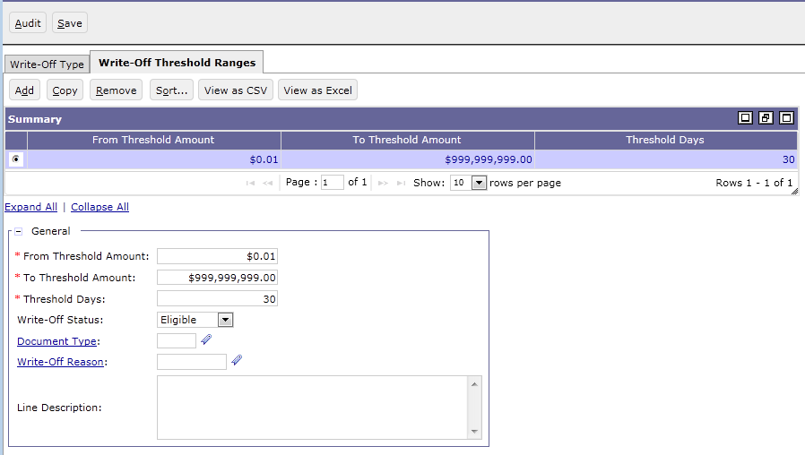
Write-Off Type Reference Table
Threshold Amount range and Days are used by the Write-Off Selection batch job to determine which Debt Accounts should be marked as eligible for Write-Off
GSA then uses the Write-Off Entry Query to review and approve eligible Debt Accounts for Write-Off
The Write-Off Generation batch job will create Write-Off Cash Receipt documents for any approved Debt Accounts

Slide 36
Segment 2:
Detail Billing Record Related
Reference Tables

Slide 37
Segment Outline
Segment 1: Pegasys General BAAR Reference Tables
Segment 2: Detail Billing Record Reference Table
Detail Billing Crosswalk Configuration
Segment 3: Referral Reference Table
Segment 4: Debt Account Reference Tables
Segment 5: Allowance For Loss Reference Table
Segment 6: VCSS Reference Table Management
Segment 7: VCSS Security Authorization Framework & Principal Management
Segment 8: VCSS System Settings Table
Segment 9: Online VCSS Vendor Registration Process
Segment 10: Online VCSS New User Access Process

Slide 38
Dunning
Detail Billing Crosswalk Configuration

Slide 39
Detail Billing Crosswalk Reference Table
Name Detail Billing Crosswalk
Purpose Allows GSA to configure which field (or set of fields) will determine the value of a different field (or set of fields) on detail billing records.
Crosswalk criteria are used to determine the fields and document attributes to be recorded on the summarized Pegasys billing transaction (BD/NV).
Navigation Pegasys > Reference > Accounts Receivable > Detail Billing Crosswalk
Related Items Detail Billing Crosswalk batch job
Detail Billing Summarization batch job

Slide 40
Detail Billing Crosswalk Configuration
Provides flexibility for DBR feeder systems that cannot send all the Pegasys specific fields required to process BD/NVs
Defines values for blank “shared fields”
Shared Fields: Detail Billing Record fields that are also present on the document header or accounting lines of BD/NVs
The value of these fields cannot be changed once a DBR has been associated to a document
Crosswalk batch process: uses the Detail Billing Crosswalk table to fill in the specified fields as defined in the Crosswalk table based on priority order
The Crosswalk batch process will never overwrite fields that already contain a value sent from the feeder system (are not null)
If any “To” field contains a value, then all sequences within that Rule Grouping will not populate ANY values
Crosswalk batch process is run after each Detail Billing Record Import batch process
Note: For a complete list of valid Phase 3 Wave 3.3 and 3.4 Detail Billing Crosswalk values,
view the “BAAR 25b COTS Software DBE Crosswalk - Wave 3.3_3.4” spreadsheet

Slide 41
Detail Billing Crosswalk Reference Table
Detail Billing Crosswalk Rule Groupings:
Define rule groupings that can be placed in priority order
Identified using a unique Code
Rule groupings define Priority, “From” fields, and “To” fields:
Priority: Determines the order in which the rules are run
From fields: The field names to be crosswalked from
To fields: The field names to be crosswalked to
Detail Billing Crosswalk Options tab
Code: AASITSAUTO Priority: 115 Sequence: 1
From Fields:
1. External System ID
2. Program Dimension
3. Advance Indicator
To Fields:
1. Template Doc Type
2. Trans Type
3. Business Line
4. Receivable Type
5. Remit To Office
6. Remit To Office Address
Crosswalk Rule Group 1
Some crosswalk rules are executed for all Business Lines while other crosswalk rules are only executed for specific Business Lines

Slide 42
Detail Billing Crosswalk Reference Table
Phase 3 DBR Standard Rule Groupings
Code: AASITSAUTO:
GSA will use the AASITSAUTO crosswalk rules for R6 AAS, ITS, Telecom, and WAN Interfaced Detail Billing Records to determine the appropriate Document type, Transaction Type, and Buyer Transaction Type in Pegasys
Code: AASITSMANL:
GSA will use the AASITSMANL crosswalk rules for R6 AAS, ITS, Telecom, and WAN manually entered Detail Billing Records to determine the appropriate Document type, trans type, Buyer Transaction Type, and Unit of Measure in Pegasys
Code: AASITSALL:
GSA will use crosswalk rules for both automated and manual R6 AAS, ITS, Telecom, and WAN DBRs to determine various general Pegasys fields such as Funding Authorization Source, Receivable Type, Remit To Code, Remit To Address Code, Assignment Code, Customer Treasury Symbol, BETC, Contract Number, Dunning Print Flag, Customer Code, Order Number, and Product Code

Slide 43
Detail Billing Crosswalk Reference Table
Detail Billing Crosswalk Data Details: Define specific From and To field value rules using a flexible set of operators and flags
Detail Billing Crosswalk Options tab
Code: AASITSAUTO Priority: 115
Detail Billing Crosswalk Details tab
From Fields:
1. External System ID
2. Program Dimension
3. Advance Indicator
Sequence 1
Sequence 2
From Fields:
1. External System ID = NBA
2. Program Dimension = AA10
3. Advance Indicator = T
From Fields:
1. External System ID = RBA
2. Program Dimension = IT23
3. Advance Indicator = T
To Fields:
1. Template Doc Type
2. Trans Type
3. Business Line
4. Receivable Type
5. Remit To Office
6. Remit To Office Address
To Fields:
1. Template Doc Type = BAN
2. Trans Type = ADV
3. Business Line = AASFEDSIM
4. Receivable Type = AASITSADV
5. Remit To Office = AASITSNI
6. Remit To Office Address = AASITSNI_RMT
To Fields:
1. Template Doc Type = BAN
2. Trans Type = ADV
3. Business Line = ITSEXPSER
4. Receivable Type = AASITSADV
5. Remit To Office = AASITSNI
6. Remit To Office Address = AASITSNI_RMT

Slide 44
Detail Billing Crosswalk Reference Table
Detail Billing Crosswalk Rules and Crosswalk Batch Process:
AAS & ITS Crosswalk Batch Job:
Selects DBRs depending on whether they were automated or manually created
Manual = External System ID of EXPSERMANL, FEDSIMMANL, HSPD12MANL, ITSWANMANL, IWACMANL, NATITCMMAN, REGTELMANL, or REGITMANL
Automated = External System ID of NBA or RBA
AAS & ITS Crosswalk Rules:
Rule Groupings are run in order of their priority - smallest to largest:
Depending on the External System ID, the below Rule Grouping will be executed:
AASITSAUTO (Priority 100s) for Automated DBRs, or
AASITSMANL (Priority 200s) for Manual DBRs
Rule Grouping AASITSALL (Priority 300s) will then be run for both Manual and Auto DBRs
Once a Rule Grouping is determined, it will be run based on priority order and sequence number order
Run
AASITSAUTO
Rule Grouping
Run
AASITSALL
Rule Grouping
Automated
or Manual?
Auto
AAS & ITS
Crosswalk
Batch Process
Manual
Run
AASITSMANL
Rule Grouping
Run
AASITSALL
Rule Grouping

Slide 45
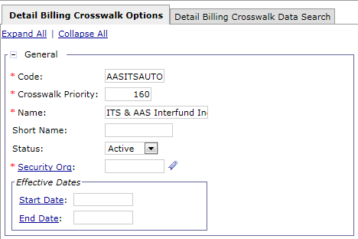
Creating a New Detail Billing Crosswalk
New Crosswalk rule:
Navigate to Reference > Accounts Receivable > Detail Billing Crosswalk
Select New
Enter Code (AASITSAUTO, AASITSMANL, or AASITSALL if creating a rule for an existing rule grouping)
Enter Priority: determines when the new rule will be run from within the rule grouping
Note: Combination of Code and Priority must be unique
Enter Name
Note: The BAAR crosswalk rule “Crosswalk Priority” field has been configured with 10 digit gaps from one rule to the next so that additional rules can be created and inserted in the correct order without having to re-number all subsequent rules in that grouping
Note: If required to create a new or update an existing crosswalk rule, review the current rule structure of the other rules that fall within the same rule grouping so as to ensure the new/updated rule will work correctly within the greater rule grouping

Slide 46
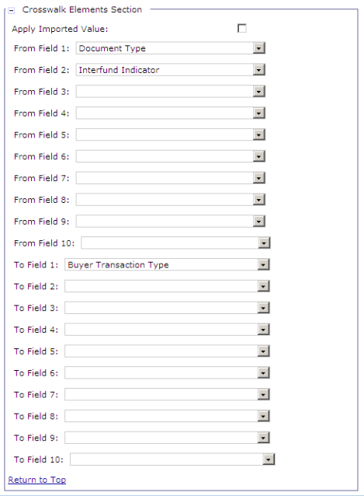
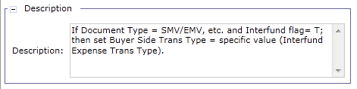
Creating a New Detail Billing Crosswalk (cont.)
New Crosswalk rule:
In the Crosswalk Elements Section, enter:
Apply Imported Value: If selected, rule will directly transfer the value of the From field to the To field
Note: If selected, only From Field 1 can be specified and From Fields 2-10 are disabled
From Field 1-10: Specify from each dropdown the field from which values should be crosswalked
To Field 1-10: Specify from each dropdown the field to which values should be crosswalked
Description: enter a detailed description identifying the purpose of the crosswalk rule
Notes:
Speaker Note: Based on the screen shot, this crosswalk rule will determine the doc type and trans type. First it checks the Internal Voucher flag, then the Bill Type to determine which of the Rent doc types to assign. The Internal Voucher flag/Credit Adjustment Indicator are used to determine if a trans type is needed

Slide 47
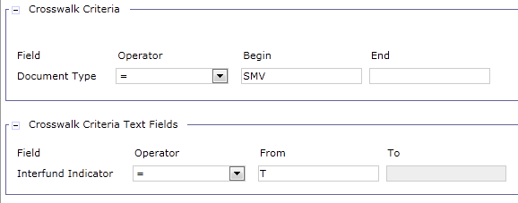
Creating a New Detail Billing Crosswalk (cont.)
New Crosswalk rule:
Select the Detail Billing Crosswalk Data Search tab
The system will dynamically generate the necessary sections based on the items entered in the Crosswalk Elements section in step 6.
Example screenshot showing
two sections dynamically
generated based on values
specified in step 6
Select Add

Slide 48
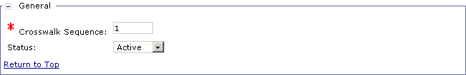
Creating a New Detail Billing Crosswalk (cont.)
New Crosswalk rule:
In the General Section:
Crosswalk Sequence: Enter the sequence number of the detail record
Status: Enter “Active” to make the rule detail active

Slide 49
Creating a New Detail Billing Crosswalk (cont.)
New Crosswalk rule:
In the sections generated, fill in the corresponding fields based on the desired crosswalk:
From Field Operator: Select from dropdown the operator to be used (Any, =, >, >=, Not Null, Null, Like, <, <=, <>, Range)
Begin/From: Enter the value of the From field (for a range, this would be the 1st value in the range)
End/To: Enter the value of the To field (for a range, this would be the last value in the range)
Note: If not using a range, End/To field should not be populated
Note: When using non-numeric values, the range is determined based on the corresponding decimal ASCII value - this means that the order would be (least to greatest) Symbols ! " # $ % & ' ( ) & + , - . / Numbers 0 1 2 3 4 5 6 7 8 9 Symbols : ; < = > ? @ Upper Case Letters Symbols [ \ ] ^ _ ` Lower Case Letters Symbols { | } ~
Notes:
Note: Fields specified in the Crosswalk Elements Section in step 6 of these instructions will drive the sections generated on the Detail Billing Crosswalk Details page.

Slide 50

Creating a New Detail Billing Crosswalk (cont.)
New Crosswalk rule:
In the Crosswalk Fields section:
To Field: Enter the value of the To field based on the values of the From fields
Notes:
Note: Fields specified on the Detail Billing Crosswalk Options (header) page, will be displayed on the Detail Billing Crosswalk Data Search screen in order to set the crosswalk values.
The Crosswalk Fields box represent the fields chosen as the TO fields (in this example, the To field is “Buyer Transaction Type”.)

Slide 51
Exercise
Exercise 1 – Create Detail Billing Crosswalk Rule
Exercise 2 – Modify Detail Billing Crosswalk Rule

Slide 52
Segment 3:
Referral Reference Table

Slide 53
Segment Outline
Segment 1: Pegasys General BAAR Reference Tables
Segment 2: Detail Billing Record Reference Table
Segment 3: Referral Reference Table
Account Referral Destination
Segment 4: Debt Account Reference Tables
Segment 5: Allowance For Loss Reference Table
Segment 6: VCSS Reference Table Management
Segment 7: VCSS Security Authorization Framework & Principal Management
Segment 8: VCSS System Settings Table
Segment 9: Online VCSS Vendor Registration Process
Segment 10: Online VCSS New User Access Process

Slide 54
Dunning
Account Referral Destination

Slide 55
Treasury Referral
If after 90 days the debt remains outstanding, then GSA may initiate the Treasury Referral process
U.S. Treasury Financial Management System Center:
Provides “referral” service to GSA when GSA is unable to collect on outstanding debts
When referred for “Treasury Cross-Servicing”, Treasury will make attempts at collection by contacting debtors and requesting they remit payment
Facilitated via the Treasury FedDebt system
Treasury recoups a fee for their collection services
Two primary stages of the Treasury Referral process:
Referral Submission
Treasury Collection

Slide 56
Referral Submission
Delinquent Debt
Transmit to FedDebt
Treasury successfully collects
Treasury IPACs money back to Agency & records on the weekly Collections file
Agency records collections in their system against the debt

Slide 57
Referral Submission Lifecycle
Referral Selection (1)
Review and Approve (2)
Referral Generation (3)
Referral File (4)

Slide 58
Account Referral Destination Referece Table
Name Account Referral Destination
Purpose Used to identify the destinations available to GSA for referral of delinquent accounts for further collection activity.
Indicates whether interest penalty, and administrative charges should continue to accrue in Pegasys for debts referred to a given location.
Navigation Pegasys > Reference > Accounts Receivable > Account Referral Destination
Related Items Referral Selection batch job

Slide 59
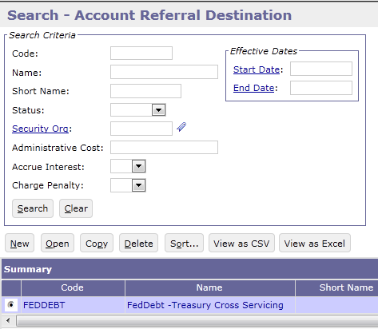
Account Referral Destination Reference Table
Reference > Accounts Receivable > Account Referral Destination
NOTE: Currently FedDebt is the Treasury system used to manage collection activities for debts referred by GSA

Slide 60
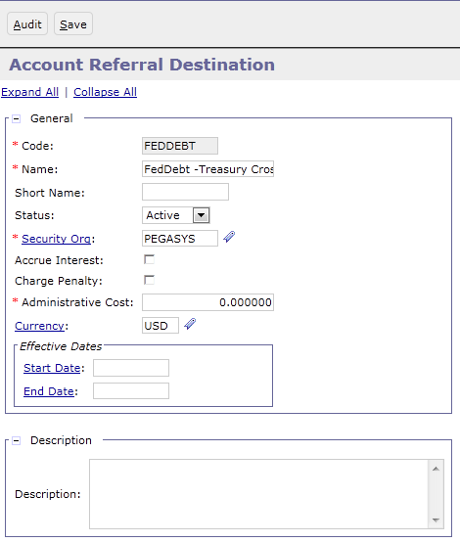
Account Referral Destination Reference Table
Code: The unique identifier of the Referral Destination
Accrue Interest: Indicates whether interest continues to accrue in Pegasys for Billing Documents and Debt Accounts referred to FedDebt
Charge Penalty: Indicates whether penalty charges continue to accrue in Pegasys for Billing Documents and Debt Accounts referred to FedDebt
Administrative Cost: Indicates whether a one-time administrative cost is assessed to a Billing Document or Debt Account if referred to FedDebt

Slide 61
Segment 4:
Debt Account Reference Tables

Slide 62
Segment Outline
Segment 1: Pegasys General BAAR Reference Tables
Segment 2: Detail Billing Record Reference Table
Segment 3: Referral Reference Table
Segment 4: Debt Account Reference Tables
Debt Account Overview
Debt Account Group
Amortization Schedule
Segment 5: Allowance For Loss Reference Table
Segment 6: VCSS Reference Table Management
Segment 7: VCSS Security Authorization Framework & Principal Management
Segment 8: VCSS System Settings Table
Segment 9: Online VCSS Vendor Registration Process
Segment 10: Online VCSS New User Access Process

Slide 63
Dunning
Debt Account Overview

Slide 64
Debt Account Lifecycle Introduction
Debt is owed to GSA
GSA Establishes a Debt Account
Financial transactions post against the Debt Account
\
In order to establish and manage a “claim” in Pegasys, GSA processes a Debt Account Document
The Debt Account has two functions:
Establish and manage the claim in Pegasys through its lifecycle
Record the financial impact in the Pegasys General Ledger
Notes:
Two reference tables are related to this lifecycle:
Debt Account Groups
Amortization Schedule
Each will be explained in this section

Slide 65
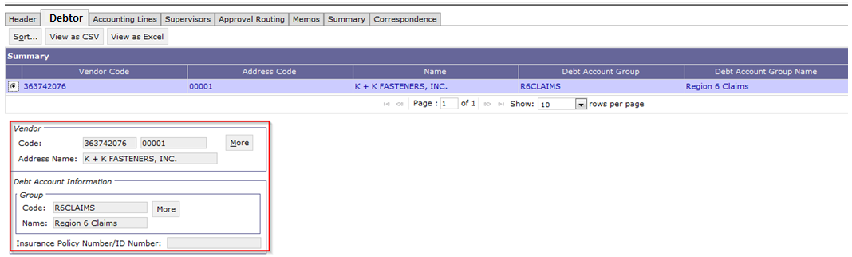
Debt Account Document Overview
Debtor Tab
Vendor Code
Vendor Address Code
Vendor Name
Debt Account Group ID
Notes:
The Debt Account Group can be found on each DA document

Slide 66
Dunning
Debt Account Group

Slide 67
Debt Account Group Reference Table
Name Debt Account Group
Purpose Used to define valid debt account groups that can be referenced on debt accounts in Pegasys
Categorize GSA’s debt accounts as Region 6, Region 7, or External Services
Navigation Pegasys > Reference > Accounts Receivable >
Debt Account Groups
Related Items Debt Account By Debt Account Group Query
Debt Account Documents

Slide 68
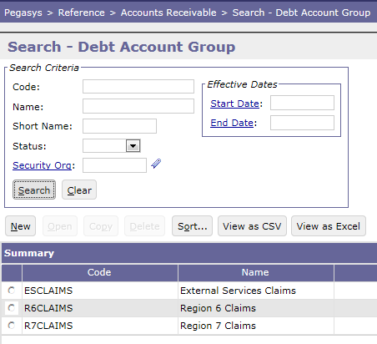
Debt Account Group Reference Table
Reference > Accounts Receivable > Debt Account Groups

Slide 69
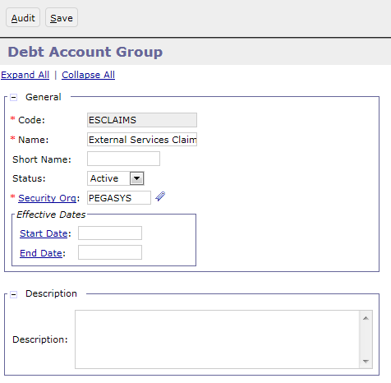
Debt Account Group Reference Table
ESCLAIMS
Managed by External Services
DES document type
R6CLAIMS
Managed by Region 6
DAV or D6M document types
R7CLAIMS
Managed by Region 7
D7M document type

Slide 70
Dunning
Amortization Schedule

Slide 71
Promissory Note Process – Overview and Lifecycle
Upon receipt of First Demand Letter, the debtor has 30 days to either:
Remit payment for the full debt amount to GSA
Establish a payment schedule due to financial hardship
The Promissory Note Process is used to establish and execute the payment schedule
Once the Promissory Note is activated, the debtor will:
Remit the agreed upon payment at each interval
OR
Become subject to: overdue charges, dunning, and possible referral to Treasury

Slide 72





Promissory Note Process
Debtor Request for Payment Schedule
GSA Establishes Amortization Schedule
Generate Pegasys Promissory Note
GSA Sends Promissory Note to Debtor
Debtor Receives Promissory Note
GSA Receives Signed and Notarized Copy of Promissory Note

Slide 73
Promissory Note Process – Amortization Schedule
Amortization Schedules
Provide the ability to extend flexible payment terms to debtors who cannot repay the debt in full by the due date
Amortization schedule set up as an installment payment schedule, including:
Number of payments
Interest rate and cumulative interest to be paid
For each payment:
Principal Amount
Interest Amount
Due Date
Notes:
Pull out example to separate slide

Slide 74
Promissory Note Process – Amortization Schedule
GSA rents a vehicle to a Federal customer
The customer is involved in an accident (hit by another car)
GSA establishes a Debt Account against the owner of the other car for damages to the GSA vehicle for $5,000
The debtor requests GSA extend payment terms to pay in monthly installments
GSA sets up an Amortization Schedule defining the monthly payment amounts

Slide 75
Promissory Note Process
GSA Establishes Amortization Schedule
The Amortization Schedule Reference Table is where schedules for individual debt accounts are created and maintained
It will be configured/managed by Finance and not by GSA Operations

Slide 76
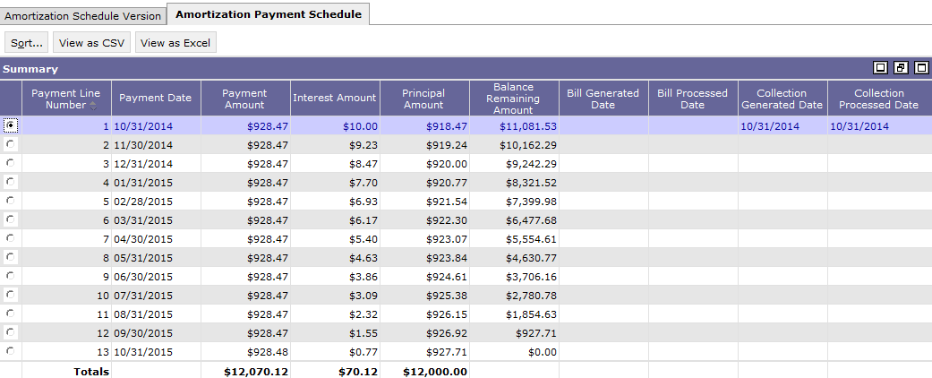
Collection from Debtor – Amortization Schedule
Collections referencing Debt Accounts with an Amortization Schedule:
Update the Amortization Schedule Query based on:
Referenced Amortization Schedule
Referenced Amortization Schedule Payment Line Number:
\
Notes:
The Amortization Schedule Table maintains the scheduled that can eventually be tied to specific payments

Slide 77
Amortization Schedule Reference Table
Name Amortization Schedule
Purpose Allows GSA to generate amortization schedules to track repayment of debts
GSA can enter various interest rates and frequencies to generate schedules
Pegasys provides the ability to associate an active amortization schedule with a debt account line
Navigation Pegasys > Reference > Accounts Receivable > Amortization Schedule
Related Items Amortization Schedule Query
Promissory Note Report

Slide 78
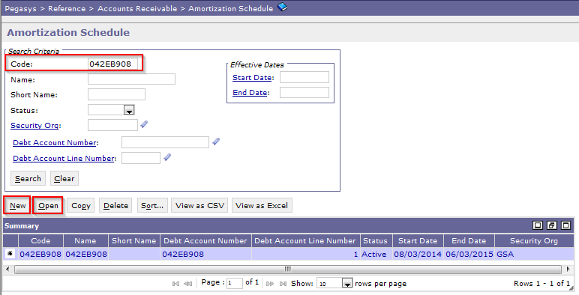
Promissory Note Process – Amortization Schedule
Users may access the Amortization Schedule reference table by navigating to Reference > Accounts Receivable > Amortization Schedule
From the query, users have the option to:
Search for and view existing Amortization Schedules
Create new Amortization Schedules via the New or Copy button

Slide 79
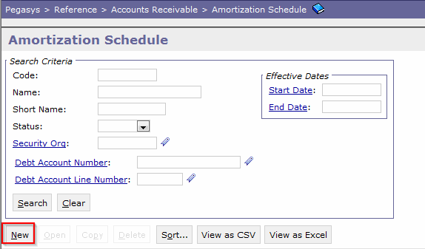
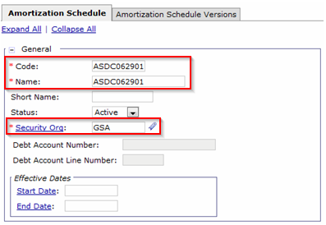
Promissory Note Process – Amortization Schedule
Steps to create a new Amortization Schedule:
Navigate to Reference > Accounts Receivable > Amortization Schedule and click New
Enter a unique Amortization Schedule Number in the Code and Name fields and enter any other required fields
Enter Security Org = GSA

Slide 80
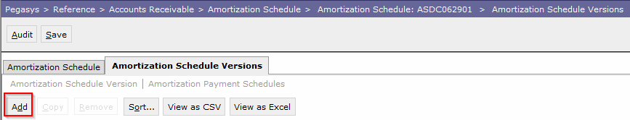
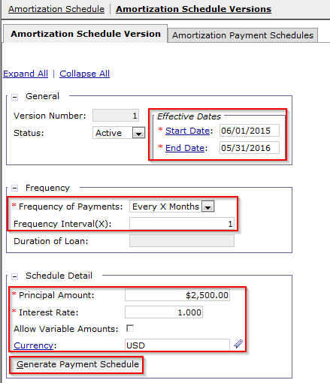
Promissory Note Process – Amortization Schedule
Steps to create a new Amortization Schedule:
Navigate to the Amortization Schedule Versions page and click Add
Enter the following:
Effective Dates = Date range over which the payment schedule will be active
Frequency of Payments
Principal Amount = Outstanding Debt Account amount
Interest Rate
Currency = USD
Click the Generate Payment Schedule button

Slide 81
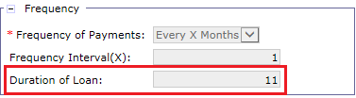
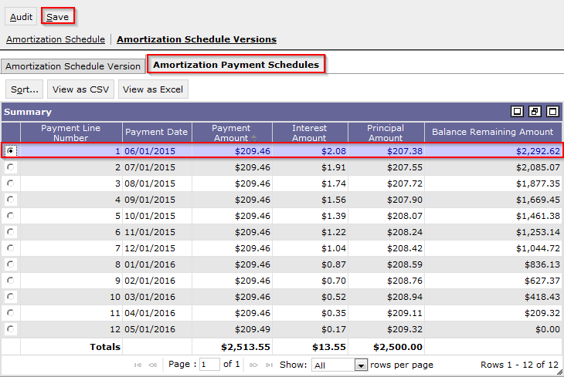
Promissory Note Process – Amortization Schedule
Steps to create a new Amortization Schedule (cont.):
The Duration of Loan is system-calculated based on the Effective Dates
Navigate to the Amortization Payment Schedules tab
Review the payment schedule for accuracy
Click Save

Slide 82
Segment 5:
Allowance For Loss Reference Table

Slide 83
Segment Outline
Segment 1: Pegasys General BAAR Reference Tables
Segment 2: Detail Billing Record Reference Table
Segment 3: Referral Reference Table
Segment 4: Debt Account Reference Tables
Segment 5: Allowance For Loss Reference Table
Allowance For Loss Selection Criteria
Segment 6: VCSS Reference Table Management
Segment 7: VCSS Security Authorization Framework & Principal Management
Segment 8: VCSS System Settings Table
Segment 9: Online VCSS Vendor Registration Process
Segment 10: Online VCSS New User Access Process

Slide 84
Dunning
Allowance for Loss
Selection Criteria

Slide 85
Allowance for Loss – Overview
An allowance for estimated losses is recorded for receivables that GSA believes will not be fully collected
Receivables are presented on the Balance Sheet at Net Realizable Value
Net Realizable Value = Total Accounts Receivable - Allowance for Loss
Established based on the history of collections and responses or non-responses from debtor customers
Business Lines establish selection criteria to calculate the Allowance for Loss on the Allowance For Loss Selection Criteria reference table
The Allowance for Loss (ARALLOWLOS) batch job calculates and records the Allowance for Loss in Pegasys
‹#›
CGI Federal Proprietary and Confidential

Slide 86
Allowance for Loss – Batch Selection Criteria
Primary Criteria used for Setup:
Receivable Type:
Used as selection criteria to define the BD and DA Document Types to be selected
Consolidates the Selection Criteria by combining manual and automated Document Types
Age Category:
Determines the age %age used to calculate the Allowance for Loss
Based on the “age days”
Age Percentage:
Established for each set of Selection Criteria, based on Age Category
Used to calculate the Allowance for Loss for each set of Selection Criteria
Allowance for Loss Age Categories
A = 1-90 Days
B = 91-180 Days
C = 181-365 Days
D = 1-2 Years (366-730 Days)
E = 2-6 Years (731-2190 Days)
F = 6-10 Years (2191-3650 Days)
G = Over 10 Years (>3650)
N = Current Receivables, NULL)
‹#›
CGI Federal Proprietary and Confidential

Slide 87
Allowance for Loss (ARALLOWLOS) Batch Process
The Allowance for Loss (ARALLOWLOS) batch process
Posts the Allowance for Loss at the detail accounting dimension level
Generates a self-reversing Standard Voucher (SV) document that processes a balance sheet transfer for the Allowance for Loss
Does not calculate Allowance for Losses for
Foreign debts
Disputed records
Produces an Allowance for Loss Reconciliation Output file
Notes:
On Federal AFL SVs:
· Transaction Event: Revenue (bc these post to a contra-revenue account rather than to bad debt expense)
· Increase/Decrease Indicator: Decrease
· Revenue Source Code: RSC from related BDs
· Sub-Object Class: null
On non-Federal AFL SVs:
· Transaction Event: GL Transfer
· Increase/Decrease Indicator: Increase
· Revenue Source Code: null
· Sub-Object Class: Default value of T01

Slide 88
Allowance For Loss Selection Criteria Table
Name Allowance For Loss Reference
Purpose Maintains selection criteria for the Allowance for Loss Process:
Receivable Type
Age Category
Age Percentage
Navigation Pegasys > Reference > Accounts Receivable > Allowance For Loss Selection Criteria
Related Items Allowance For Loss Process (ARALLOWLOS)
Allowance For Loss SV Documents

Slide 89
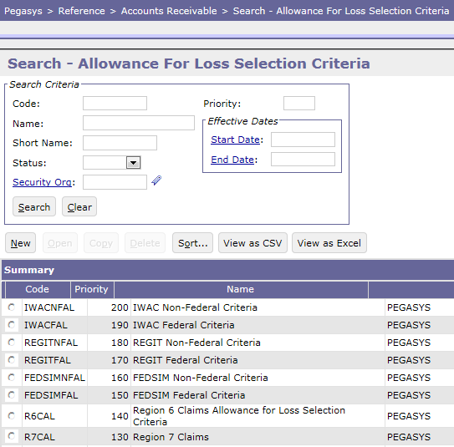
Allowance For Loss Selection Criteria Table
Business Line | Criteria Code
AAS – FEDSIM | FEDSIMFAL FEDSIMNFAL
AAS - Regional - IT | REGTFAL REGTNFAL
HSPD-12 | HSPD12FAL HSPD12NFAL
IWAC | IWACFAL IWACNFAL
National IT Commodity | NATITCMFAL NATITCMNF
Outlease | OUTLS
R7 Manual | R7MANFED R7MANNFED
R7 Claims | R7CAL
R6 Claims | R6CAL
Regional Network Service-Expanded Service | EXPSERFAL EXPSERNFAL
Regional Network Services-Telecom Federal | REGTELFAL REGTELNFAL
WAN | WANFAL WANNFAL

Slide 90
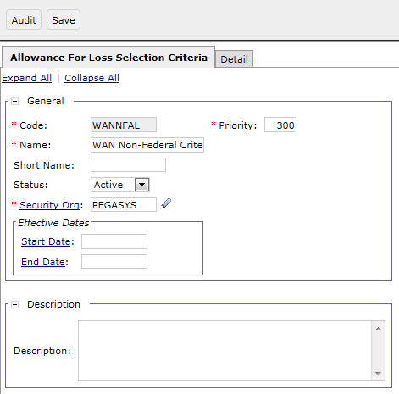
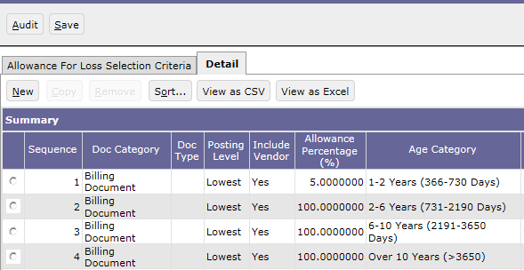
Allowance For Loss Selection Criteria Table

Slide 91
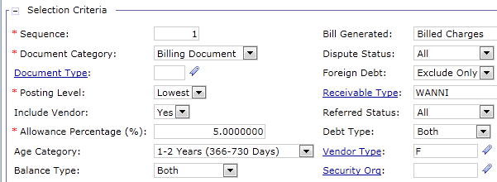
Allowance For Loss Selection Criteria Table
Field | Description
Posting Level | Set at Lowest to post Allowance for Loss at lowest individual accounting dimension level.
Include Vendor | Set to Yes to record vendor on the SV document and to summarize by the Vendor/Vendor Address Code and Transfer TSYM.
Allowance Percentage | Defines the percentage for each Age Category associated to a set of selection criteria and is used to calculate the Allowance for Loss.
Age Category | Specifies the Age Category value to be used to calculate the Allowance for Loss
Balance Type | Set at Both to calculate Allowance for Loss on Principal and Overdue Charges
Field | Description
Receivable Type | Defines the BD and DA Document Types to be selected and consolidates selection by combining manual and automated Document Types
Debt Type | Specifies if the Allowance for Loss is for a Federal or Non-federal vendor

Slide 92
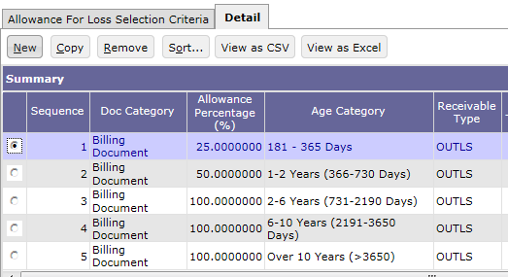
Allowance For Loss Example
The following documents are outstanding BDs:
The Allowance For Loss Process uses the following selection criteria:
Document Number | Collection Due Date | Vendor | Outstanding Amount | Accounting Info
ODNO0000118-001 | 10/2/2012 | Nextel | $975 | Fund 192X Reg 00
ODNO0007654-001 | 10/2/2014 | Nextel | $975 | Fund 192X Reg 11
ODNO0011532-001 | 4/2/2014 | A&B Inc. | $975 | Fund 192X Reg 11
ODNO0033754-001 | 10/2/2015 | A&B Inc. | $975 | Fund 192X Reg 11

Slide 93
Allowance For Loss Example
The following calculations are performed:
In the current month, the Allowance For Loss Process will create a self-reversing SV with 3 accounting lines:
Document Number | Doc Date | Age | Vendor | Amt | % | AFL | Accounting Info
ODNO0000118-001 | 10/2/2012 | 731-2190 days | Nextel | $975 | 100 | $975 | Fund 192X Reg 00
ODNO0007654-001 | 10/2/2014 | 366-730 days | Nextel | $975 | 50 | $487.50 | Fund 192X Reg 11
ODNO0011532-001 | 4/2/2014 | 181-365 days | A&B Inc. | $975 | 25 | $243.75 | Fund 192X Reg 11
ODNO0033754-001 | 10/2/2015 | < 180 days | A&B Inc. | $975 | 0 | $0 | Fund 192X Reg 11
Document Number | Total Amt | Acct Ln | Vendor | Ln Amt | Accounting Lines
ONL201510080001 | $1706.25 | 1 | Nextel | $975 | Fund 192X Reg 00
 |  | 2 | Nextel | $487.50 | Fund 192X Reg 11
 |  | 3 | A&B Inc. | $243.75 | Fund 192X Reg 11

Slide 94
Exercise
Exercise 3 – Create Allowance for Loss Selection Criteria record
Exercise 4 – Modify Allowance for Loss Selection Criteria record

Slide 95
Segment 6:
VCSS Reference Table Management
(from within VCSS)

Slide 96
Segment Outline
Segment 1: Pegasys General BAAR Reference Tables
Segment 2: Detail Billing Record Reference Table
Segment 3: Referral Reference Table
Segment 4: Debt Account Reference Tables
Segment 5: Allowance For Loss Reference Table
Segment 6: VCSS Reference Table Management
VCSS Notices
Segment 7: VCSS Security Authorization Framework & Principal Management
Segment 8: VCSS System Settings Table
Segment 9: Online VCSS Vendor Registration Process
Segment 10: Online VCSS New User Access Process

Slide 97
Dunning
VCSS Notices

Slide 98
VCSS Notices Reference Table
Name VCSS Notices
Purpose Provides the ability to record notices/ messages displayed to customers upon logging into VCSS
Notices will be used to communicate to customers when different business line billings have been run and that their current statement can be accessed from within the system
Navigation System Administration > Reference > Notices
Related Items VCSS Home Page

Slide 99
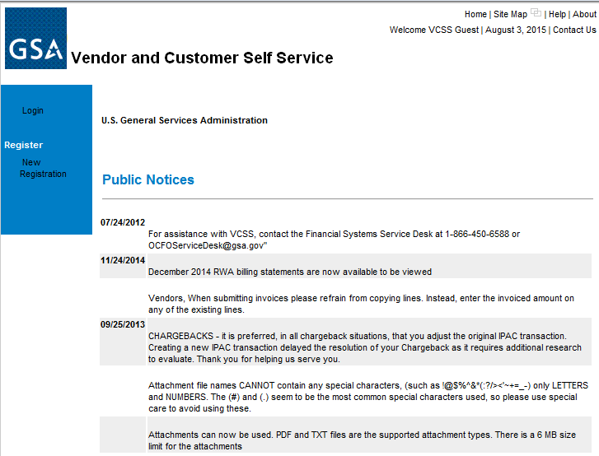
VCSS Public Notices

Slide 100
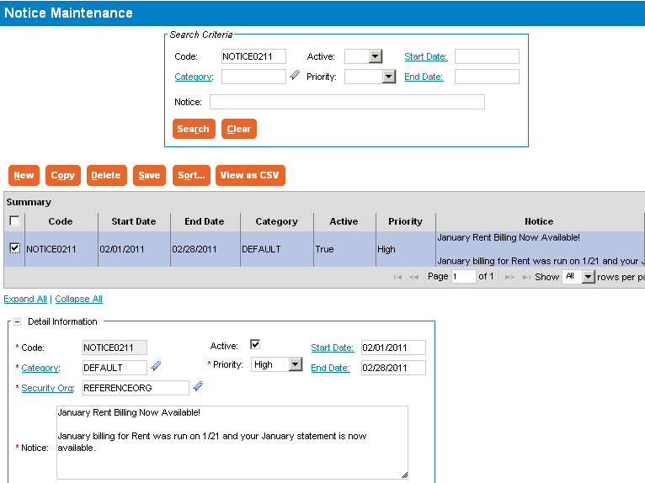
VCSS Notices Reference Table (from within VCSS)
System Administration > Reference > Notices

Slide 101
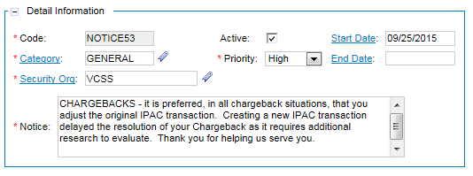
VCSS Notices Reference Table (from within VCSS)
Detail Information – Includes information that uniquely identifies each notice record (Code, Category)
Also provides the ability to assign active status, priority, start/end dates, and the notice text to be displayed to customers upon logging into VCSS

Slide 102
Segment 7:
VCSS Security Authorization Framework and Principal Management

Slide 103
Segment Outline
Segment 3: Referral Reference Table
Segment 4: Debt Account Reference Tables
Segment 5: Allowance For Loss Reference Table
Segment 6: VCSS Reference Table Management
Segment 7: VCSS Security Authorization Framework & Principal Management
Identity Provider (IdP)
VCSS Security Categories
VCSS Security Roles
VCSS Security Organization
VCSS Users
Segment 8: VCSS System Settings Table
Segment 9: Online VCSS Vendor Registration Process
Segment 10: Online VCSS New User Access Process

Slide 104
Dunning
Identity Provider (IdP)

Slide 105

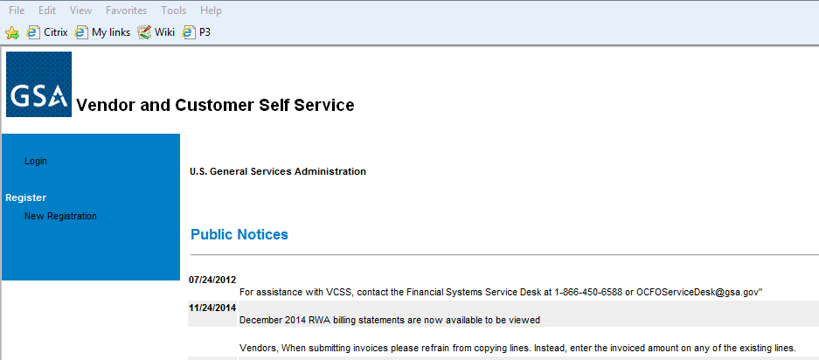
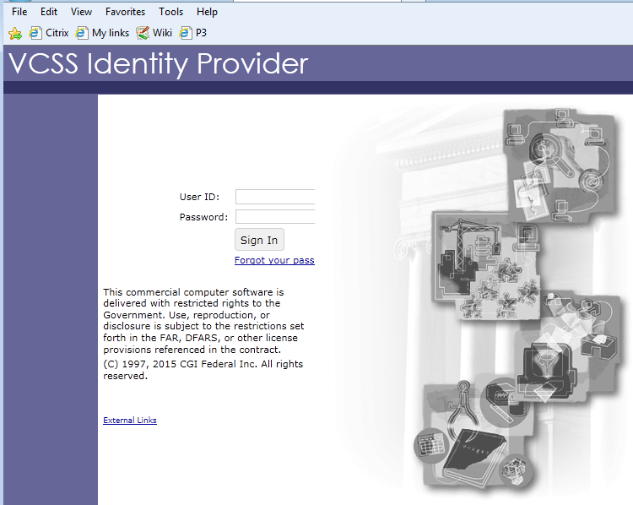
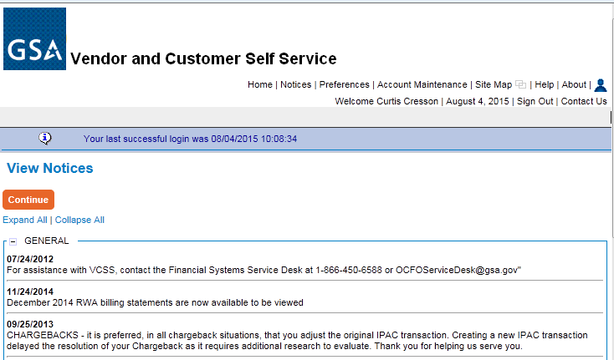
VCSS Security Authorization Framework and Principal Management
Identity Provider (IdP): The entity responsible to authenticate the user as a known and valid identity. A separate application called the VCSS Core IdP manages the VCSS Identity Provider.
VCSS IdP
Authentication
VCSS App
Authorization
Functionality

Slide 106
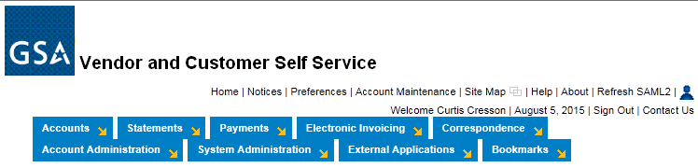
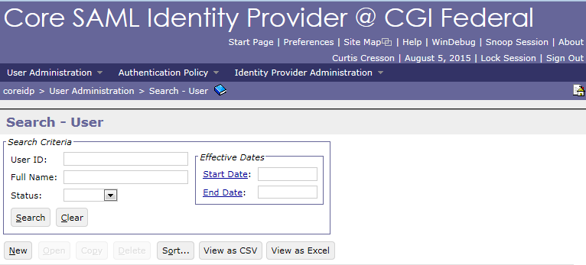
VCSS Security Authorization Framework and Principal Management

Slide 107
VCSS Security Authorization Framework and Principal Management
Action | VCSS Core IdP | VCSS Application
Set up new users | X | X
Reset expired users | X
Reset password | X
Maintain security categories |  | X
Maintain security roles |  | X
Maintain security organizations |  | X
Maintain users | X | X

Slide 108
VCSS Security Authorization Framework and Principal Management
7.1 VCSS Security Model:
Current Pegasys security authorization framework includes:
Categories
Roles
Organizations
Users
The combination of security categories, roles, and organizations and their association with users determines the VCSS security authorization framework

Slide 109
Dunning
VCSS Security Categories

Slide 110
VCSS Security Authorization Framework and Principal Management
VCSS Security Categories:
Each object in VCSS is associated with a security category
Documents the available system-specified permitted actions for each object
Documents the security entries made for each category:
Roles to which the security category has been associated
System-specified permitted actions assigned by GSA security administrator to each role
VCSS Security Categories are system created, they cannot be created by a user in VCSS
The Security Category Load batch job created the initial security categories in VCSS

Slide 111


VCSS Security Authorization Framework and Principal Management
System Administration > Security Maintenance > Security Category

Slide 112
Dunning
VCSS Security Roles

Slide 113

VCSS Security Authorization Framework and Principal Management
VCSS Security Roles:
Provide the ability to group security categories and assign the permitted actions from each security category to the role
System Administration > Security Maintenance > Security Role

Slide 114

VCSS Security Authorization Framework and Principal Management
System Administration > Security Maintenance > Security Role

Slide 115
Dunning
VCSS Security Organizations

Slide 116

VCSS Security Authorization Framework and Principal Management
VCSS Security Organizations:
Organize distinct/logical groups of data and determine which data groups a user should be provided access
A distinct security organization is automatically created for each vendor registration (occurs at the vendor address code level)

Slide 117
Dunning
VCSS Users

Slide 118
VCSS Security Authorization Framework and Principal Management
VCSS System Administrator User Table:
Used to create and maintain user accounts for those GSA analysts and customers requiring access to VCSS
Provides the ability to administer user accounts using security organizations and roles
Administering users from this table enables system administrators to determine a user’s security settings as they relate to the Security Organization and Security Role tables

Slide 119

VCSS Security Authorization Framework and Principal Management
System Administration > Security Maintenance > Users
Edit User Details tab – Provides high level security information about the user, including ID, Name, Policy, Email, etc.
The AR User field determines what page the VCSS user should be displayed upon logging in to VCSS (after the Notices screen)
If checked (set to true), the user is displayed the Outstanding Balances By Account page
If not checked (set to False), the user is displayed the normal VCSS home screen

Slide 120

VCSS Security Authorization Framework and Principal Management
System Administration > Security Maintenance > Users
Security Organizations tab – Specifies “object level” security organization(s), which determine the other system users able to maintain the user account
Only System/Vendor Administrators with permissions under the specified security organization are provided the ability to maintain the user

Slide 121


VCSS Security Authorization Framework and Principal Management
System Administration > Security Maintenance > Users
Roles tab – The assignment of “role level” security organizations determine the vendor associations associated with the user account:
The assignment of roles under each role level sec org determines the objects a user can access and the actions the user is permitted to take on/from those objects:

Slide 122

VCSS Security Authorization Framework and Principal Management
Customer User can only access objects with an object sec org of “EPA” (due to the Customer’s role level sec org of ‘EPA’)
The list of objects is limited to bills via the security category associated with the Customer’s role
Customer User can only access the bill object with an object security organization of EPA (and cannot access the bill associated with HUD)
Permitted actions - View, Add/View Attachment, Add/View Correspondence, View Correspondence, and Add Dispute when accessing the EPA bill

Slide 123
Segment 8:
VCSS System Settings Table

Slide 124
Segment Outline
Segment 1: Pegasys General BAAR Reference Tables
Segment 2: Detail Billing Record Reference Table
Segment 3: Referral Reference Table
Segment 4: Debt Account Reference Tables
Segment 5: Allowance For Loss Reference Table
Segment 6: VCSS Reference Table Management
Segment 7: VCSS Security Authorization Framework & Principal Management
Segment 8: VCSS System Settings Table
VCSS Systems Settings
Segment 9: Online VCSS Vendor Registration Process
Segment 10: Online VCSS New User Access Process

Slide 125
Dunning
VCSS System Settings

Slide 126

VCSS System Settings Table
VCSS System Settings Table – Provides the ability to establish preferred system options that apply to all users using VCSS, including:
External Application Links – Provides the ability to define the web addresses used when selecting a link from the External Applications menu

Slide 127

VCSS System Settings Table
System Information – Provides the ability to establish security settings used in various system processing, including the following:
Default Policy - provides the ability to record a default security policy that will be applied to new/updated VCSS user accounts if a security policy is not entered at the time of VCSS user account creation/update
Notes:
NOTE: GSA does not use User Types in VCSS

Slide 128

VCSS System Settings Table
System Information – Provides the ability to establish security settings used in various system processing, including the following:
Default Reference Data Security Organization - provides the ability to record a default security organization code to be applied to new users automatically created via the registration process or manually created via a vendor administrator to ensure all users may access VSS public data transactions
Default Reference Data Security Role – provides the ability to record a default security role enabling actions on system reference data to be applied to new users automatically created via the registration process or manually created via a vendor administrator
Notes:
NOTE: GSA does not use User Types in VCSS

Slide 129

VCSS System Settings Table
System Information – Provides the ability to establish security settings used in various system processing, including the following:
Default Public Data Security Organization - provides the ability to record a default security organization code to be applied to new users automatically created via the registration process or manually created via a vendor administrator to ensure all users may access VSS public data transactions
Default Public Data Security Role - provides the ability to record a security role enabling actions on public data transactions to be applied to new users automatically created via the registration process or manually created via a vendor administrator
Notes:
NOTE: GSA does not use User Types in VCSS

Slide 130
Segment 9:
Online VCSS Vendor Registration Process

Slide 131
Segment Outline
Segment 1: Pegasys General BAAR Reference Tables
Segment 2: Detail Billing Record Reference Table
Segment 3: Referral Reference Table
Segment 4: Debt Account Reference Tables
Segment 5: Allowance For Loss Reference Table
Segment 6: VCSS Reference Table Management
Segment 7: VCSS Security Authorization Framework & Principal Management
Segment 8: VCSS System Settings Table
Segment 9: Online VCSS Vendor Registration Process
VCSS Vendor Registration
Segment 10: Online VCSS New User Access Process

Slide 132
Dunning
VCSS Vendor Registration

Slide 133
Online VCSS Vendor Registration Process
The online VCSS vendor registration process provides GSA customers the ability to:
Register for and, if approved, create a customer account in VCSS for their agency/business to manage GSA billings
If approved, create a VCSS user ID (for the customer administrator registering the customer)
New and existing users can then request access to the customer account via the online VCSS new user access process (reviewed in later slides)
Customers can initiate the online VCSS vendor registration process from the GSA Launch page (http://vcss.gsa.gov)

Slide 134

Online VCSS Vendor Registration Process
Notes:
The steps associated with the process flow or this slide and the next are explained on a separate slide.

Slide 135

Online VCSS Vendor Registration Process

Slide 136
Online VCSS Vendor Registration Process
GSA VCSS Security Administrator Responsibilities to Approve a Registration:
Once GSA Finance has approved the customer’s registration request and the customer has submitted additional user information (steps 1 – 22):
GSA VCSS Security Administrator reviews pending registration and approves/rejects the request (steps 23 – 24, see next slide for user ID format verification as part of this process)
If approved, GSA VCSS Security Administrator (steps 25 – 29):
Updates the VCSS vendor data (“approved”) (step 26)
As a result of approving the registration, VCSS:
Automatically generates the new user ID as specified on the Approve Registration screen (step 27) - GSA VCSS Security Administrator updates new user ID with proper security
Automatically sends 2 separate emails to the Customer Administrator/Vendor Representative (steps 28 – 29):
1st email contains Customer Administrator/Vendor Representative new user ID
2nd email contains temporary password for new user ID
If rejected, VCSS sends email to Customer Administrator/Vendor Representative notifying them that their vendor registration request was rejected (steps 24, 30 – 31)

Slide 137
Online VCSS Vendor Registration Process User ID Format Verification
GSA VCSS Security Administrator Responsibilities to Approve a Registration:
Note: As part of the review process, the GSA VCSS Security Administrator verifies that the new VCSS User ID assigned during the registration process meets the required standards (e.g, firstnamelastname)
If not, the GSA VCSS Security Administrator will create a new user id using the correct format and will configure it with:
The new Security Organization associated with the registration
The “VIEWVCSS” role under the new Security Organization associated with the registration

Slide 138

Online VCSS Vendor Registration Process: Approve Registration
Account Administration > Approve Registration

Slide 139

Online VCSS Vendor Registration Process: Update New Vendor Representative User ID
Once the registration is approved, the system automatically:
Creates a new, unique Security Organization associated with the new registration
Updates the newly created Security Organization (created for the new registration) to set the Parent Security Organization to “VCSS”

Slide 140
Online VCSS Vendor Registration Process: Update New Vendor Representative User ID
Once the registration is approved, the VCSS System Administrator must:
Update the newly created user ID to include the “Customer" or “Vendor” role under the Security Organization associated with the new registration
For Customers:
Update the newly created user ID to set the AR User flag to True (i.e. checked)
Include the "Customer" role under the Security Organization associated with the new registration
For Vendors:
Update the newly created user ID to include the "Vendor" role under the Security Organization associated with the new registration
Note: See the next 2 slides for more information on updating the user id with the appropriate settings described above.

Slide 141

Online VCSS Vendor Registration Process: Update New Vendor Representative User ID
Update the newly created user ID to set the AR User flag to True (i.e. checked)
System Administration > Security Maintenance > Users
NOTE: The AR User flag is only checked for users that are assigned the customer role.

Slide 142


Online VCSS Vendor Registration Process: Update New Vendor Representative User ID
Update the newly created user ID to include the “Customer" role under the Security Organization associated with the new registration
System Administration > Security Maintenance > Users
On the Roles tab, select the newly created Security Organization and select the Select Roles hyperlink:
Select Add to add the CUSTOMER role:

Slide 143
Segment 10:
Online VCSS New User Access Process

Slide 144
Segment Outline
Segment 1: Pegasys General BAAR Reference Tables
Segment 2: Detail Billing Record Reference Table
Segment 3: Referral Reference Table
Segment 4: Debt Account Reference Tables
Segment 5: Allowance For Loss Reference Table
Segment 6: VCSS Reference Table Management
Segment 7: VCSS Security Authorization Framework & Principal Management
Segment 8: VCSS System Settings Table
Segment 9: Online VCSS Vendor Registration Process
Segment 10: Online VCSS New User Access Process
New User Access

Slide 145
Dunning
New User Access

Slide 146
Online VCSS New User Access Process Types of Requests
Once a customer account has been registered, the online VCSS new user access process can be used by GSA customers to:
Request a User ID login to access an existing customer account
Customer needs to request access to an existing VCSS customer account and does not have an existing User ID login to VCSS
Request access to an additional customer account
Customer that already has access to an existing VCSS customer account needs to request access to another customer account (already has an existing User ID login to VCSS)
Customers can initiate the online VCSS new user access process from the GSA Launch page (http://vcss.gsa.gov)

Slide 147
Online VCSS New User Access Process Review and Approval of Access Request
GSA VCSS Security Administrator Responsibilities to Approve New User Access:
Once the customer has submitted their request for new user access from the GSA Registration/Access site:
GSA VCSS Security Administrator reviews the request and determines whether to approve or reject:
If the request is for a new customer account (not already set up in VCSS):
If approved, the GSA VCSS Security Administrator approves the request and creates the account
If rejected, the GSA VCSS Security Administrator sends an email to the customer notifying them that their new access request has been rejected

Slide 148
Online VCSS New User Access Process Review and Approval of Access Request
GSA VCSS Security Administrator Responsibilities to Approve New User Access:
If the request is for access to an existing customer account (already set up in VCSS):
The request for user access is sent to the Customer/Vendor Account Administrator
If approval granted by the Customer Administrator, the GSA VCSS Security Administrator approves the request and updates the user ID
If rejected, the GSA VCSS Security Administrator sends an email to the customer and the Customer Administrator notifying them that the new access request has been rejected
Instructs customer to follow up with the Customer Administrator if they have any questions

Slide 149
Online VCSS New User Access Process
GSA VCSS Security Administrator Responsibilities to Approve New Access:
If approved, GSA VCSS Security Administrator:
Determines whether the customer is requesting a new user ID or new customer account access for an existing user ID:
If requesting a new user ID, GSA VCSS Security Administrator:
Creates the new user ID and associates with proper vendor registration
VCSS then sends 2 separate emails to the customer requesting new access
1st email contains new user ID
2nd email contains temporary password for new user ID
If requesting new user customer account access, GSA VCSS Security Administrator:
Updates the existing user ID to associate with proper vendor registration
Sends an email to the customer and the Customer Administrator notifying them of the approved new user access

Slide 150



Online VCSS New User Access Process
System Administration > Security Maintenance > Users
Add new user:
Update current user:

Slide 151

Questions

