Slide 1
Receipts
Notes:
Introduction
Who you are
The class
What will we do in the class

Slide 2
Receipt
A Receipt (receiving report) is used to record the actual expense of an ordered good or service. The document types are RK or RW.
Because receipts must reference purchase orders, the system requires the user to copy forward a purchase order when creating a receipt.
Receipts do not have to be approved; however, they must be processed.

Slide 3
Standard Purchasing Chain
Invoice
M7/M6
Request
PR
Order
GP
FP, TP, QP
PJ, PN, PP
XP
OP
Payment
Authorization
P7/P6
Receipt
RW/RK
Notes:
High level Purchase Chain Review
Forward the PR to procurement
A CO or authorized buyer will create and approve the PO
Once the PO is approved it is sent to the vendor
Vendor sends goods or renders services
Vendor submits an invoice
User creates a Receipt
Detailed Purchase Chain Review
PR gets the process started and answers: what we want, do we have the funds and what funding code will be used
3 approvals are needed
A GP, which is an agreement between GSA and its vendors, is created and says: vendor will do this, GSA will pay that
1 approval: if < $3000 then authorized buyer
> $3000 then Contracting Officer
An Invoice is sent to the finance center once the GP is created
Pegasys will search for a receipt, if the system can not find one a request for receipt will be e-mailed to the address on the delivery tab under office addresses and the contact on the order tab
Now lets discuss the receipt
General Notes
A Receipt is created when good or services are received and accepted by GSA. Once accepted, we can pay the vendor.
PR’s are approved by 3 people
When these 3 match, Request-Order-Receipt, there will be a payment
This is general chain, just pay attention to your part
RW is GM&A and FAS
RK is everything else
Request is commitment
Order is obligation
The email prompting a receipt goes to the email address on the PR first and if it is not done it goes to the address on the PO
M6 is a Match Invoice document all others and entered into the system by the finance center in Region 6
M7 is a Match Invoice document for FTS or PBS and entered into the system by the finance center in Region 7
P6 is a payment authorization for accounts payable in Region 6
P7 is a payment authorization for accounts payable in Region 7

Slide 4
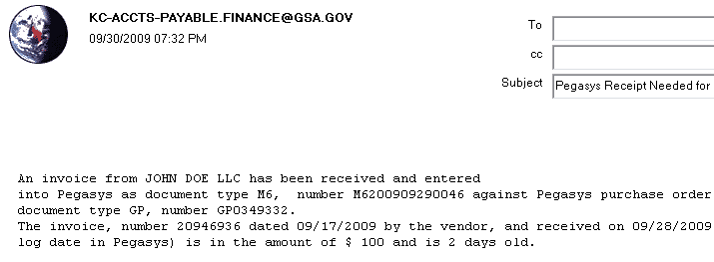
Pegasys Request for a Receipt (RK)
Note: If you did not receive an Invoice but you have received the goods or services, you can still create a Receipt
Notes:
You do not have to wait for an Invoice to create a Receipt if you have the goods or services

Slide 5
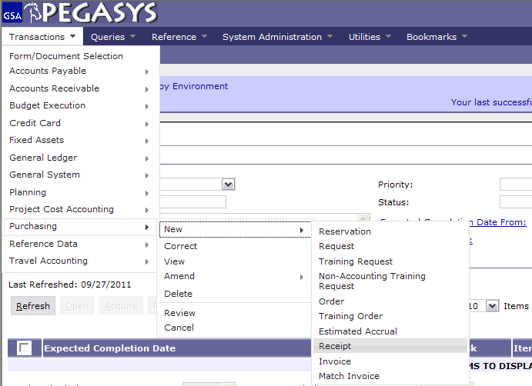
Creating Pegasys Forms & Documents
Select :
- Transactions
- Purchasing
- New
- Receipt
Notes:
To create a new Receipt, click Transactions—Purchasing—New—Receipt

Slide 6
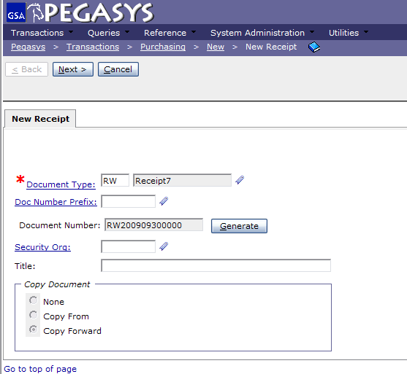
Creating Receipts
Doc Types
RK – Kansas City
RW – Fort Worth
- Enter Document Type
- Press Tab
- Click Generate
- Click Next
Copy Forward
Auto default for RKs and RWs
Copies information from the
previous document (PO) in the
chain
Notes:
Here you enter the document type and click Generate to create a unique document number
Doctypes: RK, RW
Every Receipt has to liquidate an obligation
Note: Copy Forward selection will default

Slide 7
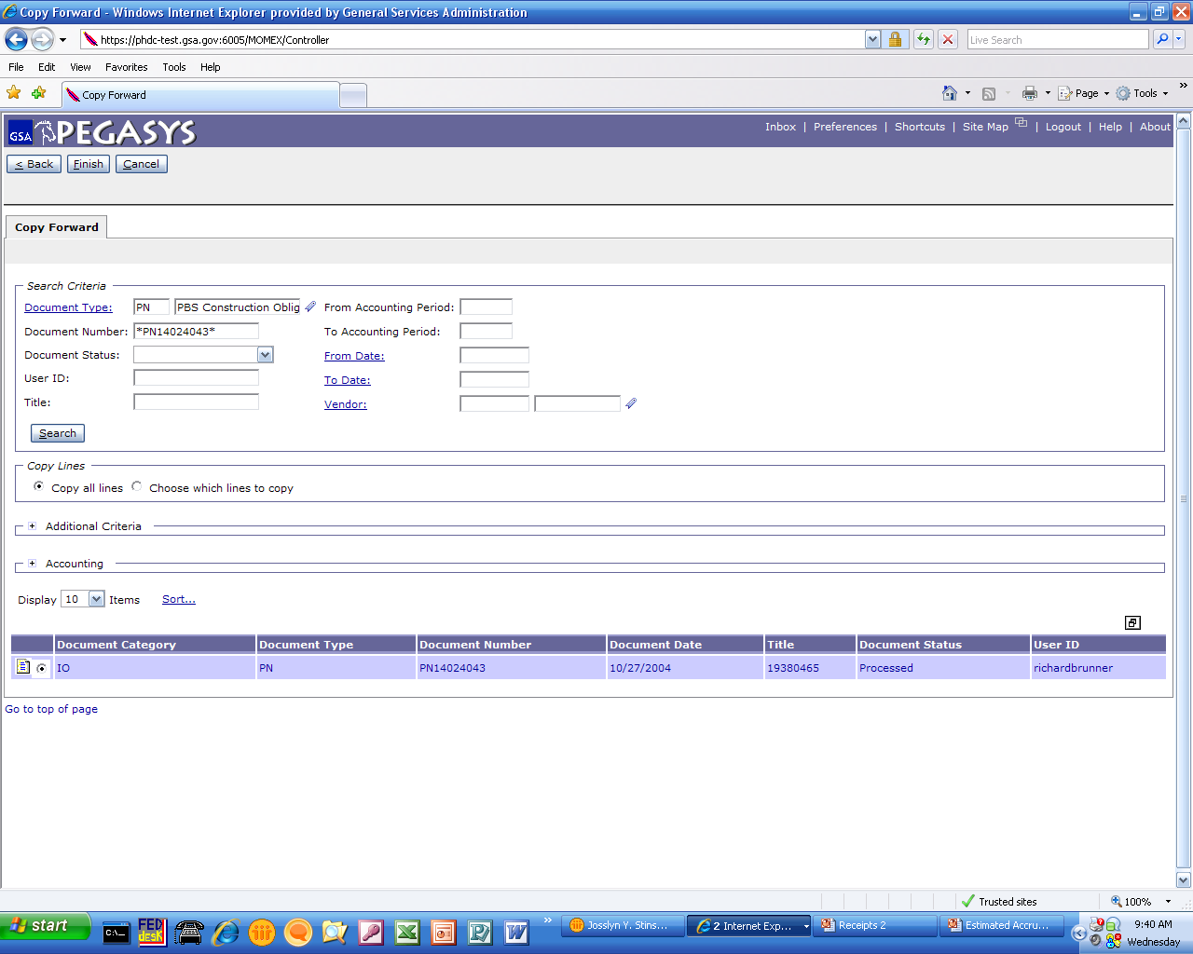
Copy Forward
Enter :
- Document Type
Document Number
Click :
Search
Highlight :
Document
Click :
- Finish
Purchase Orders
GP = GM&A
QP, FP, TP= FAS
XP = Clients
PJ, PN, PP = PBS

Slide 8
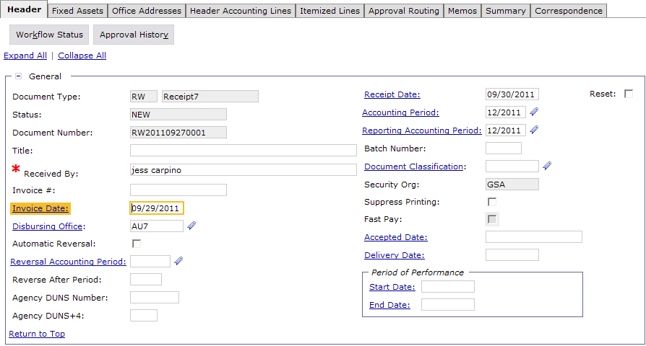
Full Receipt of Goods
Enter :
- Received By
- Invoice #
- Invoice Date
- Accepted Date
- Delivery Date
Note: Dollar amount does not change on a full receipt.
Notes:
A Full Receipt is created when an order is received in full; You have received all items or services listed on the PO
Verify there is a name in the “Received By:” field. This name should be copied from the PO
The Finance Center requires the user to input the Invoice Date and Invoice Number
Fill in the Accepted Date and Delivery Date
No approvals are needed for Receipts
Click:
Save
Verify
Submit
This completes a Full Receipt
Flip Chart Example
Have a flip chart with example of Full vs. Partial Receipt by amount
GP = $2000
Invoice = $2000
RK = $2000

Slide 9
Partial Receipt by Dollar Amount
Enter :
Received By
- Invoice #
- Invoice Date
- Accepted Date
- Delivery Date
Notes:
A Full Receipt is created when an order is received in full; You have received all items or services listed on the PO
Verify there is a name in the “Received By:” field. This name should be copied from the PO
The Finance Center requires the user to input the Invoice Date and Invoice Number
Fill in the Accepted Date and Delivery Date
No approvals are needed for Receipts
Click:
Save
Verify
Submit
This completes a Full Receipt
Flip Chart Example
Have a flip chart with example of Full vs. Partial Receipt by amount
GP = $2000
Invoice = $2000
RK = $2000

Slide 10
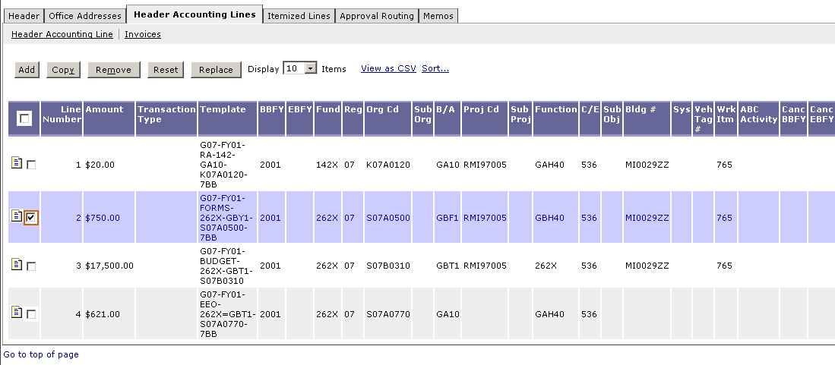
Partial Receipts by Dollar Amount (2)
Click :
- Header Accounting Lines Tab
Highlight :
- Accounting Line
Click :
- Header Accounting Line hyperlink
Save Often
Notes:
A Full Receipt is created when an order is received in full; You have received all items or services listed on the PO
Verify there is a name in the “Received By:” field. This name should be copied from the PO
The Finance Center requires the user to input the Invoice Date and Invoice Number
Fill in the Accepted Date and Delivery Date
No approvals are needed for Receipts
Click:
Save
Verify
Submit
This completes a Full Receipt
Flip Chart Example
Have a flip chart with example of Full vs. Partial Receipt by amount
GP = $2000
Invoice = $2000
RK = $2000

Slide 11
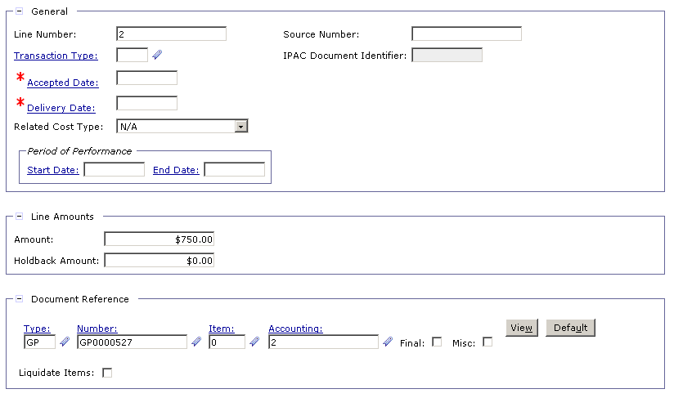
Partial Receipt by Dollar Amount (3)
Enter :
Amount of invoice received
Notes:
Partial Receipt occurs when order is not received in full; You have received some of the items listed or services
Procedure
Complete copy forward; fill in invoice date, invoice number, delivery date and acceptance date
Go to the Header Accounting Line tab
Highlight the appropriate line
Click on the Header Accounting Line hyperlink to the upper left and enter the amount in the Amount field of the Line Amounts box to match the invoice price
Click:
Save
Verify
Submit
Flip Chart Example
GP = $2000
Invoice = $700
RK = $700

Slide 12
Partial with Multiple Accounting Lines
Example:
Purchase Order: $2,000 Invoice A
Line 1 1,000 $1,500
Line 2 500
Line 3 500
RK Revised RK
Line 1 $1,000 Line 1 $ 700
Line 2 500 Line 2 400
Line 3 500 Line 3 400
Invoice B
$ 400
RK Revised RK
Line 1 300 Line 1 $ 200
Line 2 100 Line 2 100
Line 3 100 Line 3 100
Notes:
Now let’s discuss the Partial By Accounting Lines
Flip Chart example:
Say I have a Purchase Order (GP):
Available Balance $2,000
Line 1 1,000
Line 2 500
Line 3 500
Now, Invoice (A)
$1,500
Due to Copy Forward ,RK After making adjustments to Revised RK
Line 1 $1,000 Line 1 $700
Line 2 500 Line 2 400
Line 3 500 Line 3 400
Pegasys receives 2nd Invoice (B) we create 2nd Receipt RK
$ 500 Line 1 $300 Line 2 100 Line 3 100

Slide 13
Partial with Multiple Accounting Lines
Enter :
Received By
- Invoice #
- Invoice Date
- Accepted Date
- Delivery Date
Notes:
A Full Receipt is created when an order is received in full; You have received all items or services listed on the PO
Verify there is a name in the “Received By:” field. This name should be copied from the PO
The Finance Center requires the user to input the Invoice Date and Invoice Number
Fill in the Accepted Date and Delivery Date
No approvals are needed for Receipts
Click:
Save
Verify
Submit
This completes a Full Receipt
Flip Chart Example
Have a flip chart with example of Full vs. Partial Receipt by amount
GP = $2000
Invoice = $2000
RK = $2000

Slide 14
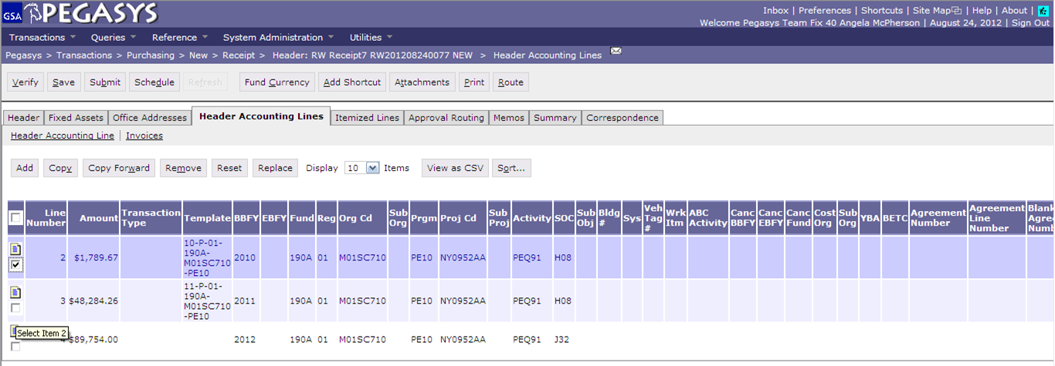
Creating Receipts - Partial with Multiple Accounting Lines
To Remove Accounting Lines
Click :
- Header Accounting Line
Highlight:
- Line(s) to be removed
Click :
- Remove
Removing an accounting line does not remove it from the PO, just the Receipt
Notes:
When creating a Partial RK by Accounting Lines you have to determine what amount from each line makes up the invoice total.
If a particular Accounting Line isn’t included on the invoice you must remove it from the Receipt by highlighting it and clicking Remove. This does not remove it from the PO, just the Receipt.

Slide 15
Creating Receipts – Partial by Accounting Lines
To adjust dollar amounts :
Click Header Accounting Line
Highlight the line
Click the Header Accounting Line hyperlink
Notes:
When creating a Partial RK by Accounting Lines you have to determine what amount from each line makes up the invoice total.
If a particular Accounting Line isn’t included on the invoice you must remove it from the Receipt by highlighting it and clicking Remove. This does not remove it from the PO, just the Receipt.

Slide 16
Creating Receipts – Partial Dollar Amount
Header Accounting Line
- Change dollar amount
Notes:
Partial Receipt occurs when order is not received in full; You have received some of the items listed or services
Procedure
Complete copy forward; fill in invoice date, invoice number, delivery date and acceptance date
Go to the Header Accounting Line tab
Highlight the appropriate line
Click on the Header Accounting Line hyperlink to the upper left and enter the amount in the Amount field of the Line Amounts box to match the invoice price
Click:
Save
Verify
Submit
Flip Chart Example
GP = $2000
Invoice = $700
RK = $700

Slide 17
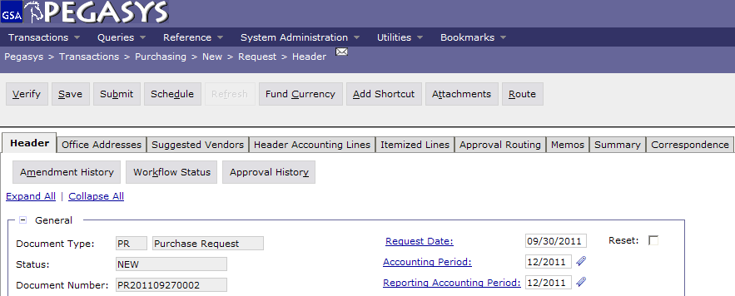
Save, Verify, Submit
  To finish the Form:
  - Save the form
  - Verify and correct any errors
  - Submit the document for processing

Slide 18
Additional Assistance
Pegasys Web Site - http://pegasys.gsa.gov
  User Guides
  Quick Reference Cards
  Pegasys Training Classes
OCFO Consolidated Service Desk
  1-866-450-6588
  ocfoservicedesk@gsa.gov
ocfocustomerservice.gsa.gov
Notes:
If 90% of the time when you do a credit card it is same funding then set up the accounting string as a default.

Slide 19

Goals of Information Security
Confidentiality
  Data must be protected against unauthorized disclosure
Integrity
  Systems must not permit processes or data to be changed without authorization
Availability
  Systems must be functional and operational
Confidentiality
Availability
Integrity
Notes:
Please take a few moments and review the remaining slides on Information Security

Slide 20
Why is Information Security Important?
Must be in compliance with regulatory requirements such as OMB Circular A-130, Computer Security Act, FISMA and GSA IT security policies
Protects GSA information resources from potential abuse and misuse
Follows sounds business practices

Slide 21
User Responsibility
Responsible for adherence to GSA information security policy
Protect Pegasys login ID and password
  Do not allow others to use your login ID / password
  Do not write it down
Log out whenever you are not using Pegasys
Protect sensitive information
  Shred reports containing sensitive information
Report security incidents
  Refer to OCFO Incident Handling Procedures for further guidance
  Report security incidents to your supervisor

Slide 22

Keys to Incident Prevention
Keys to Incident Prevention
Awareness - be aware of the value of the assets you are using to do your job and the nature of associated threats vulnerabilities and suspicious activities
Compliance - comply with established safeguards, policies, and processes
Common Sense - if something appears to be off, it generally is

Slide 23

Remember ...
Security is a PEOPLE issue,
not only a TECHNICAL one!

