Slide 1
Seizure Recording Data Processing
By Thomas Dang

Slide 2
Overview
Background
Seizure recording files description
Preictal and Interictal states
Summary .txt file
Program design summary

Slide 3
Background of this program
Taken from the Melbourne University AES/MathWorks/NIH Seizure Prediction Kaggle competition:
“There is emerging evidence that the temporal dynamics of brain activity can be classified into 4 states: Interictal (between seizures, or baseline), Preictal (prior to seizure), Ictal (seizure), and Post-ictal (after seizures). Seizure forecasting requires the ability to reliably identify a preictal state that can be differentiated from the interictal, ictal, and postictal state. The primary challenge in seizure forecasting is differentiating between the preictal and interictal states. The goal of the competition is to demonstrate the existence and accurate classification of the preictal brain state in humans with epilepsy.”
“Intracranial EEG (iEEG) data clips are organized in folders containing training and testing data for each human patient. The training data is organized into ten minute EEG clips labeled "Preictal" for pre-seizure data segments, or "Interictal" for non-seizure data segments.”
My program focuses on identifying preictal and interictal states to produce a dataset that could be used for future machine learning research.
The dataset files that my program produces are smaller time frames of every preictal and interictal periods between seizures. Having smaller time frames is similar to the technique that Melbourne University used for its Kaggle competition.
Ictal and post-ictal are completely ignored as they don’t impact the effectiveness of predicting seizures.

Slide 4
Lets dissect a seizure recording file
Seizure recordings are represented as a matrix
Each row represents individual channels within the brain
Some channels have positive or negative values whereas
other channels might be nonexistent.
Columns represent time duration of seizure recording.
The further right the column is, the longer the time is during
the seizure recording and vice versa.
The time units from Physionet EEG files define 1 second = 256
columns. https://physionet.org/cgi-bin/atm/ATM
Columns = Time
Rows = Channels

Slide 5
Warning!!
Make sure that the dimensions of your matrices are all the same.
This program concatenates neighboring matrices in the seizure recording list, so the dimensions must be equal in order to successfully combine multiple matrices. Otherwise you get this error.

Slide 6
Preictal Parameter
A time duration parameter value can be set to define our preictal state.
This means we can set the preictal state to whatever time length as we please.
As said before, the time units from the Physionet EEG files define 1 second = 256 columns.
For your own seizure files, it is very important that you know your time units.
In the example screenshot to the right, 921600 = 3600 seconds = 1 hour.

Slide 7
Preictal variabilities between two seizures
The time length of a preictal file between 2 seizures can result in one of 2 options
If the time gap between two seizure events is greater than or equal to the preictal time duration parameter value set by the user, then the preictal time length is equal to the preictal time duration parameter set by the user.
2. If the time gap between two seizure events is less than the preictal time duration parameter value set by the user, then the preictal time length is some arbitrary value that is LESS than the preictal time duration parameter value set by the user.
Preictal Parameter = 1 hour
This is the preictal time duration parameter set by the user from
previous slide.

Slide 8
Interictal variabilities between two seizures
Remember, interictal always comes before preictal!!!!
The time length of an interictal file between 2 seizures can result in one of 2 options
If the time gap between the two seizures is GREATER than the preictal time duration parameter value set by the user, then the interictal time length is equal to the time period between the initial seizure and the start of the preictal period preceding the next seizure.
If the time gap between the two seizures is equal to or less than the preictal time duration parameter value set by the user, then the interictal time length is nonexistent.

Slide 9
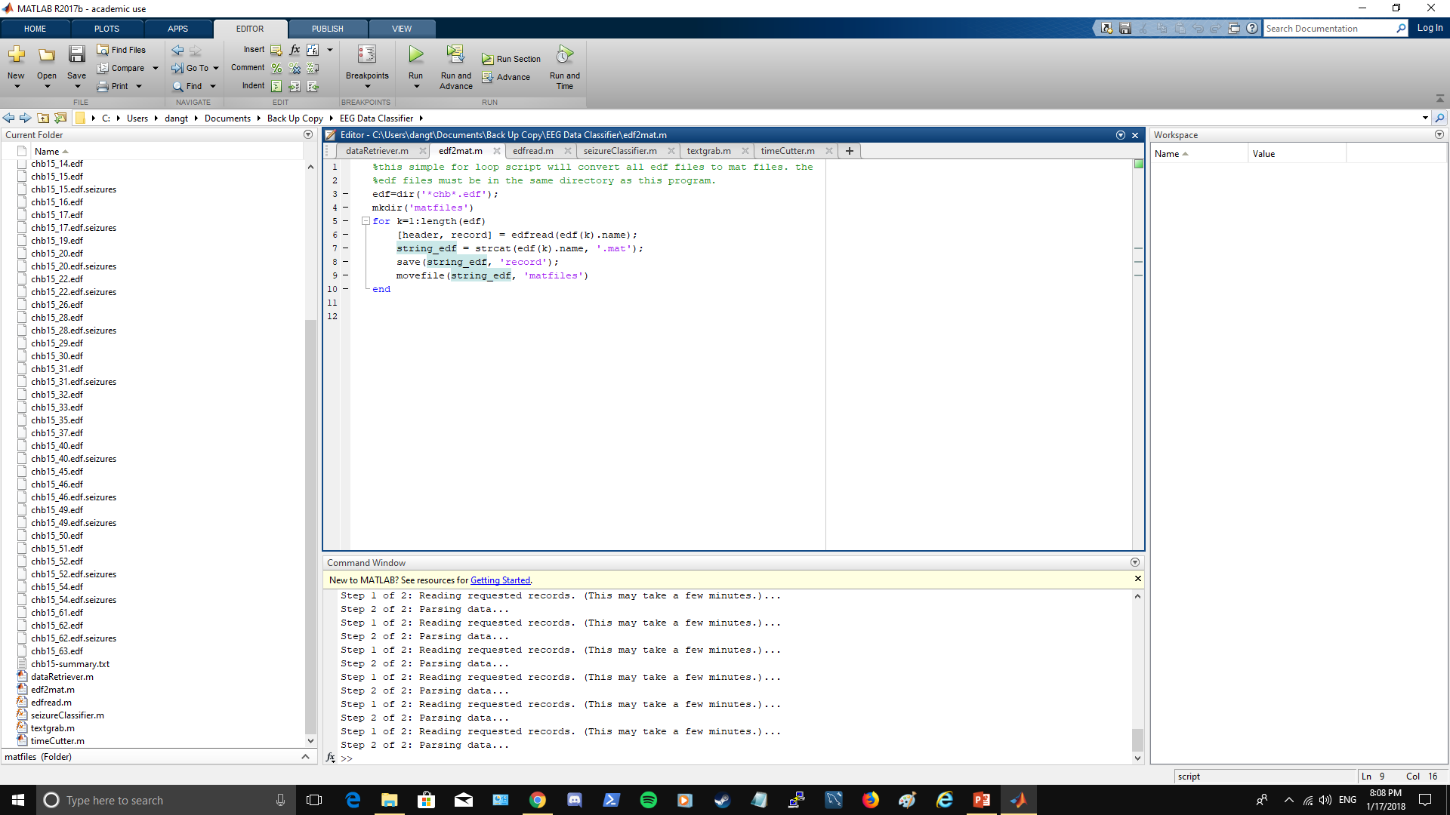
Converting EDF files into MAT files
This is where you can configure to your file naming convention
1. Copy and paste each edf
files to the same directory as
edf2mat.m and edfread.m
2. Then click run on the edf2mat.m script and the program will begin converting files.
3. It is recommended that edf files have a common naming expression. In the example to our left, all of our edf files have the substring “chb” in the name of each files.
4. Alternatively we can use the
regular expression “*.edf” in
line 3 to capture any edf files in
the same directory.

Slide 10
Once you have your mat files ready to go, copy and paste those files onto the same directory as dataRetriever.m, seizureClassifier.m, textgrab.m, and timeCutter.m.

Slide 11
Seizure Summary .txt file
The only way this program can read the .mat files is if the user has a summary .txt file of the list of seizure recordings in the same directory as dataRetriever.m. To the right is the format of what this .txt file should look like.
It is vital that this text file contains accurate info because the program must rely on this info to perform the data processing.
The .txt file must have the same format as this:
File Name: name
Number of Seizures in File: 1
Seizure Start Time: 123
Seizure End Time: 123
.
.
.
Seizure Start Time: 123
Seizure End Time: 123
Format of
.txt summary
file

Slide 12
Splitting data into Preictal/Interictal states
Once you click run on dataRetriever.mat, the script will go through a list of seizure recordings and call the function seizureClassifier.mat to split those recordings into two types of files:
Preictal state files
Interictal state files
dataRetriever.mat
seizureClassifier.mat
Function call
Navigates through a list of seizure
recordings and extracts data
Performs algorithm on extracted data to
split recording into preictal or interictal files.

Slide 13
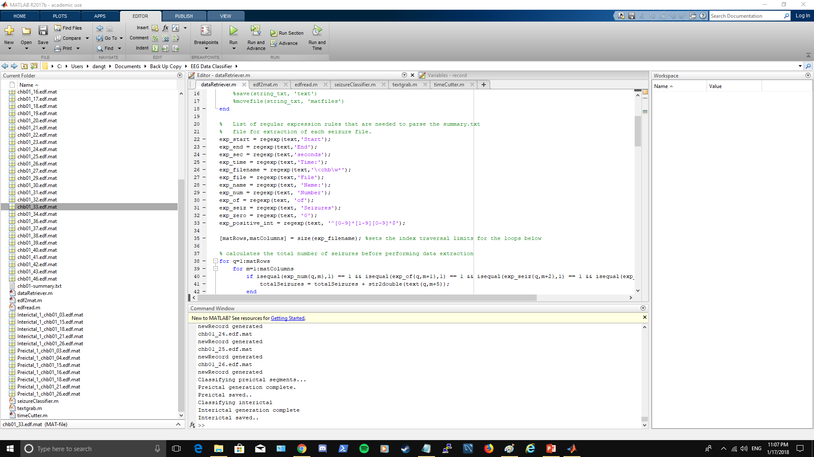
Once you have your
Interictal and preictal
files, make sure that
they are in the same
directory as
timeCutter.m so that
you can move on to the
next phase in data
Processing.

Slide 14
timeCutter.m
timeCutter.m will equally split each interictal/preictal file into smaller time frames of seizure recording files.
How small the seizure recording files are will depend on what value the user specifies for the timeLength parameter variable.
Here you can specify how small the seizure recording files should be
This is what
the result from
timeCutter.m
should look like

Slide 15


Overall program design
Convert files to .mat format
Split files into preictal and interictal states
Equally divide preictal/interictal
files into smaller timeframes
dataRetriever.m
edf2mat.m
Function call
Function calls
timeCutter.m
edfread.m
textgrab.m
seizureClassifier.m

