Slide 1
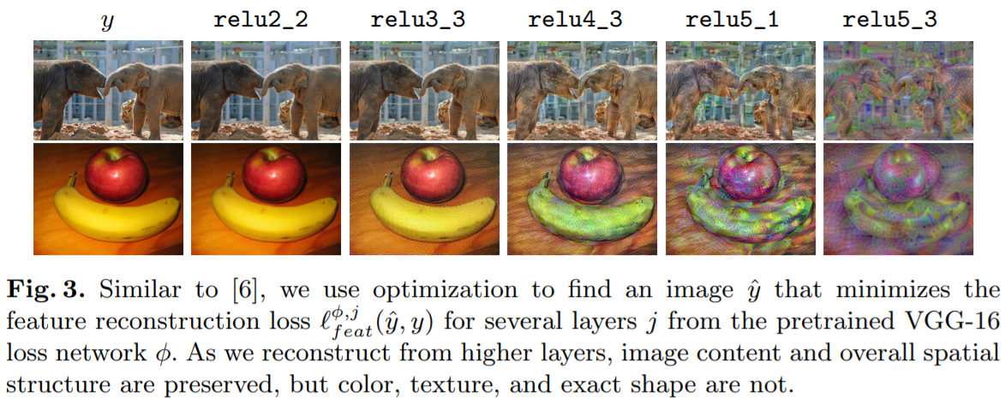
Input Image
relu2_2
relu3_3
relu4_3
relu5_1
relu5_3

