Slide 1
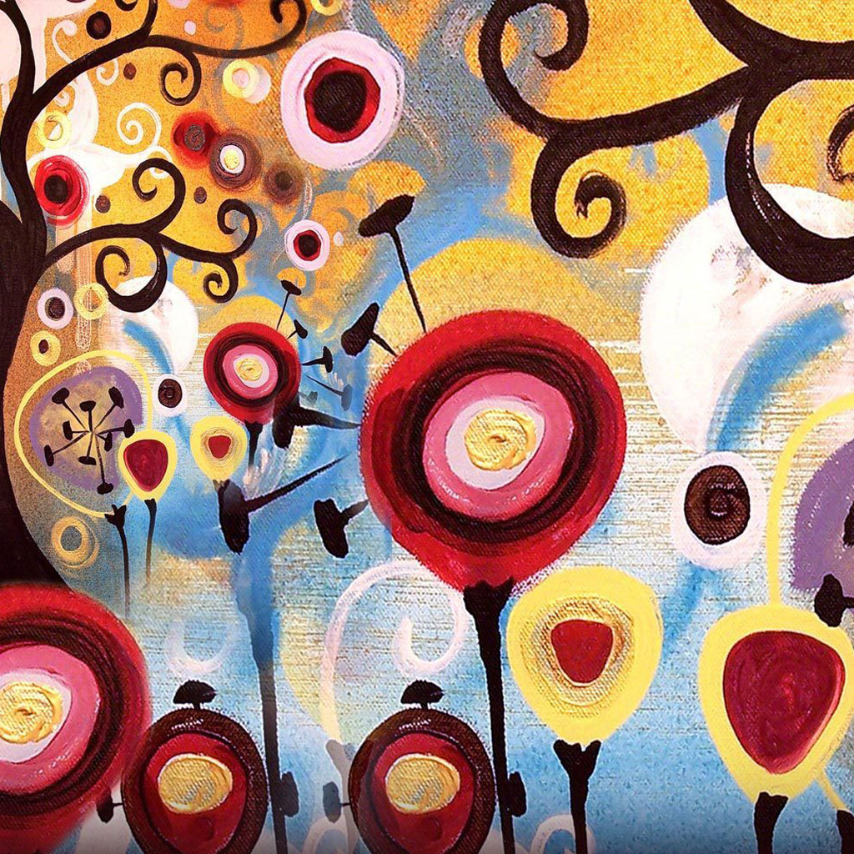
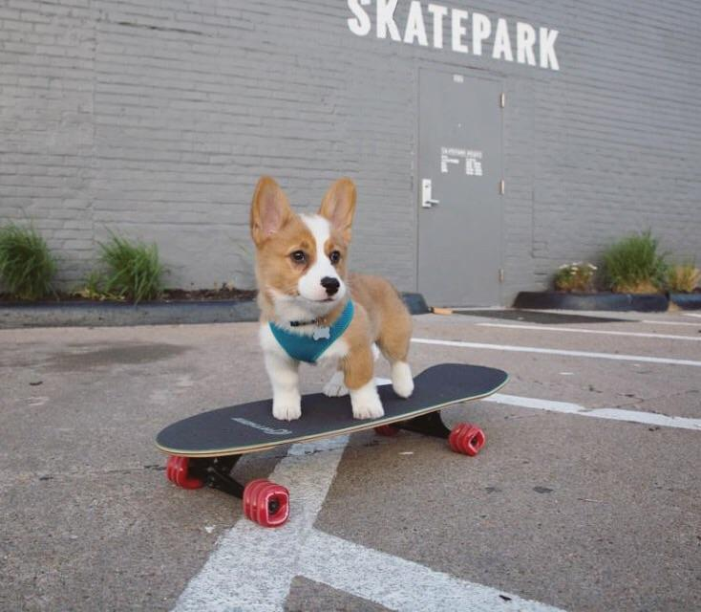
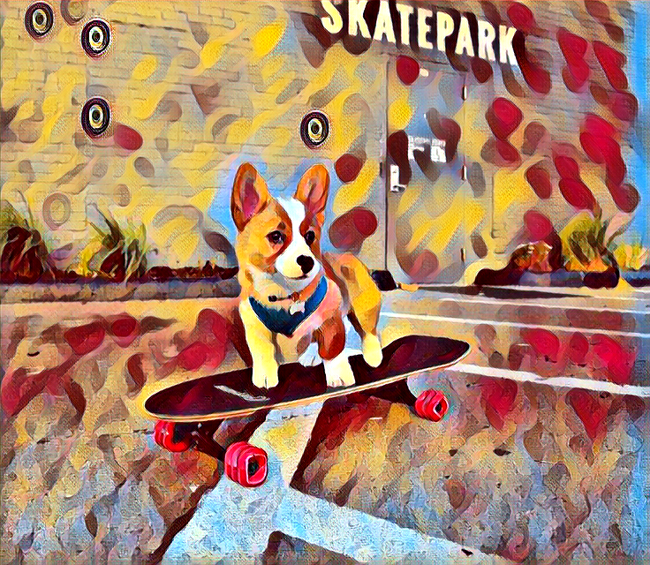
Style image
Style loss
Input image
Output image
relu 1_2
relu 2_2
relu 3_3
relu 4_3
Content image
Content loss
Image Transformation Network
Loss network (VGG-16)

