Slide 1
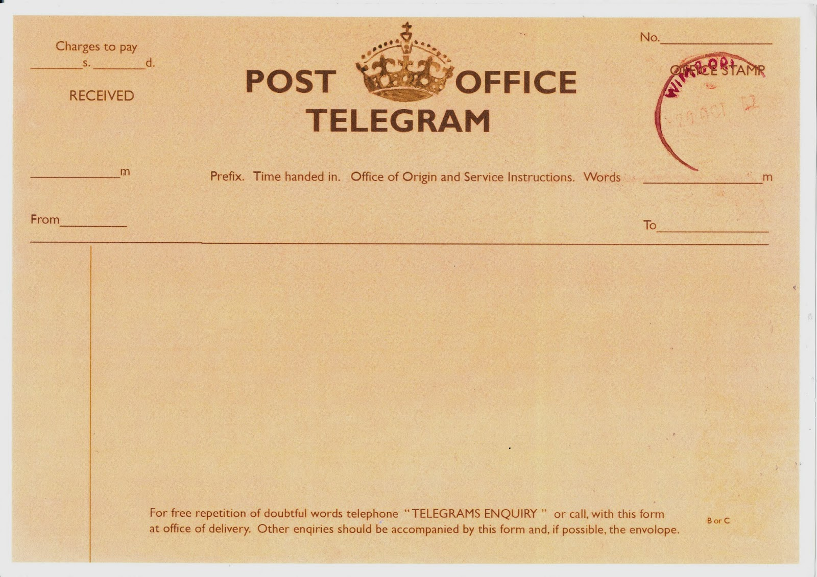

URGENT MESSAGE RECEIVED FROM FRONT:

