Slide 1
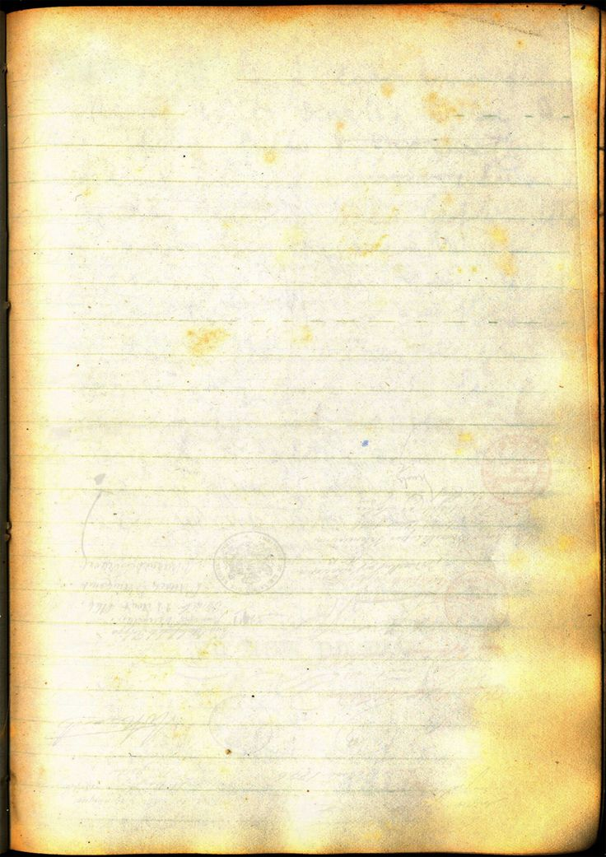
I shall be in the UK on the following dates
January 1, 8, 15, 22, 29
March 1, 2, 3, 8, 10, 15, 16, 17, 24, 31
June 1, 2, 8, 15, 16, 23, 29, 30
July 1, 2, 9, 15, 16, 22, 29, 30

Slide 2
When I’m out of the UK I will be travelling between the following countries.
Minsk to Moscow
Oslo to Stockholm
Amsterdam to Berlin to Warsaw
Prague to Budapest

