Slide 1

Caption Generation
CS 512 : Computer Vision
Benjamin Scialom A20432063
Thomas Ehling A20432671

Slide 2
Content
Project Introduction (Ben)
Data-set presentation ( Ben)
Overview of the project (Thomas)
Features Extraction : VGG model (Thomas)
Features Extraction : OUR model (Thomas)
Caption Generation Model (Ben)
Training Results (Ben)
Model evaluation : BLEU score (Thomas)
Test explication (Ben)
Live example (Thomas)

Slide 3
Introduction Plan
INTRODUCTION
OVERVIEW
FEATURES
EXTRACTION
MODEL
EVALUATION
TEST
Project Introduction
Data-set presentation
Overview of the project
Features Extraction : VGG model
Features Extraction : OUR model
Caption Generation Model
Training Results
Model evaluation : BLEU score
Test explication
Live example

Slide 4
Introduction Context
INTRODUCTION
OVERVIEW
FEATURES
EXTRACTION
MODEL
EVALUATION
TEST
First subject : Leverage Image searching using caption
Why we decided to change ?
Second subject : Caption generation

Slide 5
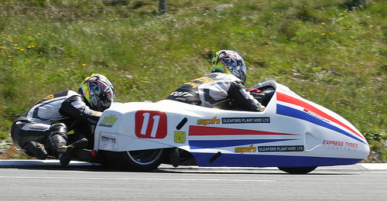
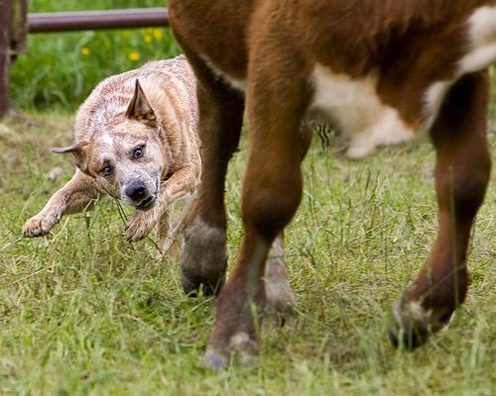
Introduction Flickr8k_Dataset
INTRODUCTION
OVERVIEW
FEATURES
EXTRACTION
MODEL
EVALUATION
TEST
A man in street racer armor be examine the tire of another racer 's motorbike
a dog nip at the feet of a cow

Slide 6
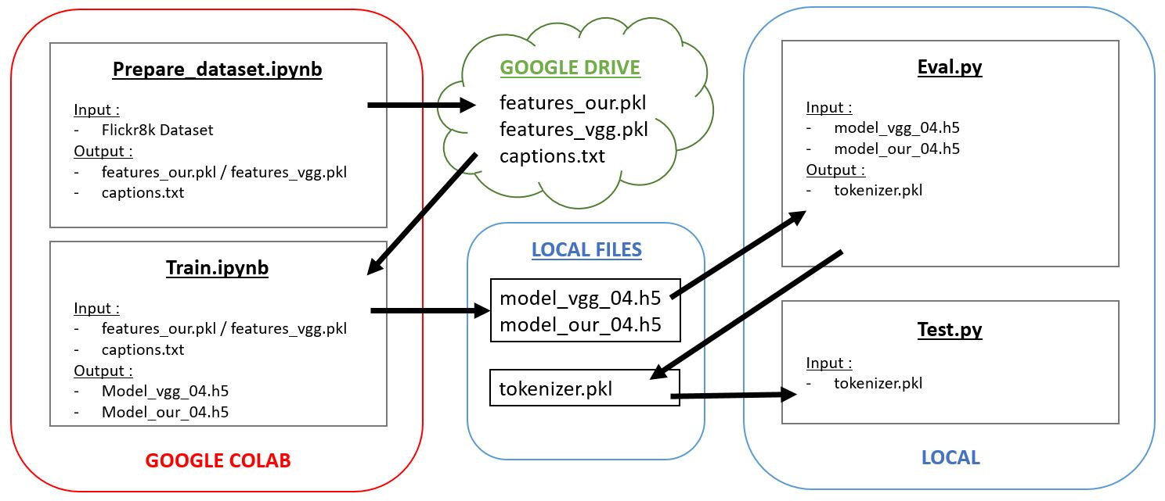
OVERVIEW
INTRODUCTION
INTRODUCTION
OVERVIEW
FEATURES
EXTRACTION
MODEL
HOW IT WORKS
MEDIA FORMATS
MPD
EVALUATION
TEST
PROFILES
LIBRARIES

Slide 7
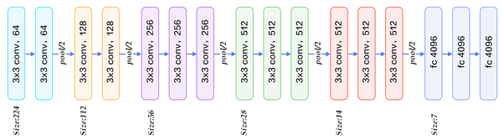
FEATURES EXTRACTION VGG16 model
INTRODUCTION
INTRODUCTION
HOW IT WORKS
OVERVIEW
MEDIA FORMATS
FEATURES
EXTRACTION
MPD
MODEL
PROFILES
EVALUATION
LIBRARIES
TEST
pooling
pooling
pooling
pooling
pooling

Slide 8
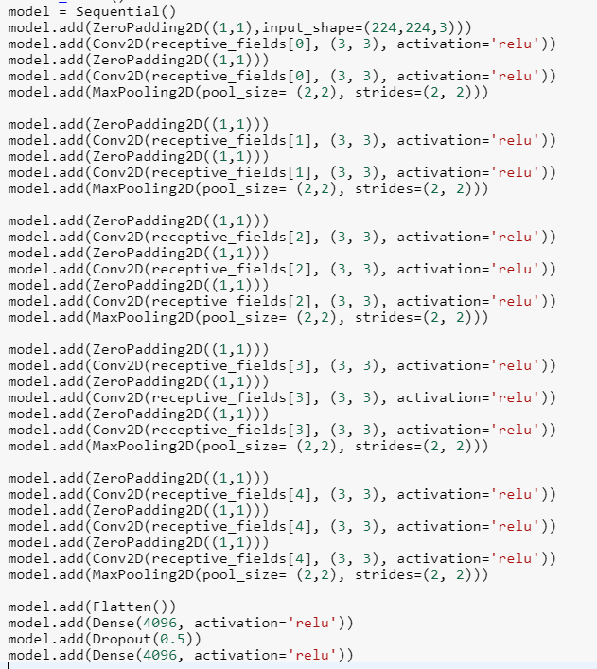
FEATURES EXTRACTION Our model
INTRODUCTION
INTRODUCTION
HOW IT WORKS
OVERVIEW
MEDIA FORMATS
FEATURES
EXTRACTION
MPD
MODEL
PROFILES
EVALUATION
LIBRARIES
TEST

Slide 9
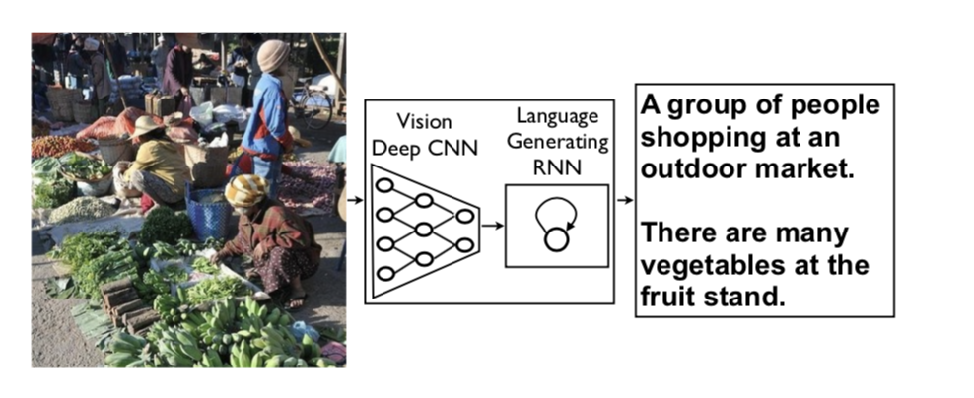
Caption Generation
INTRODUCTION
INTRODUCTION
HOW IT WORKS
OVERVIEW
MEDIA FORMATS
FEATURES
EXTRACTION
MPD
MODEL
PROFILES
EVALUATION
LIBRARIES
TEST

Slide 10
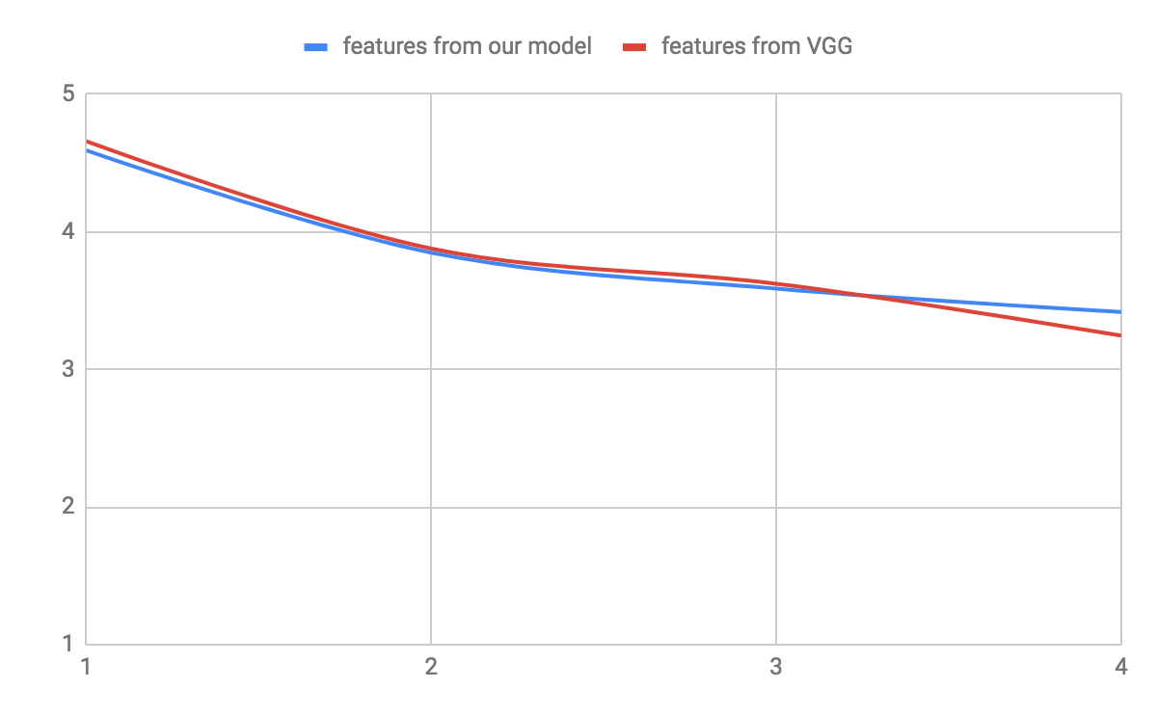
Training Result
INTRODUCTION
OVERVIEW
FEATURES
EXTRACTION
MODEL
EVALUATION
TEST
Loss evolution :

Slide 11
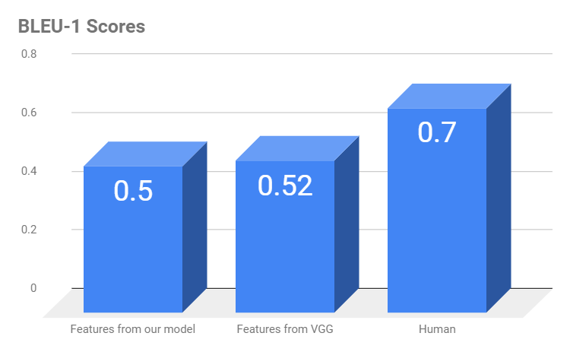
EVALUATION
INTRODUCTION
OVERVIEW
FEATURES
EXTRACTION
MODEL
EVALUATION
TEST

Slide 12
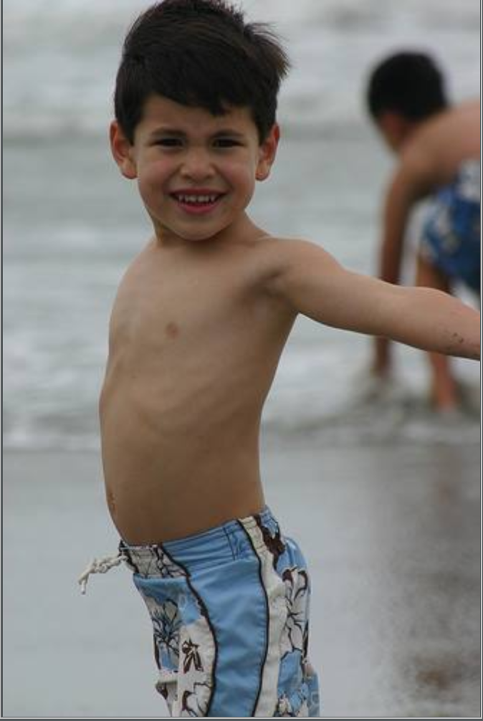
Captioning Result
INTRODUCTION
OVERVIEW
FEATURES
EXTRACTION
MODEL
EVALUATION
TEST
Our caption :
Two dogs playing in the water
VGG caption :
Young boy is jumping in the pool

Slide 13
Live Test
INTRODUCTION
OVERVIEW
FEATURES
EXTRACTION
MODEL
EVALUATION
TEST
What is your caption ?

