Slide 1


Blockchain-X
Introduction to Smart Contract Development
Thomas Ferry
Developer, Berkeley Blockchain Lab
SCET, UC Berkeley
tferry@berkeley.edu

Slide 2
Outline
1. Introduction
a) Ethereum: Brief History and Overview
b) The Ethereum Philosophy
2. Smart Contracts
a) Basic Concepts
b) Why do they matter?
c) Smart Contract Design
d) Solidity Syntax & Example Code
3. The Environment of Smart Contract Development
a) Code, Test, Deploy
b) Security overview

Slide 3
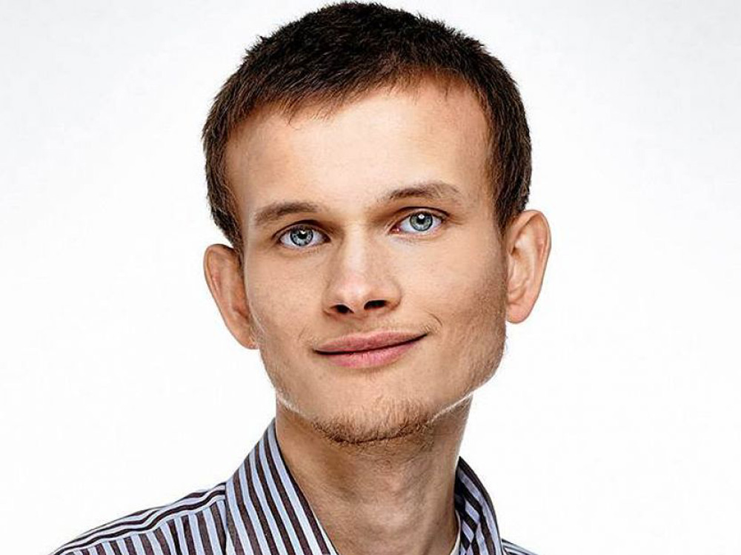

Slide 4
$6,809.93

Slide 5
1- Create your own Blockchain
2- Use Bitcoin’s Blockchain

Slide 6
Why not use Bitcoin’s Blockchain?
1. A weak scripting language
2. Systemic limitations for smart contracts
3. Resource heavy verification mechanism

Slide 7


Slide 8
“A blockchain with a built-in Turing Complete programming language, allowing anyone to write smart contracts and decentralized applications where they can create their own arbitrary rules for ownership, transaction formats and state transition functions.”
- Vitalik Buterin

Slide 9
Ethereum Core Concepts

Slide 10

 | Ethereum | Bitcoin
Data Access | Public | Public
Type | Permissionless | Permissionless
Consensus | Proof of Work (For now) | Proof of Work
Mining Reward | 5 Ether + Small Reward for Uncle Blocks + Gas | 12.5 Bitcoin per block

Slide 11
Main Chain
Main Chain
Uncle Block
Main Chain

Slide 12

$$Gas Payment \left(ETH\right)=Gas Amount \left(Gas\right)∗Gas Price (Gas / ETH)$$

Slide 13
State A
Miner
0 ETH
Node 1
10 ETH
Node 2
10 ETH
Basketball Betting
0 ETH

Slide 14
Miner
0 ETH
Node 1
10 ETH
Node 2
10 ETH
(5 ETH, “Win”)
Basketball Betting
0 ETH

Slide 15
State B
Miner
5.01 ETH
Node 1
4.99 ETH
Node 2
10 ETH
Basketball Betting
5 ETH

Slide 16
Miner
5.01 ETH
Node 1
4.99 ETH
Node 2
10 ETH
(5 ETH, “Lose”)
Basketball Betting
5 ETH

Slide 17
State C
Miner
10.02 ETH
Node 1
4.99 ETH
Node 2
4.99 ETH
Basketball Betting
10 ETH

Slide 18
Miner
10.02 ETH
Node 1
4.99 ETH
Node 2
4.99 ETH
(Withdraw)
Basketball Betting
10 ETH

Slide 19
Miner
10.02 ETH
Node 1
4.99 ETH
Node 2
4.99 ETH
(Withdraw)
(Send 10 ETH)
Basketball Betting
10 ETH

Slide 20
State D
Miner
15.03 ETH
Node 1
14.98 ETH
Node 2
4.99 ETH
Basketball Betting
0 ETH

Slide 21
Exercise !
Calculate the dollar price to run the following function.
Open a browser and go to:
https://tinyurl.com/countinggas

Slide 22
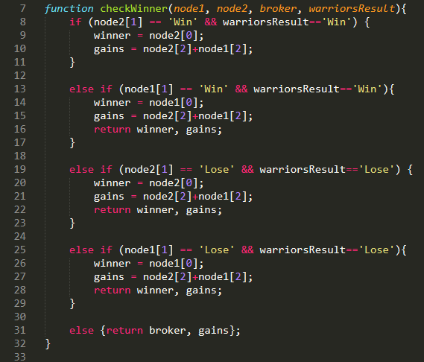
Exercise !
Assume:
node1 and node2 are lists with format [str,str,int]
size(node1[0]) = 4 words size(node2[0]) = 4 words
node1[1] = “Lose”
node2[1] = “Win”
node1[2] = 5
node2[2] = 4
warriorsResult = ‘Lose’
Gas price = 2E-08 ETH/gas
Assume $700/ETH

Slide 23
Exercise !
4*(EQ+AND+EQ) + 4*MSTORE + MSTORE
36 + 12 + 3 = 51 gas
51 gas * 0.00000002 ETH/gas = 1.02E-06 ETH
1.02E-06 * 700 = $ 0.000714

Slide 24
Ethereum’s Philosophy

Slide 25
Ethereum’s Core Values
1. Simplicity
2. Universality
3. Modularity
4. Agility
5. No Discrimination, No Censorship

Slide 26
Smart Contracts

Slide 27
Benefits of Smart Contracts
1. Automatic
2. Store Ether
3. Transparent
4. Uncorruptible

Slide 28
Limitations of Smart Contracts
1. Expensive
2. Transparent
3. Rigid

Slide 29
Smart Contracts
Decentralized Applications

Slide 30
Bitcar: The ride sharing DAO
Driver
0 GCC
Gold Contract
Miner
8 GCC
(8 SCC)
(1 GCC)
(90 SCC)
MINING
(2 SCC)
(10 SCC)
Miner
2 GCC
SCC
$$$
(1 GCC)
User
0 GCC
Silver Contract
(100 SCC)
$$$
SCC

Slide 31
Smart Contracts
Initial Coin Offerings

Slide 32
Smart Contracts
Implications for the Economy

Slide 33
Implications for the Economy
1. Notaries will disappear
2. New kind of lawyers will emerge
3. Democratization of investments
4. Automatic Supply Chains

Slide 34
Smart Contracts
Decentralized Start-ups

Slide 35


Slide 36


Slide 37


Slide 38
Smart Contracts
Design

Slide 39
Smart Contracts: Basic Design
contract someContract {
event someEvent()
constructor someConstructor(){
activator = addressOfActivator()
}
}

Slide 40
Smart Contracts
Solidity Syntax

Slide 41
http://remix.ethereum.org

Slide 42
The Ethereum Environment
Design – Test - Deploy

Slide 43
The Ethereum Environment
Design

Slide 44
The Ethereum Environment
Test

Slide 45
Testing
TRUFFLE
Project Management
Migration
GANACHE
Local Virtual Blockchain
CLI & GUI

Slide 46
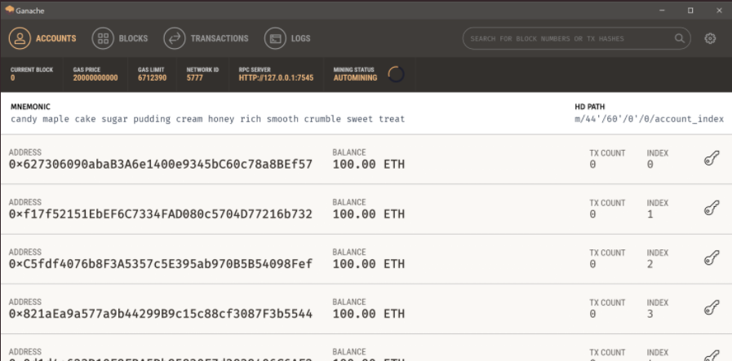
Ganache GUI

Slide 47
Testing
TRUFFLE
Project Management
Migration
GANACHE
Local Virtual Blockchain
CLI & GUI
GETH
Local Virtual Blockchain
Connection to TestNet
Connection to MainNet
MIST
Realistic GUI interface
GUI for TestNet
GUI MainNet

Slide 48
The Ethereum Environment
Deploy

Slide 49
Overview
REMIX IDE
Syntax Highlighting
Simple compiling
Quick testing
TRUFFLE
Project Management
Migration
Design
GANACHE
Local Virtual Blockchain
CLI & GUI
MIST
Realistic GUI interface
GUI for TestNet
GUI MainNet
Test
Deploy
GETH
Local Virtual Blockchain
Connection to TestNet
Connection to MainNet

Slide 50
The Ethereum Environment
Security

Slide 51
Parting Words

Slide 52

Thanks!
Connect with me:
E-mail
LinkedIn
tferry@berkeley.edu
linkedin.com/in/tferry

