Slide 1


WEB PROJECT
Website for internships
Delage Tanguy / Fevre Thomas / Quillet-Jaquot Aristide / Cormier Mathieu

Slide 2


SUMMARY
1 – Context reminder
2 – Working environnement
3 – Functional specifications
4 – Technical specifications
5 – Database
6 – Website overview

Slide 3
Context reminder
Personnal network
Students
Professional network
Solution : Y-work.other.fr
Spontaneous application
Companys
Offers

Slide 4





Working environnement

Slide 5

Functional specifications
Access management
Account management
Application management
Company management
Offer mannagement

Slide 6
Technical specifications
Organisation : GIT
Hosting : Apache/Vhosts/access
Syntaxe : HTML/Forms
Front-end : HTML5/CSS3/jQuery/Javascript
Asynchronous mechanism : dynamic/pagination/security
Back-end : MVC/POO/template/cookies
PWA : Manifest/Service Worker/mobile/Lighthouse

Slide 7
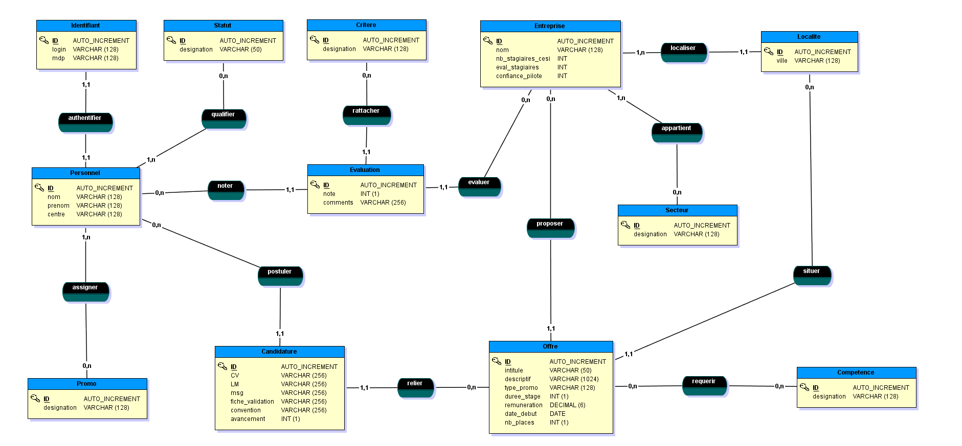
Database

Slide 8
C
Website overview

Slide 9
Question and answer time

