Slide 1
Hardware Software Platforms Project Presentation
Board Altera DE1: Driver Temperature Sensor and 7-segment display
Destrait Maxime 170989@umons.ac.be
Godesiabois-Galand Thomas 131671@umons.ac.be

Slide 2
Contents
Introduction
Driver temperature sensor
Path
7-segment display
Applications
Conclusion

Slide 3
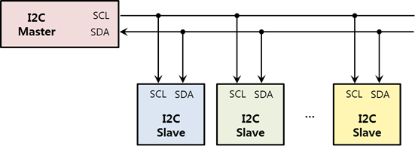
Introduction
I2C is a half-duplex bidirectional synchronous serial bus

Slide 4
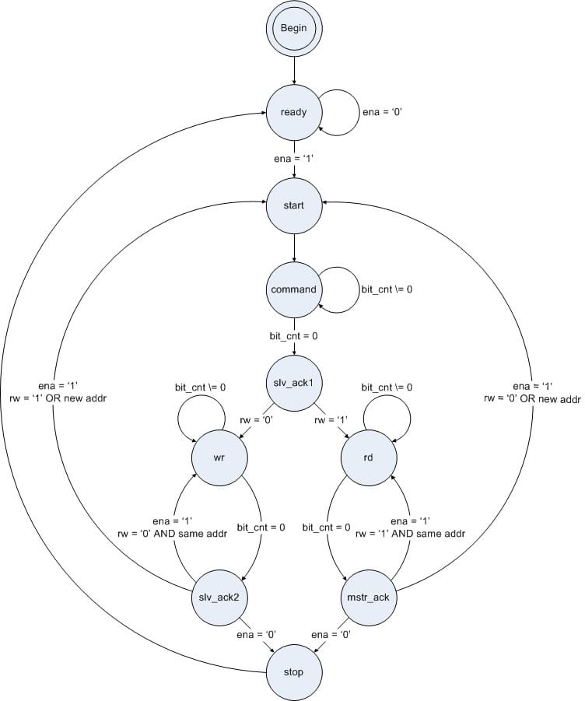
Driver temperature sensor
How our I2C Master State Machine work?
Starts in the ready state and waits for the ena signal.
The slv−ack1 state captures and then checks the slave acknowledgement.
The rw or wr command determines whether the component writes data to the slave or receives data from the slave.
Once completed, the master captures and verifies the slave’s response(slv−ack2 state).

Slide 5
Driver temperature sensor
How to install a VHDL code?
Launch Quartus II-64bits
Create a VHDL projet: File→New Project Wizard→Click "Next"until the new project is created
Create a new file in the project
Paste the VHDL code
Save the file and the project
Compile (use the shortcut represented with a play symbol)

Slide 6
Driver temperature sensor
How to perform a Test Bench?
Create the VHDL Test Bench
Go to Assignement→Settings→General: Make sure that file intop-level entity correspond with the Test Bench
Go to Assignement→Settings→EDA Tool Settings→Simualtion :Make sure that the Tool name is Modelsim-Altera
Compile: Make sure that there aren’t any errors
Go to Tools→Run Simulation Tools→RTL simulation

Slide 7
Driver temperature sensor
How to perform a Test Bench?
Openning of Modelsim
Go to Compile→Compile→Check his own Test Bench
Go to Library Windows→work→our Test Bench→Architecture ofour Test Bench
Objects Appearance
Select all the objects and add to a new wave
Select the simulation time and run

Slide 8
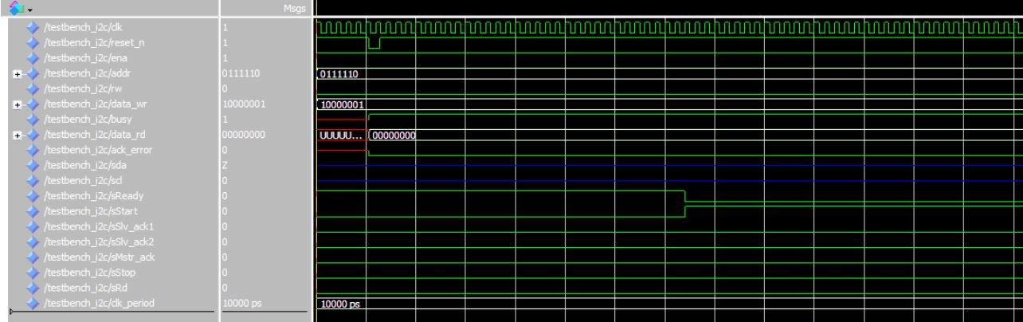
Driver temperature sensor
How to perform a Test Bench?

Slide 9
Path
state machine linked to the temperature sensors
Resolution adjustement
Temperature reading

Slide 10
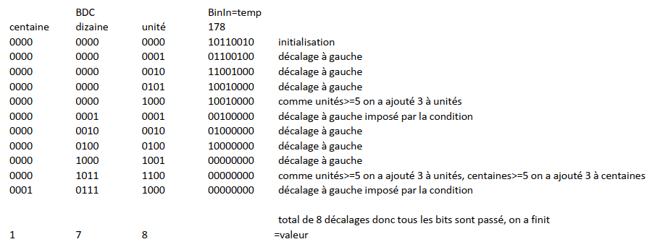
7-segment display
BDC
Binary Coded Decimal
1111 1111
255
complex
easy
hundreds
tens
unit
hundreds
tens
unit
0010
0101
0101
2
5
5
Algorith double dabble or ‘shift-and-add 3 algorithm’

Slide 11
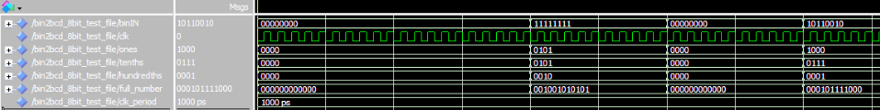
7-segment display
255
178
2
5
5
1
7
8

Slide 12
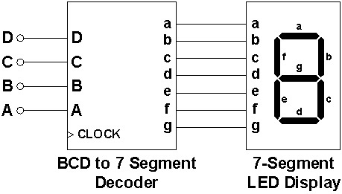
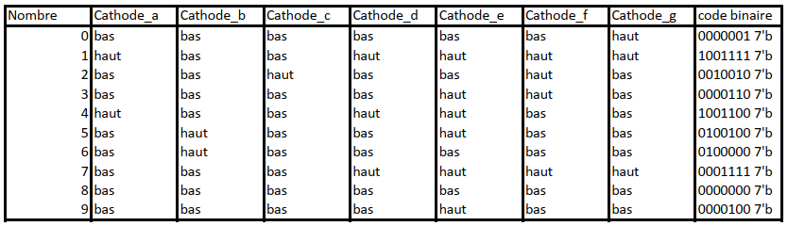
7-segment display
cathode
‘0’=>led on
‘1’=>led off

Slide 13
Applications
Projet that takes into account the I2C communication
Projetsim when we fix the input data

Slide 14
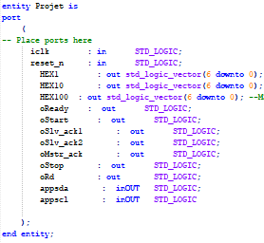
Applications
Inputs and Outputs of the Projet

Slide 15
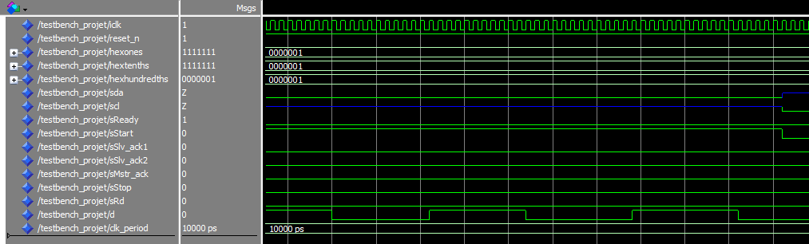
Applications
Test bench Projet

Slide 16
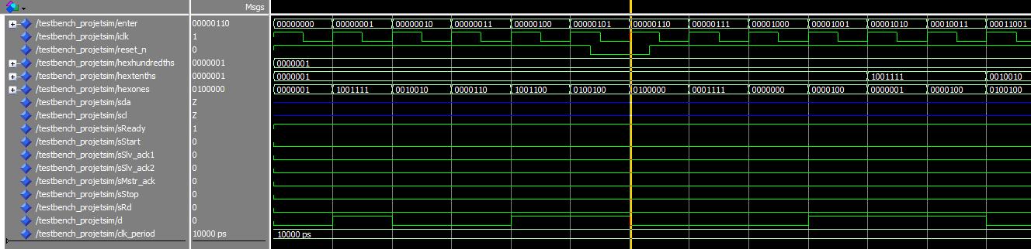
Applications
Test bench Projetsim

Slide 17
Conclusion
Familiar with VHDL coding
Familiar with test bench.
The lockdown.
Test in lab

Slide 18
THANKS!
Some questions ?

