Slide 1
Finite Difference Method
A Numerical Technique for PDEs
Thomas Gartman

Slide 2
1D Heat equation
I chose to model the 1D heat equation of the form U_{t} = c² U_{xx} where U(x, t) is the temperature at a given position and time with initial and boundary conditions to be determined.
Remember that physically, this equation models a rod of length L where the temperature at any cross sectional area at point x is homogeneous.

Slide 3
Forward Finite Difference Method
According to Numerical Analysis (Burden & Faires, 7 ed., pg. 704), the forward finite difference method is given by
u_{i,j+1} = (1 – 2c²(k/h²))u_{ij} + c²(k/h²)(u_{i+1,j} + u_{i-1, j})
Where x is split into n discrete steps and t is split into m discrete steps such that k = t_{f}/m, h = L/n, 0 ≤ i ≤ n, and 0 ≤ j ≤ m.
We derive this expression by taking the Taylor series expansion in t and x then taking the difference of the two expressions.
The Forward FDM is conditionally stable. I.e. it converges at rate O(k + h²) only when c²k/h² ≤ .5. Note: This is usually slow (relative to other methods).

Slide 4
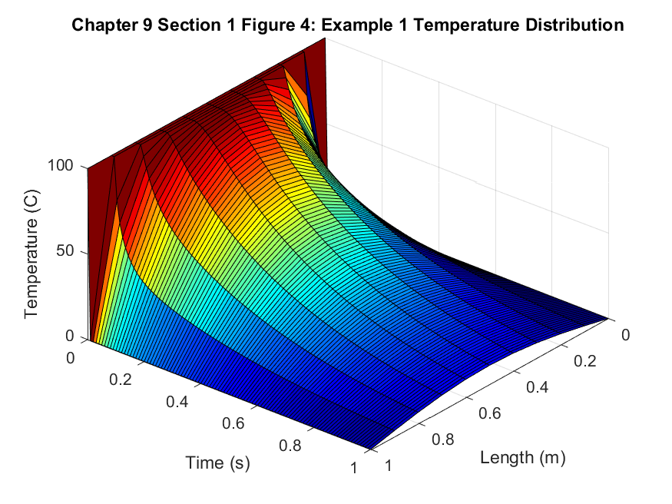
Example 1
Take the initial condition to be f(x) = 100
Take the boundary conditions to be 0 at both ends
Let k = .01, h = .1, c = .5

Slide 5
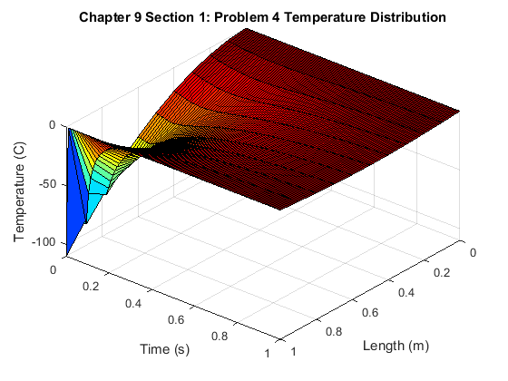
Nonconstant initial conditions - Problem 4
Take the initial condition to be f(x) = x(1 – x)
Take the boundary conditions to be 0 at both ends
Let k = .01, h = .1, c = .5

Slide 6
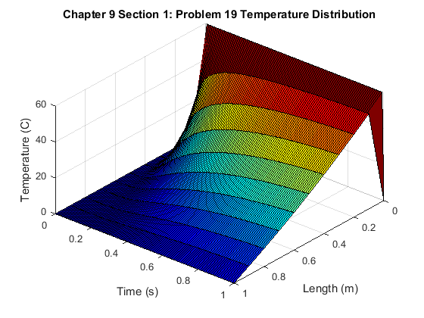
Nonhomogeneous Boundary Conditions – Problem 19
Take the initial condition to be f(x) = 0
Take u(0, t) = 60, u(1, t) = 0
Let k = .01, h = .1, c = .5

Slide 7
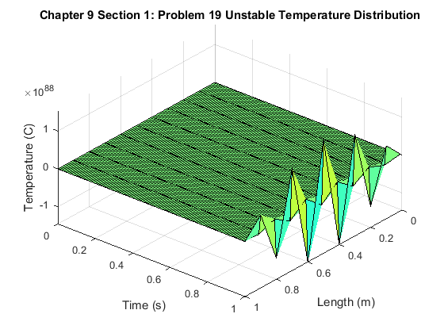
Just for fun – problem 19 unstable
This is problem 19 as before but now c²k/h² > .5.
Take the initial condition to be f(x) = 0
Take u(0, t) = 60, u(1, t) = 0
Let k = .01, h = .1, c = 1.5

Slide 8
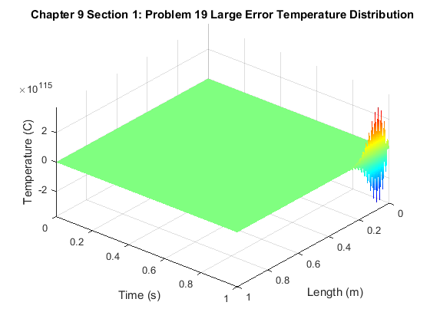
Just for fun – problem 19 Truncation Error
This is problem 19 as before but now k is very small
Take the initial condition to be f(x) = 0
Take u(0, t) = 60, u(1, t) = 0
Let k = .01, h = .01, c = .2
Fun Fact 1: MATLAB crashed while generating this plot with k and h < .001 and I got a warning upon restarting stating that MATLAB was going to use OpenGL instead of my CPU.

Slide 9
Conclusions and remarks
Knowing that the derivation of the FDM involves Taylor series, you could derive FDMs for any given variant of the heat equation (see 9.1.10-13)
More stable methods of FDM exist, specifically the backwards and central finite methods. The proof of the formulas are exercises, 9.1.15 and 9.1.16 respectively.
All numerical approximations carry an error due to the fact that machines are not infinitely precise. This is the round-off error and is usually very small.
FDMs are discretizing processes, and truncation error is introduced when moving from continuous to discrete quantities. This error can accumulate rather quickly if either k or h are very small.
Github: https://github.com/ThomasGartman/MATH647ComputerProject

Slide 10
References
Asmar, N. Partial Differential Equations with Fourier Series and Boundary Value Problems, 3rd ed. (2016). New York, NY. Dover Publications.
Burden, R. and Faires, J. Numerical Analysis, 7th ed. (2001). Pacific Grove, CA. Wadsworth Group.

