Slide 1
Bootstrapping the Support Vector Machine
maybe names or something else

Slide 2
Support Vector Machine
repetition
no distribution
no variance
no confidence intervals

Slide 3
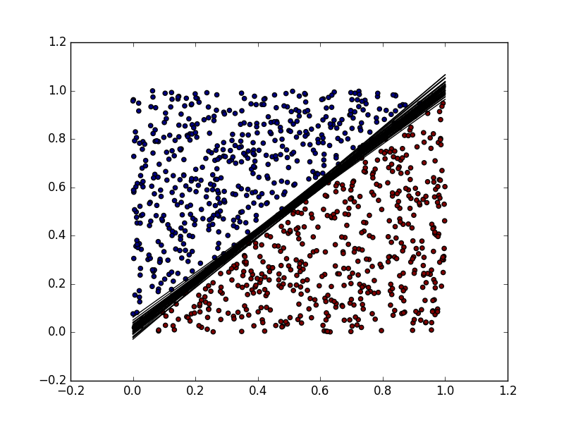
Problem
no distribution
no variance
no confidence intervals
-> Bootstrapping the SVM

Slide 4
What is Bootstrap
practice to estimate properties of an estimator
for example the variance
samples from sample
… maybe with formula

Slide 5
Idea

Slide 6
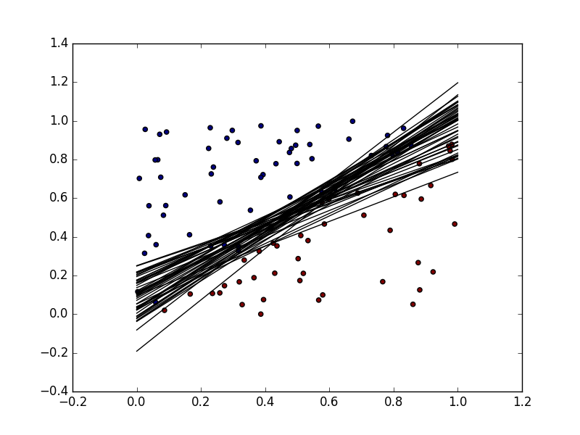
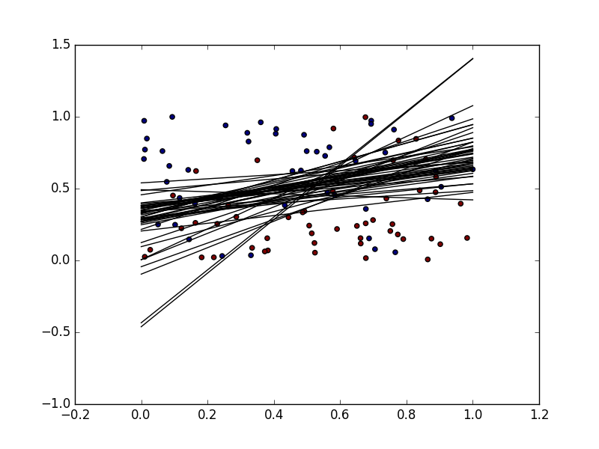
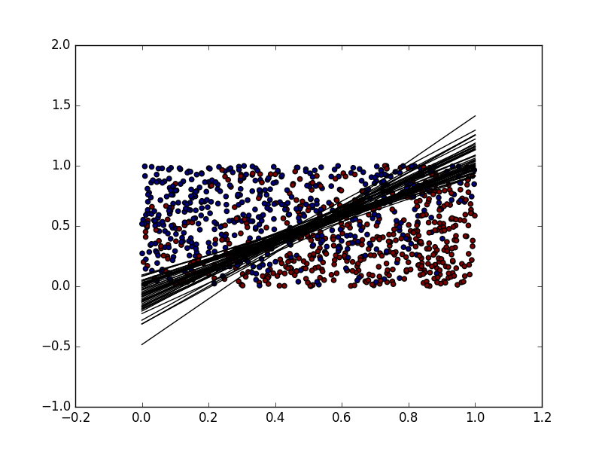
Idea
0.22828
0.28122
0.11981
0.13468

Slide 7
Implementation
what we did
keine Ahnung was wir da genau hinschreiben. uns fällt was ein

Slide 8
Simulation of Data
what we did

Slide 9
What we found out

Slide 10
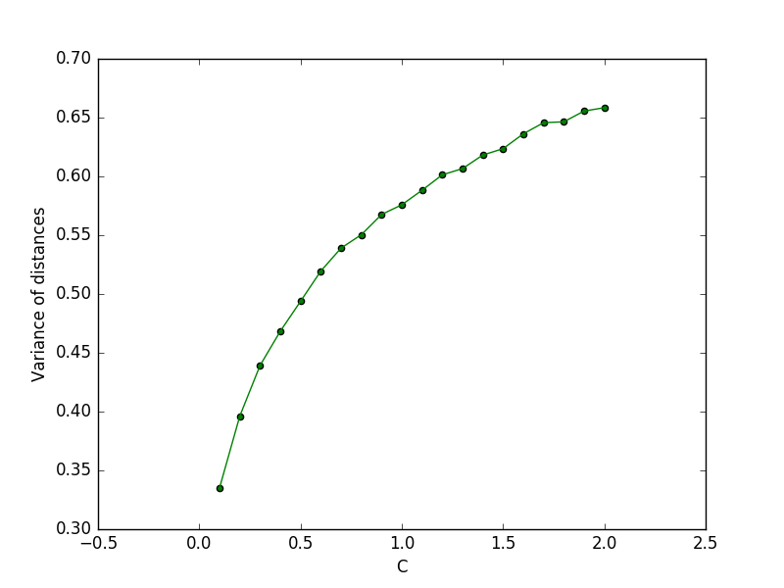
C parameter

Slide 11
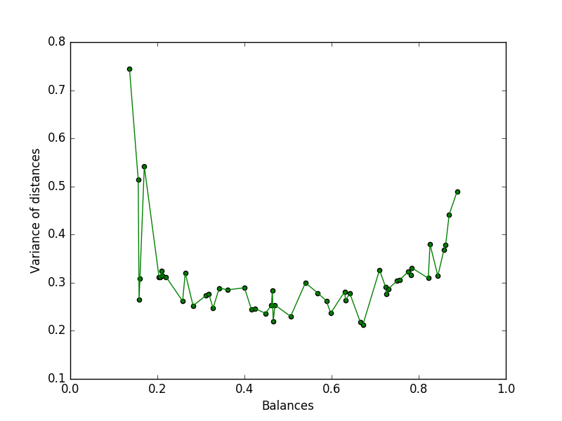
Balance of Data

Slide 12
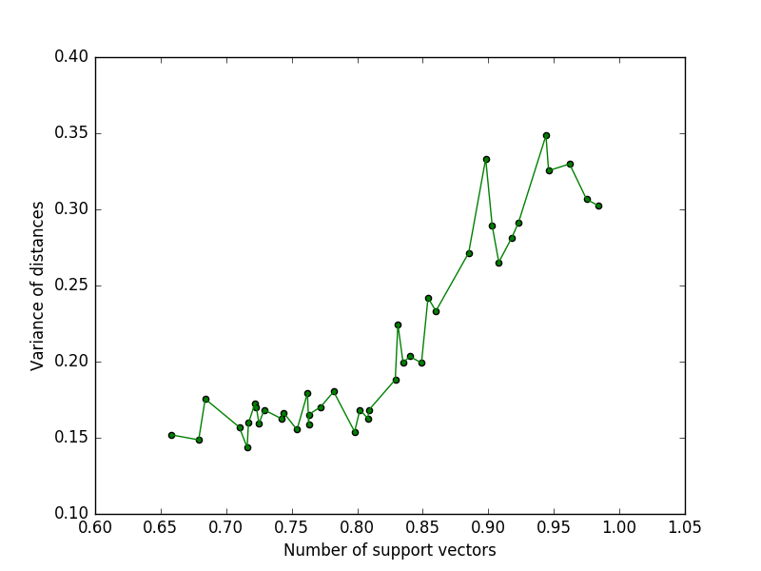
Number of support vectors

Slide 13
Conclusion
The variance of a support vector machine depends on
the C parameter
the balance of the data
the number of support vectors

Slide 14
„Kernels are powerfull!“
Herr Einstein

