Slide 1
Bootstrapping the Support Vector Machine
maybe names or something else

Slide 2
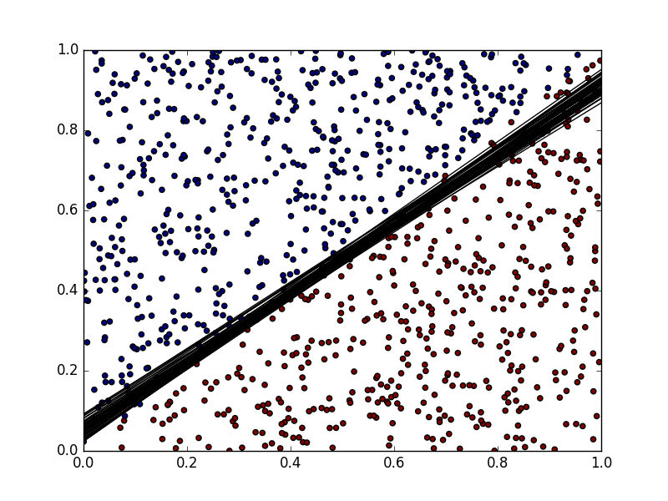
Support Vector Machine
Uses hyperplane in feature space to seperate data
Dimension of feature space controlled by choice of kernel function
Commen Kernels: linear, polynomial, gaussian(rbf)

Slide 3
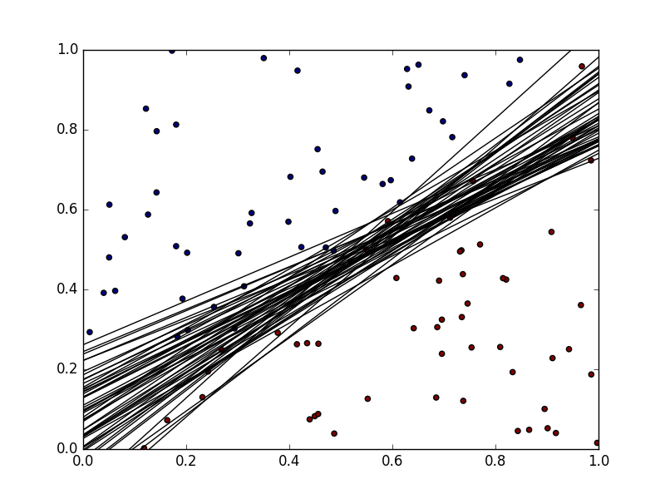
Why use Bootstrapping ?
Goal: Find influence of tuning parameters, data-distribution and svm-attributes on variances of predictions
Problem: No way to calculate uncertaincy (variance) of predicitons
Solution: Calculate sample variance based on bootstrapping

Slide 4
Application of Bootstrap
PSEUDO CODE OF BOOTSTRAPt

Slide 5
Why use distance?
Problem: Predictions are only binary variables and therefore might be identical across all bootstrap samples
Solution: Use minimal distance of predictionpoint to decision boundary as real valued substitue

Slide 6
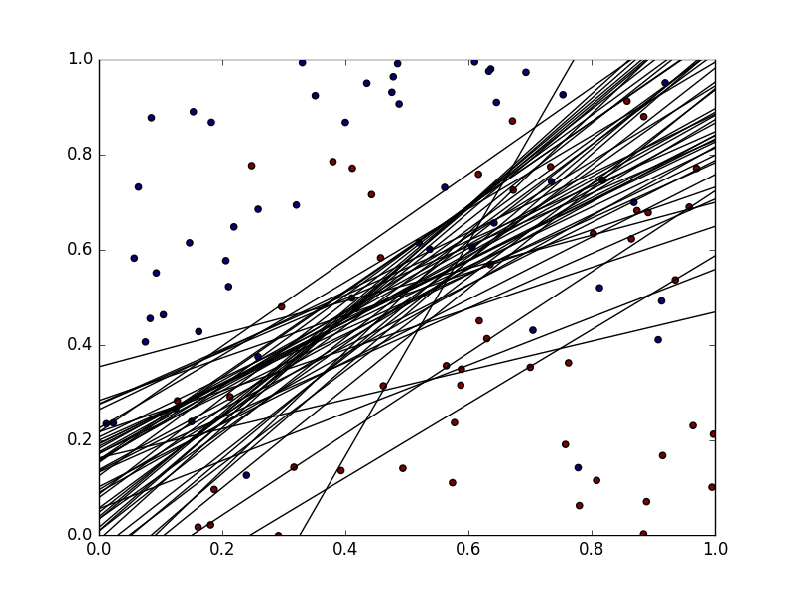
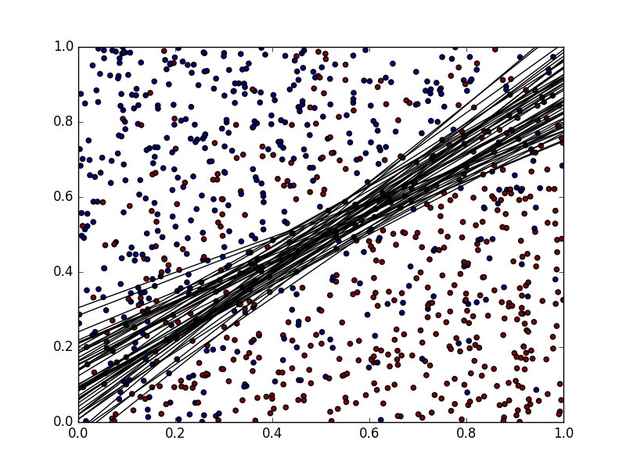
Example
0.20950
0.26697
0.12684
0.15181

Slide 7
Implementation
what we did
keine Ahnung was wir da genau hinschreiben. uns fällt was ein

Slide 8
Simulation of Data
what we did

Slide 9
What we found out

Slide 10
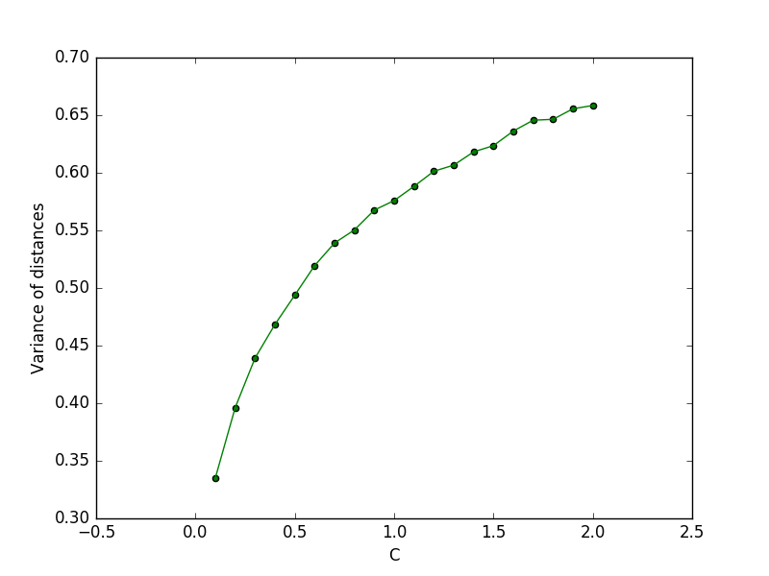
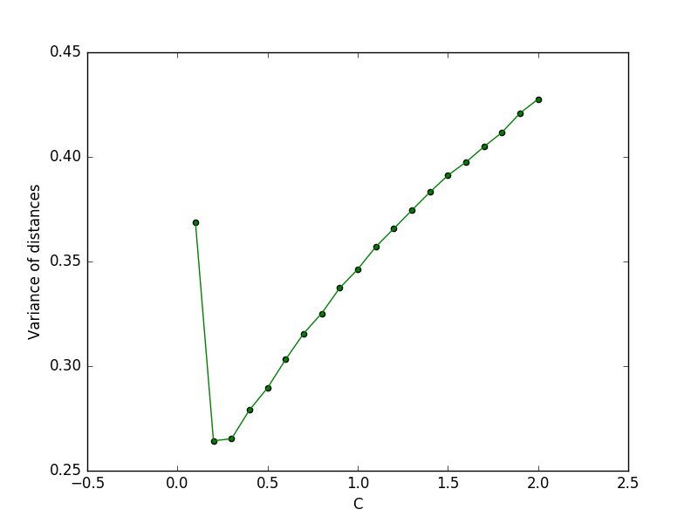

C parameter
Linear
Gaussian

Slide 11
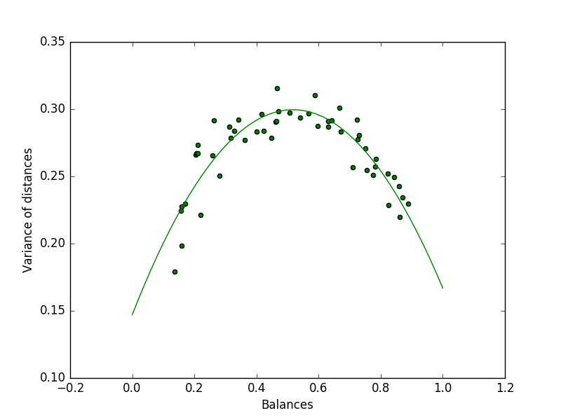
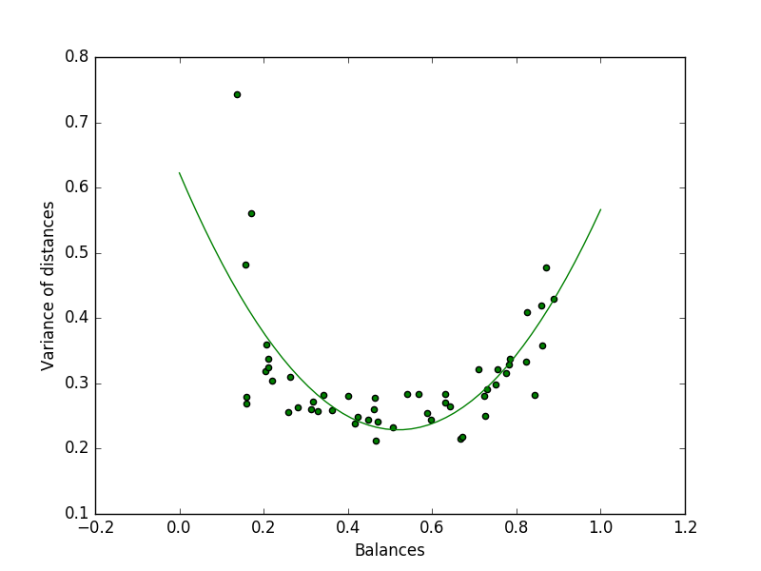
Balance of Data
Linear
Gaussian

Slide 12
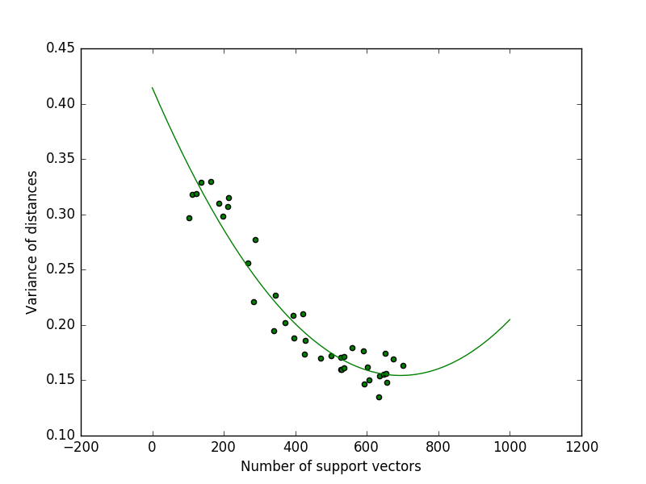
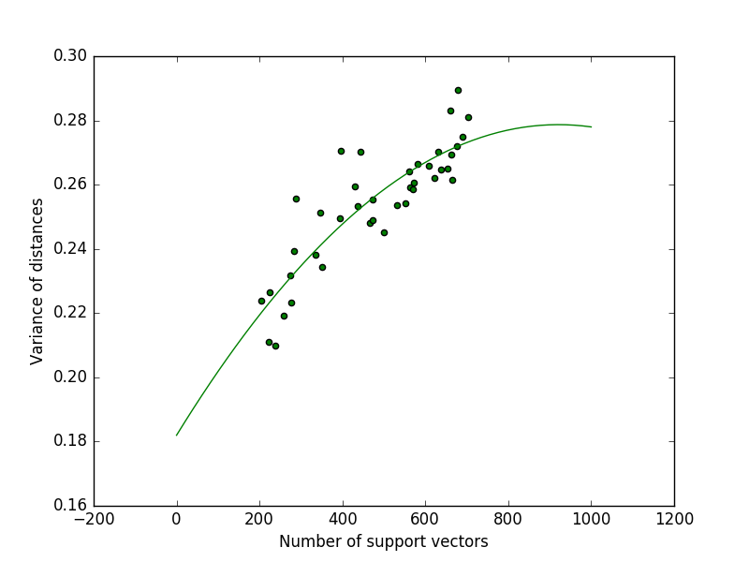
Number of support vectors
Linear
Gaussian

Slide 13
Conclusion
Influence of different aspects on variance
C-Parameter: both same
Balance of Data: differnt
The attribute number of support vectors: different

Slide 14
„Kernels are powerfull!“
Herr Einstein

