Slide 1
Bootstrapping the Support Vector Machine
Patricia Craja, Thomas Goerttler, Christian Koopmann

Slide 2
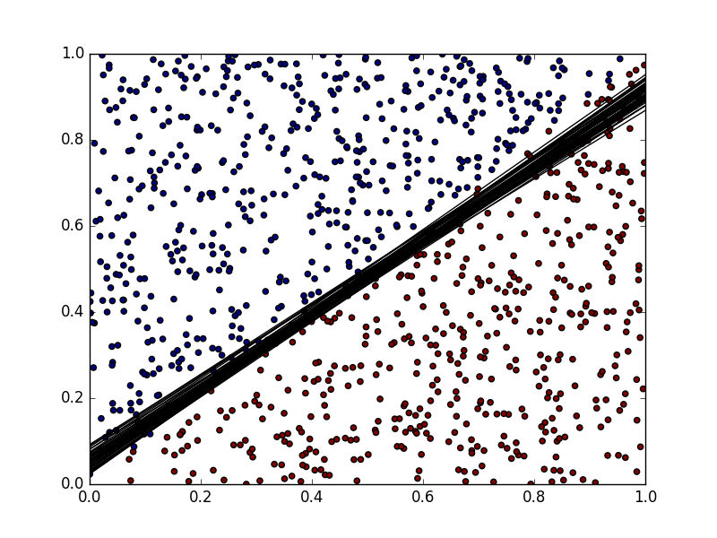
Support Vector Machine
Uses hyperplane in feature space to seperate data
Dimension of feature space controlled by choice of kernel function
Commen Kernels: linear, polynomial, gaussian(rbf)

Slide 3
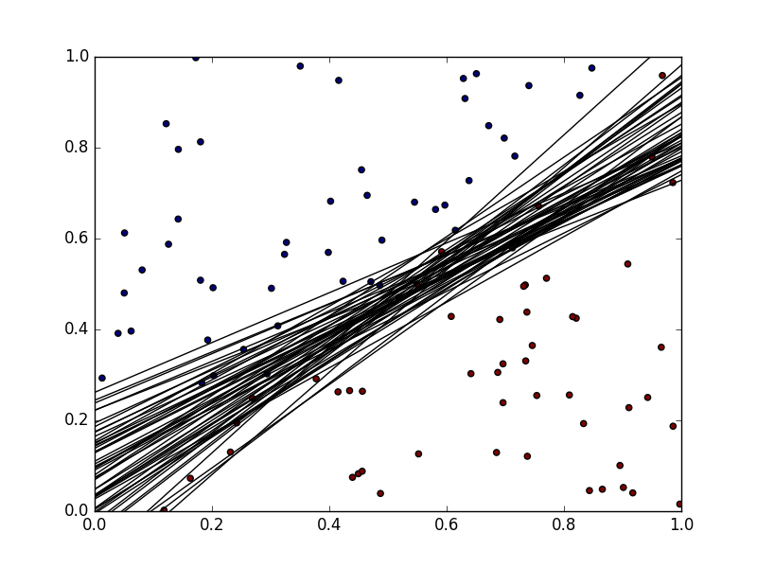
Why use Bootstrapping ?
Goal: Find influence of tuning parameters, data-distribution and svm-attributes on variances of predictions
Problem: No way to calculate uncertaincy (variance) of predicitons
Solution: Calculate sample variance based on bootstrapping

Slide 4
Implementation of Bootstrap
Input: Training-Data, Test-Data, SVM-Parameters, N = #Bootstrap-Replications
Output: Full-SVM, Variance of TestData-Distances
Train SVM on full Training-Data
Repeat N-times:
Draw random sample of full size with replacement from Training-Data
Train SVM on sampled Data
Return distance from decision boundary for each point in Test-Data
Calculate Variance of distances for each Test-Point and average those Variances

Slide 5
Why use distance?
Problem: Predictions are only binary variables and therefore might be identical across all bootstrap samples
Solution: Use minimal distance of predictionpoint to decision boundary as real valued substitue

Slide 6
Simulation of Data
Hyperplane-Approach
Centroid-Approach
Input:
Hyperplane-Parameters w
Constant c
X-Distribution
error-distribution
Algorithm:
Randomly draw n-observations from X- and error-distribution
Calculate Latent variable y* = c + w’x + error
Calculate labels as y = sign(y*)
Input:
Centroid-Locations z_{i}
Centroid-Parameters a_{i}
Constant c
X-Distribution
error-distribution
Distance function d(a,b)
Algorithm:
Randomly draw n-observations from X- and error-distribution
Calculate Latent variable y* = c + a₁*(d(x,z₁)⁻¹.... + error
Calculate labels as y = sign(y*)

Slide 7
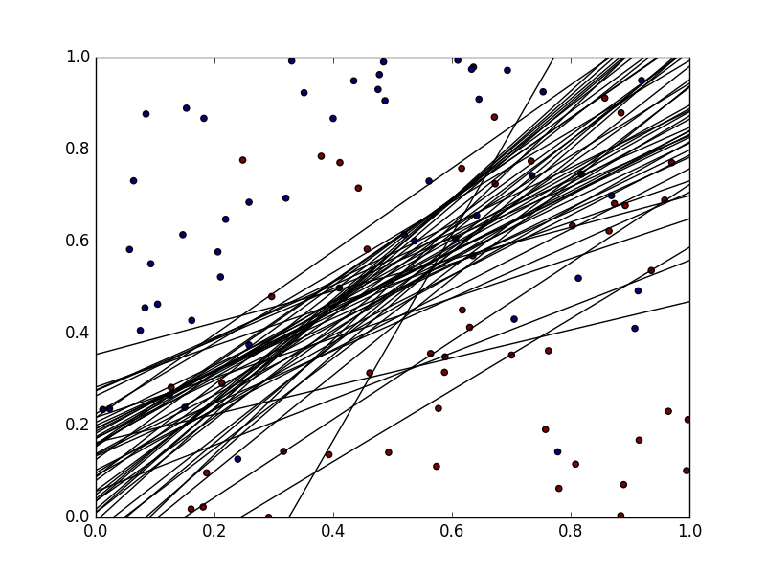
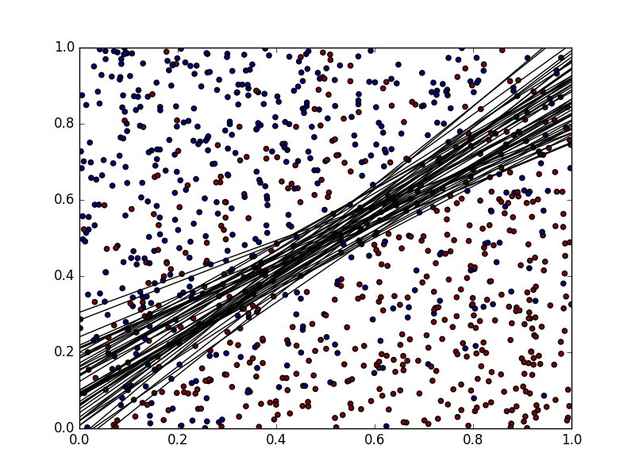
Example
0.20950
0.26697
0.12684
0.15181

Slide 8

Results
We analysed impact of following factors on prediction variance for both linear and gaussian kernel SVMs:
Choice of C-Parameter
Balance of the Training-Data (relative Proportion of 1 Label-category)
Number of support vectors of the original SVM
Model ........

Slide 9
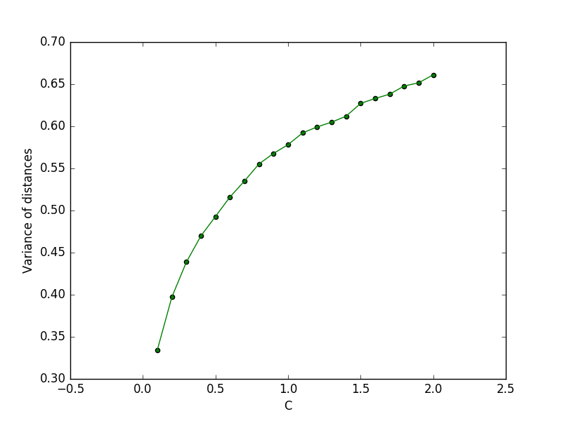
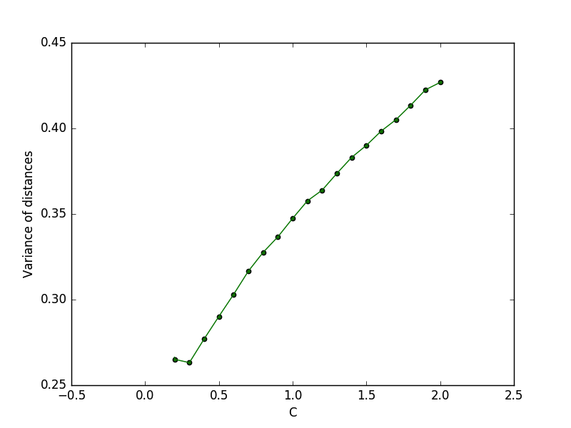
C parameter
Linear
Gaussian
Datasets: 20
Datasize: 100
Replications: 1000
Datasets: 20
Datasize: 100
Replications: 1000

Slide 10
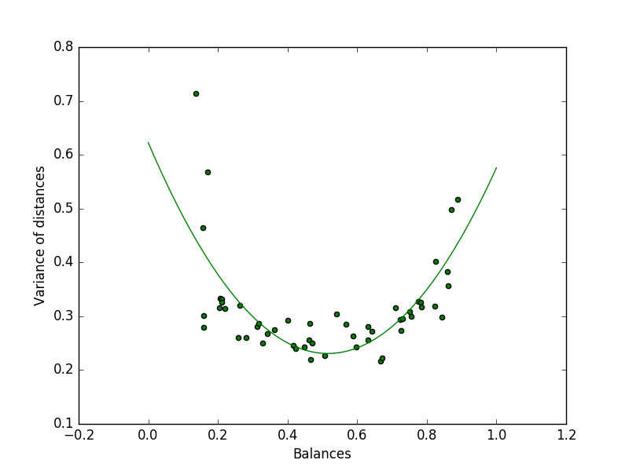
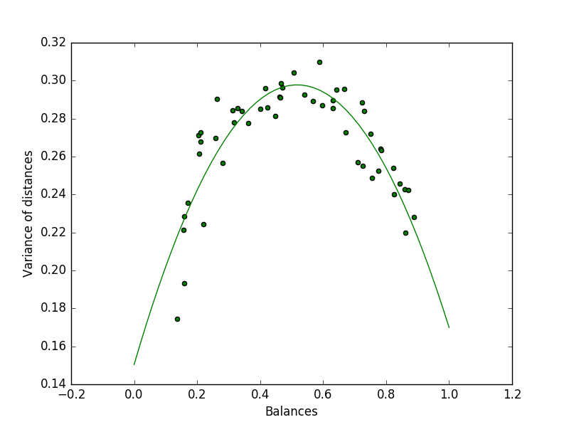
Balance of Data
Linear
Gaussian
Datasize: 500
Replications: 1000
Datasize: 500
Replications: 1000

Slide 11
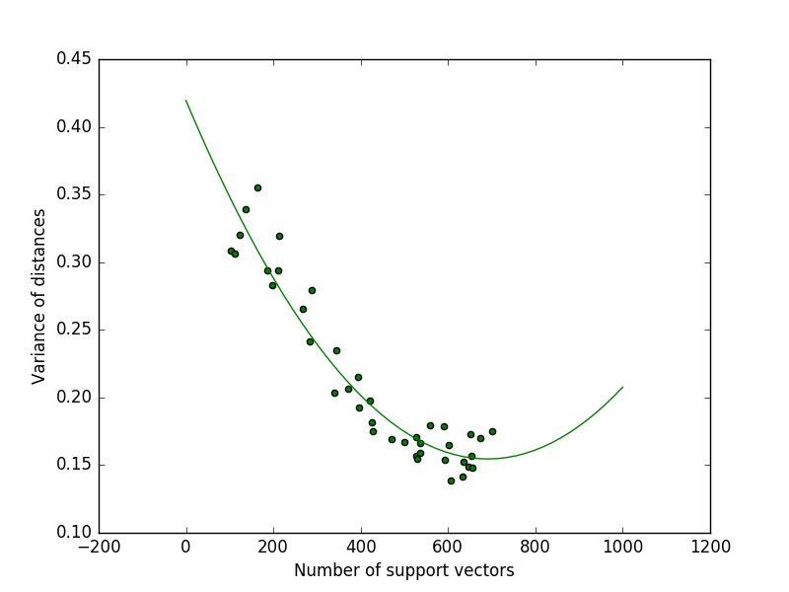
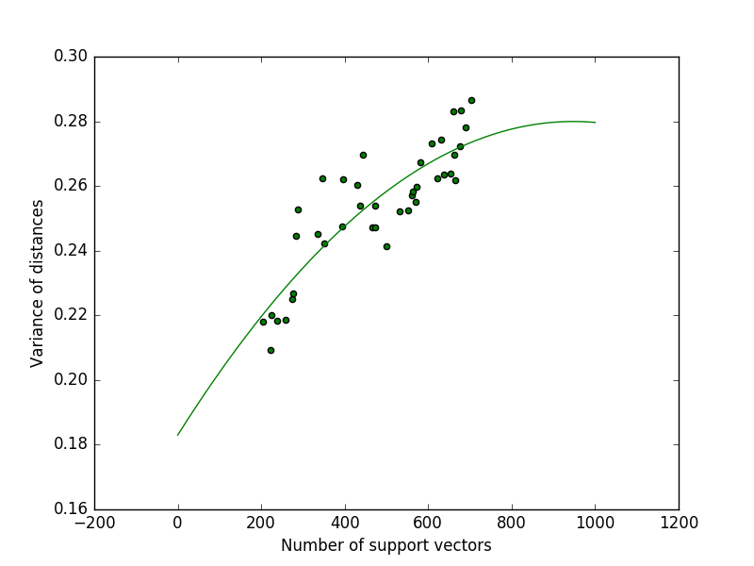
Number of support vectors
Linear
Gaussian
Datasize: 1000
Replications: 500
Datasize: 1000
Replications: 500

Slide 12
Conclusion
Influence of different aspects on variance
C-Parameter: Positive but decreasing influence on variance
Balance of Data: Positive Quadratic influence for Linear and negative quadratic influence for Gaussian SVM. Both with extremum around 0.5 (perfect balance).
Number of support vectors: Positive influence for Gaussian and negative influence for linear SVMs

Slide 13
Outlook
Further analysis of potential interest:
Analyse influence of dimensionality on variances
Analyse Data simulated from more "exotic" distributions
Analyse influence of other tuning parameters e.g. "Gamma" of rbf-kernel, degree of polynomial kernel etc.

