Slide 1
Deployment of Microservices with Kubernetes and Helm
Unterüberschrift – kann auch komplett entfallen
tt.mm.jjjj, Bastian Drüsedow

Slide 2
Agenda
Why use Docker?
Dockerfile – Best Practices
Why Kubernetes?
Kubernetes components and features
Deployment with Kubernetes
Helm – K8s package manager
Deployment with Continous Delivery Pipeline
Conclusion

Slide 3

Why use Docker?
What is Docker?
What is a Docker Container?

Slide 4
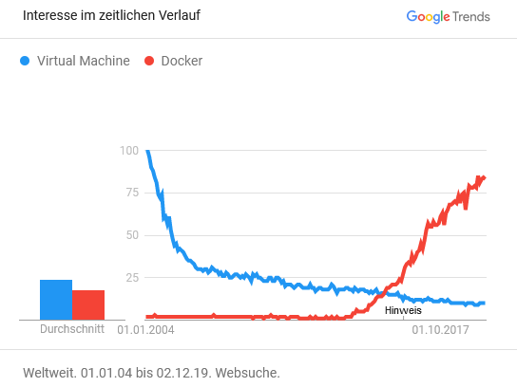
Why use Docker?
VM resources are set during setup and changing these require a complete restart
VM’s go through the whole boot process on every start-up, like any other hardware
Docker uses virtualization technology in the Linux kernel
Containers abstract the OS, not the hardware
Every container using the exact same OS

Slide 5
Why use Docker?
Containers…
are lightweight
only include executables and its dependencies
always share the same OS
require no hypervisor
can share the some of their image files
are very fast
VM
App A
App B
Container
Bins/Libs
Bins/Libs
App A
App B
Guest OS
Guest OS
Bins/Libs
Bins/Libs
Hypervisor
Docker Engine
Host OS
Host OS
Server
Server
Start Time: | 30-45 sec | < 50 ms
Stop Time: | 5-10 sec | < 50 ms

Slide 6
Dockerfile – Best Practices
Thinking in Layers:
A Dockerfile is just a series of layers built on top of each other
Every Layer is a command or a set of commands
Starting from base image
Dockerfile
Docker Image
Docker Container

Slide 7
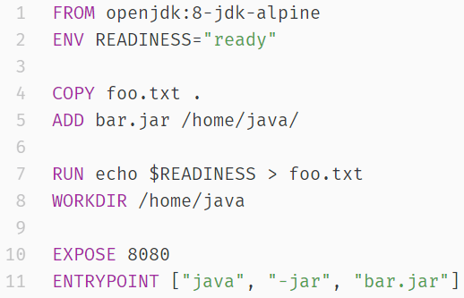
Dockerfile – Best Practices
Dockerfile Example:
Dockerfile
FROM defines the base image and version
ENV defines the environment variables
COPY and ADD basically do the same thing
Let you copy files from the host into the container
RUN let’s you execute a command
WORKDIR sets the working directory
EXPOSE forwards a port
ENTRYPOINT defines an command which will be bound to the container
Docker Image
Docker Container

Slide 8
Dockerfile – Best Practices
Building a Dockerfile will result in a Docker Image
Every layer builds in order
Every layer will be attached to the last layer image and create a new image
Dockerfile
Docker Image
Docker Container

Slide 9
Dockerfile – Best Practices
Dockerfile
Docker Image
Docker Container

Slide 10

Why Kubernetes?
Orchestrating containers is the next logical step after containerizing applications.
Kubernetes is the “best-of-breed”.
Kubernetes …
Groups containers and resources into logical units
Automates the deployment, scaling and management of containers
Keeps the modularity
Simplifies the deployment and update of software

Slide 11
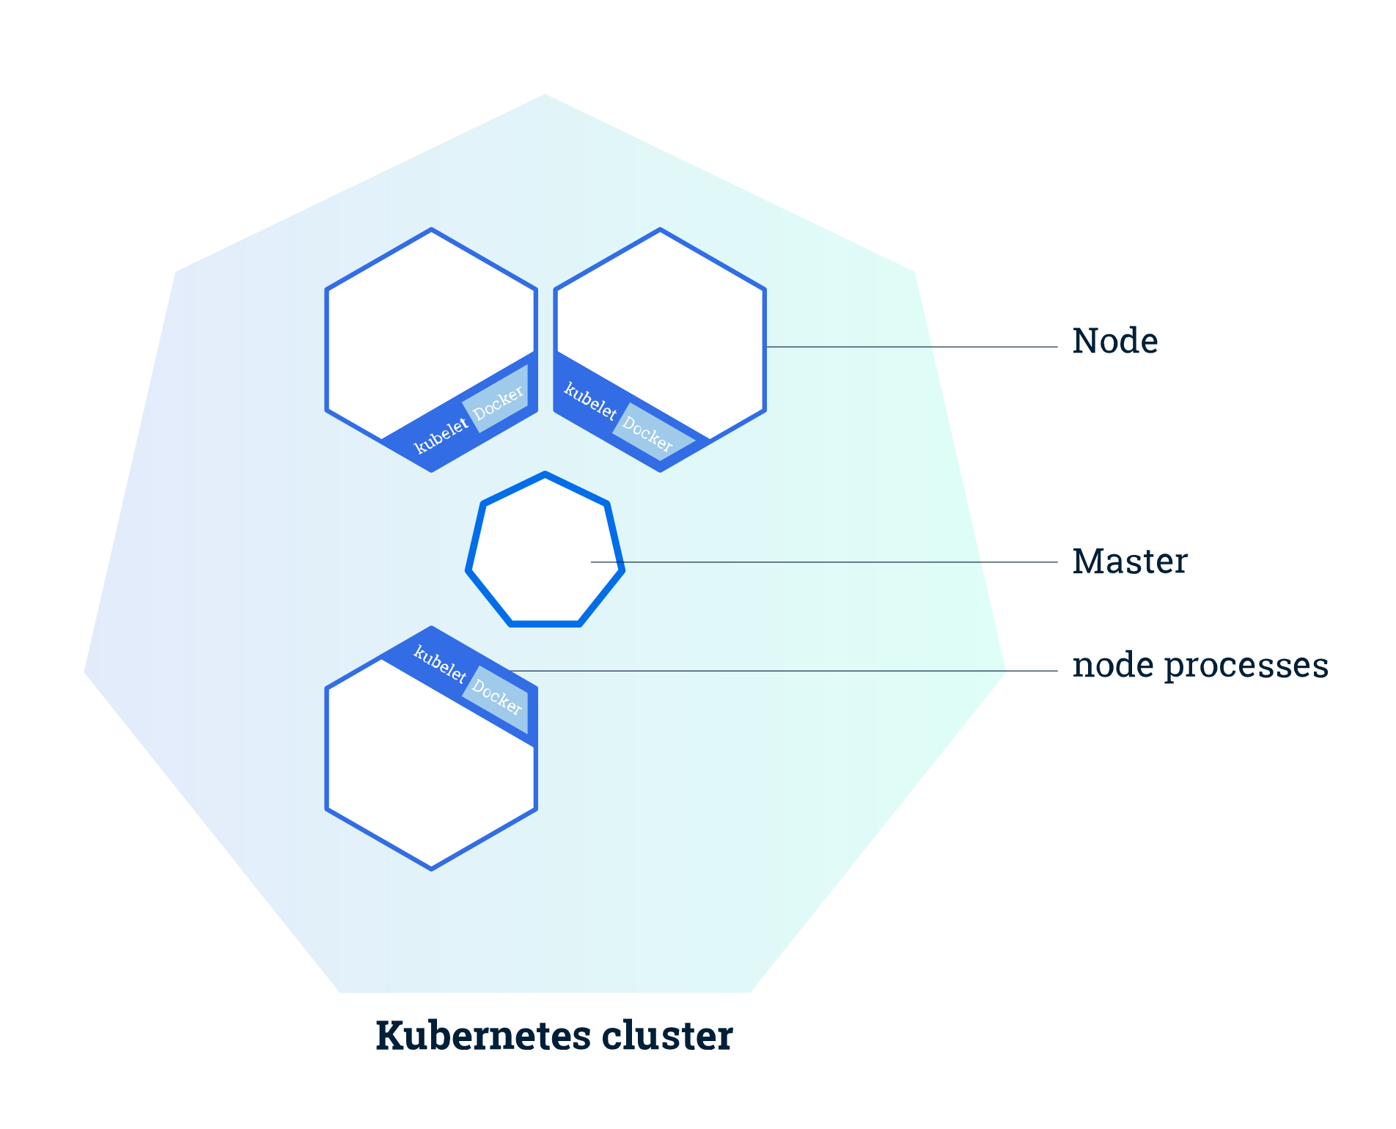
Kubernetes Components
Cluster and Nodes:
K8s coordinates a highly available cluster of computers that are connected to work as a single unit
Nodes are VM’s or physical Computers that serves as a worker machine
Master Node manages the whole cluster
Worker Nodes host the running applications

Slide 12
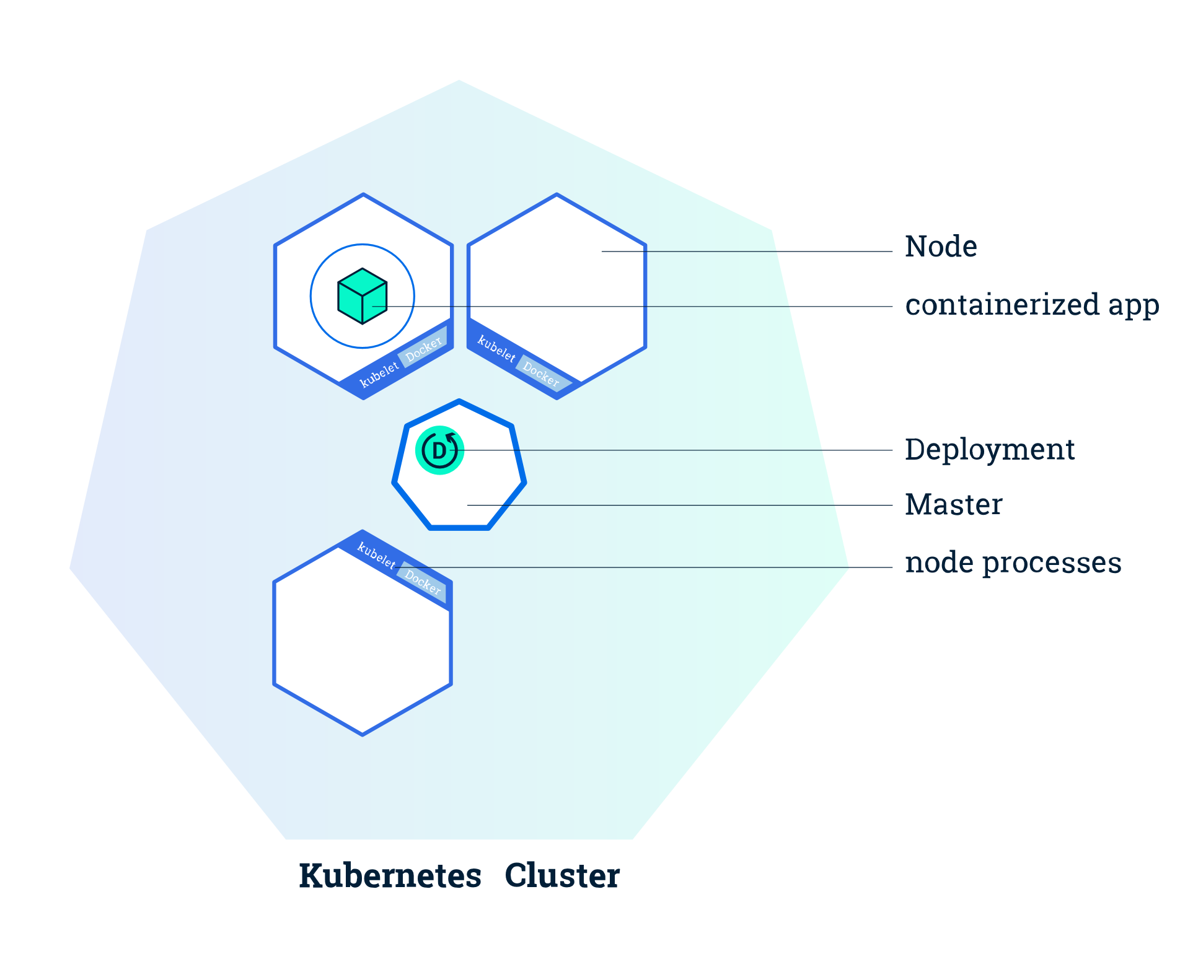
Kubernetes Components
Deployments:
Deployments create and update instances of the application
Managed by the master Node
Schedules application instances onto individual nodes in the cluster
Instances are monitored to provide a self-healing mechanism

Slide 13
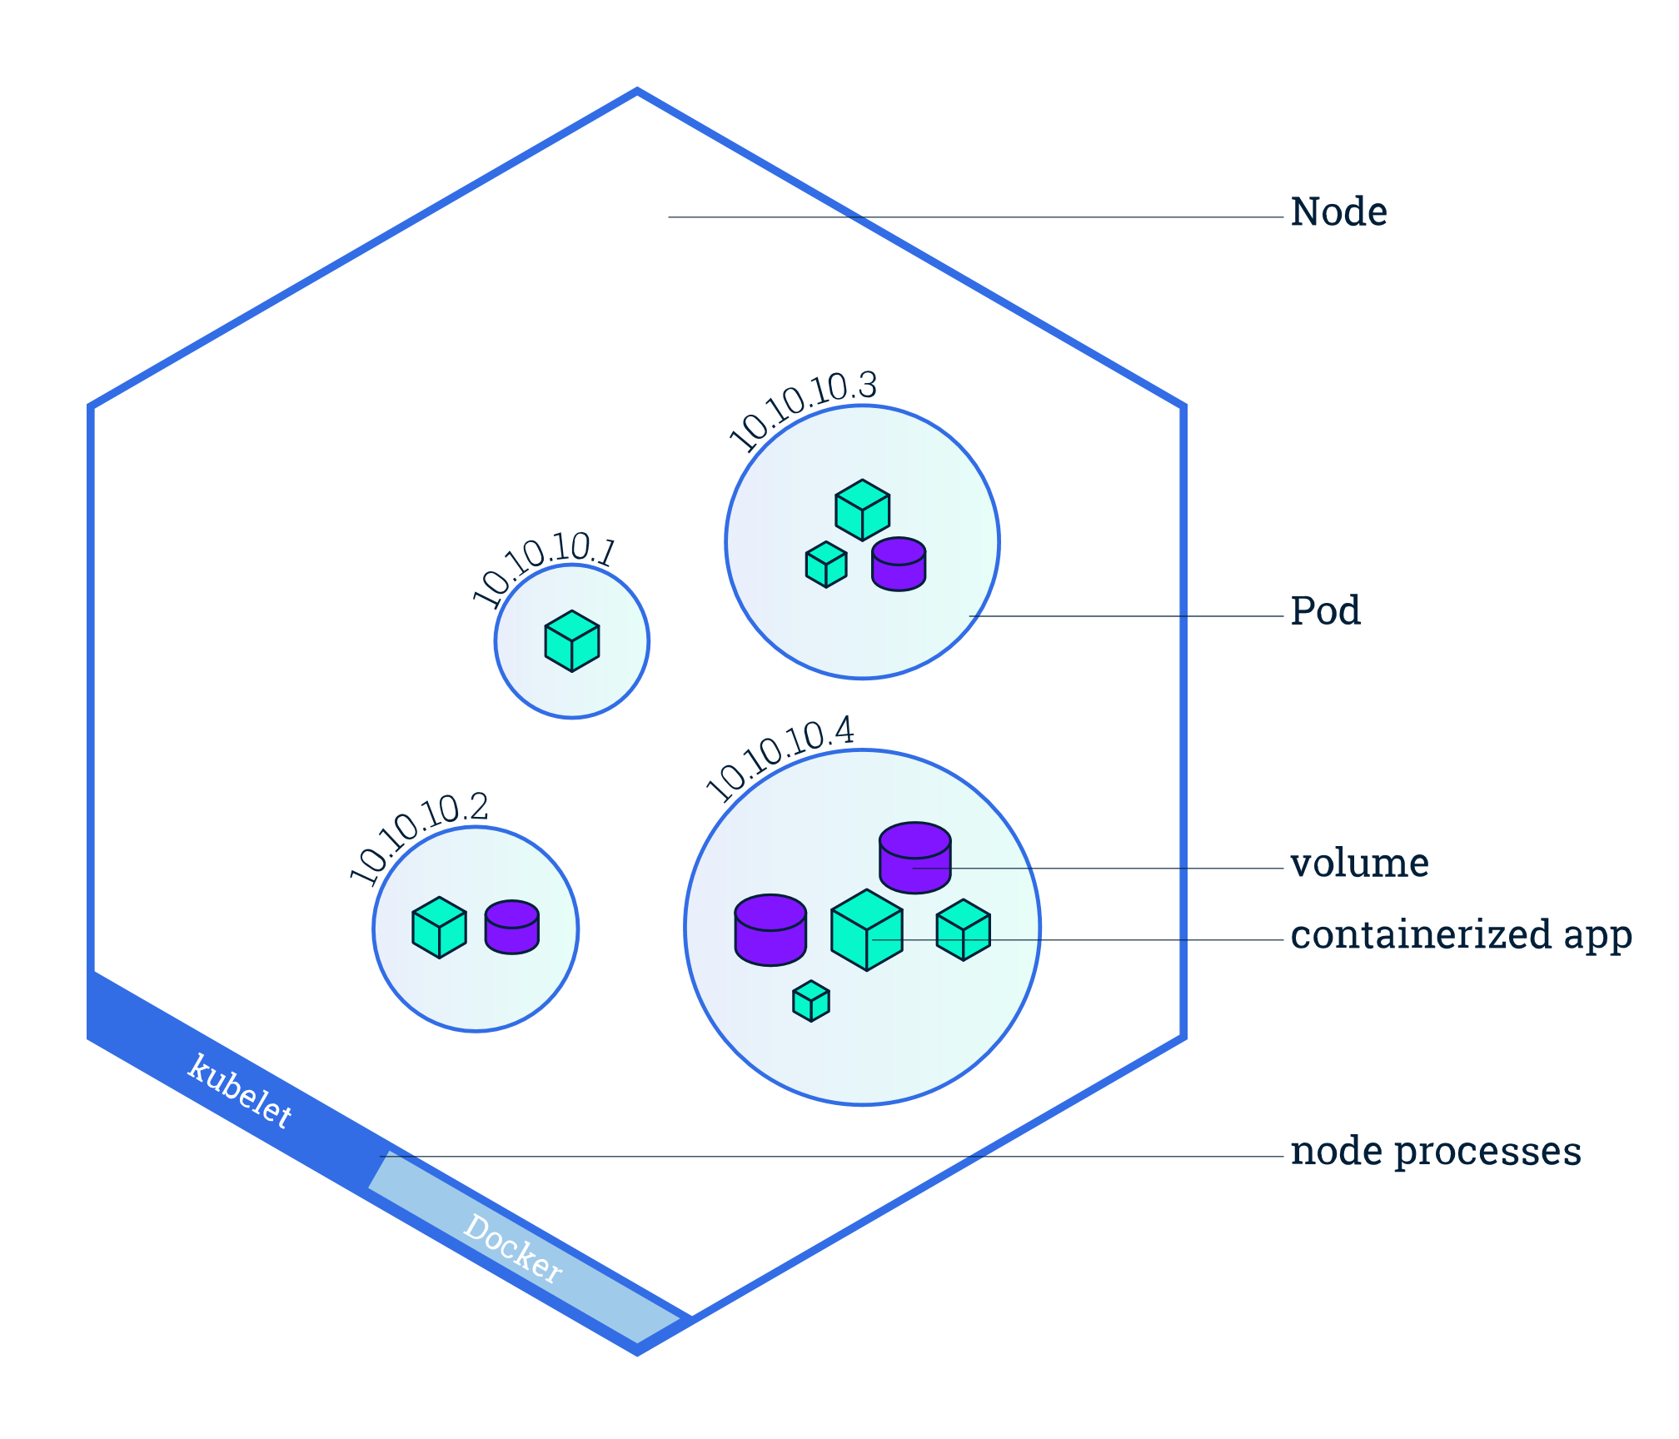
Kubernetes Components
Pods and Nodes:
Pod is a group of one or more application containers
Includes volumes, IP address and information about how to run each container
Pods run on Nodes
A Node can contain many Pods

Slide 14
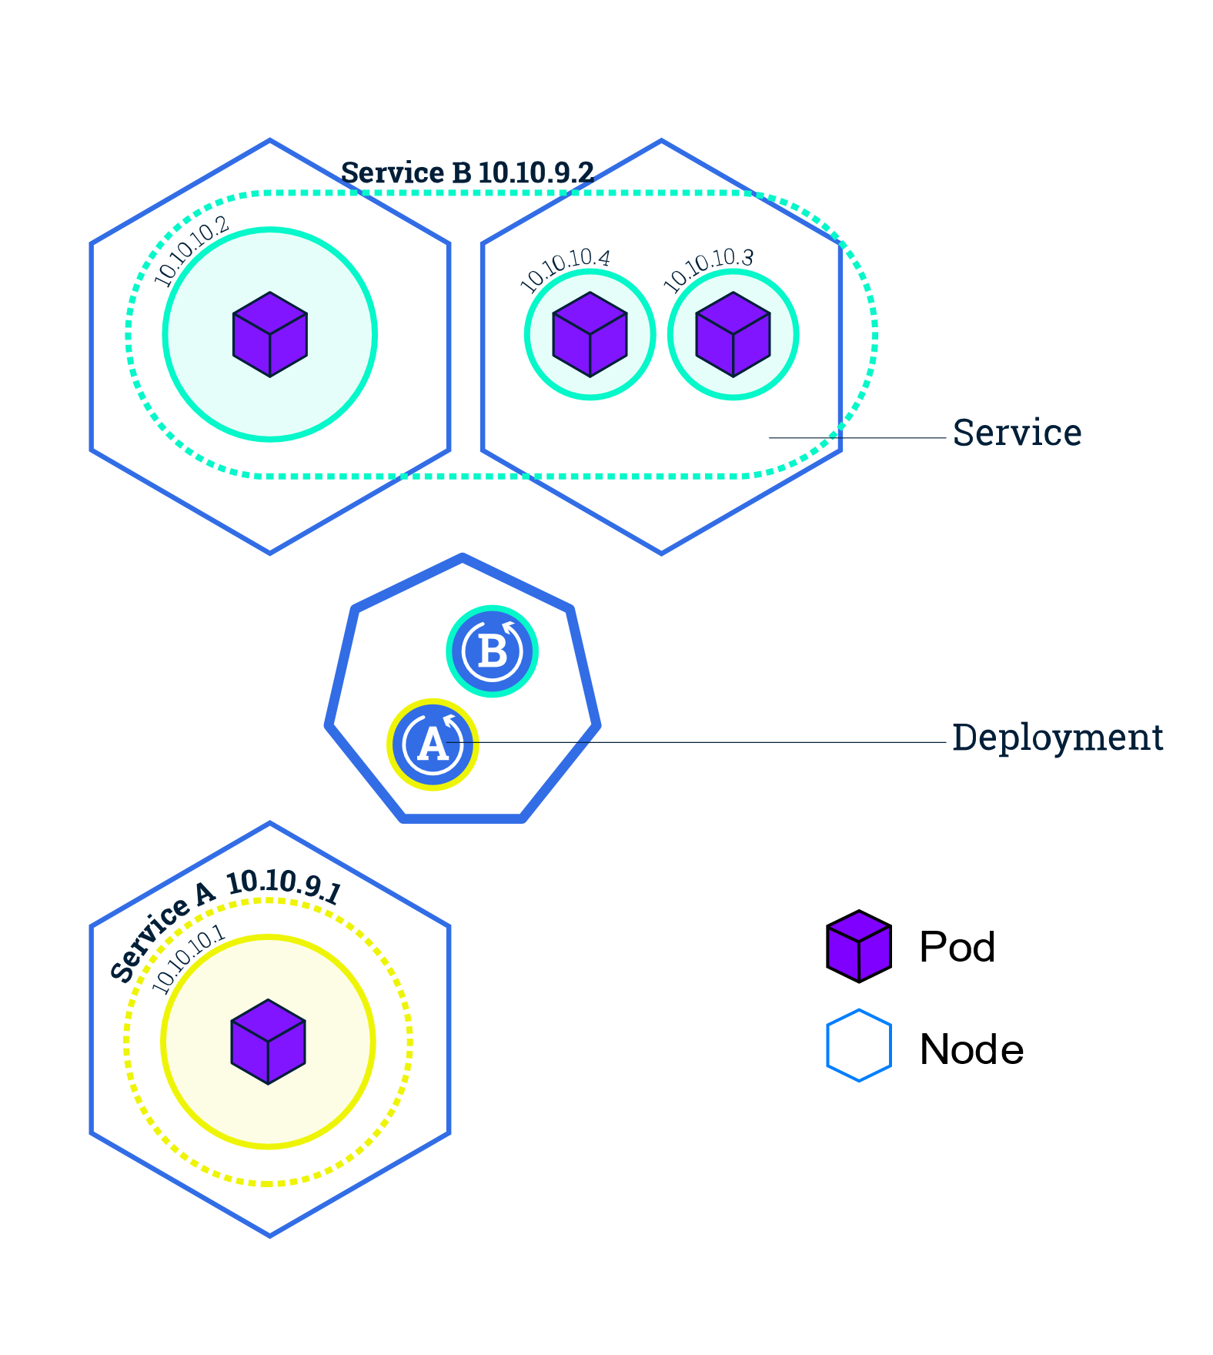
Kubernetes Components
Services:
A Service is an abstraction layer which defines a logical set of Pods
Enables external traffic exposure, load balancing and service discovery for the pods
Service types: ClusterIP, NodePort, LoadBalancer, ExternalName
Allows Pods to die and replicate without impacting the application

Slide 15
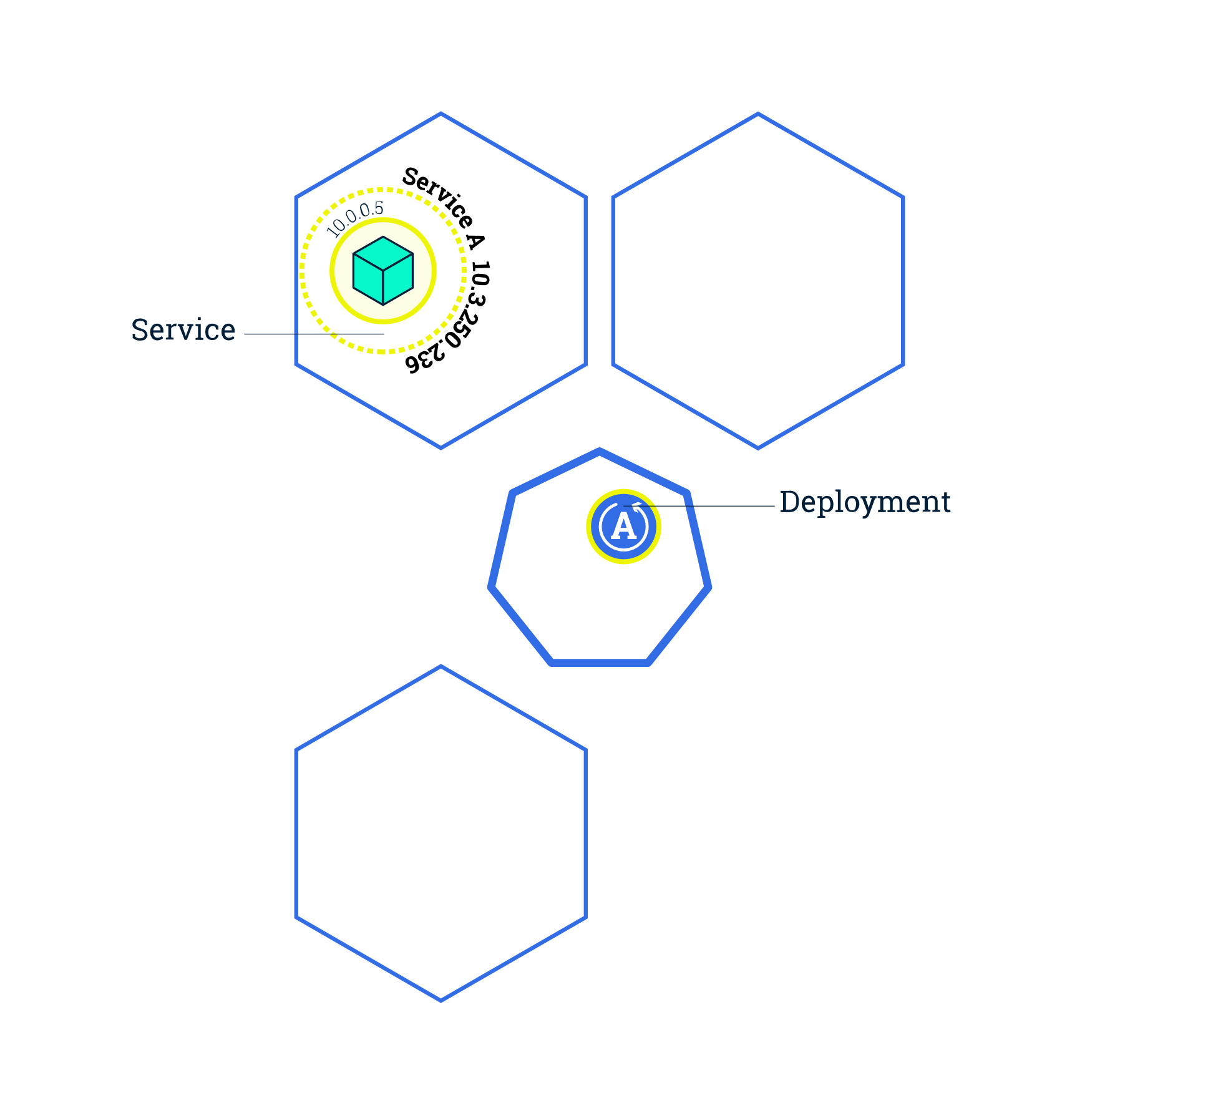
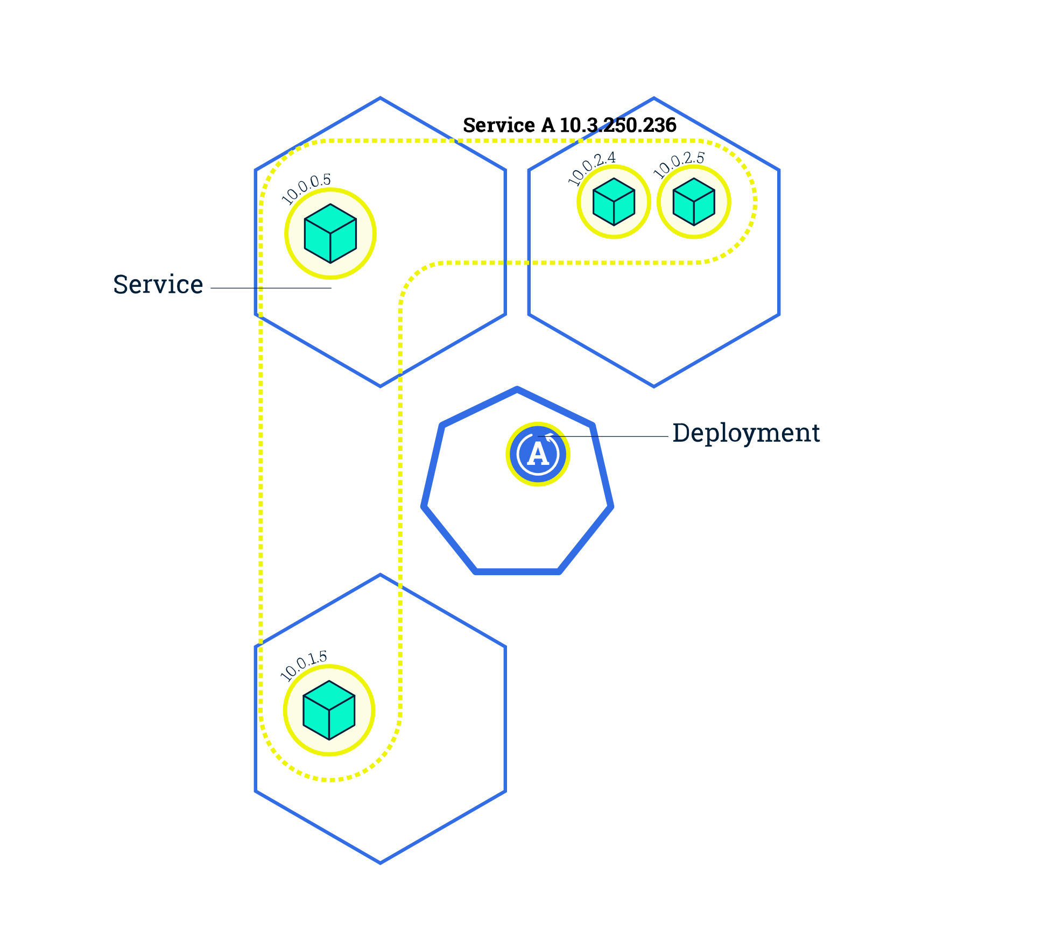
Kubernetes Features
Scaling:
Deployments can create multiple instances of pods by changing the number replicas
Will Schedule new pods to Nodes with available resources
Kubernetes supports autoscaling

Slide 16
Kubernetes Features
Rolling Update:
Deployments can create multiple instances of pods by changing the number replicas
Will Schedule new pods to Nodes with available resources
Kubernetes supports autoscaling

Slide 17

Vielen Dank.
Firmenzentrale
InMediasP GmbH
Neuendorfstraße 18a
16761 Hennigsdorf
www.inmediasp.de
info@inmediasp.de
Ansprechpartner
Vorname Name (name@inmediasp.de)
Vorname Name (name@inmediasp.de)

Slide 18

Prozesse.
Systeme.
Lösungen.

Slide 19
Farben!
Die InMediasP-Farbpalette – RGB-Werte!
+80%
179 212 255
204 226 246
202 245 245
221 244 206
252 247 210
245 240 200
249 215 210
226 221 238
196 237 255
212 214 232
+60%
103 168 255
153 197 238
149 236 235
187 233 157
249 239 165
255 226 144
243 176 164
196 187 222
137 219 255
189 194 222
+40%
027 125 255
102 167 229
095 226 225
153 222 108
245 230 121
255 211 089
237 136 119
167 154 205
079 200 255
148 166 204
000 056 130
031 108 181
030 166 165
091 172 038
239 214 031
233 171 000
223 058 030
108 086 172
000 149 216
092 118 148
052 082 124
000 042 098
023 081 136
022 125 124
068 129 029
189 168 014
175 128 000
167 044 022
081 064 130
000 112 162
-25%
000 039 084
000 028 065
016 054 091
015 083 082
046 086 019
126 112 009
116 086 000
111 029 015
054 042 087
000 074 108
-50%

Slide 20
Farbverläufe auf Basis der Haupt- und Standardfarben
000/039/084
000/019/064
030/166/165
010/146/145
031/108/181
011/088/161
000/056/130
000/036/110
091/172/038
071/152/018
239/214/031
219/194/011
108/086/172
088/066/152
000/149/216
000/129/196
233/171/000
213/151/000
233/058/030
213/038/010

