Slide 1
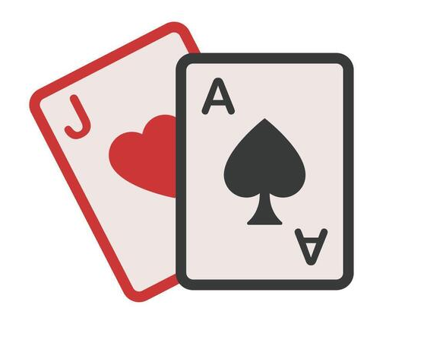
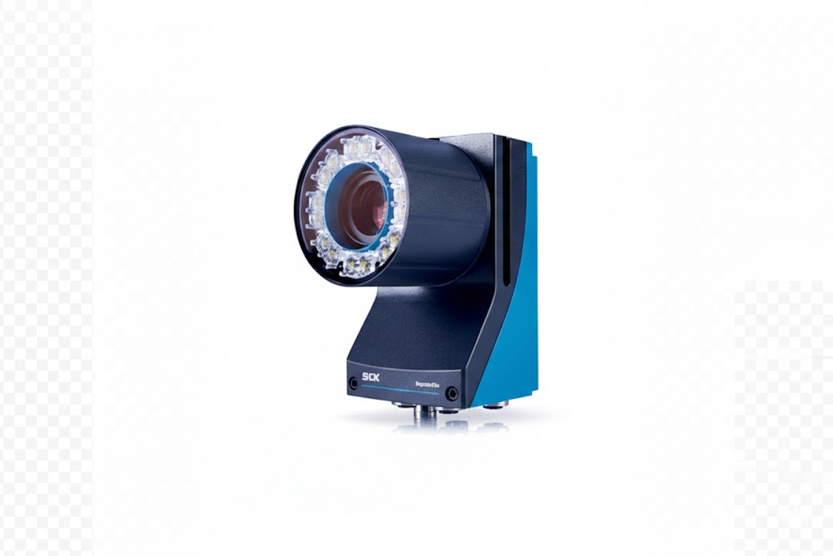



White Jacks
Hackathon
HUYET Thomas | RIVAL Thibaut | BRAMERIE Noah | MARTIN Thomas

Slide 2

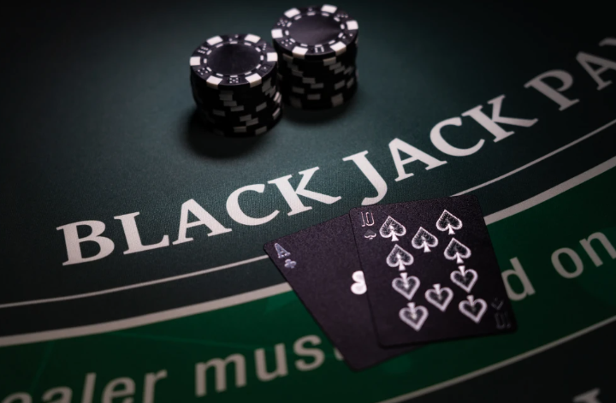
Introduction

Slide 3
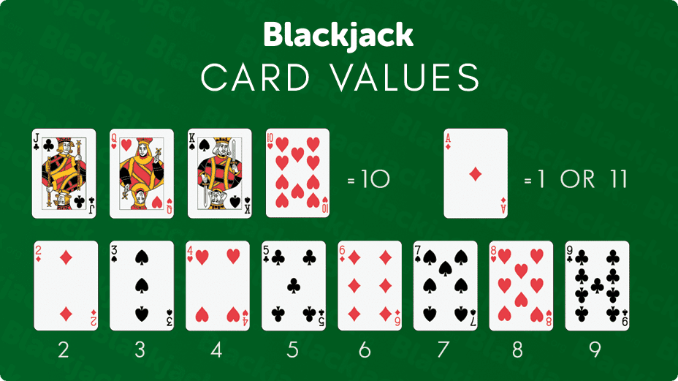
Rules
Player : Get close to 21 and be higher than the dealer
Dealer : Draw cards while the hand is below 17

Slide 4

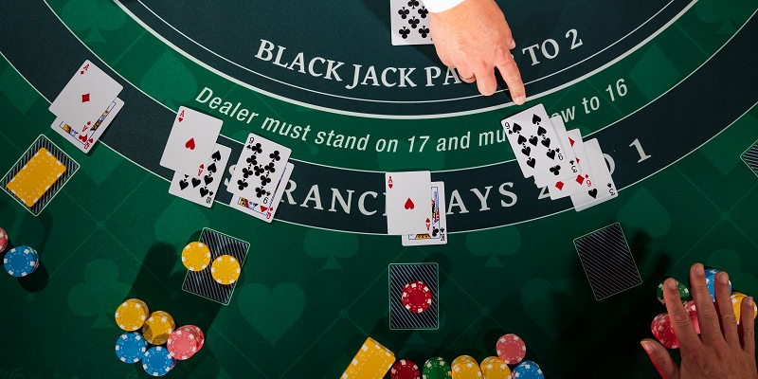
Points to work on
Give Tips to player
Card Overlay
Differents Area Of Interests
Count Cards values

Slide 5


Problem Encountered
- IA Image capacity < 100
- Can’t count 2 cards simultaneously
- Trigger to get cards or player switch

Slide 6

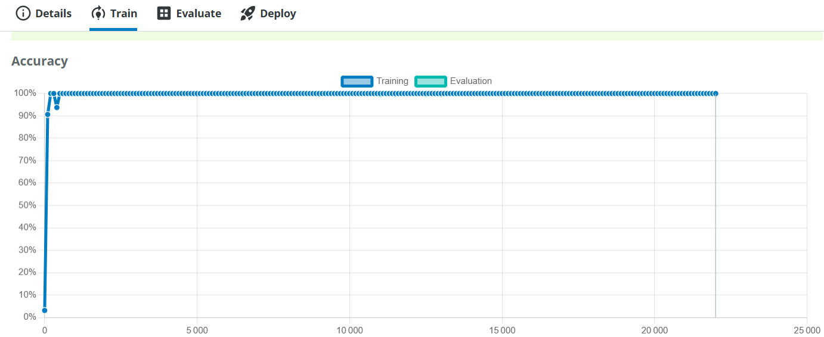
Solutions
Solution for card identification and overlay

Slide 7
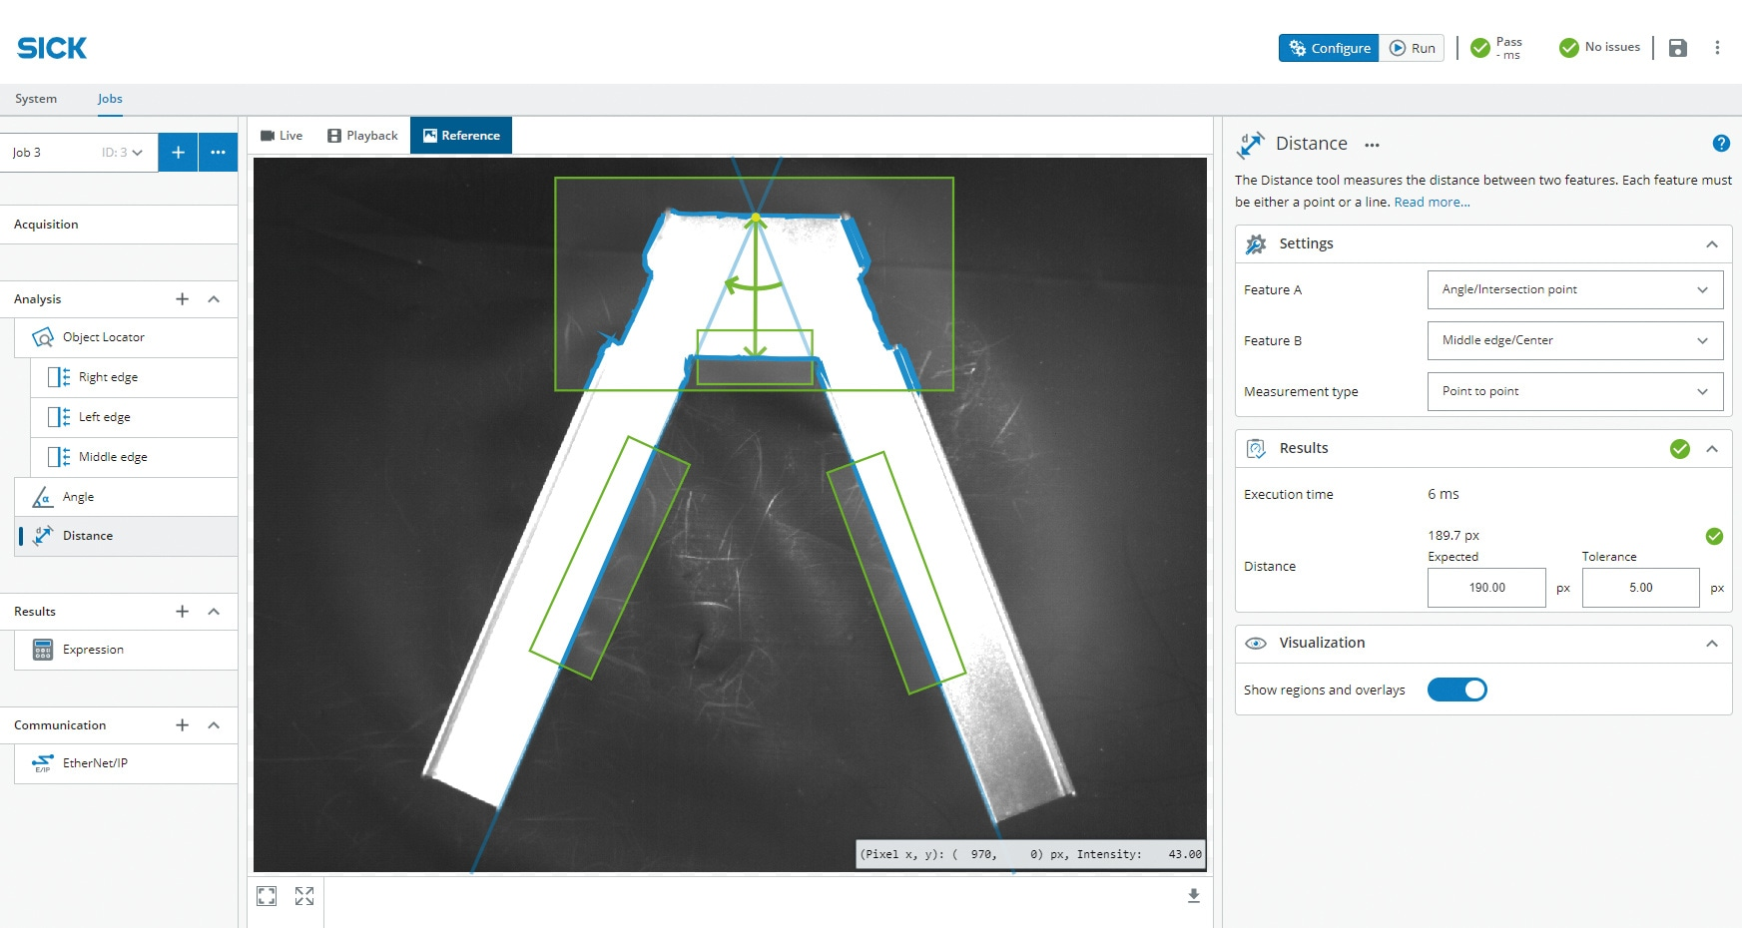



User Interface
Get data
Nova

Slide 8
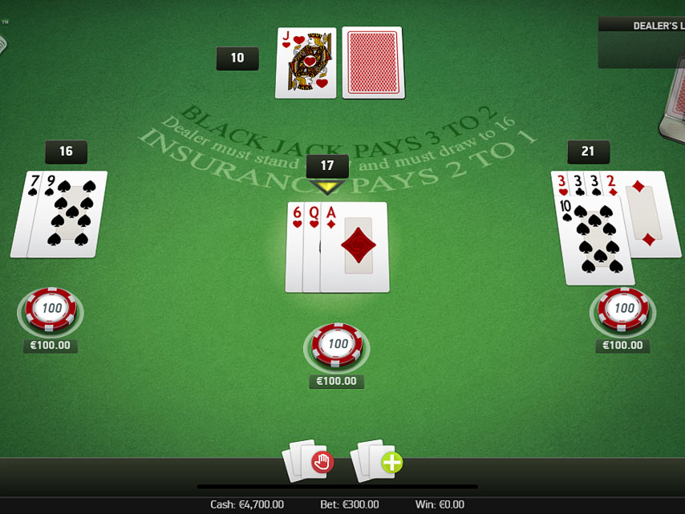

Demonstration

Slide 9
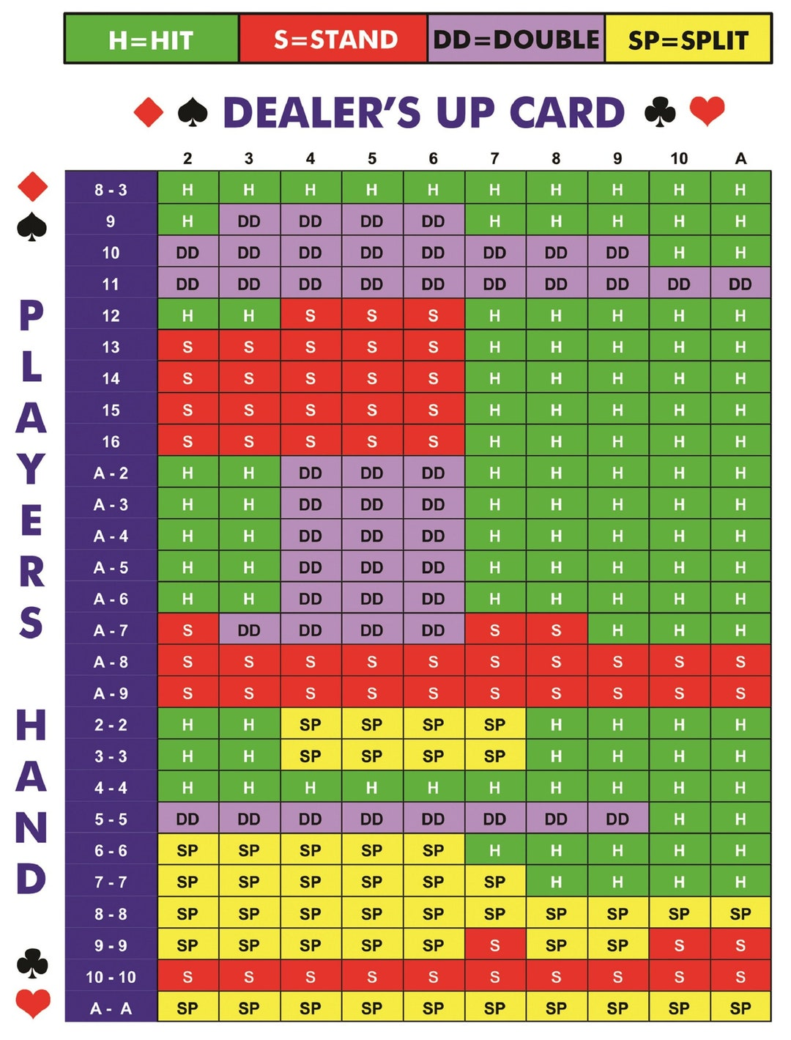
BlackJack Strategy

Slide 10
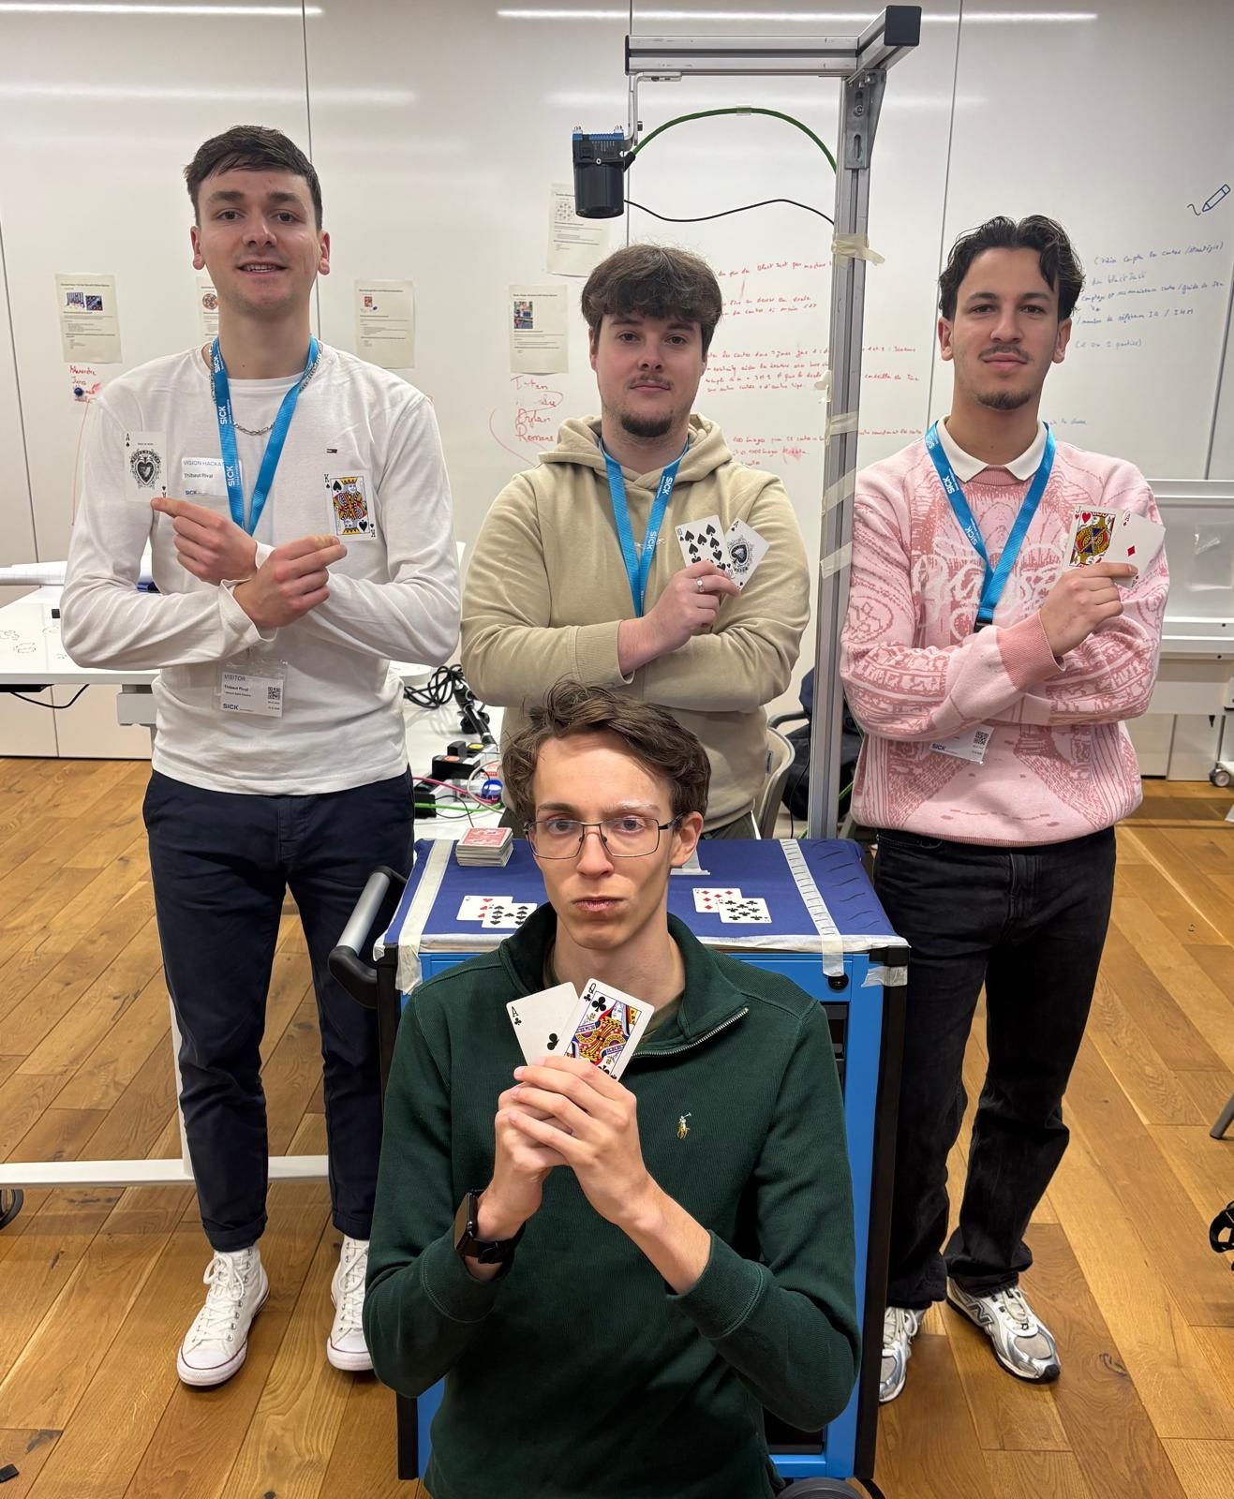
Thanks

