Slide 1
Protein Synthesis and Gene Finding
Day 2

Slide 2
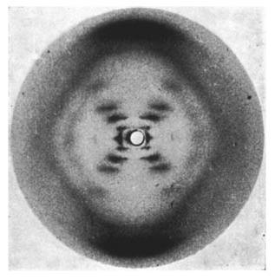
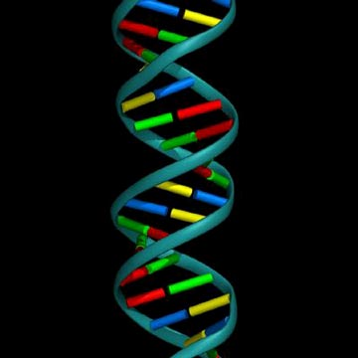
Bio Crash Course: DNA
Photo 51: X-ray diffraction created by Raymond Gosling under the supervision of Rosalind Franklin May, 1952
Double Helix Structure: Watson and Crick

Slide 3
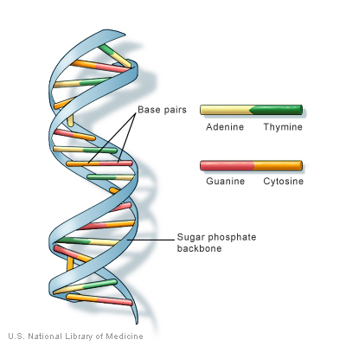
DNA and the Central Dogma
The blueprints for making all the proteins necessary for life are contained within DNA. Or, more succinctly: DNA Makes RNA, RNA makes Protein

Slide 4
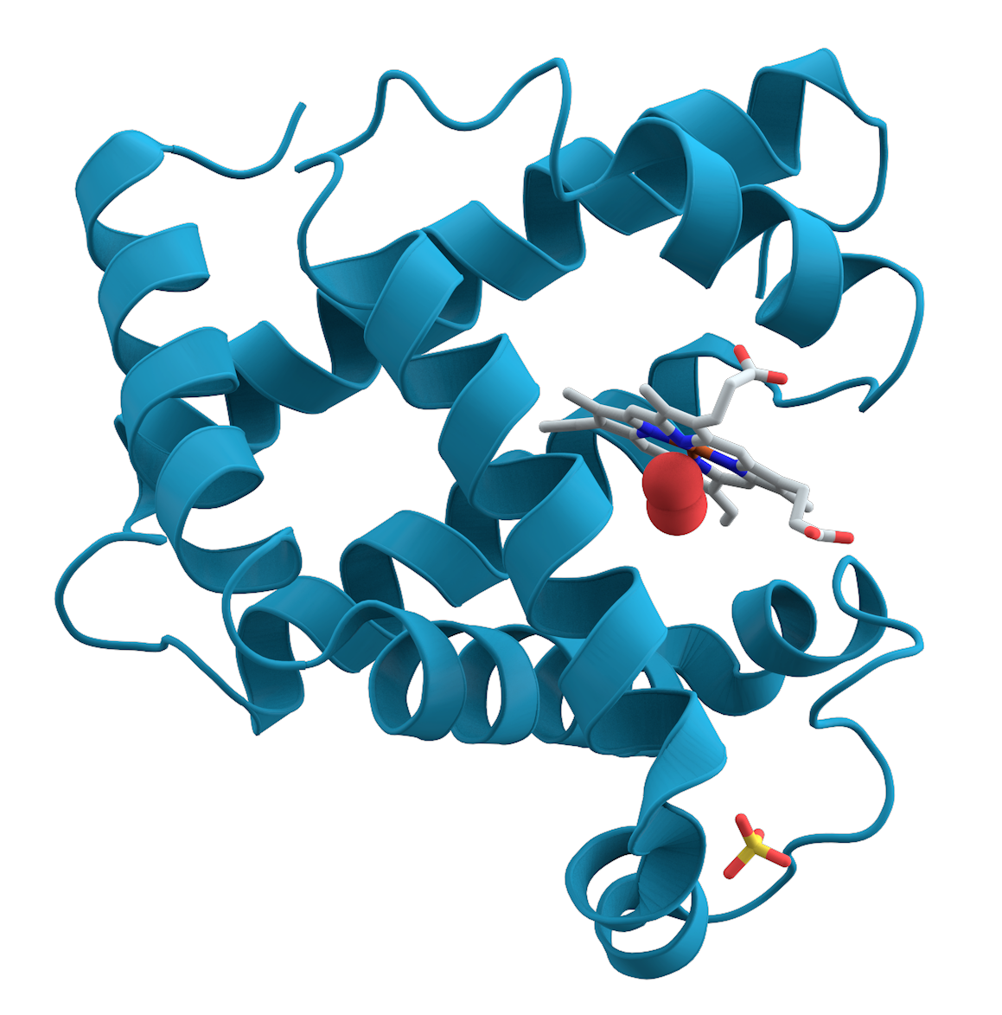
Proteins
Proteins are chains of Amino Acids
Notes:
Need to beef this up a bit.

Slide 5
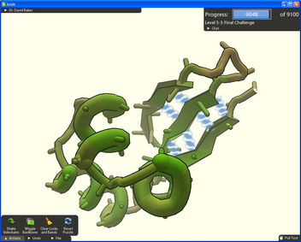
Aside: Protein Secondary Structure Prediction
Goal: find the lowest energy configuration of an amino acid chain
Unfortunately this problem is hard!
How hard is it? This hard: http://www.cs.berkeley.edu/~christos/hp.ps
Fold-it: a gameified approach to computing this structure
Notes:
Created when the Amino Acids twist up on themselves and adhere using Hydrogen bonding. Lowest energy state.
TODO: find complexity of computational problem, how well has this approached work. Discuss DARPA grand challenge around shredded documents.

Slide 6
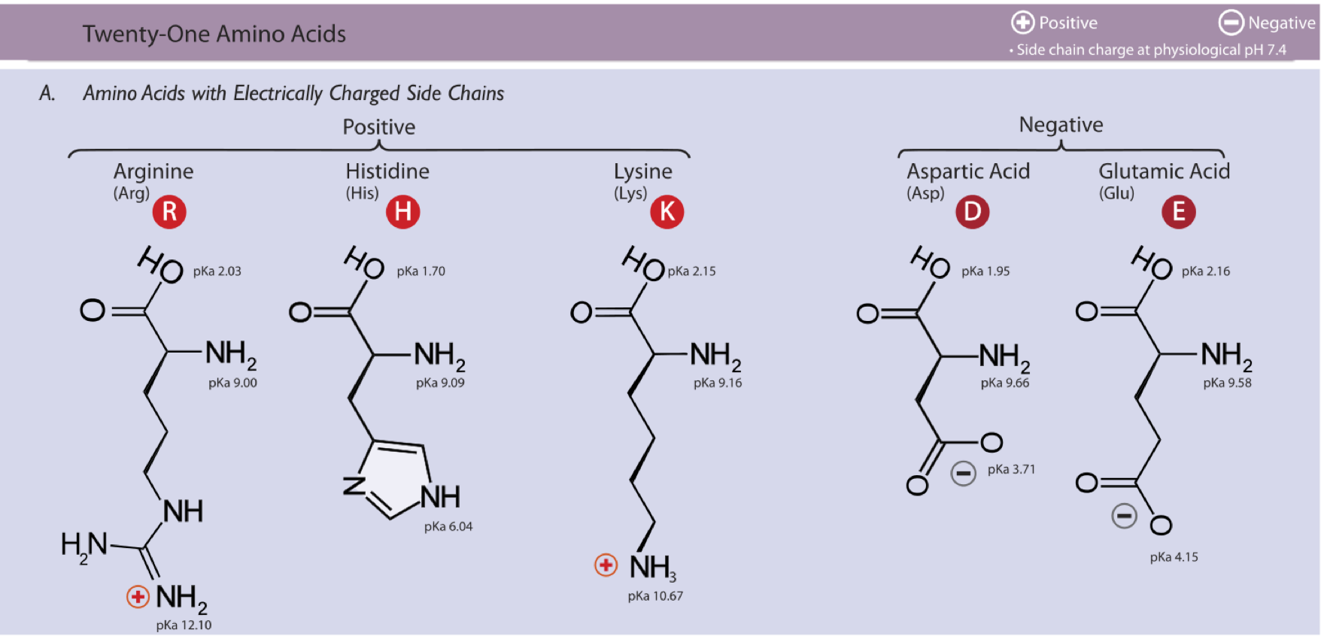
Proteinogenic Amino Acids
http://en.wikipedia.org/wiki/Amino_acid

Slide 7
DNA and Protein Synthesis
Stage 1: an enzyme “decides” that it is time to synthesize a protein (epigenetics)
Stage 2: DNA is unzipped and paired with a complementary strand of RNA (transcription)
Stage 3: tRNA attaches amino acids to complementary segments of RNA (translation)

Slide 8
Protein Synthesis Detailed Example
5’ – AGCAATGTTCCAGATGTAATT – 3’
3’ – TCGTTACAAGGTCTACATTAA – 5’

Slide 9
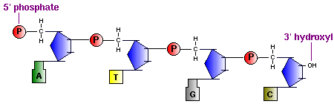
Quick Aside: 5’ vs. 3’
5’ – AGCAATGTTCCAGATGTAATT – 3’
3’ – TCGTTACAAGGTCTACATTAA – 5’
Image source: http://www.vivo.colostate.edu/hbooks/genetics/biotech/basics/nastruct.html

Slide 10
Protein Synthesis Step 1: Transcription Initiation
Coding Strand
ATG is also known as the start codon. This is where transcription starts.
5’ – AGCAATGTTCCAGATGTAATT – 3’
3’ – TCGTTACAAGGTCTACATTAA – 5’
Template Strand

Slide 11
Protein Synthesis Step 2: Messenger RNA Attaches
This new strand is known as messenger RNA
ATGTTCCTGATGTAATT – 3’
5’ – AGCA
AUGUUCCUGAUGUAAUU – 3’
3’ – TCGTTACAAGGACTACATTAA – 5’

Slide 12
Protein Synthesis Step 3: Messenger RNA Breaks Away
5’ - AUGUUCCUGAUGUAAUU – 3’

Slide 13
Protein Synthesis Step 4: Amino Acid Chain Forms
M
F
D
M
UAC
AAG
GAC
UAC
5’ - AUGUUCCUGAUGUAAUU – 3’
Known as an Open Reading Frame (ORF)
Stop Codon

Slide 14
Protein Synthesis Some things to Notice
M
F
D
M
UAC
AAG
GAC
UAC
5’ - AUGUUCCUGAUGUAAUU – 3’
Out of frame Stop codon
Stop Codon
Another Start Codon (Nested Reading Frame)

Slide 15
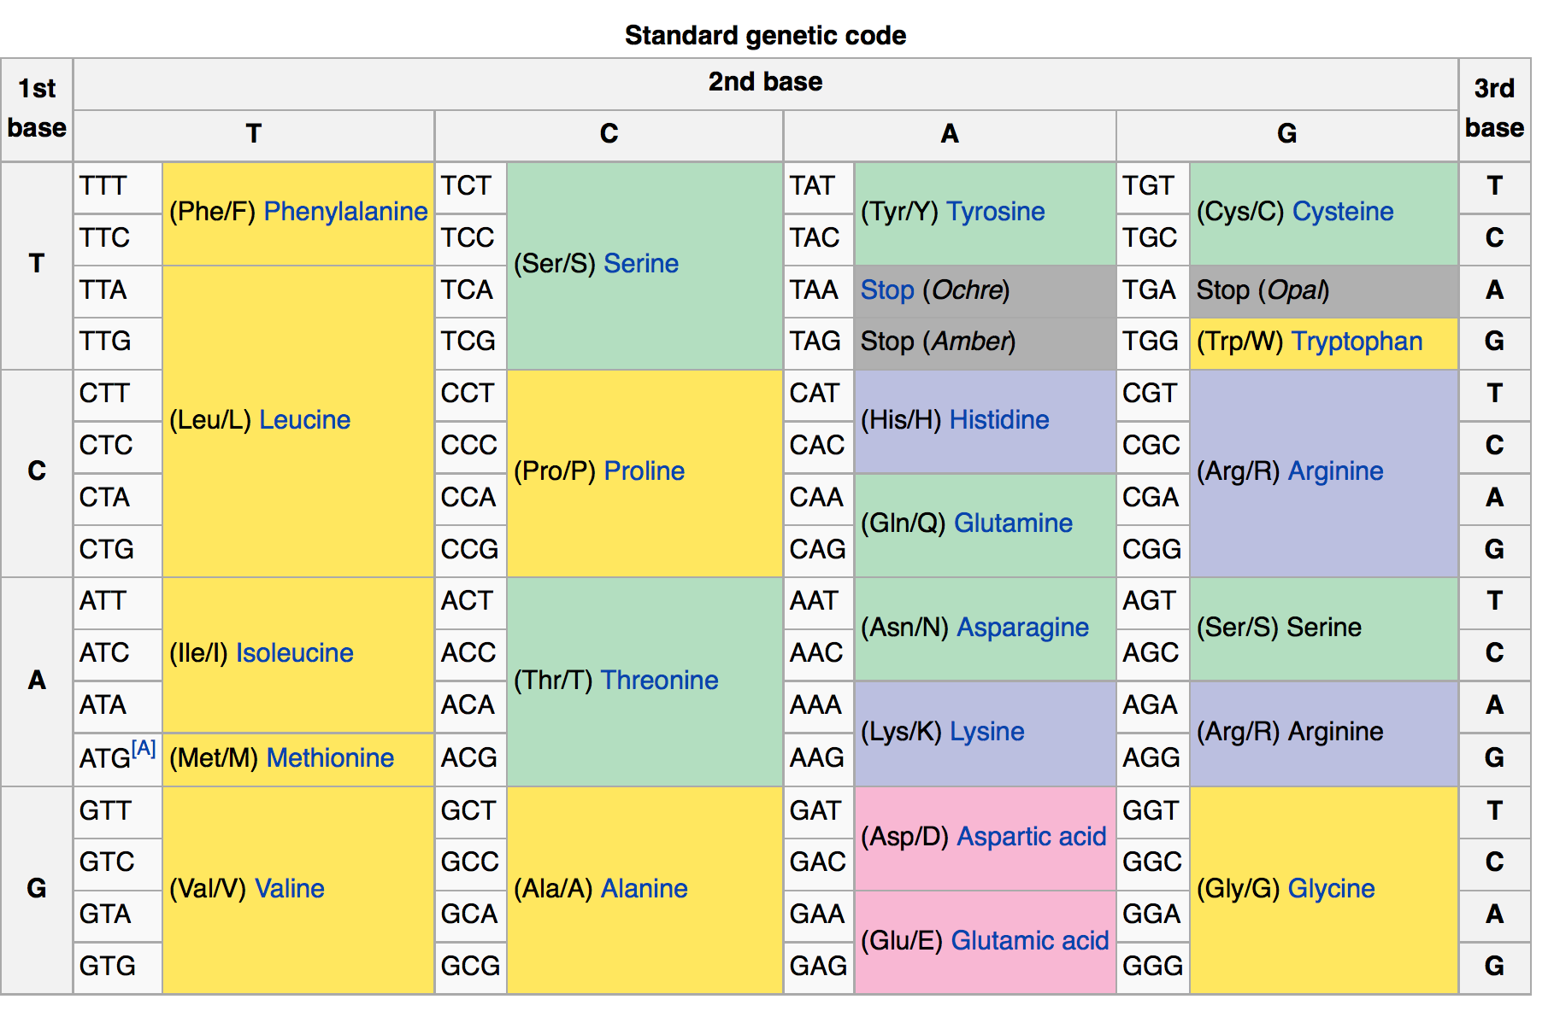
DNA Codon Table
This code is read from 5’ to 3’ on the DNA strand
Notes:
More convenient to work with than RNA. The genetic code is traditionally represented as a RNA codon table due to the biochemical nature of the protein translation process. However, with the rise of computational biology and genomics, proteins have become increasingly studied at a genomic level. As a result, the practice of representing the genetic code as a DNA codon table has become more popular. The DNA codons in such tables occur on the sense DNA strand and are arranged in a 5' → 3' direction.

Slide 16
6 Reading Frames: Reading Frame 5
Codons read in this direction
5’ – AGCAATGTTCCAGATGTAATT – 3’
3’ – TCGTTACAAGGTCTACATTAA – 5’

Slide 17
6 Reading Frames: Reading Frame 5
Codons read in this direction
5’ – AGCAATGTTCCAGATGTAATT – 3’
3’ – TCGTTACAAGGTCTACATTAA – 5’

Slide 18
6 Reading Frames: Reading Frame 6
Codons read in this direction
5’ – AGCAATGTTCCAGATGTAATT – 3’
3’ – TCGTTACAAGGTCTACATTAA – 5’

Slide 19
6 Reading Frames: Reading Frame 5
5’ – AGCAATGTTCCAGATGTAATT – 3’
3’ – TCGTTACAAGGTCTACATTAA – 5’
Codons read in this direction

Slide 20
6 Reading Frames: Reading Frame 5
5’ – AGCAATGTTCCAGATGTAATT – 3’
3’ – TCGTTACAAGGTCTACATTAA – 5’
Codons read in this direction

Slide 21
6 Reading Frames: Reading Frame 5
5’ – AGCAATGTTCCAGATGTAATT – 3’
3’ – TCGTTACAAGGTCTACATTAA – 5’
Codons read in this direction

Slide 22
Mini-Project: Gene Finder!
Create a python program that performs ab initio gene finding by
Determining which DNA segments likely code for proteins
Outputting the amino acid sequences coded by these regions of DNA
Run these amino acid sequences through a search engine to determine their function!

Slide 23
Ab-Initio Gene Finding Strategy
Tell-tale marker: suspiciously long ORFs
Suspicious is defined as being improbable to find in non-coding DNA
Q: How can we possibly compute the probability of finding an ORF of a particular length in non-coding DNA?

Slide 24
(part of) Next time
Joanne Pratt will guest lecture on a genetic search engine called BLAST (and its uses) as well as the role of BLAST in studying pathogenesis.

