Slide 1
Datamanagement with Docker

Slide 2
Content
Storage drivers & R/W layer
Volumes
Bind mounts
tmpfs mounts
Which storage should I use?
Demo

Slide 3
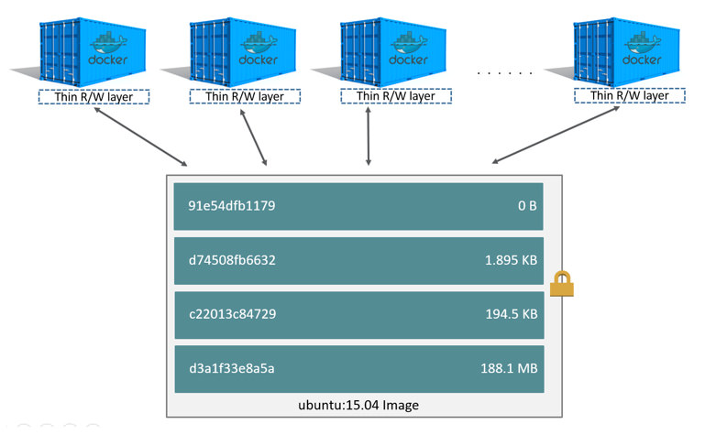
Storage drivers & Writable layer
Container adds R/W layer on top of image
Files created by container are stored in R/W layer
Data does not persist after container is removed
Storage drivers save ephemeral data generated on runtime in R/W layer.
Write intensive data reduces performance -> User Docker volumes
From: https://docs.docker.com/storage/

Slide 4

Where should we store our files

Slide 5
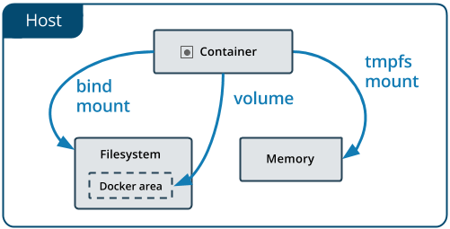
Storage options
Persistend:
Volume (prefered)
directory on host machine
managed by docker
Bind mount
directory on host machine
Temporary:
tmpfs mount
saved in memory (RAM)
From: https://docs.docker.com/storage/

Slide 6
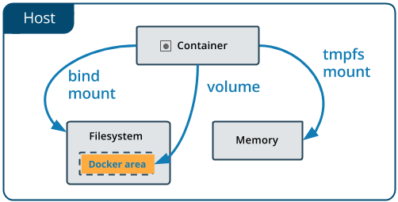
Volumes
Area in hosts file-system which is managed by Docker
Accessible via Docker CLI / Docker API
Easy to share between multiple containers
Work with Linux and Windows containers
Connectable to remote hosts / cloud providers
From: https://docs.docker.com/storage/

Slide 7
Volumes
Create Volume | $ docker volume create myvol
Start container with volume | $ docker run -d \ --name miniserver_1 \ -v myvol:/app \ miniserver:latest
Use with docker-compose | version: "3.9" services: frontend: image: miniserver:latest volumes: - server-volume:/app/storage volumes: myvol:

Slide 8
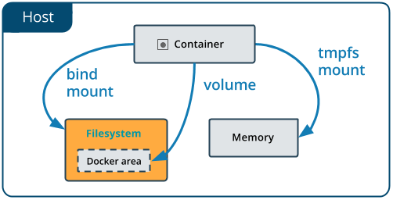
Bind mounts
Directory from host machine is mounted into container. (created if does not exist)
Pre-existent directory contents are obscured
Depend on directory structure and OS
From: https://docs.docker.com/storage/

Slide 9
Bind mounts
Start container with bind volume (pwd - print working directory) | $ docker run -d \ --name miniserver_1 \ -v "$(pwd)"/target:/app \ miniserver:latest
Use with docker-compose | version: "3.9" services: frontend: image: miniserver:latest volumes: - type: bind source: ./static target: /app/static

Slide 10
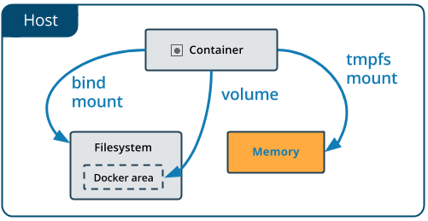
tmpfs mounts (temporary file system)
Files stored in memory (RAM)
Beneficial for temporary files and increased reading/writing speed
Limitations
Files not shareable between containers
Only available on Linux
From: https://docs.docker.com/storage/

Slide 11
tmpfs mounts
Start container with tmpfs mount | $ docker run -d \ --name miniserver_1 \ --tmpfs /app \ miniserver:latest
Use with docker-compose | version: "3.8" services: miniserver: image: miniserver:latest volumes: - type: tmpfs target: /app tmpfs: size: 1000 # bytes

Slide 12
Which storage option should I use?

Slide 13
Volumes | Bind mounts | tmpfs mounts
Share data between multiple containers Storing data on remote host / cloud provider | Sharing files from host machine with container | Security: Files should be deleted after container shutdown Performance Read/Write faster in memory than file-system

Slide 14
Demo
…combined with networking-overview

