Slide 1
Docker Networking

Slide 2
Why do we need docker networking?
Communication between apps, the host, or external network

Slide 3
Contents
Network drivers
Bridge
Overlay
Host
IPvlan
Macvlan
(no network)
What type network should I use?
Demo

Slide 4
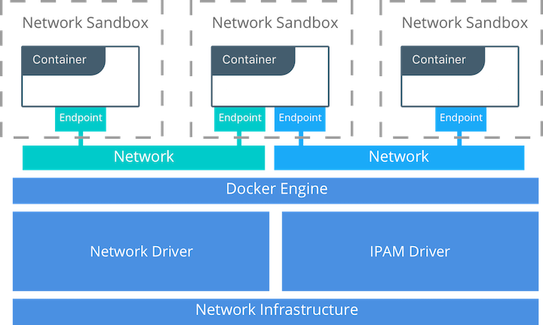
Network drivers
Container Networking Model (CNM)
Provide network functionality to containers
Plugable subsystem with different drivers
From: https://docs.mirantis.com/containers/v3.0/dockeree-ref-arch/networking/scalable-container-networks.html

Slide 5
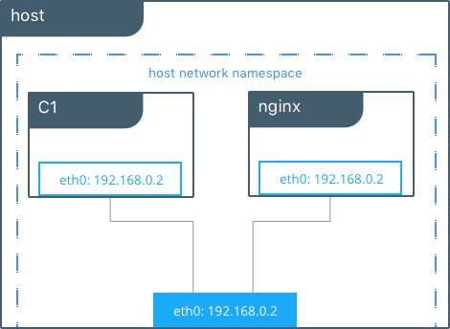
Host networks
Removed network isolation between container and Docker host system
Command: host $ docker run --net host miniserver
From: https://docs.mirantis.com/containers/v3.0/dockeree-ref-arch/networking/scalable-container-networks.html

Slide 6
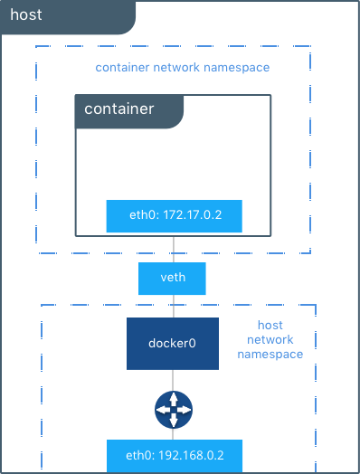
Bridge networks
A bridge network connects containers which should communicate
Default network: > bridge < Containers automatically added if not explicitly specified.
Command: host $ docker run miniserver
From: https://docs.mirantis.com/containers/v3.0/dockeree-ref-arch/networking/scalable-container-networks.html

Slide 7
Bridge networks
User-defined vs. default bridge
Automatic DNS resolution: Containers callable by name instead of IP-address
Better isolation
Containers detachable/attachable on runtime. (Not when using default bridge)
Configurable bridge for different requirements
Containers on the user-defined bridge expose all ports to each other

Slide 8
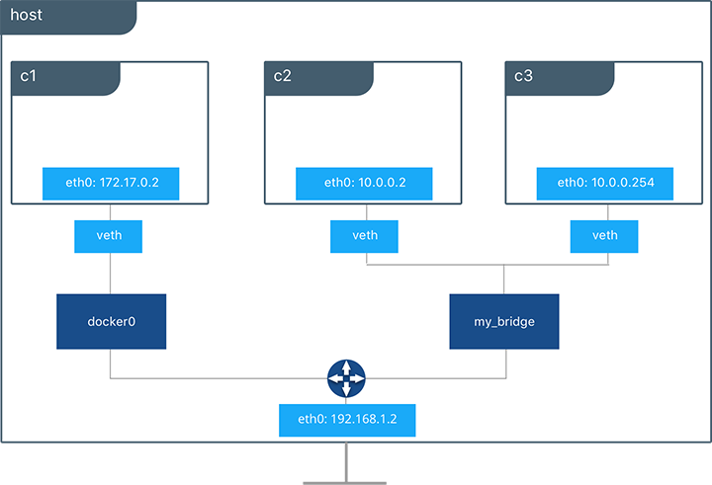
Bridge network - (user-defined)
Specifies sub-network
Command: host $ docker network create -d bridge --subnet 10.0.0.0/24 my_bridge
host $ docker run --name C2 --net my_bridge miniserver
host $ docker run –name C3 --net my_bridge --ip 10.0.0.254 miniserver
From: https://docs.mirantis.com/containers/v3.0/dockeree-ref-arch/networking/scalable-container-networks.html

Slide 9
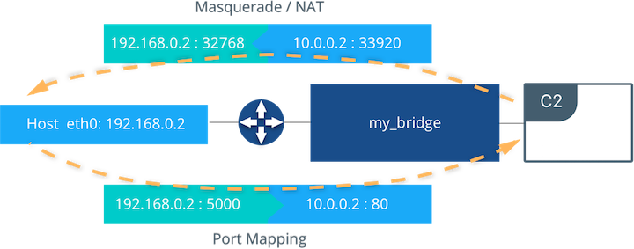
Bridge networks - external access
External access must be specified explicitly
Command:
host $ docker run --net my_bridge -p 5000:80 --name C2 miniserver
From: https://docs.mirantis.com/containers/v3.0/dockeree-ref-arch/networking/scalable-container-networks.html

Slide 10
Overlay networks
Connect multiple Docker deamons (on different hosts/machines)
Enable swarm services - Swarm distributed control plane
… covered next week …

Slide 11
IPvlan networks
Control over IPv4 & IPv6 addressing (inside host network)
Control of layer 2 VLAN tagging & IPvlan layer 3 routing ??
Commands:
$ docker network create -d ipvlan --subnet 192.168.1.0/24 \ --gateway 192.168.1.1 -o ipvlan_mode=l2 -o parent=eth0 ip_net $ docker run --net ip_net miniserver

Slide 12
Macvlan networks
Assign MAC address to container. Simulate physical device (inside host network)
Used to deal with legacy applications which expect direct connection to physical network
Commands:
$ docker network create -d macvlan --subnet=172.16.86.0/24 \ --gateway=172.16.86.1 -o parent=eth0 pub_net
$ docker run --net pub_net --ip 172.16.86.10 -p 5000:80 miniserver

Slide 13
Which network driver to use?

Slide 14
Bridge networks Communication between multiple containers on same host | Host networks Network stack should not be isolated from host (but things like filesystem/libraries should)
Overlay networks Communication between containers on different hosts Swarm services for multiple applications | Macvlan/Ipvlan networks Simulation of physical hosts via containers with unique MAC/IP address Migration from VM setup

Slide 15
Third party network plugins
exists.

Slide 16
Demo
Datamanagement &
Networking

Slide 17
Linux network fundamentals - used by CNM
Linux Bridge Virtual impl. of switch | Network Namespaces Define isolated networks E.g. host network namespace contains host interfaces & routing tables
Virtual Ethernet Devices (veth) Simulates connection wire between network namespaces | iptables packet filtering system L3/L4 firewall (marking, masquerading, dropping)

