Slide 1
„Javascript, the bad parts”
  Presented by: Thomas Juhász

Slide 2
Table of contents
Scope, Closure
Hoisting
Function Declaration, Function Expression
IIFE
This
Event loop, Event queue, Run to completion

Slide 3
Scope, Closure
In JS up to ES5 there are only function scopes
Closure is a function with all of its variables and functions that are available to it. (lexical scope)
https://jsfiddle.net/ThomasJuhasz/mdzL0d7e/
Notes:
From ES6 we have block scopes as well (let)
Modify code to have a let variable in it

Slide 4
Hoisting
The compiler looks through the code to find function and variable declarations to move those declarations to the top of their scopes.
https://jsfiddle.net/ThomasJuhasz/js54314m/
Notes:
Modify code so a=5 is in an if statement.
Modify code so myFunction() is above it’s declaration.
Variables declared with the „let” variables don’t get hoisted, they work similar to the C# variables.

Slide 5
Function declaration
Function declaration is when you create/register a new function to the scope. Like a variable it also gets hoisted to the top of the scope, but unlike a variable it’s value is set immediately.
function myFunc() {
//..code
}
Notes:
See previous example for function declaration

Slide 6
Function expression
Function expression is when you don’t register a function in the scope, just create one inline and use it right away.
var myFunc = function() {
//..code
};
https://jsfiddle.net/ThomasJuhasz/zhqg36tg/
Notes:
Note: In the example varFunc throws TypeError-not a function so it should be commented when showing the example

Slide 7
IIFE
Immediately Invoked Function Expression
(function($) {
//..code
})(jQuery);
https://jsfiddle.net/ThomasJuhasz/dyrxyvfa/

Slide 8
this
  https://jsfiddle.net/ThomasJuhasz/n8efjxsp/

Slide 9
this
dynamically binds
4.5 steps to determine this:
  Was the function called with the new keyword: this is the new object
  Was the function explicitly called with a context passed in: this is bound to the passed context (call / apply / bind)
  Was the function called on an object (implicit binding): this is bound to the object
  Was the function called in the outer scope, if so
    If we are in strict mode: this is undefined
    Else: it’s the global object (window)

Slide 10
Event queue, Event loop, Run to completion
https://developer.mozilla.org/hu/docs/Web/JavaScript/EventLoop
https://jsfiddle.net/ThomasJuhasz/en7vcdyf/

Slide 11
„Javascript, the bad parts”
- Part 2
  Presented by: Thomas Juhász

Slide 12
Table of contents
New
Prototype
Inheritance
Revealing Module, Revealing prototype

Slide 13
new
The new keyword does 4 things:
Creates a brand new object
Links object to the constructor’s prototype
Binds the this keyword to the new object within the constructor function
Implicity returns with the new object

Slide 14
prototype
When you declare a function a prototype object is also created
Every object constructed by that function is linked to the function’s prototype
The prototype object also links back to the function through the constructor property
The prototype is shared among every object constructed via the function

Slide 15
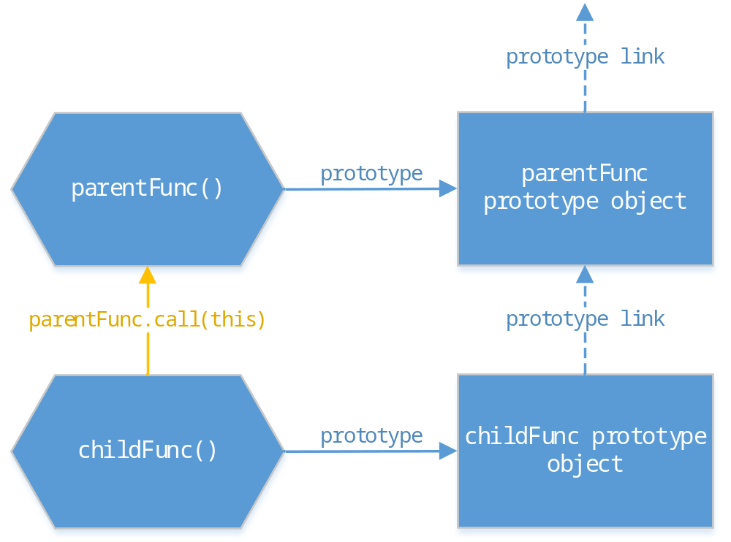
Inheritance
https://jsfiddle.net/ThomasJuhasz/emfwLymp/

Slide 16
Revealing Module, Revealing prototype
The revealing module pattern should be used for objects that only have one instances, while the revealing prototype pattern is much more effective with big loads of data
Revealing module:
https://jsfiddle.net/ThomasJuhasz/9djhLukk/
Revealing prototype:
https://jsfiddle.net/ThomasJuhasz/cdbfp8gt/

