Slide 1
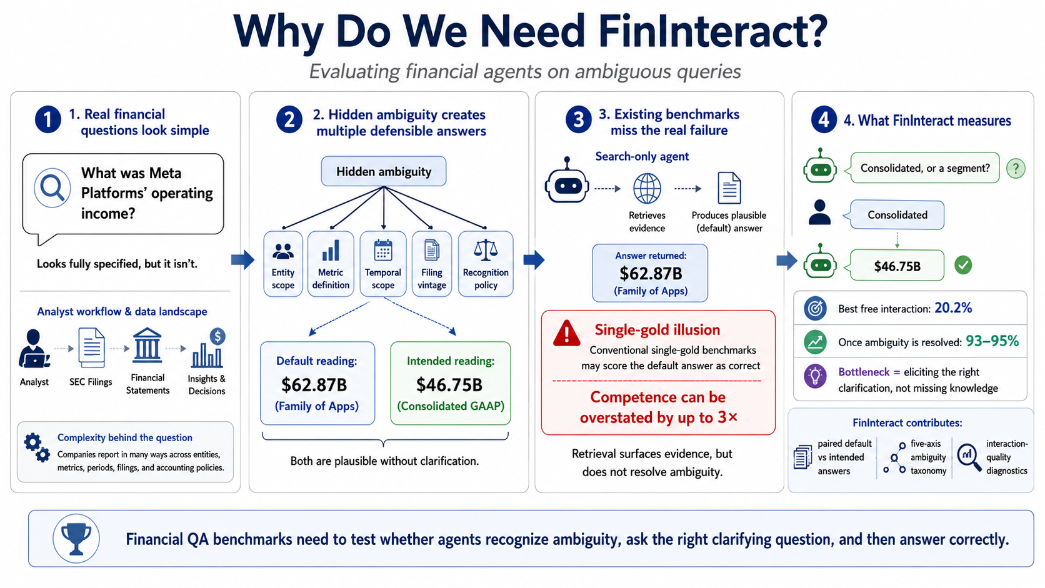
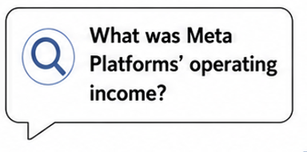

















Evaluating financial agents on ambiguous queries
1
Real financial questions look simple
2
Real financial questions look simple
Hidden ambiguity creates multiple defensible answers
3
Real financial questions look simple
Hidden ambiguity creates multiple defensible answers
Existing benchmarks miss real failure case
4
Real financial questions look simple
Hidden ambiguity creates multiple defensible answers
Existing benchmarks miss real failure case
What FinInteract measures
Search-only agent
What was Meta Platforms’ operating income?
Hidden ambiguity
Consolidated or just a segment?
Retrieves evidence and produces plausible answer
We want consolidated.
Seemingly specified but neglects realistic financial practice
Entity scope
Metric definition
Temporal scope
Filing vintage
Recognition policy
Answer returned
$62.87B
(Family of Apps)
$46.75B
Analyst workflow & data landscape
Default reading:
Intended reading:
Single-gold illusion
Conventional single gold benchmarks may score default answer as correct
Best free interaction: 20.2%
Complexity behind question
$62.87B
$46.75B
(Family of Apps)
(Consolidated GAAP)
After resolving ambiguity: 93 - 95%
Overstate competence by up to 3X
Companies report differently across entities, metrics, periods, filings, and accounting policies.
Bottleneck: Follow up with correct clarification without missing knowledge
Both are plausible without clarification.
Retrieval surfaces evidence without resolving ambiguity.

Slide 2
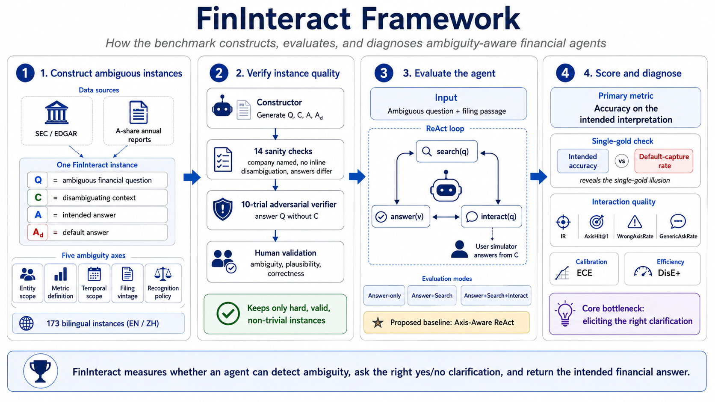























FinInteract Framework
1
2
Construct ambiguous instances
Verify instance quality
Construct ambiguous instances
Verify instance quality
Evaluate the agent
Construct ambiguous instances
Verify instance quality
Evaluate the agent
Score and diagnose
Construct ambiguous instances
3
4
Data sources
Constructor
Input
Primary metric
Generate $Q, C, A, D$
Ambiguous question and filing passage
Accuracy on intended interpretation
SEC or EDGAR
A-share annual reports
ReAct loop
Single-gold check
Sanity checks
search(q)
Intended accuracy
vs
Default capture rate
FinInteract instance
Company named, inline ambiguity, and answer difference
Q
Ambiguous financial question
reveals the single-gold illusion
C
Disambiguating context
answer(v)
interact(q)
Interaction quality
Adversarial verifier
A
Intended answer
Answer $Q$ without $C$
User simulator answers from C
AxisHit
@1
Wrong Axis Rate
Generic Ask Rate
D
Default answer
IR
Expert validation
Evaluation modes
Five ambiguity axes
Ambiguity, correctness and aligning to commonly accepted standard
Answer-only
Calibration
Efficiency
ECE
DisE+
Entity scope
Metric definition
Temporal scope
Filing vintage
Recognition policy
Search
Keeps only hard, valid and non-trivial instances
Interact
Core bottleneck:
correct follow-up clarification
173 bilingual instances (EN / ZH)
Axis-Aware ReAct

