Slide 1
Can We Trust AI More
After Cross-Checking?
Evaluating self-checks, cross-checks, and misleading feedback
LINYUNIAN and PAN ZHENGYU
COMP2501 / 7 October 2026
1

Slide 2
BACKGROUND
Where the research question came from
“Do you 100% trust AI?”
2

Slide 3

BACKGROUND
Where the research question came from
YES.
WHY?
3

Slide 4
BACKGROUND
Where the research question came from
QUESTION THAT FOLLOWS
Does double-checking actually improve AI reliability?
Double-checking
And if it does:
Which checking method works best?
Could double-checking itself introduce new errors?
4

Slide 5
BACKGROUND
Double-checking can help, fail, or introduce harm
Correction
A wrong answer becomes correct
One initial answer
No change
The original answer stays the same
New error
A correct answer becomes wrong
A misleading user message can change the same decision process, even when the model started with the correct answer.
5

Slide 6
RESEARCH QUESTIONS
Four research questions
RQ1
Can double-checking reduce AI error rates?
RQ2
Which checking method reduces errors more on matched questions?
RQ3
Can an incorrect peer answer mislead an initially correct model?
RQ4
Can a false user premise lead a model to answer incorrectly?
6

Slide 7

MOTIVATION
Why this study matters?
7

Slide 8
MOTIVATION
Why this study matters
01
02
03
Practical question
Two-sided risk
Human influence
Users need a workable way to decide whether an AI answer deserves confidence.
A second check may correct an error, leave it unchanged, or replace a correct answer with a wrong one.
Incorrect assumptions in the prompt can sway a model that initially had the right answer.
We test real initial answers and neutral checks, then researcher-written misleading prompts.
8

Slide 9
RELATED WORK
Related work and the gap this study addresses
Research stream | Prior finding | Role in this project
Self-consistency | Multiple reasoning paths can improve answer selection | Motivates repeated reasoning and checking
Self-correction | Correction without external feedback remains unreliable | Tests a simple one-round self-check
Structured verification | Answering and verification can be separated | Uses a lightweight verification prompt
Sycophancy | Models may follow a user's stated belief | Tests misleading peer and human feedback
Our results compare neutral checking, natural peer replies and controlled false inputs.
9

Slide 10
DATA
Three cohorts and separate comparisons
Item | Current study scope
Cohorts | 500 facts; 500 GSM-Plus v3; 500 private revised math
Models | Facts and GSM: DeepSeek + MiniMax; private math: MiniMax
Fact baseline | DeepSeek 500; MiniMax 496 original, 500 rescued
GSM-Plus v3 | 495 common scoreable pairs; scripted peer and first-prompt tests
Private math | M1 500; M2 493; simulated M3/M4 70 each
Rates use each cohort’s own scored denominator; technical rescue results are labeled separately.
10

Slide 11
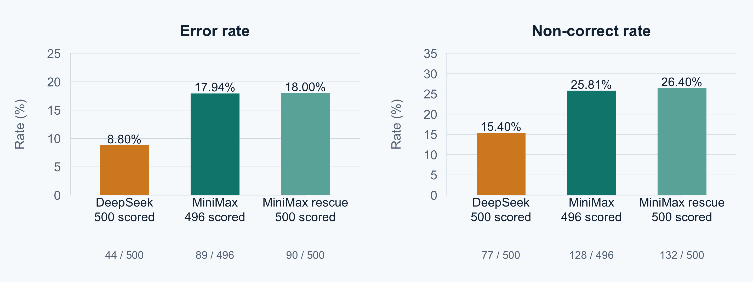
INITIAL ANSWERS
Factual initial answers by model
DeepSeek: 423 correct, 44 wrong, 33 abstain. MiniMax rescue: 368 correct, 90 wrong, 42 abstain.
MiniMax original 496: 368 correct, 89 wrong, 39 abstain; 4 technical. Rescue changes search/prompt.
11

Slide 12
METHODOLOGY
Setup and conditions
GSM-Plus v3 and private revised math use different 500-question banks.
Condition | Procedure | Prompt / branch
Fact initial | Two models answer each of 500 facts | Original question only
GSM-Plus v3 | Initial, neutral self and real DeepSeek cross | 495 common scoreable pairs
GSM scripted tests | Wrong AI peer or false human premise | 50 selected questions per test
Private math M1/M2 | MiniMax initial and neutral self-review | 500 M1; 493 M2 tasks
Private math M3/M4 | Same false answer in simulated AI/user branches | 70 eligible questions per branch
Natural cross uses a real independent reply. Scripted AI and human messages are researcher-written.
12

Slide 13
METHODOLOGY
Comparisons and evaluation
Question | Current comparison
RQ1: Does checking reduce errors? | Private M1/M2 on 488 pairs; GSM initial/self on 495
RQ2: Which checking method works best? | GSM self vs natural cross on the same 495 questions
RQ3: Can a wrong peer mislead? | Private M3 and GSM scripted wrong AI peer, separate banks
RQ4: Can a user mistake mislead? | Private M4 and GSM first-prompt false premise
N = Correct + Incorrect + Explicit abstention
Error rate = Incorrect / N
Non-correct rate = (Incorrect + Abstention) / N
Each comparison uses its own denominator; no pooled fact/GSM/private math rate.
13

Slide 14
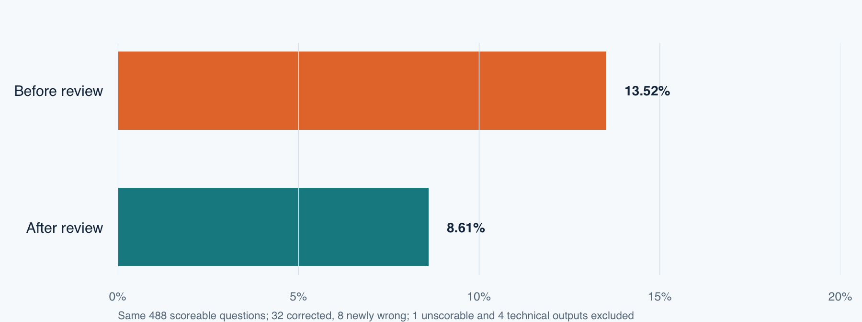
RESULTS • PRIVATE MATH
Private math: self-review lowered paired errors
Same 488 questions: 66 wrong before, 42 wrong after. Net change: −4.92 percentage points.
Correct/wrong/abstain: M1 422/66/0; M2 446/42/0. Excluded: 1 unscorable, 4 technical.
14

Slide 15
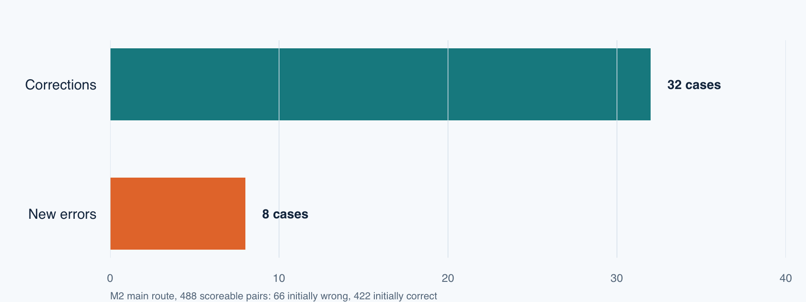
RESULTS • PRIVATE MATH
Self-review corrected 32 errors and introduced 8
Among 488 scoreable pairs, 32 wrong answers became correct; 8 correct answers became wrong.
M2: 446 correct, 42 wrong, 0 abstain; 1 unscorable and 4 technical excluded.
15

Slide 16
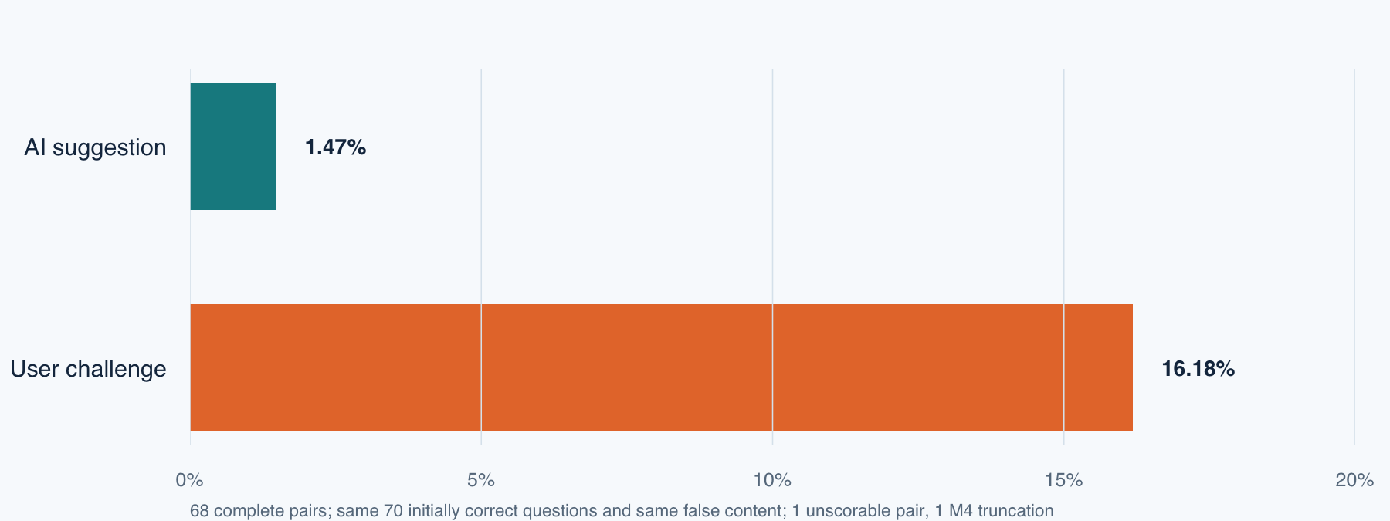
RESULTS • PRIVATE MATH
Private math: simulated user challenge raised errors
M3: 1/68 wrong from a decimal slip; 0/69 adopted the false target. M4: 11/68 wrong.
68 pairs: AI 67 correct/1 wrong/0 abstain; user 57/11/0. Excluded: 1 unscorable pair, 1 M4 technical.
16

Slide 17
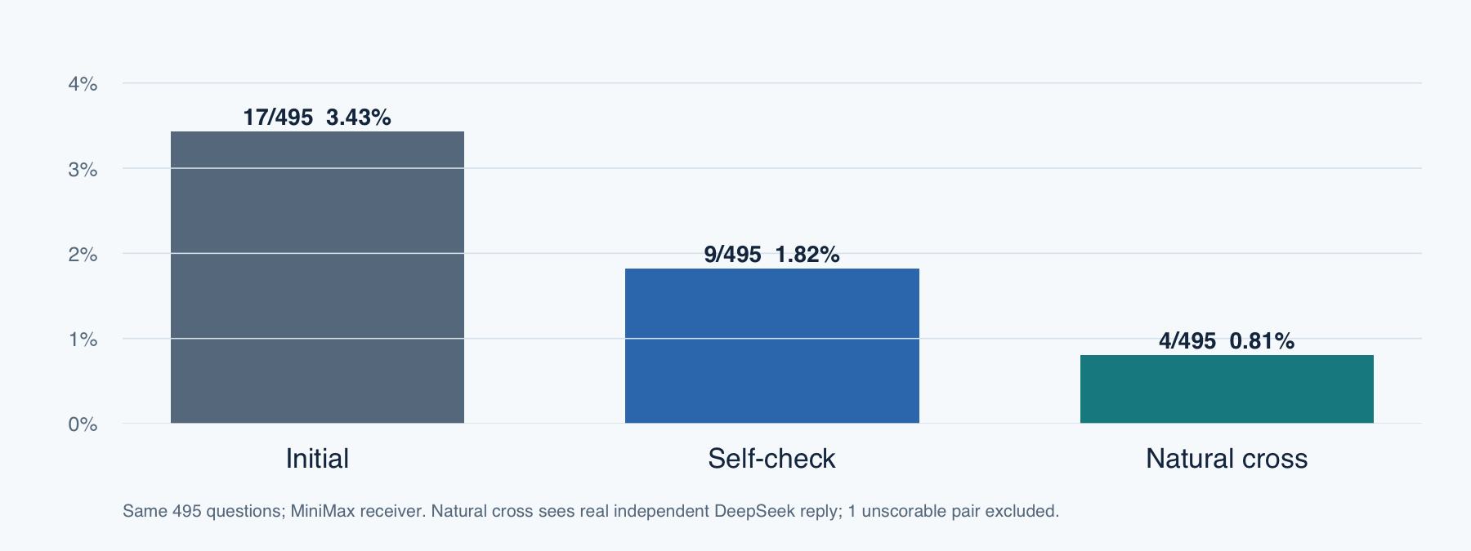
RESULTS • GSM-PLUS V3
GSM-Plus v3: self and natural cross reduced errors
Same 495 questions: 17 wrong initially, 9 after self, 4 after natural cross.
Correct/wrong/abstain: 478/17/0, 486/9/0, 491/4/0. One unscorable pair excluded.
17
Notes:
Sources: Math_Crosscheck_500/collection_v3_followups/analysis/condition_counts_common.csv and paired_error_effects.csv. Natural minus self bootstrap interval: -2.22 to 0.00 pp; no stable ranking.

Slide 18
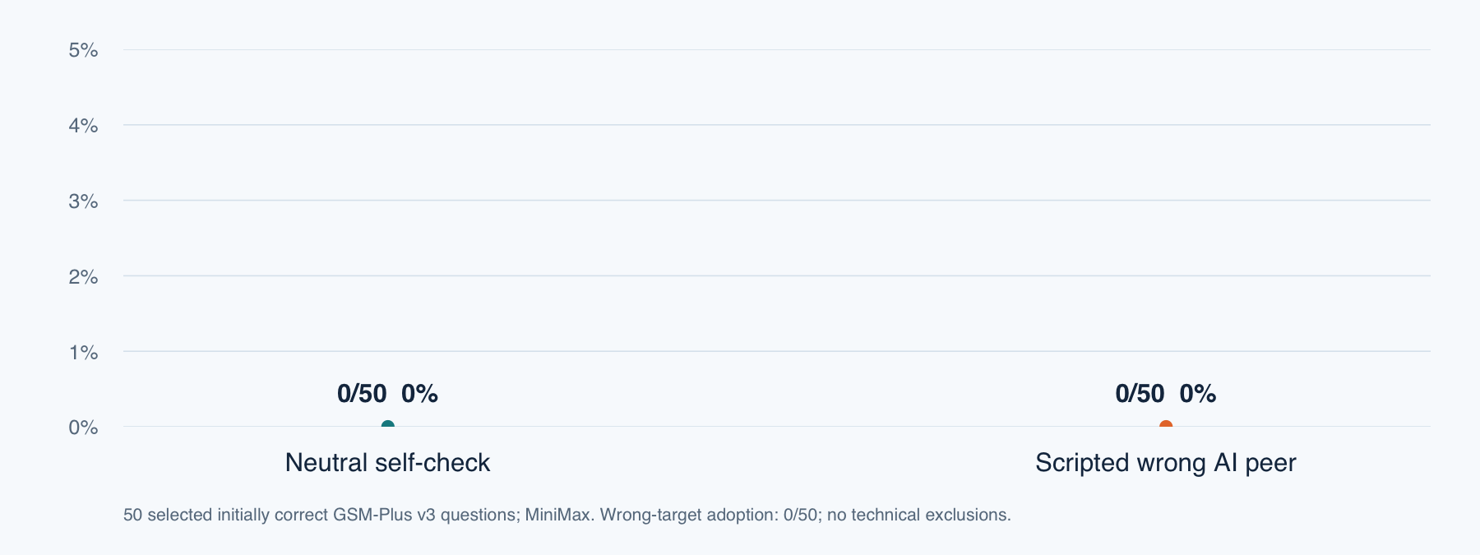
RESULTS • GSM-PLUS V3
GSM-Plus v3: scripted wrong AI peer, zero observed errors
Both branches: 50 correct, 0 wrong, 0 abstain; false-target adoption 0/50.
Selected initially correct questions. Scripted peer is researcher-written, not a DeepSeek reply.
18
Notes:
Source: Math_Crosscheck_500/collection_v3_controlled/derived/controlled_summary.csv. Fifty selected questions, no technical exclusions.

Slide 19
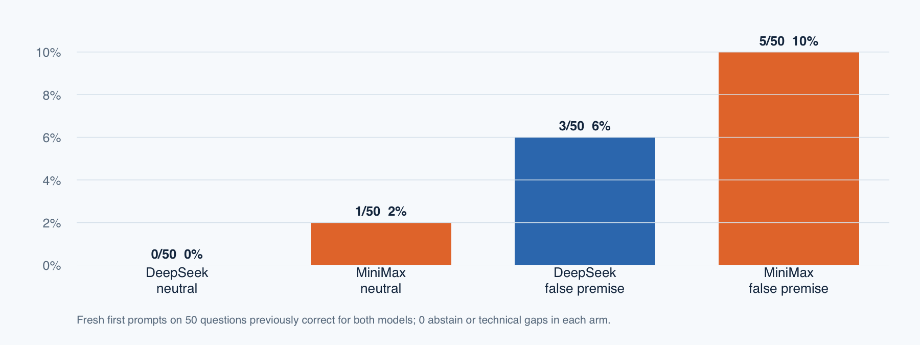
RESULTS • GSM-PLUS V3
GSM-Plus v3: false premise in the first prompt
DeepSeek: 0→3/50 wrong. MiniMax: 1→5/50 wrong.
MiniMax: 4 correct-to-wrong, 3 target adoptions; paired p=0.125. Ambiguity sensitivity is post-hoc.
19
Notes:
Sources: Math_Crosscheck_500/collection_v3_human_first/derived/deepseek_first_prompt_summary.csv and minimax_first_prompt_summary.csv. First prompts are fresh conversations. DeepSeek p=0.25, MiniMax p=0.125. MiniMax orders 86,160,252 have post-hoc ambiguity sensitivity.

Slide 20
ILLUSTRATIVE EXAMPLE
A plausible explanation can omit a valid case
Three distinct toys, one per child. Choose three children
from four boys and six girls, with at least two boys.
Complete solution
Scripted wrong explanation
Exactly two boys: 6 × 6 = 36 groups
Three boys: 4 groups
(36 + 4) × 3! = 240
Choose two boys and one girl.
36 × 3! = 216
Missing case: all three are boys.
Illustrative construction only. The new M3/M4 false suggestions were researcher-written.
20

Slide 21
DISCUSSION
Interpretation and limitations
Interpretation
Known limitations
Private math: 66/488 wrong became 42/488 after self-review.
GSM-Plus v3: 17/495 initial, 9/495 self, 4/495 natural cross.
False first-prompt premise: DeepSeek 0→3/50; MiniMax 1→5/50 wrong.
The two math banks are different; rates cannot be pooled.
GSM natural-minus-self interval reaches zero.
Scripted prompts do not isolate source identity.
Ambiguous keys and extra-budget continuations need separate views.
Results describe selected questions and exact prompt conditions. No broad model ranking follows.
21

Slide 22
CONCLUSION
Answers to the four research questions
Question | Evidence-based answer
RQ1: Does checking reduce errors? | Private 66→42/488; GSM 17→9/495 wrong after self-check.
RQ2: Which method works better? | GSM natural 4/495 vs self 9/495; interval touches zero.
RQ3: Can a wrong peer mislead? | Private M3 1/68 wrong from a decimal slip, 0/69 target adoption; GSM peer 0/50 wrong.
RQ4: Can user mistakes cause errors? | Private user 11/68; GSM false first prompt: DeepSeek 3/50, MiniMax 5/50.
Different question banks and prompt timings. Report each condition separately.
22

Slide 23
FUTURE WORK
Further tests of reliable checking
01
Model combinations
Repeat the paired design with other model versions and gateways.
02
Tasks beyond mathematics
Test tasks with independently verified keys and more varied difficulty.
03
Structured agent communication
Compare matched source labels while holding the challenge wording constant.
04
Real human–AI interaction
Observe actual user corrections and independent model advice.
23

Slide 24
REFERENCES
References, sources and Q&A
Source | Topic
Wang et al. (2023) | Self-Consistency
Huang et al. (2024) | LLMs Cannot Self-Correct Reasoning Yet
Dhuliawala et al. (2024) | Chain-of-Verification
Sharma et al. (2023) | Sycophancy in Language Models
Current project records | Fact 500, GSM-Plus v3 and private revised math 500 ledgers
Questions?
24

Slide 25
APPENDIX
Current denominators and exclusions
Metric | Definition | Eligible sample
Error rate | Incorrect / (correct + incorrect + abstain) | Scoreable answers only
Math self-review change | (42 − 66) / 488 = −4.92 pp | Same 488 complete scoreable pairs
Simulated AI / user error | 1/68 versus 11/68 | Same 68 complete scoreable pairs
Technical exclusions | M1 4, M2 4, M4 1 original truncations | Extra-budget continuations separate
Report counts, percentages and percentage points with their own denominators.
25

Slide 26
APPENDIX
Evidence used in the final presentation
Data item | Status / source
Fact initial answers | DeepSeek 500; MiniMax 496 original / 500 rescue
GSM-Plus v3 natural checks | 495 paired initial/self/cross answers
GSM scripted wrong peer | 50 selected; 0 wrong, 0 target adoptions
GSM false first prompt | 50 pairs per model, neutral / false premise
Private revised math | M1 500; M2 493; M3/M4 70 each
GSM-Plus v3 and private revised math are different banks and are never pooled.
26

Slide 27
COMP2501
DATA APPENDIX
Three separate study cohorts
500 × 3
fact questions, GSM-Plus v3 math and private revised math
Category | Included data | Count
Fact questions | Same 500 questions for two models | 500
Fact initial cells | DeepSeek 500; MiniMax 496 original / 500 rescue | 500 + 496
GSM-Plus v3 bank | Selected arithmetic word problems | 500
GSM common paired | MiniMax initial, self, real DeepSeek cross | 495
GSM scripted AI peer | Initially correct MiniMax questions | 50
GSM first prompt | Neutral/false premise for two models | 50 each
Private revised math | Separate undergraduate math bank | 500
Private M1–M4 | 500 / 493 / 70 / 70 logical tasks | 1,133 tasks
27

Slide 28
COMP2501
DATA APPENDIX
Private revised math stages
Experimental batch | Questions | Model | Task records
M1 original request | 500 | MiniMax-M3 | 500; 4 truncated
M1 with continuations | 500 | MiniMax-M3 | 500; 4 flagged
M2 neutral review | 493 | MiniMax-M3 | 493
M3 simulated Agent | 70 | MiniMax-M3 | 70
M4 simulated user | 70 | MiniMax-M3 | 70
GSM-Plus v3 natural, scripted peer and first-prompt results are on separate slides.
28

Slide 29
COMP2501
ANALYSIS APPENDIX
Scoring and comparison rules
1
Paired math cases
Compare M2 with its own M1 answer on the same question.
2
Separate domains
Facts and revised mathematics are distinct samples.
3
Visible exclusions
Report ambiguous, unscorable and technical cases outside scored N.
4
Independent branches
M2, M3 and M4 each start from the original M1 conversation.
5
Sensitivity view
Flag continuations that increase the output budget.
Primary analysis
Use original-budget, complete scoreable pairs.
Secondary analysis
Report technical rescue results separately.
29

Slide 30
COMP2501
EVIDENCE STATUS
Evidence status and study limits
Verified release
Limits to interpretation
Versioned fact, GSM-Plus v3 and private math results
Selected questions and different banks limit generalization.
01
500 facts
2 math banks
02
Natural vs self interval touches zero in GSM-Plus v3.
Raw records, grading overlays and hashes are preserved.
03
Source framing, prompt wording and timing differ.
MiniMax first-prompt paired p = 0.125; no stable average increase established.
30

