Slide 1
16.317 Microprocessor Systems Design I
Instructor: Dr. Michael Geiger
Fall 2015
Lecture 3:
x86 introduction

Slide 2
Lecture outline
Announcements/reminders
Sign up for the course discussion group on Piazza
HW 1 to be posted this week
Review
Data types
How are the bits interpreted? (int, FP, signed/unsigned)
What size are they? (byte, word, etc.)
Today’s lecture
Storage media
Alignment
Endianness
x86 introduction

Slide 3
Data storage
What characteristics do we want storage media to have?
Two primary answers
Speed
Capacity
Very difficult to get both in single storage unit
Processors use two different types of storage
Registers
Memory

Slide 4
Registers
Small, fast set of storage locations close to processor
Primarily used for computation, short-term storage
Speed → ideal for individual operations
Lack of capacity → will frequently overwrite
Reference registers by name
Example: ADD EAX, EBX → EAX = EAX + EBX
EAX, EBX are registers in x86 architecture

Slide 5
Memory
Provides enough capacity for all code, data (possibly I/O as well)
Typically organized as hierarchy
Used primarily for long-term storage
Lacks speed of registers
Provides capacity to ensure data not overwritten
Reference memory by address
Example: MOV EAX, DS:[100H]
→ EAX = memory at address DS:[100H]

Slide 6
Memory (continued)
Accessing single byte is easy
Considerations with multi-byte data
Are the data aligned?
Easier/faster to access aligned data
How are the data organized in memory (“endianness”)?
Given 32-bit number: DEADBEEFH or 0xDEADBEEF
Which byte—MSB (0xDE) or LSB (0xEF) gets stored in memory first?

Slide 7
Aligned Words, Double words
Aligned word
Aligned data: address is divisible by # of bytes
2 bytes → address must be even
4 bytes → address must be multiple of 4
x86 architecture doesn’t require aligned data access
Performance impact for accessing unaligned data in memory (32-bit data bus)
Byte address
0
4
8
12
16
20
Aligned double word
Unaligned
word
Unaligned
double
word

Slide 8
Byte order (“endianness”)
In a multi-byte operand, how are the bytes ordered in memory?
Assume the double word value 1,000,000 (0x000F4240) is stored at address 80
In a little-endian ISA (like x86), the least significant byte (the “little” end) is at address 80
In a big-endian ISA (like MIPS), it’s the other way around
 |  | 40 | 42 | 0F | 00
… | 79 | 80 | 81 | 82 | 83 | 84 | …
 |  | 00 | 0F | 42 | 40
… | 79 | 80 | 81 | 82 | 83 | 84 | …

Slide 9
Examples
Given the following memory contents:
Starting address of each line shown on left
Leftmost byte has lowest address
First line: addresses 0x200C, 0x200D, 0x200E, 0x200F
What is the value of:
The word starting at address 0x200D?
The double word starting at address 0x2012?
Are these data aligned?
 | Lo |  |  | Hi
0x200C | 40 | 96 | 2C | 00
0x2010 | 55 | 12 | CD | AB
0x2014 | 01 | 23 | 88 | 99

Slide 10
Solution
 | Lo |  |  | Hi
0x200C | 40 | 96 | 2C | 00
0x2010 | 55 | 12 | CD | AB
0x2014 | 01 | 23 | 88 | 99
Word at 0x200D = 0x2C96
Address is not divisible by 2 → unaligned
Double word at 0x2012 = 0x2301ABCD
Address is not divisible by 4 → unaligned
Remember, hexadecimal is base 16—0x12 = 18₁₀

Slide 11
Addressing modes
Addressing modes: ways of specifying operand location
Where are operands stored? (3 location types)
Registers → register addressing
Provide name of register; value read from register
Memory
Provide address in memory; value read from that location
Several modes for specifying memory address
In the instruction → immediate addressing

Slide 12
Memory addressing
Instructions accessing memory generate effective address (EA)
Address calculated as part of instruction
EA can be used as
Actual memory address in a simple memory system
Address within a particular segment in a segmented memory architecture
Effective address calculations can involve
A constant value
One or more values stored in registers
Some combination of register and constant

Slide 13
General memory addressing modes
Memory direct addressing
EA = constant value encoded in instruction
Register indirect addressing
EA = value stored in register
Base + displacement addressing
EA = constant displacement + base register(s)
Can have variations of this mode based on number and type of registers
Scaled addressing
EA = base + (scale * index)
Used for array addressing

Slide 14
x86 intro
“x86” → family of Intel processors
Starts with 8086 processor (1978)
Used (w/extensions) in current processors
General purpose processor
Supports use of 8, 16, 32, or 64 bit data
Allows both register and memory operands
Segmented or flat memory architecture
Real and protected mode operation
Protected mode supports virtual memory

Slide 15
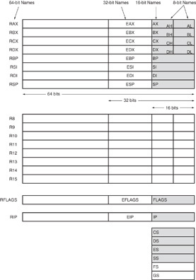
Register Set
Nine 32-bit registers
(4) Data registers- EAX, EBX, ECX, EDX, can be used as 32, 16 or 8bit
(2) Pointer registers- EBP, ESP
(2) Index registers- ESI, EDI
(1) Instruction pointer- EIP
Six 16-bit registers
(6) Segment registers- CS, DS, SS, ES, FS, GS
Flags (status) register-EFLAGS

Slide 16
Register Set
64-bit extensions
Added with Pentium 4
Data/pointer/index/IP/ flag register extended to 64 bits
For example:
RAX = 64-bit register A
RSP = 64-bit stack pointer
8 additional data registers (R8-R15)

Slide 17
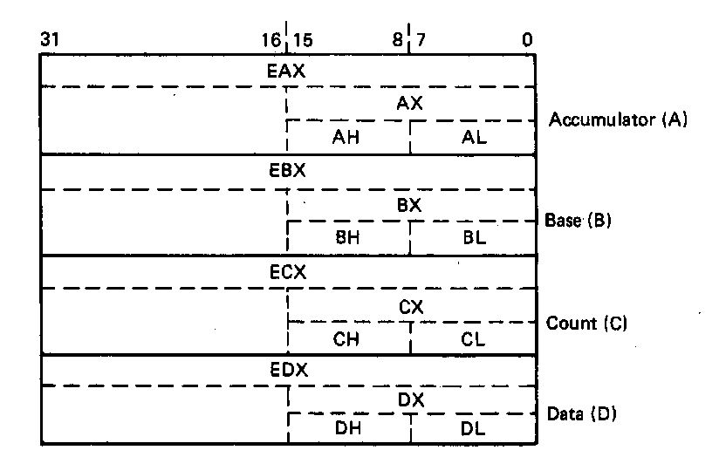
General Purpose Data Registers
Four general purpose data registers
Accumulator (A) register
Base (B) register
Count (C) register
Data (D) register
Can hold 8-bit, 16-bit, or 32-bit data
AH/AL = high and low byte value
AX = word value
EAX = double word value
General uses:
Hold data such as source or destination operands for most operations—ADD, AND, SHL
Hold address pointers for accessing memory
Some also have dedicated special uses
C—count for loop,
B—table look-up translations, base address
D—indirect I/O and string I/O

Slide 18
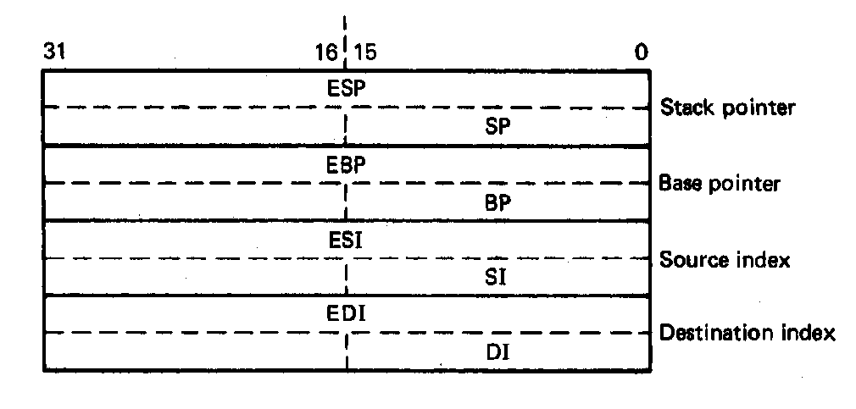
Pointer Registers
Two pointer registers
Stack pointer register
ESP = 32-bit extended stack pointer
SP = 16-bit stack pointer
Points to top of stack
Base pointer register
EBP = 32-bit extended base pointer
BP = 16-bit base pointer
Points to fixed location within current stack frame

Slide 19
Index Registers
Source index register
ESI = 32-bit source index register
SI = 16-bit source index register
Destination index registers
EDI = 32-bit destination index register
DI = 16-bit destination index register
Typically used to access source and destination operands

Slide 20
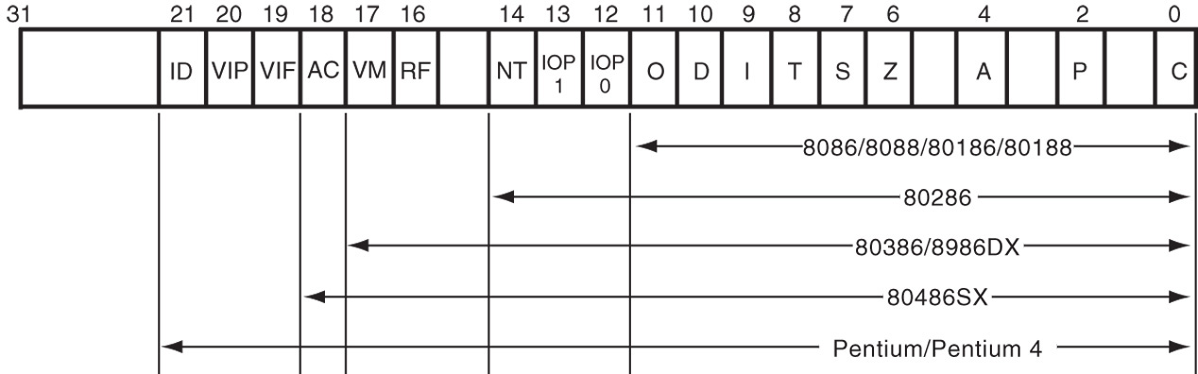
Flags Register
32-bit register holding single bit status and control information
9 active flags in real mode
Two categories
Status flags: conditions resulting from instruction
Most instructions update status
Used as test conditions
Control flags: control processor functions
Used by software to turn on/off operating capabilities

Slide 21
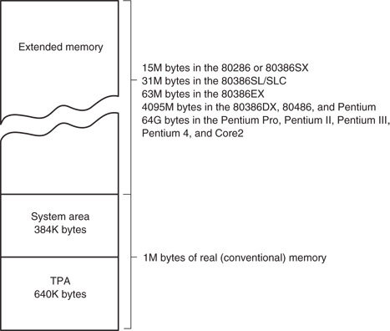
x86 memory spaces
x86 architecture implements independent memory and input/output (not shown) address spaces
Memory address space
1 MB “real” memory
System + transient program area (TPA)
Extended memory size dependent on processor
Input/output address space- 65,536 bytes long (64KB)

Slide 22
x86 memory modes
Two general modes of access
Real mode (DOS)
Protected mode (Windows)
Two memory models
Segmented memory model
Flat memory model
We’ll use this model

Slide 23
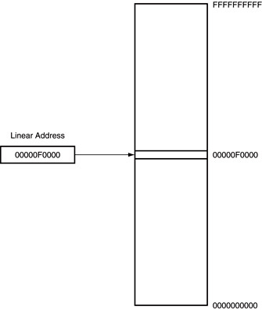
Flat mode addressing
No segmentation
Entire address space active
Address generated by instruction = linear address being accessed
Generates 40-bit external address

Slide 24
Final notes
Next time:
Assembly programming basics
Reminders:
Sign up for the discussion group on Piazza
HW 1 to be posted this week; due date TBD

