Slide 1
EECE.2160 ECE Application Programming
Instructors:
Dr. Michael Geiger & Peilong Li
Spring 2016
Lecture 12:
For loops

Slide 2
Lecture outline
Announcements/reminders
Exams to be returned Wednesday or Friday
Program 2 grading done; regrades due 3/4
Program 4 due 2/29
Today’s lecture
For loops

Slide 3
Iterative methods (Program 4)
Repeat calculation until correct value reached
“Correctness” defined as:
Difference between old, new value <= max error
Max error == .000001 in Prog. 4
General process:
newVal = <initial value>;
do {
oldVal = newVal;
newVal = <equation based on oldVal>;
} while (fabs(newVal – oldVal) > max_err);
You can’t use <math.h>, so you’ll need your own way of computing absolute value (fabs())

Slide 4
Justifying for loops
Common loop structure
Initialize variable
Loop until that variable reaches certain limit
At end of each iteration, change variable by fixed amount
Example: squares program
i = 0;
while (i <= 10) {
iSquared = i * i;
printf("%2d%10d\n", i, iSquared);
i = i + 1;
}

Slide 5
for loops
for loops include all three aspects in one construct
Form:
for (<init var>; <test>; <change var>)
<statements>
<init var> is basic assignment
<test> same type of condition as if, while
<change var> change variable by fixed amount
Example: for (i = 0; i < 20; i++)
… You may be wondering what i++ means

Slide 6
Changing variables
Can do operation + assignment w/one operator
Simply adding/subtracting 1:
x++ → x = x + 1 (post-increment)
x-- → x = x – 1 (post-decrement)
++x → x = x + 1 (pre-increment)
--x → x = x – 1 (pre-decrement)
Augmented assignment: change variable by amount other than 1
x += y → x = x + y
x -= y → x = x – y
x *= y → x = x * y
x /= y → x = x / y

Slide 7
Pre- vs. post-increment/decrement
Pre-increment/decrement: perform increment/ decrement, then evaluate expression
Post-increment/decrement: evaluate expression, then perform increment/decrement
Example: what does the following print?
int n = 5;
printf(“n = %d\n”, ++n);
printf(“Now, n = %d\n”, n++);
printf(“Finally, n = %d\n”, n);

Slide 8
Example soln.
int n = 5;
printf(“n = %d\n”, ++n);
printf(“Now, n = %d\n”, n++);
printf(“Finally, n = %d\n”, n);
Output:
n = 6 (n pre-incremented)
Now, n = 6 (n post-incremented)
Finally, n = 7 (Shows effect of n++)

Slide 9
Simple usage of for loop
Common sequence of code:
x=0; while (x<12) { printf("%d ",x); x++; }
Output:
0 1 2 3 4 5 6 7 8 9 10 11

Slide 10
Intro to for loops
Common sequence of code:
x=0; while (x<12) { printf("%d ",x); x++; }
Equivalent for construct
for (x=0 ; x<12 ; x++ ) { printf("%d ",x); }
Initial value
Test condition
Body of loop (may be 0, 1, or several statements)
End of loop change

Slide 11
Repetition with for loop
Rewriting squares program with loop
int main() {
int i; // Number to square
int iSquared; // Square of the number
printf(" i i^2\n"); // Column headings
// Compute and display the squares of numbers 0 to 10
for (i = 0; i <= 10; i++) { // Loop until i > 10
iSquared = i * i;
printf("%2d%10d\n", i, iSquared);
}
return 0;
}

Slide 12
Repetition with for loop (cont.)
Generalizing program:
int main() {
int i; // Number to square
int iSquared; // Square of the number
int iStart; // Initial value
int iStop; // Last value
int iStep; // Increment
printf(“Enter start, stop, and increment: “);
scanf(“%d %d %d”, &iStart, &iStop, &iStep);
printf(" i i^2\n"); // Column headings
// Compute and display the squares of numbers iStart to iStop
// with increment iStep
for (i = iStart; i <= iStop; i += iStep) {
iSquared = i * i;
printf("%2d%10d\n", i, iSquared);
}
return 0;
}

Slide 13
Example: for loops
What does each of the following print?
for (i=5; i<40; i+=8) { printf("%d ", i); }
for (i=10; i<=100; i=i+10) { if (i%20) printf("%d ", i); }
for (i=-5; i<-10; i--) { printf("%d ", i); }
for (i=5; i<10; i+=i%2) { printf("%d ", i++); }

Slide 14
Example solution
What does each of the following print?
for (i=5; i<40; i+=8) { printf("%d ", i); }
OUTPUT: 5 13 21 29 37
for (i=10; i<=100; i=i+10) { if (i%20) printf("%d ", i); }
OUTPUT: 10 30 50 70 90
for (i=-5; i<-10; i--) { printf("%d ", i); }
OUTPUT: No output
for (i=5; i<10; i+=i%2) { printf("%d ", i++); }
OUTPUT: 5 6 8

Slide 15
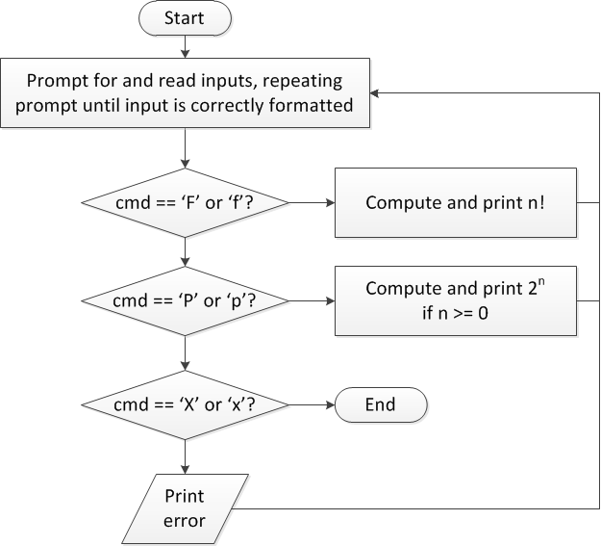
Finishing PE2: overall flow (review)

Slide 16
Finishing PE2: next steps
Write flowcharts for
Computing n!
Computing 2^{n} if n >= 0
Complete code

Slide 17
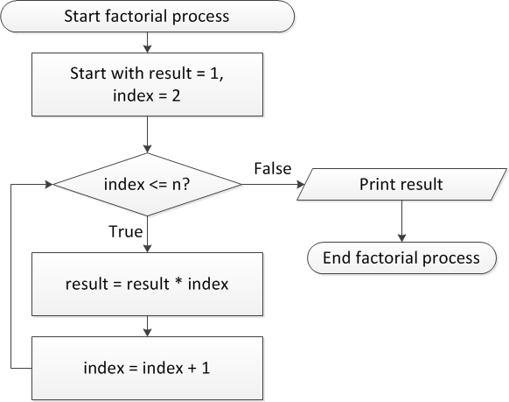
Flow charts: Calculating n!

Slide 18
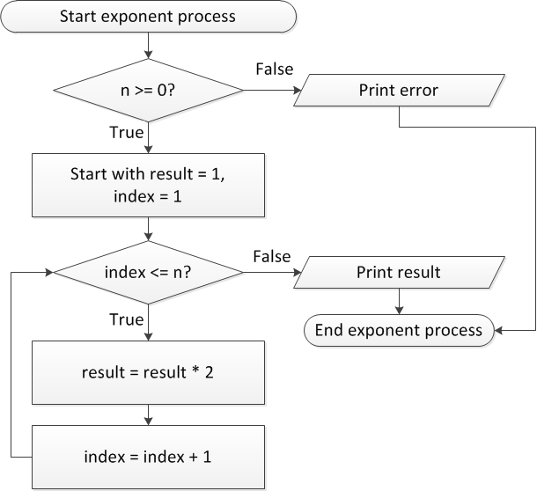
Flow charts: Calculating 2^{n}

Slide 19
Discussion: Factorial/2^{n}
Loop for each process covers fixed range of values
Use for loop
Can declare single variable to hold both results, since only one will be calculated

Slide 20
Code: factorial
result = 1;
for (i = n; i > 1; i--) {
result *= i;
}
printf("%d! = %d\n", n, result);
Slightly different approach than flow chart
Counts down instead of counting up
No benefit to doing one over the other

Slide 21
Code: 2^{n}
if (n < 0)
printf("Error: bad n value\n");
else {
result = 1;
for (i = 0; i < n; i++) {
result *= 2;
}
printf("2^%d = %d\n", n, result);
}

Slide 22
Final notes
Next time
Exams to be returned Wednesday or Friday
Functions (either Wednesday or Friday)
Reminders:
Exams to be returned Wednesday or Friday
Program 2 grading done; regrades due 3/4
Program 4 due 2/29

