Slide 1
EECE.3170 Microprocessor Systems Design I
Instructor: Dr. Michael Geiger
Spring 2016
Lecture 12:
Conditional execution

Slide 2
Lecture outline
Announcements/reminders
Exams to be returned Wednesday or Friday
HW 4 to be posted; due date TBD
Today’s lecture
Conditional execution

Slide 3
Compare Instructions
Compare 2 values; store result in ZF/SF
General format: CMP D,S
Works by performing subtraction (D) – (S)
D, S unchanged
ZF/SF/OF indicate result (signed values)
ZF = 1 → D == S
ZF = 0, (SF XOR OF) = 1 → D < S
ZF = 0, (SF XOR OF) = 0 → D > S
Notes:
(D) (S) result CF SF AF
AX BX
2345>1234 0 0 0
1234<2345 1 1 1
1234>ABCD 1 0 1
ABCD<1234 0 1 0
ABCD>A000 0 0 0
A000<ABCD 1 1 1
7FFF 8000 overflow

Slide 4
Condition codes
Conditional execution: result depends on value of flag bit(s)
Intel instructions specify condition codes
Condition code implies certain flag values
Opcodes written with cc as part of name
cc can be replaced by any valid code
Examples: CMOVcc, SETcc, Jcc
Specific examples: CMOVE, SETL, SETZ, JNE, JG

Slide 5
Condition codes (cont.)
Testing overflow
O (OF = 1), NO (OF =0)
Testing carry flag
C (CF = 1)
NC (CF = 0)
Testing sign flag
S (SF = 1), NS (SF = 0)
Testing parity flag
P or PE (PF = 1)
NP or PO (PF = 0)

Slide 6
Condition codes (cont.)
Testing equality/zero result
E or Z (ZF = 1)
NE or NZ (ZF = 0)
Signed comparison
L or NGE (SF XOR OF = 1)
NL or GE (SF XOR OF = 0)
LE or NG ((SF XOR OF) OR ZF = 1)
NLE or G ((SF XOR OF) OR ZF = 0)
Unsigned comparison
“Below” → less than, “above” → greater than
B, NAE (CF = 1)
NB, AE (CF = 0)
BE or NA (CF OR ZF = 1)
NBE or A (CF OR ZF = 0)

Slide 7
Conditional move (CMOV)
Only in Pentium Pro & later
Perform move only if condition is true
Examples:
CMOVZ AX, [SI] → move if ZF == 1
CMOVG EBX, EAX → move if greater than

Slide 8
Byte Set on Condition Instruction
Byte set on condition instruction
Used to set byte based on condition code
Can be used for boolean results—complex conditions
General format:
SETcc D
cc = one of the supported conditional relationships
Result
D = 01h if condition true
D = 00h if condition false

Slide 9
Byte Set on Condition Instruction
Operation: Flags tested for conditions defined by “cc” and the destination in a register or memory updated as follows
If cc test True:
00000001₂ = 01H → D
If cc test False:
00000000₂ = 00H → D
Examples of conditional tests:
SETE = set byte if equal → ZF = 1
SETC = set byte if carry → CF =1
SETBE = set byte if below or equal → CF = 1 +(or) ZF = 1
Example: SETA AL = set byte if above
if CF = 0 • (and) ZF = 0
(AL) = 01H
Otherwise,
(AL) =00H

Slide 10
Example
Show the results of the following instructions, assuming that
“A” = (100H) = 0001H
“B” = (102H) = 0003H
“C” = (104H) = 1011H
“D” = (106H) = 1011H
“E” = (108H) = ABCDH
“F” = (10AH) = DCBAH
What complex condition does this sequence test?
MOV AX, [100H]
CMP AX, [102H]
SETLE BL
MOV AX, [104H]
CMP AX, [106H]
SETE BH
AND BL, BH
MOV AX, [108H]
CMP AX, [10AH]
SETNE BH
OR BL, BH

Slide 11
Example solution
Condition being tested:
To simplify, treat each word as a variable named “A” through “F”
((A <= B) && (C == D)) || (E != F)
Source: http://www.arl.wustl.edu/~lockwood/class/cs306/books/artofasm/Chapter_6/CH06-4.html

Slide 12
Jump instructions
Used to change flow of program
Next instruction specified by operand
Two general types
Unconditional: JMP <target>
Always goes to address indicated by <target>
Conditional: Jcc <target>
Jump only occurs if condition true
cc replaced by valid condition code
Most codes discussed in previous lecture
Additional codes: CXZ/ECXZ
→ CX/ECX register is zero

Slide 13
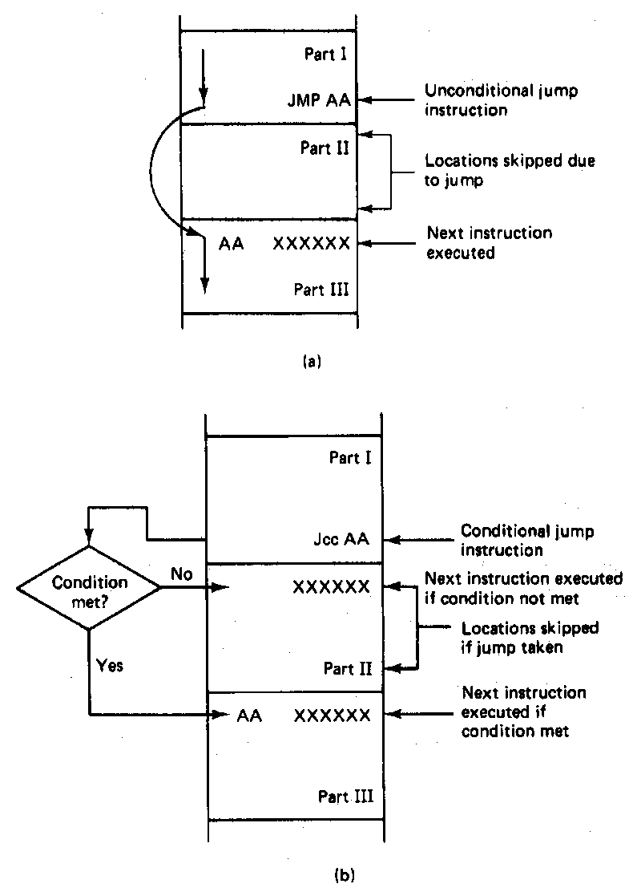
Jump Instructions

Slide 14
Example: program structure 1
Given the instructions below, what are the resulting register values if:
AX = 0010H, BX = 0010H
AX = 1234H, BX = 4321H
What type of high-level program structure does this sequence demonstrate?
Instructions
CMP AX, BX
JE L1
ADD AX, 1
JMP L2
L1: SUB AX, 1
L2: MOV [100H], AX

Slide 15
Example solution
First case: AX = BX = 0010H
CMP AX, BX → Shows AX == BX
JE L1 → Cond. true—jump to L1
ADD AX, 1
JMP L2
L1: SUB AX, 1 → AX = AX – 1 = 000F
L2: MOV [100H], AX → Store 000F at DS:100H

Slide 16
Example solution (cont.)
Second case: AX = 1234H, BX = 4321H
CMP AX, BX → Shows AX < BX
JE L1 → Cond. false—no jump
ADD AX, 1 → AX = AX + 1 = 1235H
JMP L2
L1: SUB AX, 1 → AX = AX – 1 = 000F
L2: MOV [100H], AX → Store 000F at DS:100H

Slide 17
Example solution (cont.)
High-level program structure: if/else statement
If part: compare + jump (if (AX == BX))
Else part: what follows if condition false
Unconditional jump used to skip “if” part
Both parts have same exit (L2)

Slide 18
Example: program structure 2
Given the instructions below, what are the resulting register values if, initially, AX = 0001H?
What type of high-level program structure does this sequence demonstrate?
Instructions
MOV CL, 5
L: SHL AX, 1
DEC CL
JNZ L

Slide 19
Example: program structure 3
Given the instructions below, what are the resulting register values if, initially, AX = 0001H?
What type of high-level program structure does this sequence demonstrate?
Instructions
MOV CX, 5
L: JCXZ END
ADD AX, AX
DEC CX
JMP L
END: MOV [10H], AX

Slide 20
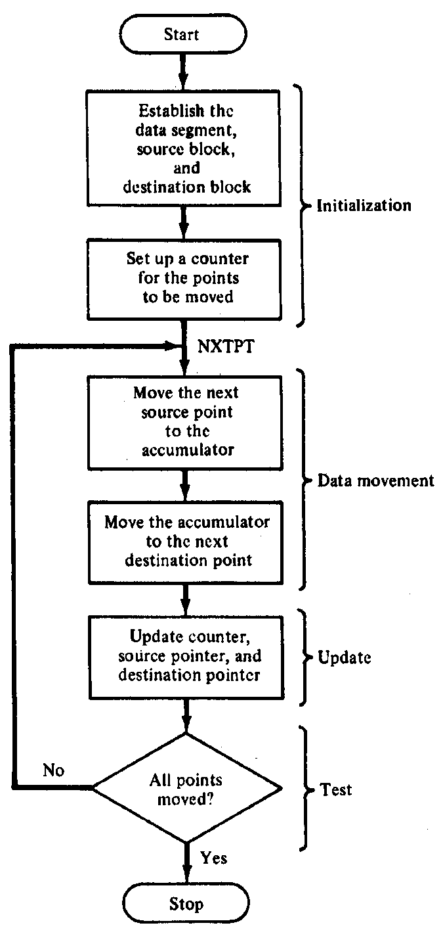
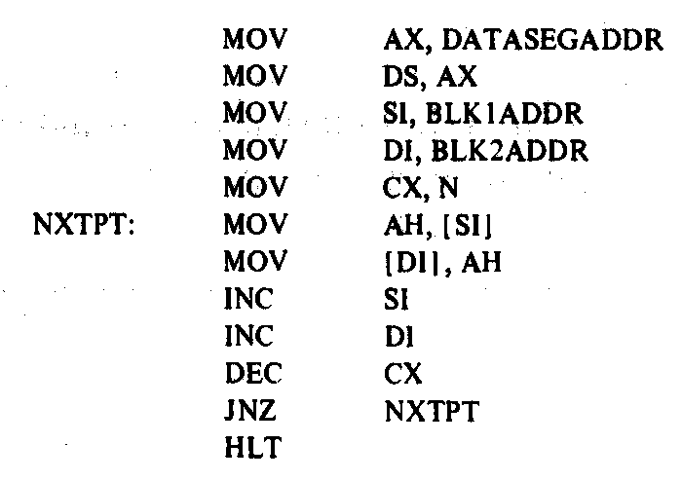
Block Move Program

Slide 21
Loop instructions
Common operations in basic loops
Compare
Conditional jump
Decrement loop counter (CX)
Loop instructions combine all into one op
All decrement CX by 1, then check if CX == 0
<target> must be short-label (8-bit immediate)
LOOP <target>: Return to <target> if CX != 0
LOOPE/LOOPZ <target>: Return to <target> if (CX != 0) && (ZF == 1)
LOOPNE/LOOPNZ <target>: Return to <target> if (CX != 0) && (ZF != 1)

Slide 22
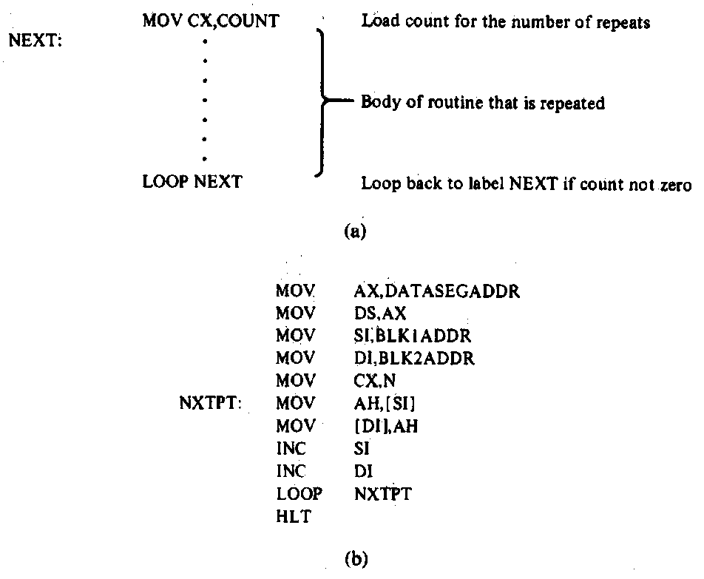
Loop Program Structure
Structure of a loop
CX = initial count
Loop body: code to be repeated
Loop instruction– determines if loop is complete or if the body is to repeat
Example: block move

Slide 23
Loop example 1
Rewrite the post-tested loop seen earlier using a loop instruction:
MOV CL, 5
L: SHL AX, 1
DEC CL
JNZ L
Solution:
MOV CL, 5
L: SHL AX, 1
LOOP L

Slide 24
Loop example 2
Describe the operation of the following program (Example 6.15-6.16).
What is the final value of ESI if the 15 bytes between 0A001 and 0A00F have the following values?
00 01 02 03 04 05 06 07 08 09 0A 0B 0C 0D 0E
MOV DL, 05
MOV EAX, 0000A000h
MOV ESI, 00000000h
MOV CX, 000F
AGAIN:INC SI
CMP [EAX + ESI], DL
LOOPNE AGAIN

Slide 25
Final notes
Next time:
Exams to be returned Wednesday or Friday
Subroutines (on whatever day I don’t return exams)
Reminders:
HW 4 to be posted; due date TBD

