Slide 1
EECE.3170 Microprocessor Systems Design I
Instructor: Dr. Michael Geiger
Spring 2016
Lecture 1:
Course overview
Role of ISA
Data types, storage, and addressing

Slide 2
Lecture outline
Announcements
HW 1 due 1:00 PM, 5/19
Exam 3: 6/23 instead of 6/27?
Lecture outline
Course overview
General microprocessor introduction
Role of the instruction set architecture

Slide 3
Course meeting times
Lectures:
Section 011: MWTh 10:30-12:50, Kitson 302
Typo in SiS has class running until 1:50
Lab: Not required; will get access to Ball 424

Slide 4
Course instructors
Instructor: Dr. Michael Geiger
E-mail: Michael_Geiger@uml.edu
Phone: 978-934-3618 (x43618 on campus)
Office: 118A Perry Hall
Office hours: TBD
Most likely: stick around to answer questions right after lecture
Available by appointment at other times

Slide 5
Course materials
Textbook: Barry B. Brey, The Intel Microprocessors: Architecture Programming, and Interfacing, 2008, Prentice Hall.
ISBN: 0135026458
Only covers first part of course; not required
Course website: http://mjgeiger.github.io/eece3170/sum16/index.htm
Will contain lecture slides, handouts, assignments
Discussion group through piazza.com
Allow common questions to be answered for everyone
All course announcements will be posted here
Will use as class mailing list—please enroll ASAP

Slide 6
Additional course policies
Prerequisites
16.216 (ECE Application Programming)
16.265 (Logic Design)
Assignments
Homework, labs, and some “hybrid” assignments (problems + programming exercise(s))
Late assignments: 10% penalty per day
All HW individual unless otherwise specified
Some assignments require instructor “check-off”

Slide 7
Academic honesty
All assignments are to be done individually unless explicitly specified otherwise by the instructor
Any copied solutions, whether from another student or an outside source, are subject to penalty
You may discuss general topics or help one another with specific errors, but not share assignment solutions
Must acknowledge assistance from classmate in submission

Slide 8
Course “rules”
A couple of unofficial rules:
Please call me “Dr. Geiger”
“Professor Geiger” is okay (although I’m technically not a professor, I’m a lecturer)
“Michael,” “Mike,” or “Geiger” is not okay
Please don’t talk when I’m talking
Doing so distracts your classmates and me
If you have a question, please raise your hand and ask—I want questions during lecture!

Slide 9
Course policies (cont.)
Grading breakdown
Assignments: 55%
Exam 1: 15%
Exam 2: 15%
Exam 3: 15%
Exam dates
Exam 1: Thursday, May 26 in class
Exam 2: Monday, June 13 in class
Exam 3: Thursday, June 23 (preferred) -or- Monday, June 27

Slide 10
What you should learn in this class
Basics of computers vs. microprocessors
Two major aspects:
How to program
Focus on assembly language
Will look at HLL → assembly translation, integration
Use of HLL with microcontrollers
How a microprocessor works with other components
Focus on interfacing circuits and control schemes
Will work with two (three?) processor families:
Intel x86 architecture → assembly language simulation
PIC microcontroller → actual microcontroller programming, interfacing
· To understand the interconnection of the CPU, memory, and I/O

Slide 11
Tentative course outline
General microprocessor introduction
Assembly language programming
Start with x86; introduce PIC microcontroller about halfway
Areas will include
Addressing modes
Instruction types
Programming modes
HLL and assembly—translation; combination
External interfacing
Processor signals used in interfacing
Interface circuitry
External memory
Interrupts
Microcontroller-based systems
Microcontrollers vs. microprocessors
Design of microcontroller-based circuits
High-level programming of microcontrollers

Slide 12
What is a computer?
From The American Heritage Dictionary:
“One who computes”
We could argue that people are computers
“A device that computes, especially a programmable electronic machine that performs high-speed mathematical or logical operations or that assembles, stores, correlates, or otherwise processes information.”
Anything from a simple abacus to the microprocessor-based computers of today

Slide 13
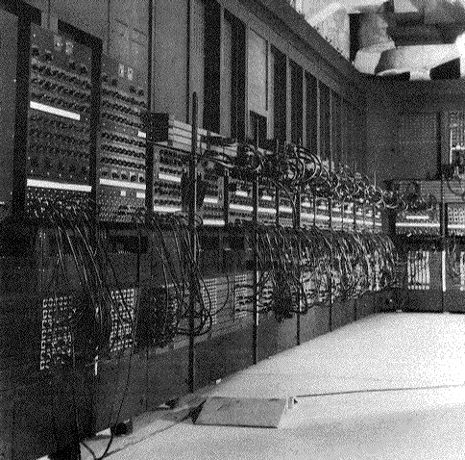
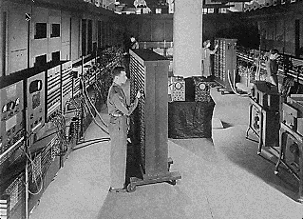
Computing history
Thirty tons
Forced air cooling
200KW
19,000 vacuum tubes
Punch card
Manual wiring
Numerical computation
The first electronic digital computer – ENIAC, built in UPenn in 1946
Source: http://ei.cs.vt.edu/~history/ENIAC.Richey.HTML

Slide 14
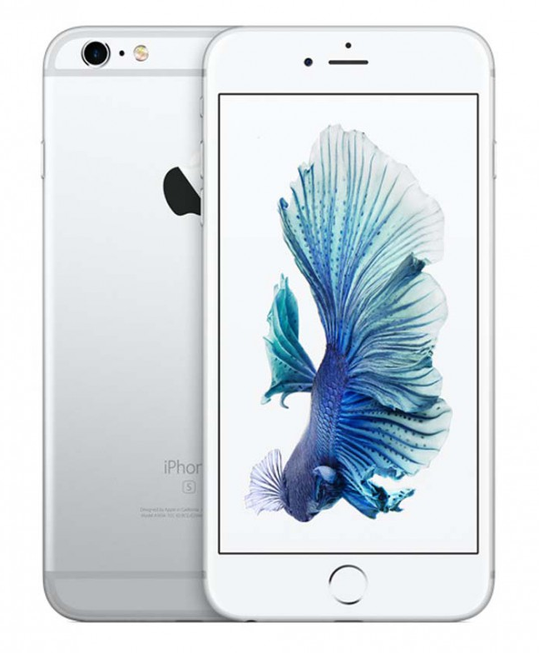
Today’s computer: one example
iPhone 6s Technical Specifications
(the 6s Plus wouldn’t fit on the slide)
Screen size 4.7 inches
Screen resolution 1334 by 750 at 326 ppi
Input method Multi-touch
Operating system iOS 9.3.1
Storage 16 / 64 / 128 GB
Cellular network UMTS/GSM/CDMA
Wireless data Wi-Fi (802.11a/b/g/n/ac) +
LTE + Bluetooth 4.2 + NFC
Camera 12.0 megapixels
Battery Up to 11 hrs Internet,
14 hrs talk,
11 hrs video, 50 hrs audio,
10 days standby
Dimensions 5.44 x 2.64 x 0.28 inches
Weight 5.04 ounces
Source: http://www.apple.com/iphone-6s/specs/

Slide 15
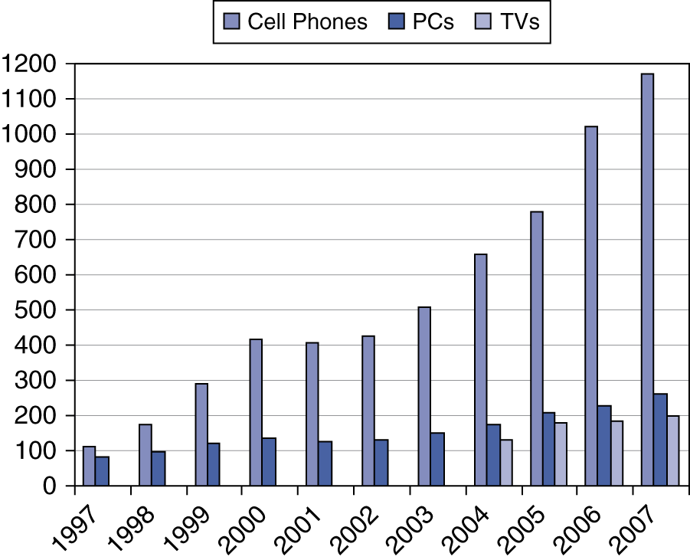
Processor market (as of 2007)
“Computer” used to just refer to PCs
Processors—and, therefore, computers—are now everywhere

Slide 16
Computer components
What are the key components of a computer?
Microprocessor (MPU/CPU) performs computation
Input to read data from external devices
Examples: Keyboard, mouse, ports (Ethernet, USB, etc.)
Output to transmit data to external devices
Examples: screen, speaker, VGA interface, ports (Ethernet, USB, etc.)
Storage to hold program code and data
RAM, hard disk, possibly other media (CD/DVD, external drive)
Power supply
Will see that microprocessor contains smaller-scale versions of these components
Computation engine
I/O interface
Internal storage

Slide 17
Processor architecture
“Architecture” can refer to
High-level description of hardware; could be
Overall system
Microprocessor
Subsystem within processor
Operations available to programmer
Instruction set architecture
Other applications to computing (e.g., “software architecture”) we won’t discuss
Commonly used to discuss functional units and how they work together

Slide 18
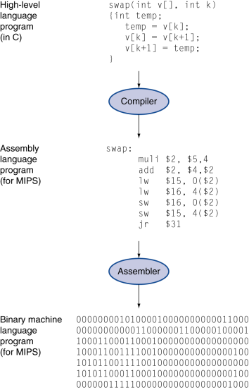
Role of the ISA
User writes high-level language (HLL) program
Compiler converts HLL program into assembly for the particular instruction set architecture (ISA)
Assembler converts assembly into machine language (bits) for that ISA
Resulting machine language program is loaded into memory and run

Slide 19
Abstraction of program control
Easiest for humans to understand high-level languages
Processor interprets machine language
Assembly language: abstraction with intermediate level of detail
Breaks machine code into instructions
Gives some insight into how each instruction behaves
More readable than bit patterns!

Slide 20
ISA design
Think about a HLL statement like
X[i] = i * 2;
ISA defines how such statements are translated to machine code
What information is needed?

Slide 21
ISA design (cont.)
Think about a HLL statement like
X[i] = i * 2;
Questions answered in every ISA (or “software model”)
How will the processor implement this statement?
What operations are available?
How many operands does each instruction use?
Where are X[i] and i?
How do we reference the operands?
What type(s) of data are X[i] and i?
What types of operands are supported?
How big are those operands?
Instruction format issues
How many bits per instruction?
What does each bit or set of bits represent?
Are all instructions the same length?

Slide 22
Operation types
Operations: what should processor be able to do?
Data transfer
Move data between storage locations
Arithmetic operations
Typical: add, subtract, maybe multiply/divide, negation
Logical operations
Typical: AND, OR, NOT, XOR
Often includes bit manipulation: shifts, rotates, test/set/clear single bit
Program control
“Jump” to another part of program
May be based on condition
Used to implement loops, conditionals, function call/return
Typically some processor-specific special purpose ops

Slide 23
Operands
Two major questions when dealing with data
“How” do we store them? → what do the bits represent?
Where do we store them?
… and how do we access those locations?
First question deals with data types
Second question deals with data storage and addressing

Slide 24
Data types
Also seen in high-level languages
Think about C types: int, double, char, etc.
What does a data type specify?
How big is each piece of data?
How do we interpret the bits representing those data?
Data sizes
Smallest addressable unit: byte (8 bits)
Can also deal with multi-byte data: 16, 32, 64 bits
Often deal with words of data
Word size processor-dependent (16 bits on x86, 32 bits on MIPS)
Can have double words, quad words, half words …
Interpreting bits
Numbers: Integers, floating-point; signed vs. unsigned
May treat as characters, other special formats

Slide 25
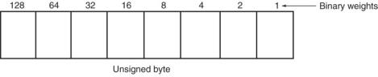
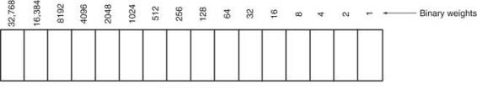
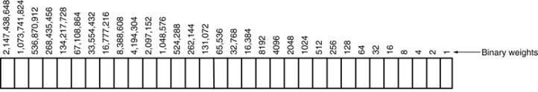
Unsigned Integers
Types:
Sizes Range
8-bit 0H → 255₁₀
16-bit 0H → 65,535₁₀
32-bit 0H → 4,294,967,295₁₀

Slide 26
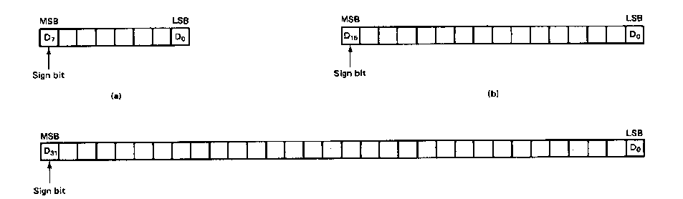
Signed Integers
MSB is sign bit ( 0/1 -> +/-)
Remaining bits represent value
Negative numbers expressed in 2’s complement notation
Types:
Sizes Range
8-bit -128 → +127
16-bit -32,768 → +32,767
32-bit -2,147,483,648 → +2,147,483,647

Slide 27
Integer Examples
Given the 8-bit value: 1001 1111₂
Calculate the decimal value of this integer as
An unsigned integer
A signed integer

Slide 28
Integer example solution
Given the 8-bit value: 1001 1111₂
Calculate the decimal value of this integer as
An unsigned integer
Solution:
(1 x 2⁷) + (1 x 2⁴) + (1 x 2³) + (1 x 2²) + (1 x 2¹) + (1 x 2⁰)
= 128 + 16 + 8 + 4 + 2 + 1 = 159
A signed integer
Solution:
MSB = 1 → negative value
To get magnitude, take 2’s complement:
0110 0001₂ = (1 x 2⁶) + (1 x 2⁵) + (1 x 2⁰)
= 64 + 32 + 1 = 97
→ Result = -97

Slide 29
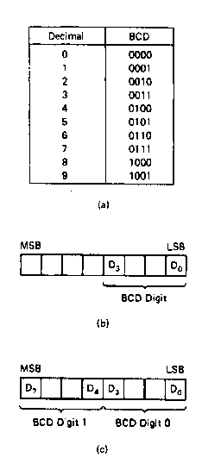
BCD Numbers
Direct coding of numbers as binary coded decimal (BCD) numbers supported
Unpacked BCD [Fig.2.10(b)]
Lower four bits contain a digit of a BCD number
Upper four bits filled with zeros (zero filled)
Packed BCD [Fig. 2.10(c)]
Lower significant BCD digit held in lower 4 bits of byte
More significant BCD digit held in upper 4 bits of byte
Example: Packed BCD byte at address 01000H is 10010001₂, what is the decimal number?
Organizing as BCD digits gives,
1001_{BCD} 0001_{BCD} = 91₁₀

Slide 30
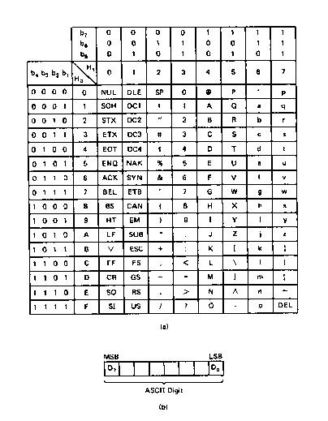
ASCII Data
American Code for Information Interchange (ASCII) code
ASCII information storage in memory
Coded one character per byte
7 LS-bits = b₇b₆b₅b₄b₃b₂b₁
MS-bit filled with 0
Example: Addresses 01100H-01104H contain ASCII coded data 01000001, 01010011, 01000011, 01001001, and 01001001, respectively. What does the data stand for?
0 100 0001_{ASCII} = A
0 101 0011_{ASCI} = S
0 100 0011_{ASCII} = C
0 100 1001_{ASCII} = I
0 100 1001_{ASCII} = I

Slide 31
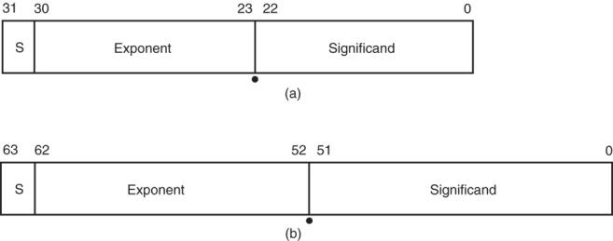
Real Numbers
Floating-point data stored in two parts
Significand (fraction)
Exponent
Single-precision (32 bits) or double-precision (64 bits)

Slide 32
Data storage
What characteristics do we want storage media to have?
Two primary answers
Speed
Capacity
Very difficult to get both in single storage unit
Processors use two different types of storage
Registers
Memory

Slide 33
Registers
Small, fast set of storage locations close to processor core (execution engine)
Primarily used for computation, short-term storage
Speed → ideal for individual operations
Lack of capacity → will frequently overwrite
Reference registers by name
Example: ADD EAX, EBX → EAX = EAX + EBX
EAX, EBX are registers in x86 architecture

Slide 34
Memory
Provides enough capacity for all code, data (possibly I/O as well)
Typically organized as hierarchy
Used primarily for long-term storage
Lacks speed of registers
Provides capacity to ensure data not overwritten
Reference memory by address
Example: MOV EAX, [100h]
→ EAX = memory at address [100h]

Slide 35
Memory (continued)
Accessing single byte is easy
Considerations with multi-byte data
Are the data aligned?
Easier/faster to access aligned data
How are the data organized in memory (“endianness”)?
Given 32-bit number: DEADBEEFh or 0xDEADBEEF
Which byte—MSB (0xDE) or LSB (0xEF) gets stored in memory first?

Slide 36
Aligned Words, Double words
Aligned word
Aligned data: address is divisible by # of bytes
2 bytes → address must be even
4 bytes → address must be multiple of 4
x86 architecture doesn’t require aligned data access
Performance impact for accessing unaligned data in memory (32-bit data bus)
Byte address
0
4
8
12
16
20
Aligned double word
Unaligned
word
Unaligned
double
word

Slide 37
Byte order (“endianness”)
In a multi-byte operand, how are the bytes ordered in memory?
Assume the double word value 1,000,000 (0x000F4240) is stored at address 80
In a little-endian ISA (like x86), the least significant byte (the “little” end) is at address 80
In a big-endian ISA (like MIPS), it’s the other way around
 |  | 40 | 42 | 0F | 00
… | 79 | 80 | 81 | 82 | 83 | 84 | …
 |  | 00 | 0F | 42 | 40
… | 79 | 80 | 81 | 82 | 83 | 84 | …

Slide 38
Examples
Given the following memory contents:
Starting address of each line shown on left
Leftmost byte has lowest address
First line: addresses 0x200C, 0x200D, 0x200E, 0x200F
What is the value of:
The word starting at address 0x200D?
The double word starting at address 0x2012?
Are these data aligned?
 | Lo |  |  | Hi
0x200C | 40 | 96 | 2C | 00
0x2010 | 55 | 12 | CD | AB
0x2014 | 01 | 23 | 88 | 99

Slide 39
Solution
 | Lo |  |  | Hi
0x200C | 40 | 96 | 2C | 00
0x2010 | 55 | 12 | CD | AB
0x2014 | 01 | 23 | 88 | 99
Word at 0x200D = 0x2C96
Address is not divisible by 2 → unaligned
Double word at 0x2012 = 0x2301ABCD
Address is not divisible by 4 → unaligned
Remember, hexadecimal is base 16—0x12 = 18₁₀

Slide 40
Final notes
Next time:
x86 introduction
Assembly basics
Data transfer instructions
Reminders:
HW 1 due 1:00 PM, 5/19
Sign up for the discussion group on Piazza

