Slide 1
16.216 ECE Application Programming
Instructors:
Dr. Michael Geiger & Nasibeh Nasiri
Fall 2015
Lecture 17:
More on pointer arguments

Slide 2
Lecture outline
Announcements/reminders
Program 5 due 10/19
Dropbox folder invites sent; contact Dr. Geiger re: issues
Regrades: P2 due Friday, 10/16
Fix file and upload to Dropbox folder
Please do not change file name
E-mail Dr. Geiger to say that you have resubmitted program
Today’s lecture
More on pointers

Slide 3
Review: pointers
Pointer: address of a variable
Can get address of existing object using &
Can get value of existing pointer using *
Can assign pointers of same type to each other
Pointer declaration:
<base type>* <pointer name>
Base type determines how reference is interpreted
Use pointers as function arguments → pass by address

Slide 4
Review: pointer arguments
Functions can only return one value
Arguments passed by value hold copy of value from calling function
Arguments passed by address hold location of variable in calling function
Argument type is pointer (e.g., int *ptr)
Allows function to change multiple values outside its scope
Dereference pointer to access “value being pointed to”: *ptr

Slide 5
Example: pointer arguments
What does the following print?
int f(int *a, int *b);
int main() {
int x = 1;
int y = 2;
int result1, result2, result3;
result1 = f(&x, &y);
result2 = f(&y, &result1);
result3 = f(&result1, &result2);
printf("x = %d, y = %d\n", x, y);
printf("Result 1: %d\n", result1);
printf("Result 2: %d\n", result2);
printf("Result 3: %d\n", result3);
return 0;
}
int f(int *a, int *b)
{
int copyB = *b;
while (*a > 1) {
*b += copyB;
(*a)--;
}
return *b;
}

Slide 6
Example solution
After first call to function
x = 1, y = 2, result1 = 2
After second call to function
y = 1, result1 = 4, result2 = 4
After third call to function
result1 = 1, result2 = 16, result3 = 16
Final output
x = 1, y = 1
Result 1: 1
Result 2: 16
Result 3: 16

Slide 7
Example: writing functions with pointers
Write a function that:
Given two integer arguments, x and y, store the quotient and remainder of x / y into locations specified by arguments q and r, respectively.
Uses pointers to swap the values of two double-precision variables

Slide 8
Example solution
Given two integer arguments, x and y, store the quotient and remainder of x / y into locations specified by arguments q and r, respectively.
void divQR(int x, int y,
int *q, int *r)
{
*q = x / y;
*r = x % y;
}

Slide 9
Example solution (cont.)
Use pointers to swap the values of two double-precision variables
void swap(double *a, double *b)
{
double temp;
temp = *a;
*a = *b;
*b = temp;
}

Slide 10
PE3: Change problem
Given any amount of change under $2.00, determine and print out the minimum number of coins required to make that amount of change.
Available coins are Halves (half dollars), Quarters, Dimes, Nickels, and Pennies.

Slide 11
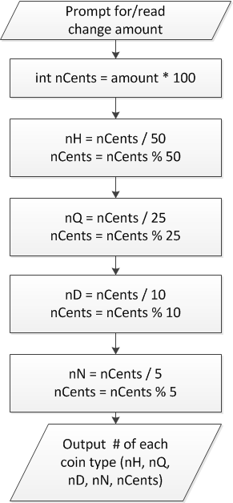
Flowchart
Treat change amount as integer (nCents)
Can now use division & modulus
nCents = # pennies after previous four coin types have been taken out

Slide 12
When to use functions
Find a particular step or series of steps being repeated in your code
If code is exactly the same, you need no arguments
If one or more values change, but actual calculations are the same, values can be function arguments
If function modifies:
1 variable: just return it
2+ variables: use pointer argument(s)
Reassess change example
Steps for creating change are extremely similar
What changes each time?
How should we use those values in a function?
Inputs, outputs, variables … ?

Slide 13
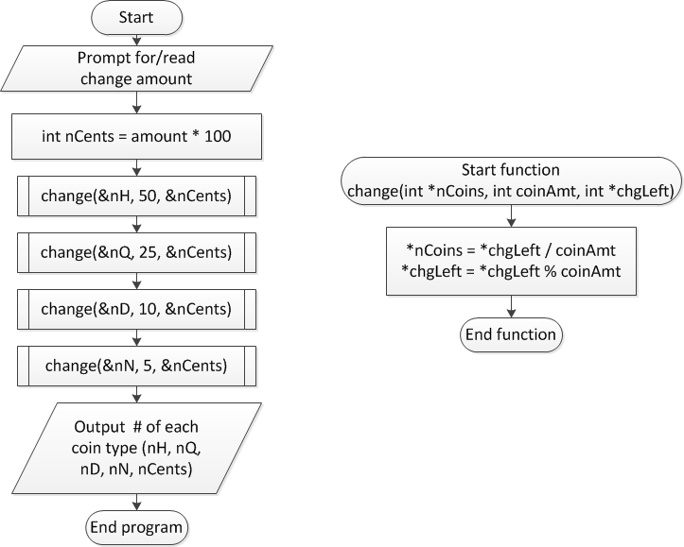
Overall flowchart

Slide 14
Final notes
Next time
Arrays
Reminders:
Program 5 due 10/19
Dropbox folder invites sent; contact Dr. Geiger re: issues
Regrades: P2 due Friday, 10/16
Fix file and upload to Dropbox folder
Please do not change file name
E-mail Dr. Geiger to say that you have resubmitted program

