Slide 1
16.317 Microprocessor Systems Design I
Instructor: Dr. Michael Geiger
Fall 2015
Lecture 19:
PIC microcontroller intro

Slide 2
Lecture outline
Announcements/reminders
HW 3 due Wednesday
HW 4 to be posted; due date TBD
Today’s lecture: PIC microcontroller intro

Slide 3
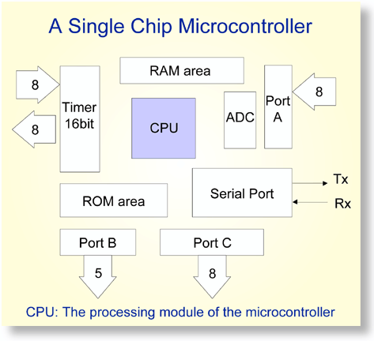
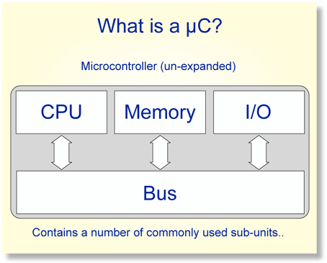
Overview of Microcontrollers
Basically, a microcontroller is a device which integrates a number of the components of a microprocessor system onto a single microchip.
Reference: http://mic.unn.ac.uk/miclearning/modules/micros/ch1/micro01notes.html#1.4

Slide 4
Microcontroller features
Processor
Usually general-purpose but can be app-specific
On-chip memory
Often RAM for data, EEPROM/Flash for code
Integrated peripherals
Common peripherals
Parallel I/O port(s)
Clock generator(s)
Timers/event counters
Special-purpose devices such as:
Analog-to-digital converter (sensor inputs)
Mixed signal components
Serial port + other serial interfaces (SPI, USB)
Ethernet

Slide 5
Microcontroller features
Benefits
Typically low-power/low-cost
Target for embedded applications
Easily programmable
Simple ISAs (RISC processors)
Use of development kits simplifies process
Limitations
Small storage space (registers, memory)
Restricted instruction set
May be required to multiplex pins
Not typically used for high performance

Slide 6
PIC microcontrollers
Manufactured by Microchip Technology
High performance/low cost for embedded applications
Work strictly with 8-bit data*
*unless you’re using one of the newer 16- or 32-bit ones
Varying complexity, characterized by
Interfaces supported
SPI, I²C, Ethernet, etc.
Number of instructions
Anywhere from ~35 to ~80
Amount of internal memory available
Internal modules
Capture, compare, timers, etc.

Slide 7
PIC16F1829
Mid-range PIC microcontroller
49 different instructions
Interrupt capability
Direct, indirect, relative addressing mode
Low Power
650nA @ 32KHz, 1.8V
Peripheral Features
Up to 17 I/O pins with individual direction control
10-bit A/D converter
8/16-bit timer/counters
Special Microcontroller Features
Internal/external oscillator
Power saving sleep mode
High Endurance Flash/EEPROM cell

Slide 8
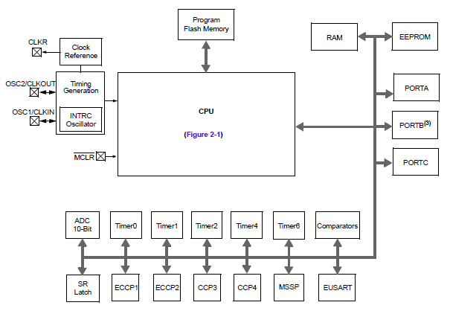
PIC16F1829 Block Diagram

Slide 9
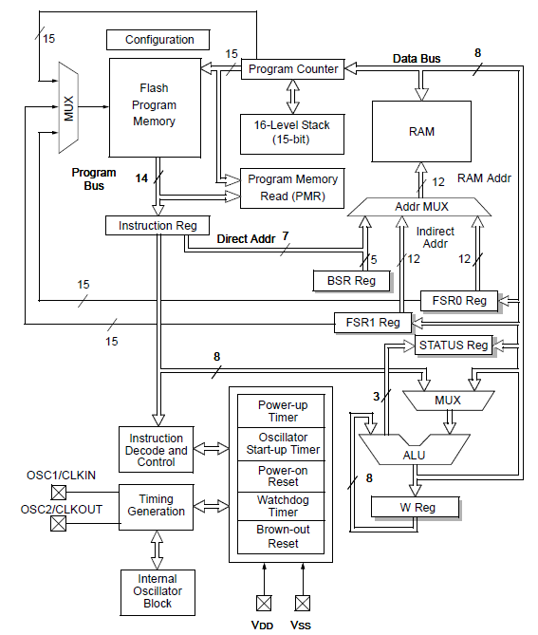
PIC16F1829 CPU Block Diagram

Slide 10
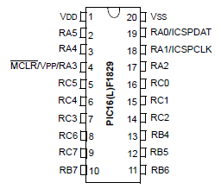
PIC16F1829 Pinout
20 pins
Mostly I/O ports A/B/C
Some pins multiplexed for in circuit debug (ICD)

Slide 11
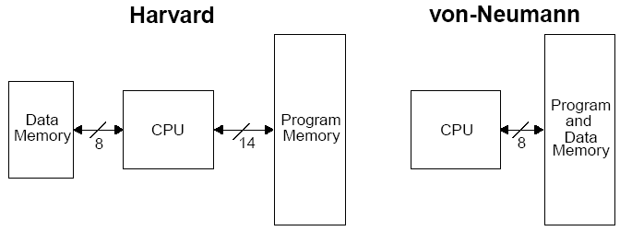
Harvard vs Von Neumann
Organization of program and data memory
PIC MCU technically “modified Harvard architecture”

Slide 12
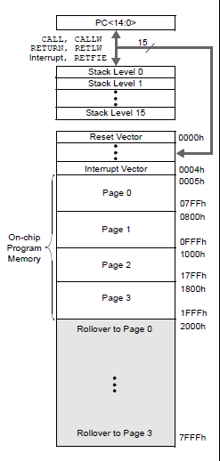
Program Memory Space
15-bit program counter to address 32K locations
Each location is 14-bit wide (instructions are 14 bits long)
RESET vector is 0000h
When the CPU is reset, its PC is automatically cleared to zero.
Interrupt Vector is 0004h
0004h is automatically loaded into the program counter when an interrupt occurs
Vector → address of code to be executed for given interrupt

Slide 13
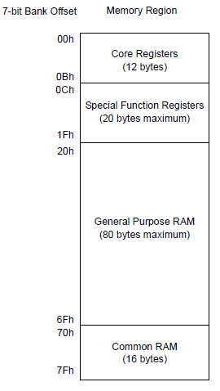
Data Memory Map
Core registers
Affect basic operation of device
Shared across all banks
Special function registers (SFRs)
Control peripheral operations
General purpose registers/RAM (GPRs)
Data storage/scratch pad operations
Common RAM
Same 16 bytes accessible in all banks

Slide 14
Core registers
WREG, the working register
To move values from one register to another register, the value must pass through the W register.
FSR0/FSR1, File Select Register
Indirect data memory addressing pointer
INDF0/INDF1
accessing INDF accesses the location pointed by IRP+FSR
PC, the Program Counter, PCL/PCLATH
BSR, Bank Select Register
Selects which bank of memory is actually being accessed

Slide 15
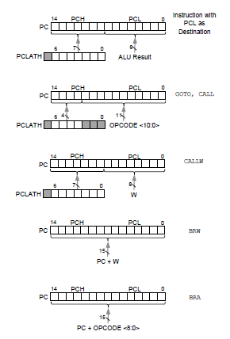
PCL and PCLATH
PC: Program Counter, 15 bits
PCL (02h): 8 bits, the lower 8 bits of PC
PCLATH (0Ah): PC Latch, provides the upper 7 bits of PC when PCL is written
Can change by
Writing PCL directly
Jump (GOTO)
Calling function (CALL, CALLW)
Relative branches (BRA/BRW)

Slide 16

STATUS register
STATUS
NOT_TO: Time Out bit, reset status bit
NOT_PD: Power-Down bit, reset status bit
Z: Zero bit ~ ZF in x86
DC: Digital Carry bit ~ AF in x86
C: Carry bit ~ CF in x86 (note: for subtraction, borrow is opposite)

Slide 17
Stack
16-level deep x 15-bit wide hardware stack
The stack space is not part of either program or data space
The PC is “PUSHed” onto the stack when a CALL instruction is executed, or an interrupt causes a branch.
The stack is “POPed” in the event of a RETURN, RETLW or a RETFIE instruction execution.
However, NO PUSH or POP instructions !
The stack operates as a circular buffer:
After the stack has been PUSHed 16 times, the 17th push overwrites the value that was stored from the first push.
Can track stack overflow/underflow to handle such conitions

Slide 18
Banking
Data memory is partitioned into banks
In this PIC family, each bank holds 128 bytes (max offset = 7Fh)
16F1829 has 32 banks (bank 0-bank 31)
Total data memory: 32 * 128 = 4096 = 4 KB
Overall data memory address: 12 bits
Upper 5 bits: bits 4:0 from BSR (bank select)
To switch banks, simply write new bank number to BSR
Lower 7 bits: bits 6:0 from instruction

Slide 19
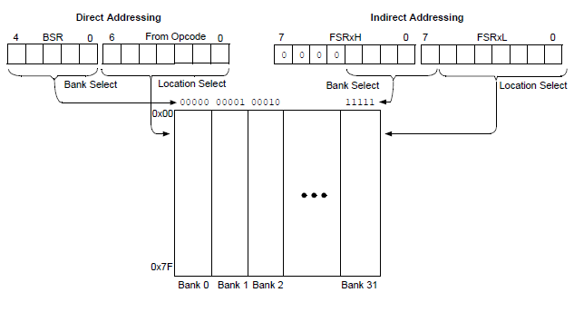
Direct/Indirect Addressing

Slide 20
Final notes
Next time:
Start discussing PIC instruction set
Reminders:
HW 3 due Wednesday
HW 4 to be posted; due date TBD

