Slide 1
EECE.3170 Microprocessor Systems Design I
Instructor: Dr. Michael Geiger
Fall 2016
Lecture 4:
x86 intro

Slide 2
Lecture outline
Announcements/reminders
Sign up for the course discussion group on Piazza
HW 1 posted; due Wednesday, 9/14, 2:00 PM
Bring hard copies to class or leave in envelope on office door (Perry 118A)
E-mail electronic submissions to Dr. Geiger
Please attach only a single file (archives not accepted)
Review
Alignment and endianness
Today’s lecture
Addressing modes
x86 introduction
x86 memory accesses

Slide 3
Review: data storage
Registers
Small, fast set of on-chip storage (primarily for speed)
Referenced by name
Memory
Larger, slower set of storage (primarily for capacity)
Organized as hierarchy …
… but programmer references single range of addresses
Memory issues
Aligned data: address divisible by number of bytes
Endianness: 80x86 data is little endian

Slide 4
Addressing modes
Addressing modes: ways of specifying operand location
Where are operands stored? (3 location types)
Registers → register addressing
Provide name of register; value read from register
Memory
Provide address in memory; value read from that location
Several modes for specifying memory address
In the instruction → immediate addressing

Slide 5
Memory addressing
Instructions accessing memory generate effective address (EA)
Address calculated as part of instruction
EA can be used as
Actual memory address in a simple memory system
Address within a particular segment in a segmented memory architecture
Effective address calculations can involve
A constant value
One or more values stored in registers
Some combination of register and constant

Slide 6
General memory addressing modes
Memory direct addressing
EA = constant value encoded in instruction
Register indirect addressing
EA = value stored in register
Base + displacement addressing
EA = constant displacement + base register(s)
Can have variations of this mode based on number and type of registers
Scaled addressing
EA = base + (scale * index)
Used for array addressing

Slide 7
x86 intro
“x86” → family of general purpose Intel processors
Starts with 8086 processor (1978)
Used (w/extensions) in current processors
Supports use of 8, 16, 32, or 64 bit data
“IA-32”: x86 for 32-bit processors (80386 and later)
“x86-64”: x86 with 64-bit extensions (AMD, Intel, VIA)
“IA-64”: old name for Itanium server architecture (not extension of x86)
Allows both register and memory operands
Segmented or flat memory architecture
Real and protected mode operation
Protected mode supports virtual memory

Slide 8
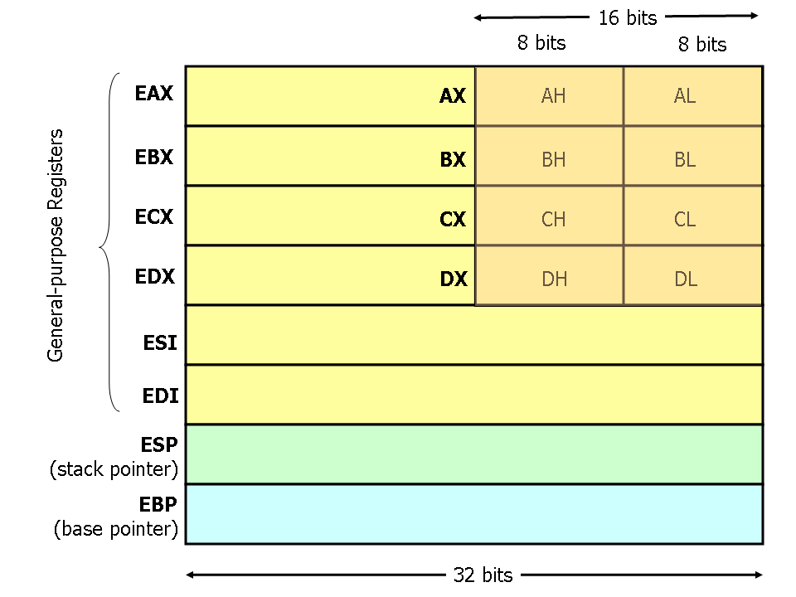
Register Set
Nine 32-bit registers
Data registers- EAX, EBX, ECX, EDX, can be used as 32, 16 or 8bit
Pointer registers- EBP, ESP
Index registers- ESI, EDI
Instruction pointer- EIP (not shown)
Flags (status) register-EFLAGS (not shown)
Source: http://www.cs.virginia.edu/~evans/
cs216/guides/x86.html

Slide 9
Register Set
64-bit extensions added with Pentium 4
Data/pointer/index/IP/ flag register extended to 64 bits
For example:
RAX = 64-bit register A
RSP = 64-bit stack pointer
8 additional data registers (R8-R15)

Slide 10
General Purpose Data Registers
Four general purpose data registers
Accumulator (A) register
Base (B) register
Count (C) register
Data (D) register
Can hold 8-bit, 16-bit, or 32-bit data
AH/AL = high and low byte value
AX = word value
EAX = double word value
General uses:
Hold data such as source or destination operands for most operations—ADD, AND, SHL
Hold address pointers for accessing memory
Some also have dedicated special uses
C—count for loop,
B—table look-up translations, base address
D—indirect I/O and string I/O

Slide 11
Pointer/Index Registers
Two pointer registers (32-/16-bit versions)
Stack pointer register (ESP/SP)
Points to top of stack
Base pointer register (EBP/BP)
Points to fixed location within current stack frame
Two index registers
Source index (ESI/SI)
Destination index (EDI/DI)
Typically used in memory addressing

Slide 12
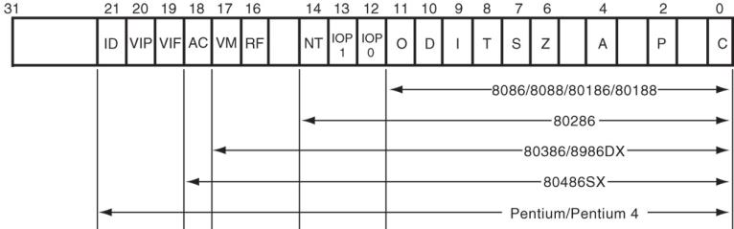
Flags Register
32-bit register holding single bit status and control information
9 active flags in real mode
Two categories
Status flags: conditions resulting from instruction
Most instructions update status
Used as test conditions
Control flags: control processor functions
Used by software to turn on/off operating capabilities

Slide 13
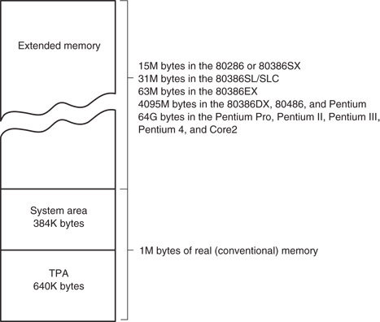
x86 memory spaces
x86 architecture implements independent memory and input/output (not shown) address spaces
Memory address space
1 MB “real” memory
System + transient program area (TPA)
Extended memory size dependent on processor
Input/output address space- 65,536 bytes long (64KB)

Slide 14
x86 memory modes
Two general modes of access
Real mode (DOS)
Protected mode (Windows)
Two memory models
Segmented memory model
Flat memory model
We’ll use this model

Slide 15
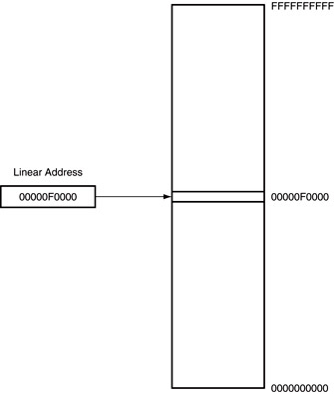
Flat mode addressing
No segmentation
Entire address space active
Address generated by instruction = linear address being accessed
Generates 40-bit external address

Slide 16
x86 addressing modes
Addresses in x86 instructions enclosed by brackets
Addressing modes: all examples of general addressing modes discussed earlier
Direct addressing
EA = constant value
Example: MOV AX, [0100H]
Register indirect addressing
EA = value stored in register
Example: MOV [EDI], AX
Base-plus-index addressing
EA = sum of two registers
Example: MOV AX, [EBX+ESI]

Slide 17
x86 addressing modes (cont.)
Register relative addressing
EA = register + constant
Examples:
MOV CL, [EBX+4]
MOV AX, ARRAY[EBX] ARRAY is constant memory location
Base relative-plus-index addressing
EA = base register + index register + constant
Example: MOV AX, 10H[ESI][EBX] -or-
MOV AX, [10H+SI+BX]
Scaled-index addressing
EA = register + (scaling factor * second register)
Often useful for array accesses
Scaling factor = element size (2, 4, 8 bytes)
Example: MOV EDX, [EAX + 4*EBX]

Slide 18
Example
Compute the address for the memory operand in each of the following instructions.
You do not need to specify what data is transferred
The register contents and variables are as follows:
(ESI) = 00000100₁₆
(EDI) = 00000200₁₆
(EBX) = 00000300₁₆
MOV [EBX+0400h], CX
MOV [EDI+2*EBX], AH
MOV [EBX+EDI+0400h], AL

Slide 19
Example solutions
Memory operand in: MOV [EBX+0400h], CX
Addr = value in EBX + 0400h
= 00000300h + 0400h = 00000700h
Memory operand in: MOV [EDI+2*EBX], AH
Addr = value in EDI + 2 * value in EBX
= 00000200h + 2 * 00000300h
= 00000200h + 00000600h
Memory operand in MOV [EBX+EDI+0400h], AL
Addr = EBX + EDI + 0400h
= 00000300H + 00000200H + 0400h = 00000900h

Slide 20
Final notes
Next time:
Assembly basics
Data transfer instructions
Reminders:
Sign up for the course discussion group on Piazza
HW 1 posted; due Wednesday, 9/14, 2:00 PM
Bring hard copies to class or leave in envelope on office door (Perry 118A)
E-mail electronic submissions to Dr. Geiger
Please attach only a single file (archives not accepted)

