Slide 1
EECE.2160 ECE Application Programming
Instructors:
Dr. Michael Geiger & Dr. Peilong Li
Spring 2017
Lecture 11:
Finishing PE2
For loops

Slide 2
Lecture outline
Announcements/reminders
Program 3 due today
Program 4 due 2/22
TA office hours will be T/Th 10-12 starting next week
Room still to be determined—have Ball 313 reserved 10-11 but nothing for 11-12 yet
Regrade deadline for P1/P2 to be determined
Today’s lecture
Program 4 review
For loops

Slide 3
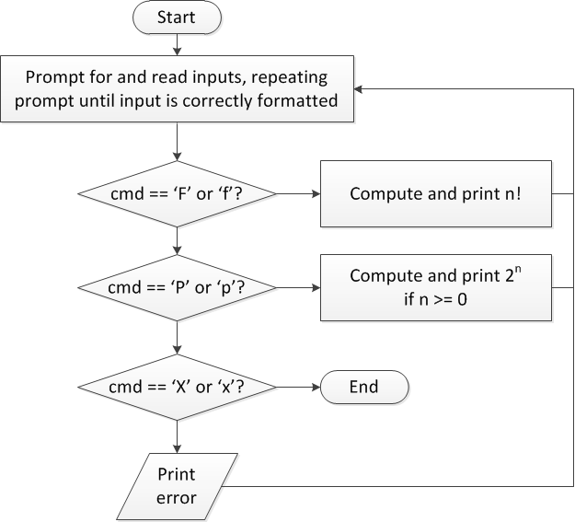
Review: overall flow

Slide 4
Review: overall flow (skeleton code)
while (1) { // Loop repeats until user enters 'X' or 'x'
/* Code to read cmd, n */
/* Evaluate cmd and perform appropriate operation */
switch (cmd) {
case 'F':
case 'f':
/* Calculate n! */
break;
case 'P':
case 'p':
/* Calculate 2^n, if n >= 0; print error otherwise */
break;
case 'X':
case 'x':
return; // Exit program
default:
printf("Invalid command %c entered\n", cmd);
}
}

Slide 5
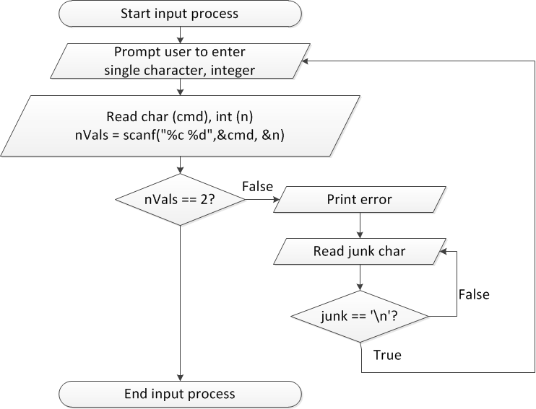
Flow charts: reading input

Slide 6
Discussion: Reading input
Loop that repeats as long as input incorrect
Loop inside that one to handle reading of remainder of line
Read character until you reach end of line
Both while/do-while loops

Slide 7
Code: Reading input
do {
printf("Enter command and integer: ");
nVals = scanf("%c %d", &cmd, &n);
// Otherwise, print error & clear line
if (nVals != 2) {
printf("Incorrectly formatted input\n“);
do {
scanf("%c", &junk);
} while (junk != '\n');
}
} while (nVals != 2);

Slide 8
Input errors
In general, may want to repeat prompt if any error occurs
Logical OR of all error conditions to continue loop
Prioritize error testing—format errors usually first
Why test inputs if they weren’t read correctly?
Example: also test for n < 0 as an error
do {
printf("Enter command and integer: ");
nVals = scanf("%c %d", &cmd, &n);
if (nVals != 2) {
// Handle error
}
else if (n < 0) { ← Test after we know no
// Handle error formatting error
}
} while ((nVals != 2) || (n < 0));

Slide 9
Iterative methods (Program 4)
Repeat calculation until correct value reached
“Correctness” defined as:
Difference between old, new value <= max error
Max error == .000001 in Prog. 4
General process:
newVal = <initial value>;
do {
oldVal = newVal;
newVal = <equation based on oldVal>;
} while (fabs(newVal – oldVal) > max_err);
You can’t use <math.h>, so you’ll need your own way of computing absolute value (fabs())

Slide 10
Justifying for loops
Common loop structure
Initialize variable
Loop until that variable reaches certain limit
At end of each iteration, change variable by fixed amount
Example: squares program
i = 0;
while (i <= 10) {
iSquared = i * i;
printf("%2d%10d\n", i, iSquared);
i = i + 1;
}

Slide 11
for loops
for loops include all three aspects in one construct
Form:
for (<init var>; <test>; <change var>)
<statements>
<init var> is basic assignment
<test> same type of condition as if, while
<change var> change variable by fixed amount
Example: for (i = 0; i < 20; i++)
… You may be wondering what i++ means

Slide 12
Changing variables
Can do operation + assignment w/one operator
Simply adding/subtracting 1:
x++ → x = x + 1 (post-increment)
x-- → x = x – 1 (post-decrement)
++x → x = x + 1 (pre-increment)
--x → x = x – 1 (pre-decrement)
Augmented assignment: change variable by amount other than 1
x += y → x = x + y
x -= y → x = x – y
x *= y → x = x * y
x /= y → x = x / y

Slide 13
Pre- vs. post-increment/decrement
Pre-increment/decrement: perform increment/ decrement, then evaluate expression
Post-increment/decrement: evaluate expression, then perform increment/decrement
Example: what does the following print?
int n = 5;
printf(“n = %d\n”, ++n);
printf(“Now, n = %d\n”, n++);
printf(“Finally, n = %d\n”, n);

Slide 14
Example soln.
int n = 5;
printf(“n = %d\n”, ++n);
printf(“Now, n = %d\n”, n++);
printf(“Finally, n = %d\n”, n);
Output:
n = 6 (n pre-incremented)
Now, n = 6 (n post-incremented)
Finally, n = 7 (Shows effect of n++)

Slide 15
Simple usage of for loop
Common sequence of code:
x=0; while (x<12) { printf("%d ",x); x++; }
Output:
0 1 2 3 4 5 6 7 8 9 10 11

Slide 16
Intro to for loops
Common sequence of code:
x=0; while (x<12) { printf("%d ",x); x++; }
Equivalent for construct
for (x=0 ; x<12 ; x++ ) { printf("%d ",x); }
Initial value
Test condition
Body of loop (may be 0, 1, or several statements)
End of loop change

Slide 17
Repetition with for loop
Rewriting squares program with loop
int main() {
int i; // Number to square
int iSquared; // Square of the number
printf(" i i^2\n"); // Column headings
// Compute and display the squares of numbers 0 to 10
for (i = 0; i <= 10; i++) { // Loop until i > 10
iSquared = i * i;
printf("%2d%10d\n", i, iSquared);
}
return 0;
}

Slide 18
Repetition with for loop (cont.)
Generalizing program:
int main() {
int i; // Number to square
int iSquared; // Square of the number
int iStart; // Initial value
int iStop; // Last value
int iStep; // Increment
printf(“Enter start, stop, and increment: “);
scanf(“%d %d %d”, &iStart, &iStop, &iStep);
printf(" i i^2\n"); // Column headings
// Compute and display the squares of numbers iStart to iStop
// with increment iStep
for (i = iStart; i <= iStop; i += iStep) {
iSquared = i * i;
printf("%2d%10d\n", i, iSquared);
}
return 0;
}

Slide 19
Example: for loops
What does each of the following print?
for (i=5; i<40; i+=8) { printf("%d ", i); }
for (i=10; i<=100; i=i+10) { if (i%20) printf("%d ", i); }
for (i=-5; i<-10; i--) { printf("%d ", i); }
for (i=5; i<10; i+=i%2) { printf("%d ", i++); }

Slide 20
Example solution
What does each of the following print?
for (i=5; i<40; i+=8) { printf("%d ", i); }
OUTPUT: 5 13 21 29 37
for (i=10; i<=100; i=i+10) { if (i%20) printf("%d ", i); }
OUTPUT: 10 30 50 70 90
for (i=-5; i<-10; i--) { printf("%d ", i); }
OUTPUT: No output
for (i=5; i<10; i+=i%2) { printf("%d ", i++); }
OUTPUT: 5 6 8

Slide 21
Finishing PE2: overall flow (review)

Slide 22
Finishing PE2: next steps
Write flowcharts for
Computing n!
Computing 2^{n} if n >= 0
Complete code

Slide 23
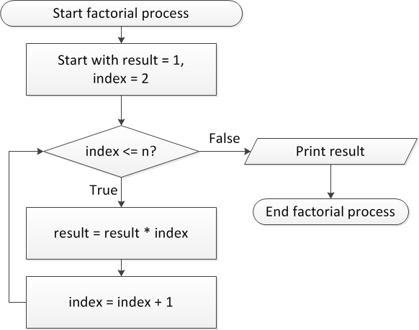
Flow charts: Calculating n!

Slide 24
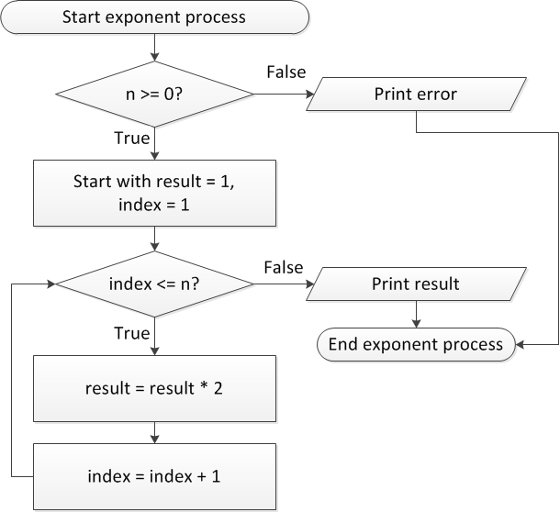
Flow charts: Calculating 2^{n}

Slide 25
Discussion: Factorial/2^{n}
Loop for each process covers fixed range of values
Use for loop
Can declare single variable to hold both results, since only one will be calculated

Slide 26
Code: factorial
result = 1;
for (i = n; i > 1; i--) {
result *= i;
}
printf("%d! = %d\n", n, result);
Slightly different approach than flow chart
Counts down instead of counting up
No benefit to doing one over the other

Slide 27
Code: 2^{n}
if (n < 0)
printf("Error: bad n value\n");
else {
result = 1;
for (i = 0; i < n; i++) {
result *= 2;
}
printf("2^%d = %d\n", n, result);
}

Slide 28
Final notes
Next time
Functions
Return exams
Reminders:
Program 3 due today
Program 4 due 2/22
TA office hours will be T/Th 10-12 starting next week
Room still to be determined—have Ball 313 reserved 10-11 but nothing for 11-12 yet
Regrade deadline for P1/P2 to be determined

