Slide 1
EECE.3170 Microprocessor Systems Design I
Instructor: Dr. Michael Geiger
Summer 2016
Lecture 10:
PIC instruction set (continued)
Exam 2 Preview

Slide 2
Lecture outline
Announcements/reminders
HW 4 due 1:00 PM today
Exam 2: Monday, 6/13
Will again be allowed one 8.5” x 11” note sheet, calculator
Instruction list to be provided
PICkits to be handed out soon
Will have to work in groups (3 students preferred size)
Review
PIC instruction set basics
Data transfers
Bit manipulation instructions
Today’s lecture
Logical instructions
Shift/rotate instructions
Program control instructions

Slide 3
Review: PIC instructions
Four typical instruction formats (+ few special purpose)
Upper bits of all hold opcode
Byte-oriented includes 1 bit destination, 7 bit direct address
Bit-oriented includes 3 bit position (0-7), 7 bit direct address
Literal/control includes 8 bit literal
CALL/GOTO includes 11 bit literal
Variable declarations
cblock <start_address>: start of variable declarations
All names between cblock/endc directives assigned to consecutive bytes starting at <start_address>

Slide 4
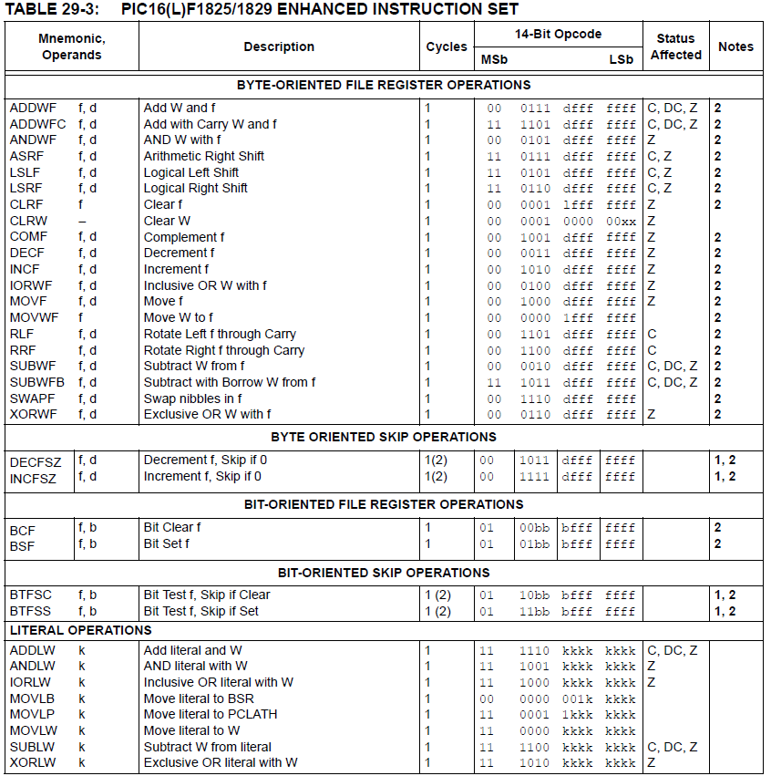

Slide 5
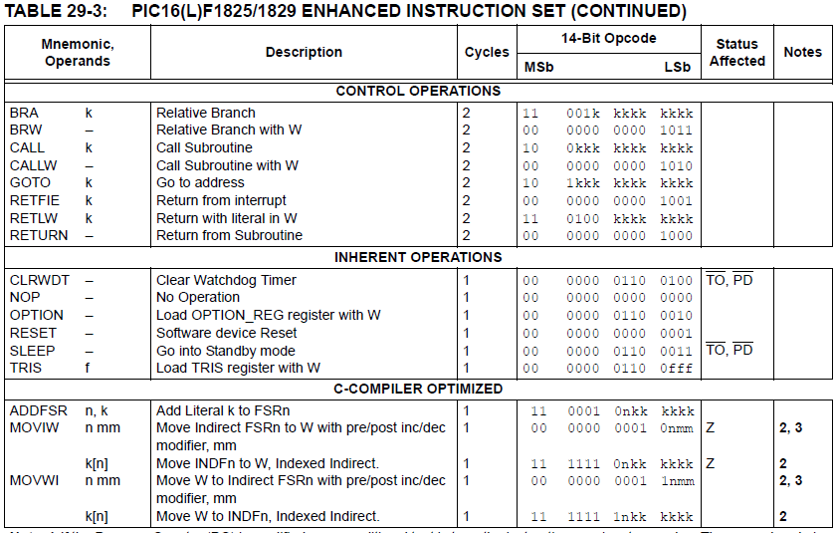

Slide 6
Review: PIC instructions (cont.)
Clearing register: clrw/clrf
Moving values: movlw/movwf/movf
Swap nibbles: swapf
Single bit manipulation: bsf/bcf

Slide 7
Review: Increment/Decrement/ Complement
incf f, F(W) ; increment f, putting result in F or W
decf f, F(W) ;decrement f, putting result in F or W
comf f, F(W) ;complement f, putting result in F or W
STATUS bits:
Z
Examples:
incf TEMP1, F ;Increment TEMP1
incf TEMP1, W ;W <- TEMP1+1; TEMP1 unchanged
decf TEMP1, F ;Decrement TEMP1
comf TEMP1, F ;Change 0s and 1s to 1s and 0s

Slide 8
Review: Addition/Subtraction
addlw k ;add literal value k into W
addwf f, F(W) ;add w and f, putting result in F or W
addwfc f, F(W) ;add w, f, and C, putting result in F or W
sublw k ;subtract W from literal value k, putting
;result in W
subwf f, F(W) ;subtract W from f, putting result in F or W
subwfb f, F(W) ;subtract f – W – (~C), putting result in F or W
STATUS bits:
C, DC, Z
Examples:
addlw 5 ; W = 5+W
addwf TEMP1, F ; TEMP1 = TEMP1+W
sublw 5 ; W = 5-W (not W = W-5 )
subwf TEMP1, F ; TEMP1 = TEMP1 - W

Slide 9
Multi-bit Manipulation
andlw k ; AND literal value k into W
andwf f, F(W) ; AND W with f, putting result in F or W
iorlw k ; Inclusive-OR literal value k into W
iorwf f, F(W) ; Inclusive-OR W with f, putting result in F or W
xorlw k ; Exclusive-OR literal value k into W
xorwf f, F(W) ; Exclusive-OR W with f, putting result in F or W
Examples:
andlw B’00000111’ ;force upper 5 bits of W to zero
andwf TEMP1, F ;TEMP1 <- TEMP1 AND W
andwf TEMP1, W ;W <- TEMP1 AND W
iorlw B’00000111’ ;force lower 3 bits of W to one
iorwf TEMP1, F ;TEMP1 <- TEMP1 OR W
xorlw B’00000111’ ;complement lower 3 bits of W
xorwf TEMP1, W ;W <- TEMP1 XOR W
STATUS bits:
Z

Slide 10
Shift/Rotate
asrf f, F(W) ; copy f into F or W; shift F or W right one bit, keeping
; sign intact; shift LSB into C
lsrf f, F(W) ; copy f into F or W; shift F or W right one bit, shifting
; 0 into MSB; shift LSB into C
lslf f, F(W) ; copy f into F or W; shift F or W left one bit, shifting
; 0 into LSB; shift MSB into C
rlf f, F(W) ; copy f into F or W; rotate F or W left through
; the carry bit
rrf f, F(W) ; copy f into F or W; rotate F or W right through
; the carry bit
STATUS bits:
C

Slide 11
Example
Show the values of all changed registers after the following sequence
Assume the carry bit is initially 0
cblock 0x40
z
endc
clrf z
movlw 0xF0
iorwf z, F
xorlw 0xFF
rrf z, F
andwf z, W
lslf z, F
asrf z, F

Slide 12
Example solution
clrf z → z = 0
movlw 0xF0 → W = 0xF0
iorwf z, F → z = z OR W = 0xF0
xorlw 0xFF → W = W XOR 0xFF
= 0xF0 XOR 0xFF
= 0x0F
rrf z, F → Rotate z right thru carry
Before rotate, (z, carry) = 1111 0000 0₂
→ z = 0111 1000₂ = 0x78, C = 0
andwf z, W → W = z AND W
= 0x78 AND 0x0F = 0x08
lslf z, F → Shift z left
Before shift, z = 0111 1000₂
→ z = 1111 0000₂ = 0xF0, C = 0
asrf z, F → Arithmetic shift right
z = 1111 1000₂ = 0xF8, C = 0

Slide 13
Control flow
STATUS bits:
none
goto label ; Go to labeled instruction
bra label ; Go to labeled instruction
brw ; Relative branch using W as offset
call label ; Call labeled subroutine
callw ; Subroutine call using W as address
return ; Return from subroutine
retlw k ; Return from subroutine, putting literal
; value in W
retfie ; Return from interrupt service routine;
; re-enable interrupts
Examples:
goto There ; Next instruction to be executed is labeled “There”
call Task1 ; Push return address; Next instruction to be
; executed is labeled “Task1”
return ; Pop return address off of stack
retlw 5 ; Pop return address; W <- 5
retfie ; Pop return address; re-enable interrupts

Slide 14
Conditional Execution
Conditional execution in PIC: skip next instruction if condition true
Two general forms
Test bit and skip if bit clear/set
Increment/decrement register and skip if result is 0
STATUS bits:
none
btfsc f, b ;Test bit b of register f, where b=0 to 7, skip if clear
btfss f, b ;Test bit b of register f, where b=0 to 7, skip if set
decfsz f, F(W) ;decrement f, putting result in F or W, skip if zero
incfsz f, F(W) ;increment f, putting result in F or W, skip if zero
Examples:
btfsc TEMP1, 0 ; Skip the next instruction if bit 0 of TEMP1 equals 0
btfss STATUS, C ; Skip the next instruction if C==1
decfsz TEMP1, F ; Decrement TEMP1, skip if TEMP1==0
incfsz TEMP1, W ; W <- TEMP1+1 , skip if W==0 (TEMP1==0xFF)
; Leave TEMP1 unchanged

Slide 15
Example
Show the values of all changed registers after each of the following sequences
What high-level operation does each perform?
(a) movf a, W
sublw 0x1A
btfsc STATUS, Z
goto L1
incf b, W
goto L2
L1
decf b, W
L2
movwf a
(b) movf NUM2, W
subwf NUM1, W
btfss STATUS, C
goto BL
movf NUM1, W
goto Done
BL
movf NUM2, W
Done
movwf MAX

Slide 16
Example solution (part a)
movf a, W → W = a
sublw 0x1A → W = 0x1A – a
btfsc STATUS, Z → Skip goto if result
is non-zero
goto L1 → Goto L1 if result == 0
→ Reach this point if
result non-zero
incf b, W → W = b + 1
goto L2
L1
decf b, W → W = b - 1
L2
movwf a → a = W → value depends
on what’s executed before this
High-level operation:
if (a == 0x1A)
a = b – 1
else
a = b + 1

Slide 17
Example solution (part b)
movf NUM2, W → W = NUM2
subwf NUM1, W → W = NUM1 – W
= NUM1 – NUM2
btfss STATUS, C → Carry indicates borrow of 0
→ if set, NUM1 >= NUM2
goto BL
movf NUM1, W → if (NUM1 >= NUM2)
W = NUM1
goto Done → Skip “below” section
BL
movf NUM2, W → if (NUM1 < NUM2)
W = NUM2
Done
movwf MAX
High-level operation:
if (NUM1 >= NUM2)
MAX = NUM1
else
MAX = NUM2

Slide 18
Exam 2 notes
Allowed
One 8.5” x 11” double-sided sheet of notes
Calculator
No other notes or electronic devices (phone, laptop, etc.)
Exam will last 2 hours and 20 minutes
Covers lectures 6-10
Format similar to previous exam
1 multiple choice question
2-3 short problems to solve/code sequences to evaluate

Slide 19
Review: compare
CMP D, S
Flags show result of (D) – (S)
Condition codes: mnemonics implying certain flag conditions

Slide 20
Review: conditional instructions
Conditional move
Move performed only if condition is true
SETcc D
Sets single byte destination to 1 (01H) if condition true; all 0s (00H) if condition false
Can be used to build up complex conditions

Slide 21
Review: jump, loop
Two general types of jump
Unconditional: JMP <target>
Always go to target address
Conditional: Jcc <target>
Go to target address if condition true
Loop instructions
Combines CX decrement with JNZ test
May add additional required condition
LOOPE/LOOPZ: loop if ((CX != 0) && (ZF == 1))
LOOPNE/LOOPNZ: loop if (CX != 0) && (ZF == 0))

Slide 22
Review: subroutines
Subroutines: low-level functions
When called, address of next instruction saved
Return instruction ends routine; goes to that point
May need to save state on stack
x86 specifics
CALL <proc>: call procedure
<proc> can be label (16-/32-bit imm), reg, mem
RET: return from procedure
Saving state to stack: push instructions
Store data “above” current TOS; decrement SP
Basic PUSH stores word or double word
Directly storing flags: PUSHF
Storing all 16-/32-bit general purpose registers: PUSHA/PUSHAD
Restoring state: POP/POPF/POPA/POPAD

Slide 23
Review: HLL → assembly
Data accesses
Global variables → static; allocated in data segment
Other variables → dynamic; allocated on stack
Stack frame for each function contains (from top)
Saved variables within function
Local variables for function (starting at EBP – 4)
Saved EBP
Saved EIP
Function arguments (starting at EBP + 8)
Conditional statements (if-then-else)
Evaluate condition (CMP instruction(s))
Conditional jump (often to “else” case)
“If” case ends with unconditional jump to skip “else”
Loops
Initialize variable at start
Test loop condition (similar to if)
Change loop variable

Slide 24
Review: PIC instructions
Four typical instruction formats (+ few special purpose)
Upper bits of all hold opcode
Byte-oriented includes 1 bit destination, 7 bit direct address
Bit-oriented includes 3 bit position (0-7), 7 bit direct address
Literal/control includes 8 bit literal
CALL/GOTO includes 11 bit literal
Variable declarations
cblock <start_address>: start of variable declarations
All names between cblock/endc directives assigned to consecutive bytes starting at <start_address>

Slide 27
Review: PIC instructions (cont.)
Clearing register: clrw/clrf
Moving values: movlw/movwf/movf
Swap nibbles: swapf
Single bit manipulation: bsf/bcf
Unary operations: incf/decf/comf
Arithmetic: addlw/addwf/addwfc/
sublw/subwf/subwfb

Slide 28
Review: PIC instructions (cont.)
Logical operations
andlw/andwf
iorlw/iorwf
xorlw/xorwf
Rotates/shifts
rrf/lsrf/asrf
rlf/lslf
Jumps/calls/return
goto/bra
call
return/retlw/retfie
Conditional execution
Test bit and skip next instruction if clear/set: btfsc/btfss
Increment/decrement register and skip next instruction if zero: incfsz/decfsz
Example use: combined with goto to create conditional jump

Slide 29
Final notes
Next time:
Exam 2
Reminders:
HW 4 due 1:00 PM today
Exam 2: Monday, 6/13
Will again be allowed one 8.5” x 11” note sheet, calculator
Instruction list to be provided
PICkits to be handed out soon
Will have to work in groups (3 students preferred size)

