Slide 1
EECE.3170 Microprocessor Systems Design I
Instructor: Dr. Michael Geiger
Spring 2016
Lecture 17
HLL → assembly (continued)

Slide 2
Lecture outline
Announcements/reminders
HW 4 due 1:00 PM, 3/7
HW 5 to be posted; due 3/21
Review: HLL → assembly
Static data
Stack usage with function calls
Today’s lecture
Conditional statements
Loops

Slide 3
Review: HLL → assembly
Global variables → static; allocated in data segment
Other variables → dynamic; allocated on stack
Stack frame for each function contains (from top)
Saved variables within function
Local variables for function (starting at EBP – 4)
Saved EBP
Saved EIP
Function arguments (starting at EBP + 8)

Slide 4
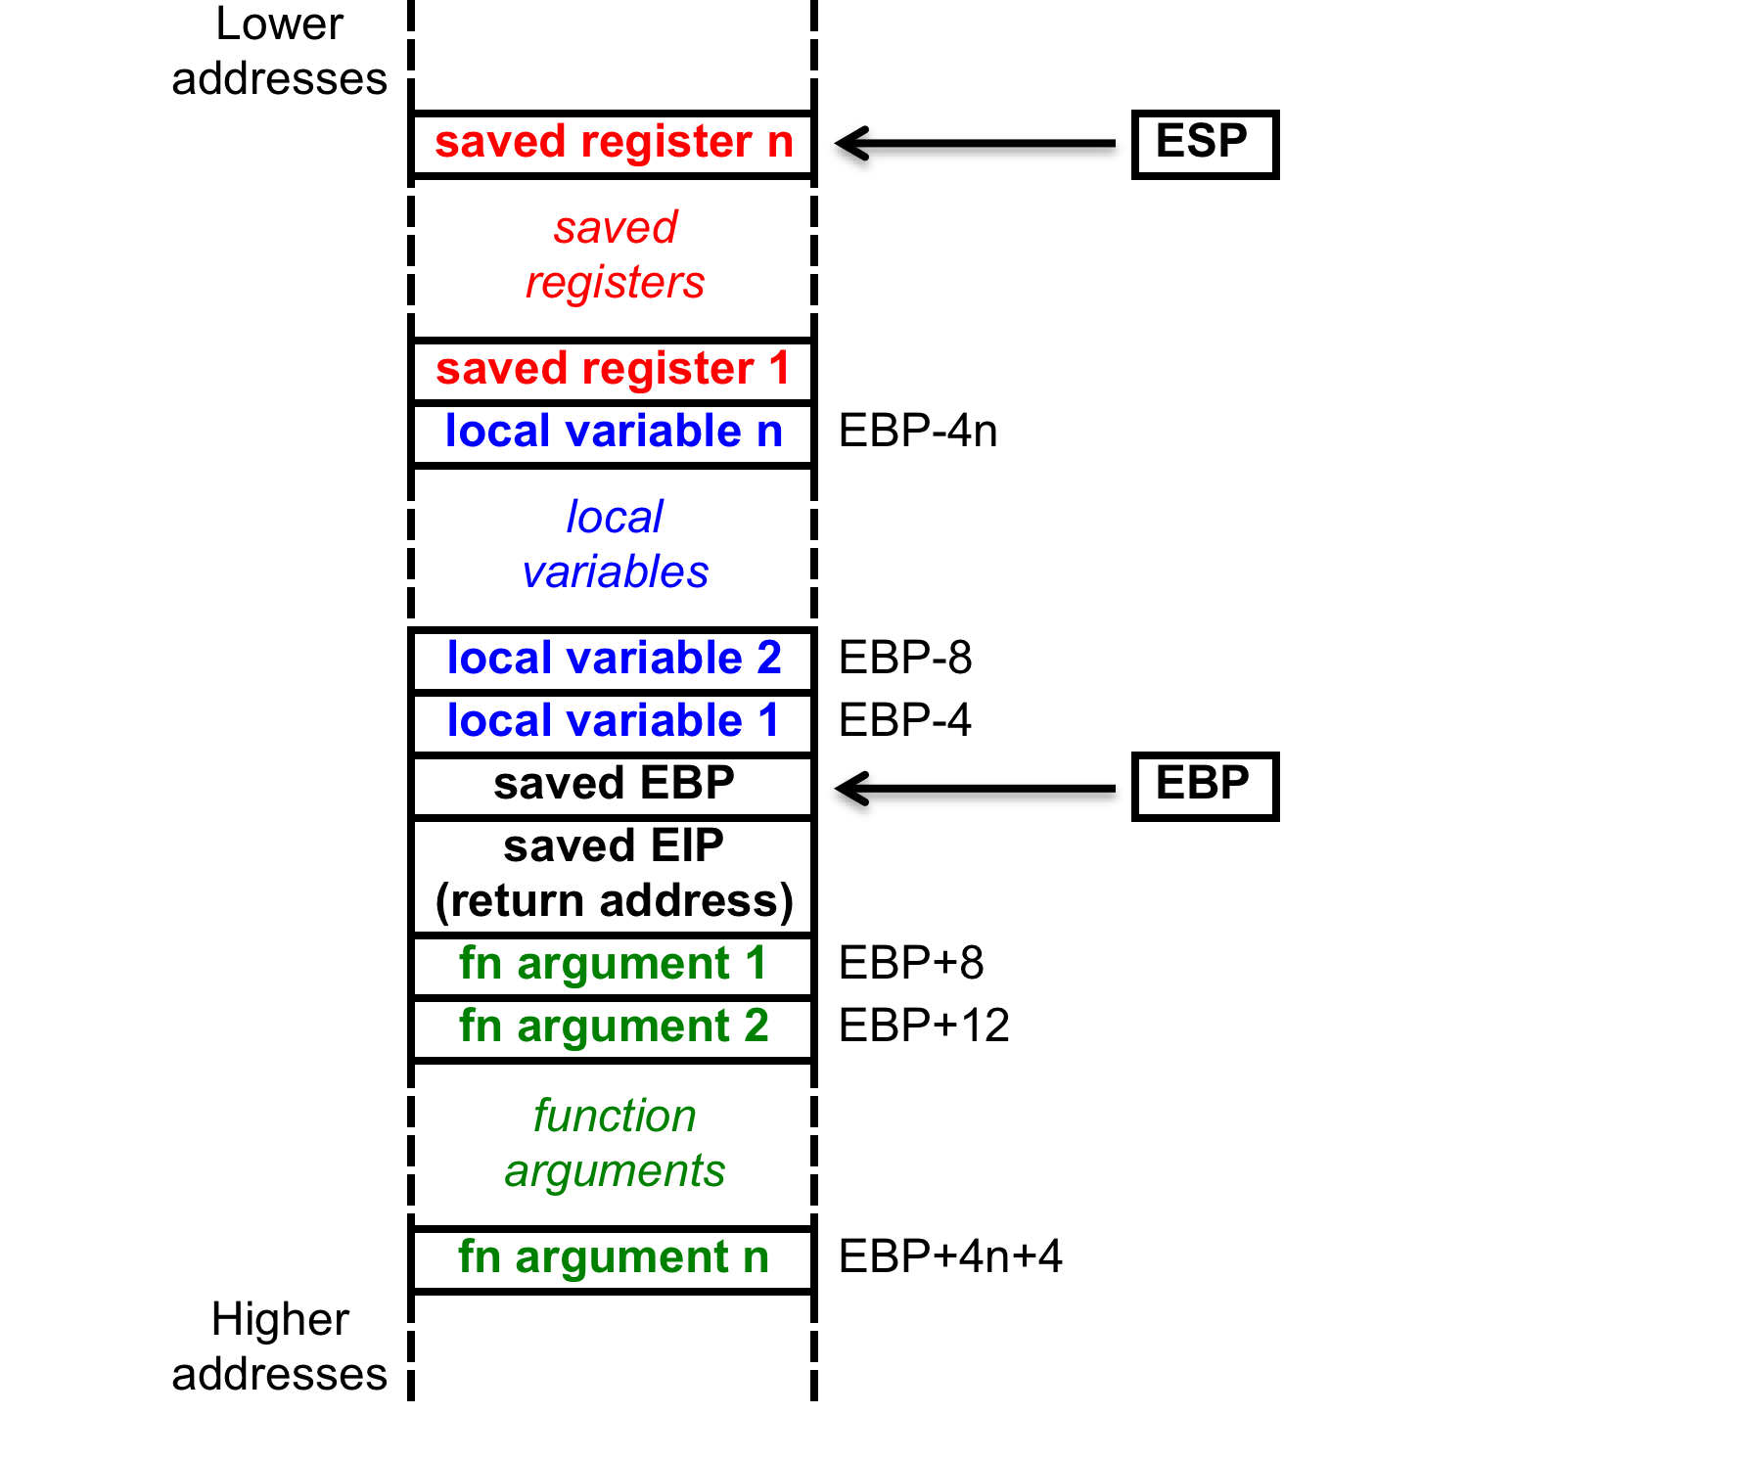
Stack accesses
On function call
SP or ESP: points to current top of stack
Lowest address in current stack frame
BP or EBP: used to reference data within frame
Arguments
Local variables

Slide 5
Stack accesses (cont.)
Arguments start at offset 8 from EBP
Local variables start at offset -4 from EBP
Starting offset of each variable can be defined as symbol
Ex. (testfile1.asm) _j$ = -120; size = 4
_i$ = -108; size = 4
_Y$ = -96; size = 40
_X$ = -48; size = 40
mov DWORD PTR _i$[ebp], 0
→ sets i = 0

Slide 6
Array accesses
To access array element, need
Base address of array
Offset into array
Offset = index * (size of each element)
For example, X[2] is 2*4 = 8 bytes into array X
In some ISAs, need to explicitly calculate this address
Multiply index by element size
Add to base address
x86 uses scaled addressing → multiplication done in memory access
Example: code for X[i] = i * 2 from testfile1:
mov eax, DWORD PTR _i$[ebp]
shl eax, 1
mov ecx, DWORD PTR _i$[ebp]
mov DWORD PTR _X$[ebp+ecx*4], eax

Slide 7
Conditional statements
If-then-else statements typically take form similar to:
<code to evaluate condition>
<conditional jump to else if false>
<code if condition true>
jmp end
else: <code if condition false>
end: …
<code to evaluate condition>
Always requires a conditional branch
Must add label to branch to “else” statement
Once statement for “if” condition is complete, jump past “else” statement
Requires insertion of another label for jump target

Slide 8
Conditional statements (cont.)
Body of inner loop:
if (j < 5)
Y[j] = X[i] + j;
else
Y[j] = X[i] – j;
cmp DWORD PTR _j$[ebp], 5
jge SHORT $LN2@main
mov eax, DWORD PTR _i$[ebp]
mov ecx, DWORD PTR _X$[ebp+eax*4]
add ecx, DWORD PTR _j$[ebp]
mov edx, DWORD PTR _j$[ebp]
mov DWORD PTR _Y$[ebp+edx*4], ecx
jmp SHORT $LN1@main
$LN2@main:
mov eax, DWORD PTR _i$[ebp]
mov ecx, DWORD PTR _X$[ebp+eax*4]
sub ecx, DWORD PTR _j$[ebp]
mov edx, DWORD PTR _j$[ebp]
mov DWORD PTR _Y$[ebp+edx*4], ecx
$LN1@main:

Slide 9
Loops
For loops are essentially three parts
Initializing loop index
Checking boundary condition
Similar idea to if-then-else statements, but simpler
If condition is false, end of loop
Branch to label at first instruction after loop
Usually done at start of loop, since no iterations should occur unless condition is true
End of loop then contains jump back to beginning
Incrementing loop index
While loops only require the boundary condition check

Slide 10
Loops (cont.)
for (j = 0; j < 10; j++) {// inner loop
mov DWORD PTR _j$[ebp], 0
jmp SHORT $LN5@main
$LN4@main:
mov eax, DWORD PTR _j$[ebp]
add eax, 1
mov DWORD PTR _j$[ebp], eax
$LN5@main:
cmp DWORD PTR _j$[ebp], 10
jge SHORT $LN3@main ; jmp to end
.
. ; Loop body here
.
jmp SHORT $LN4@main
$LN3@main:

Slide 11
Final notes
Next time:
HLL → assembly examples
Reminders:
HW 4 due 1:00 PM, 3/7
HW 5 to be posted; due 3/21

