Slide 1
EECE.3170 Microprocessor Systems Design I
Instructor: Dr. Michael Geiger
Fall 2016
Lecture 14:
Subroutines

Slide 2
Lecture outline
Announcements/reminders
HW 4 to be posted; due date TBD
Lecture Tuesday, not Monday
Review
Loop instructions
Today’s lecture
Subroutines
Stack details

Slide 3
Review: Loop instructions
Common operations in basic loops
Compare
Conditional jump
Decrement loop counter (CX)
Loop instructions combine all into one op
All decrement CX by 1, then check if CX == 0
<target> must be short-label (8-bit immediate)
LOOP <target>: Return to <target> if CX != 0
LOOPE/LOOPZ <target>: Return to <target> if
(CX != 0) && (ZF == 1)
LOOPNE/LOOPNZ <target>: Return to <target> if (CX != 0) && (ZF != 1)

Slide 4
Loop example 1
Rewrite the post-tested loop seen earlier using a loop instruction:
MOV CL, 5
L: SHL AX, 1
DEC CL
JNZ L
Solution:
MOV CL, 5
L: SHL AX, 1
LOOP L

Slide 5
Loop example 2
Describe the operation of the following program (Example 6.15-6.16).
What is the final value of ESI if the 15 bytes between 0x0A001 and 0x0A00F have the following values?
00 01 02 03 04 05 06 07 08 09 0A 0B 0C 0D 0E
MOV DL, 05
MOV EAX, 0x0000A000
MOV ESI, 0
MOV CX, 0x000F
AGAIN:INC SI
CMP [EAX + ESI], DL
LOOPNE AGAIN

Slide 6
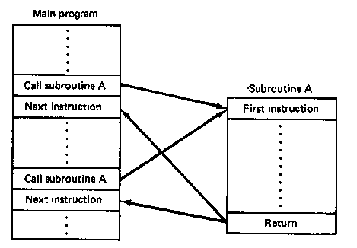
Subroutines
Subroutine: special program segment that can be “called” from any point in program
Implements HLL functions/procedures
Written to perform operation that must be repeated in program
Actual subroutine code only written once

Slide 7
Subroutine operation
When called, address of next instruction saved
State may need to be saved before call
Parameters can be passed
Control of program transferred to subroutine
After subroutine finished, return instruction goes back to saved address

Slide 8
x86 subroutines
Specify starting point with pseudo-op
<name> PROC
May save state/allocate variables at start
If so, will restore at end of subroutine
Last instruction returns to saved address
Always RET
Pseudo-op after RET indicates routine end
<name> ENDP

Slide 9
Subroutine example
SQUARE PROC
PUSH AX ; Save AX to stack
MOV AL, BL ; Copy BL to AL
IMUL BL ; AX = BL * AL
; = original BL squared
MOV BX, AX ; Copy result to BX
POP AX ; Restore AX
RET
SQUARE ENDP

Slide 10
Call/return
Calling subroutine: CALL <proc>
Address of next instruction saved on stack
Either IP or EIP (instruction pointer)
When function ends, use return instruction (RET)
Jumps to saved return address (IP/EIP)

Slide 11
Saving state
May need to save state before routine starts
Overwritten registers (that aren’t return values)
Flags
Placing data on stack: PUSH
Store data “above” current TOS; decrement SP
Stack grows toward lower addresses
New SP points to start of data just stored
Basic PUSH stores word or double word
Directly storing flags: PUSHF
Storing all 16-/32-bit general purpose registers: PUSHA/PUSHAD

Slide 12
Restoring state
Removing data from TOS: POP
Data removed from TOS; SP incremented
Basic POP removes word/double word
Directly removing flags: POPF
Removing all 16-/32-bit general purpose registers: POPA/POPAD
POP instructions generally executed in reverse order of corresponding PUSH instructions

Slide 13
Revisiting subroutine example
SQUARE PROC NEAR
PUSH AX ; Save AX to stack
MOV AL, BL ; Copy BL to AL
IMUL BL ; AL = BL * AL
; = original BL squared
MOV BX, AX ; Copy result to BX
POP AX ; Restore AX
RET
SQUARE ENDP

Slide 14
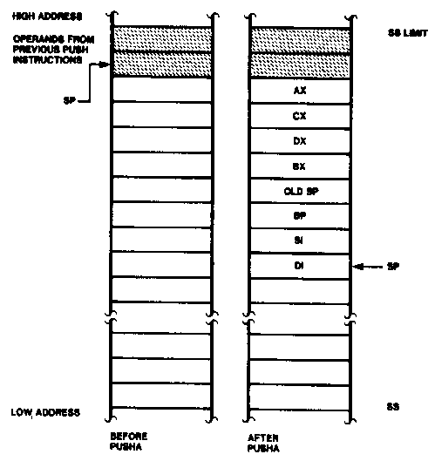
Push All and Pop All Operations

Slide 15
Stack examples
Assume initial state shown in handout
What is the resulting stack state of each of the following sequences?
PUSH BX
PUSH AX
PUSH EBX
PUSH EAX
PUSHA

Slide 16
Solution
What is the resulting stack state of each of the following sequences?
PUSH BX
PUSH AX
4 bytes pushed to stack, so SP decremented by 4 → ESP = 0x00001FFC
AX is at top of stack; BX is below that
PUSH EBX
PUSH EAX
8 bytes pushed to stack, so SP decremented by 8 → ESP = 0x00001FF8
EAX is at top of stack; EBX is below that
PUSHA
8 words = 16 bytes pushed to stack, so SP decremented by 16 → ESP = 0x00001FF0
As shown in slide 13, DI is at top of stack, followed by SI, BP, old SP, BX, DX, CX, and AX

Slide 17
Final notes
Next time (Tuesday, 10/11):
Exam 1 Review
HLL → assembly
Announcements/reminders
HW 4 to be posted; due date TBD

