Slide 1
EECE.3170 Microprocessor Systems Design I
Instructor: Dr. Michael Geiger
Fall 2016
Lecture 1:
Course overview
General microprocessor introduction

Slide 2
Lecture outline
Course overview
Instructor information
Course materials
Course policies
Resources
Tentative course outline
General microprocessor introduction
History
Role of the instruction set architecture

Slide 3
Course meeting times
Lectures:
Section 201: MWF 8-8:50, Pasteur 301
Lab: Not required; will get access to Ball 424

Slide 4
Course instructors
Primary Instructor: Dr. Michael Geiger
E-mail: Michael_Geiger@uml.edu
Phone: 978-934-3618 (x43618 on campus)
Office: 118A Perry Hall
Office hours: M 9-10:30, W 9-10:30, Th 1:30-3
Student questions are top priority during these hours
Will also be in office MW 10:30-11:45, F 9-11:45
Available by appointment at other times
TA: Xin Ma
E-mail: Xin_Ma@student.uml.edu
Office hours: TBD

Slide 5
Course materials
Textbook: None
Will post relevant online resources on schedule page
Course website: http://mjgeiger.github.io/eece3170/f16/index.htm
Will contain lecture slides, handouts, assignments
Discussion group through piazza.com
Allow common questions to be answered for everyone
All course announcements will be posted here
Will use as class mailing list—please enroll ASAP

Slide 6
Additional course policies
Prerequisites
EECE.2160 (ECE Application Programming)
EECE.2650 (Logic Design)
Assignments
Homework, labs, and some “hybrid” assignments (problems + programming exercise(s))
Late assignments: 10% penalty per day
All HW individual unless otherwise specified
Some assignments require instructor “check-off”

Slide 7
Academic honesty
All assignments are to be done individually unless explicitly specified otherwise by the instructor
Any copied solutions, whether from another student or an outside source, are subject to penalty
You may discuss general topics or help one another with specific errors, but not share assignment solutions
Must acknowledge assistance from classmate in submission

Slide 8
Course “rules”
A couple of unofficial rules:
Please call me “Dr. Geiger”
“Professor Geiger” is okay (although I’m technically not a professor, I’m a lecturer)
“Michael,” “Mike,” or “Geiger” is not okay
Please don’t talk when I’m talking
Doing so distracts your classmates and me
If you have a question, please raise your hand and ask—I want questions during lecture!

Slide 9
Course policies (cont.)
Grading breakdown
Assignments: 55%
Exam 1: 15%
Exam 2: 15%
Exam 3: 15%
Exam dates
Exam 1: Friday, September 30 in class
Exam 2: Wednesday, November 2 in class
Exam 3: TBD (during finals)

Slide 10
What you should learn in this class
Basics of computers vs. microprocessors
Two major aspects:
How to program
Focus on assembly language
Will look at HLL → assembly translation, integration
Use of HLL with microcontrollers
How a microprocessor works with other components
Focus on interfacing circuits and control schemes
Will work with two processor families:
Intel x86 architecture → assembly language simulation
PIC microcontroller → actual microcontroller programming, interfacing
· To understand the interconnection of the CPU, memory, and I/O

Slide 11
Tentative course outline
General microprocessor introduction
Assembly language programming
Start with x86; introduce PIC microcontroller about halfway
Areas will include
Addressing modes
Instruction types
Programming modes
HLL and assembly—translation; combination
External interfacing
Processor signals used in interfacing
Interface circuitry
External memory
Interrupts
Microcontroller-based systems
Microcontrollers vs. microprocessors
Design of microcontroller-based circuits
High-level programming of microcontrollers

Slide 12
What is a computer?
From The American Heritage Dictionary:
“A device that computes, especially a programmable electronic machine that performs high-speed mathematical or logical operations or that assembles, stores, correlates, or otherwise processes information.”
Anything from a simple abacus to the microprocessor-based computers of today

Slide 13
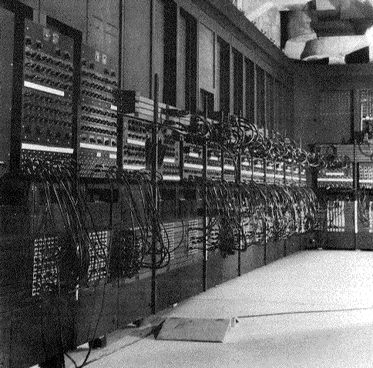
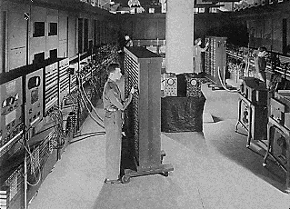
Computing history
Thirty tons
Forced air cooling
200KW
19,000 vacuum tubes
Punch card
Manual wiring
Numerical computation
The first electronic digital computer – ENIAC, built in UPenn in 1946
Source: http://ei.cs.vt.edu/~history/ENIAC.Richey.HTML

Slide 14
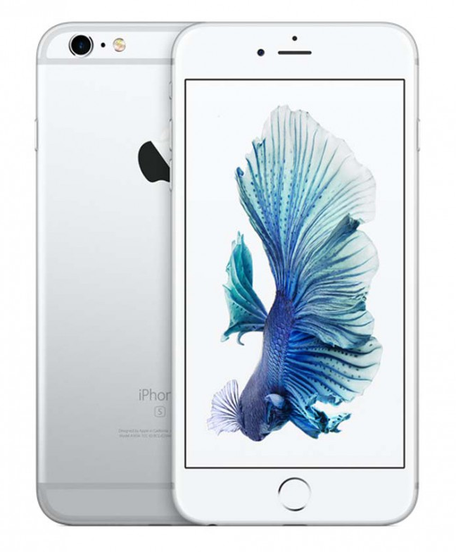
Today’s computer: one example
iPhone 6s Technical Specifications
(the 6s Plus wouldn’t fit on the slide)
Screen size 4.7 inches
Screen resolution 1334 by 750 at 326 ppi
Input method Multi-touch
Operating system iOS 9.2
Storage 16 / 64 / 128 GB
Cellular network UMTS/GSM/CDMA
Wireless data Wi-Fi (802.11a/b/g/n/ac) +
LTE + Bluetooth 4.2 + NFC
Camera 12.0 megapixels
Battery Up to 11 hrs Internet,
14 hrs talk,
11 hrs video, 50 hrs audio,
10 days standby
Dimensions 5.44 x 2.64 x 0.28 inches
Weight 5.04 ounces
Source: http://www.apple.com/iphone-6s/specs/

Slide 15
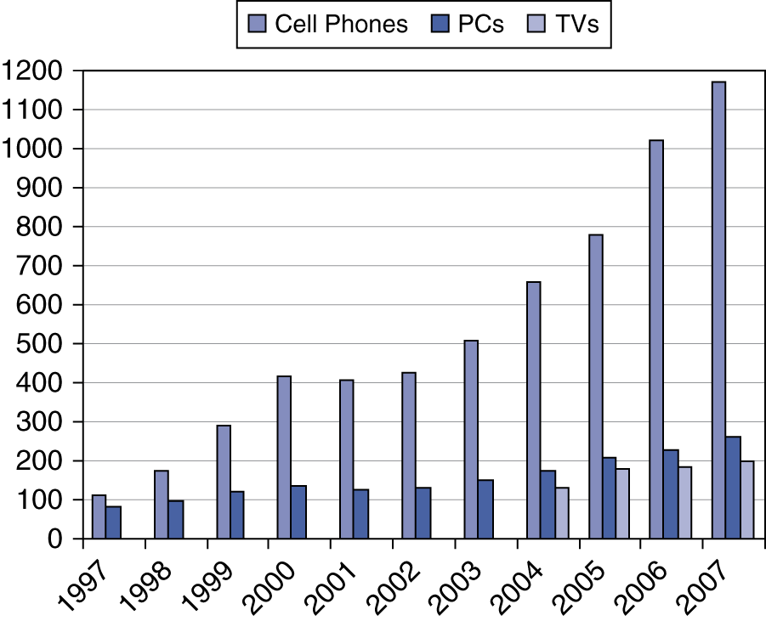
Processor market (as of 2007)
“Computer” used to just refer to PCs
Processors—and, therefore, computers—are now everywhere

Slide 16
Computer components
What are the key components of a computer?
Microprocessor (MPU/CPU) performs computation
Input to read data from external devices
Examples: Keyboard, mouse, ports (Ethernet, USB, etc.)
Output to transmit data to external devices
Examples: screen, speaker, VGA interface, ports (Ethernet, USB, etc.)
Storage to hold program code and data
RAM, hard disk, possibly other media (CD/DVD, external drive)
Power supply
Will see that microprocessor contains smaller-scale versions of these components
Computation engine
I/O interface
Internal storage

Slide 17
Final notes
Next time:
Data types
Data storage
Addressing modes
Reminders/notes:
Sign up for the discussion group on Piazza
HW 1 to be posted next week; due 9/14

