Slide 1
EECE.3170 Microprocessor Systems Design I
Instructor: Dr. Michael Geiger
Fall 2016
Lecture 3:
Data (continued): storage media, alignment, and endianness

Slide 2
Lecture outline
Announcements/reminders
Sign up for the course discussion group on Piazza
HW 1 posted; due Wednesday, 9/14, 2:00 PM
Bring hard copies to class or leave in envelope on office door (Perry 118A)
E-mail electronic submissions to Dr. Geiger
Please attach only a single file (archives not accepted)
Review
Data types
How are the bits interpreted? (int, FP, signed/unsigned)
What size are they? (byte, word, etc.)
Today’s lecture
Storage media
Alignment
Endianness

Slide 3
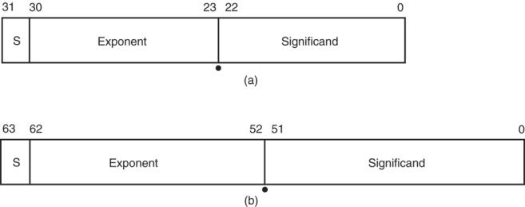
Real Numbers
Floating-point data stored in two parts
Significand (fraction)
Exponent
Single-precision (32 bits) or double-precision (64 bits)

Slide 4
Data storage
What characteristics do we want storage media to have?
Two primary answers
Speed
Capacity
Very difficult to get both in single storage unit
Processors use two different types of storage
Registers
Memory

Slide 5
Registers
Small, fast set of storage locations close to processor core (execution engine)
Primarily used for computation, short-term storage
Speed → ideal for individual operations
Lack of capacity → will frequently overwrite
Reference registers by name
Example: ADD EAX, EBX → EAX = EAX + EBX
EAX, EBX are registers in x86 architecture

Slide 6
Memory
Provides enough capacity for all code, data (possibly I/O as well)
Typically organized as hierarchy
Used primarily for long-term storage
Lacks speed of registers
Provides capacity to ensure data not overwritten
Reference memory by address
Example: MOV EAX, [100h]
→ EAX = memory at address [100h]

Slide 7
Memory (continued)
Accessing single byte is easy
Considerations with multi-byte data
Are the data aligned?
Easier/faster to access aligned data
How are the data organized in memory (“endianness”)?
Given 32-bit number: DEADBEEFh or 0xDEADBEEF
Which byte—MSB (0xDE) or LSB (0xEF) gets stored in memory first?

Slide 8
Aligned Words, Double words
Aligned word
Aligned data: address is divisible by # of bytes
2 bytes → address must be even
4 bytes → address must be multiple of 4
x86 architecture doesn’t require aligned data access
Performance impact for accessing unaligned data in memory (32-bit data bus)
Byte address
0
4
8
12
16
20
Aligned double word
Unaligned
word
Unaligned
double
word

Slide 9
Byte order (“endianness”)
In a multi-byte operand, how are the bytes ordered in memory?
Assume the double word value 1,000,000 (0x000F4240) is stored at address 80
In a little-endian ISA (like x86), the least significant byte (the “little” end) is at address 80
In a big-endian ISA (like MIPS), it’s the other way around
 |  | 40 | 42 | 0F | 00
… | 79 | 80 | 81 | 82 | 83 | 84 | …
 |  | 00 | 0F | 42 | 40
… | 79 | 80 | 81 | 82 | 83 | 84 | …

Slide 10
Examples
Given the following memory contents:
Starting address of each line shown on left
Leftmost byte has lowest address
First line: addresses 0x200C, 0x200D, 0x200E, 0x200F
What is the value of:
The word starting at address 0x200D?
The double word starting at address 0x2012?
Are these data aligned?
 | Lo |  |  | Hi
0x200C | 40 | 96 | 2C | 00
0x2010 | 55 | 12 | CD | AB
0x2014 | 01 | 23 | 88 | 99

Slide 11
Solution
 | Lo |  |  | Hi
0x200C | 40 | 96 | 2C | 00
0x2010 | 55 | 12 | CD | AB
0x2014 | 01 | 23 | 88 | 99
Word at 0x200D = 0x2C96
Address is not divisible by 2 → unaligned
Double word at 0x2012 = 0x2301ABCD
Address is not divisible by 4 → unaligned
Remember, hexadecimal is base 16—0x12 = 18₁₀

Slide 12
Final notes
Next time:
Assembly programming basics
Reminders:
Sign up for the discussion group on Piazza
HW 1 posted; due Wednesday, 9/14, 2:00 PM
Bring hard copies to class or leave in envelope on office door (Perry 118A)
E-mail electronic submissions to Dr. Geiger
Please attach only a single file (archives not accepted)

