Slide 1
EECE.2160 ECE Application Programming
Instructors:
Dr. Michael Geiger & Dr. Peilong Li
Spring 2017
Lecture 10:
PE2: Loops and conditionals

Slide 2
Lecture outline
Announcements/reminders
Program 3 due 2/10
Exam 1: Wednesday, 2/15
Will be allowed one double-sided 8.5” x 11” note sheet
No calculators or other electronic devices allowed
Review
While/do-while loops
Today’s lecture
PE2: Conditionals and while loops

Slide 3
Review: while/do-while loops
Used for repetition of code
while (<expression>)
<statement> ← loop body
do { <statements> } while ( <expression> );

Slide 4
Today’s program should:
Prompt user to enter an input character and an integer, n.
If not correctly formatted, print error, clear line, and repeat
Depending on the character entered, do the following:
‘F’ or ‘f’: Compute and print the factorial of n, n!
For example, if the user enters F 5, print 5! = 120
‘P’ or ‘p’: Compute 2^{n}, but only if n >= 0.
For example, if the user enters p 2, print 2^2 = 4
Print an error if n < 0.
‘X’ or ‘x’: Exit the program
In all other cases, print an error:
For example: Invalid command Z entered
If the user enters any command other than ‘X’ or ‘x’, return to the initial prompt and repeat the program.
Will cover parts in red in another lecture

Slide 5
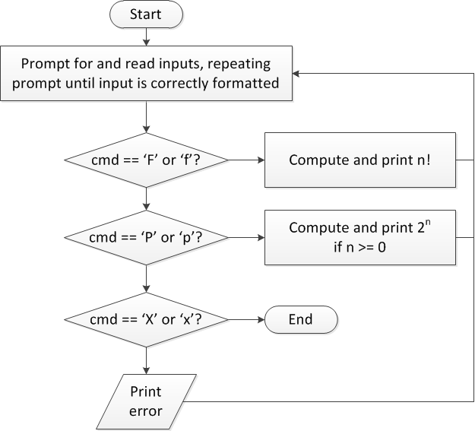
Flow charts: overall flow

Slide 6
Discussion: Overall flow
Whole program contains loop
Repeats process until user enters ‘X’ or ‘x’
Use while or do-while—unknown # of iterations
Since exit condition ends program, infinite loop
Testing cmd: switch statement
Checking equality of cmd to constant values
Exiting program: return statement
Use return at any point to end current function (including main)

Slide 7
Code: overall flow (skeleton code)
while (1) { // Loop repeats until user enters 'X' or 'x'
/* Code to read cmd, n */
/* Evaluate cmd and perform appropriate operation */
switch (cmd) {
case 'F':
case 'f':
/* Calculate n! */
break;
case 'P':
case 'p':
/* Calculate 2^n, if n >= 0; print error otherwise */
break;
case 'X':
case 'x':
return; // Exit program
default:
printf("Invalid command %c entered\n", cmd);
}
}

Slide 8
Final notes
Next time
Finish PE2
For loops
Reminders:
Program 3 due 2/10
Exam 1: Wednesday, 2/15
Will be allowed one double-sided 8.5” x 11” note sheet
No calculators or other electronic devices allowed

