Slide 1
EECE.2160 ECE Application Programming
Instructors:
Dr. Michael Geiger
Fall 2016
Lecture 12:
PE2: Loops and conditionals (continued)
For loops

Slide 2
Lecture outline
Announcements/reminders
Program 4 due 10/11
TA office hours: T 11-1, Ball 328
May add additional hours as term goes on
Exams to be returned Wednesday or Friday
Today’s lecture
Continue with PE2: Conditionals and while loops
For loops

Slide 3
Today’s program should:
Prompt user to enter an input character and an integer, n.
If not correctly formatted, print error, clear line, and repeat
Depending on the character entered, do the following:
‘F’ or ‘f’: Compute and print the factorial of n, n!
For example, if the user enters F 5, print 5! = 120
‘P’ or ‘p’: Compute 2^{n}, but only if n >= 0.
For example, if the user enters p 2, print 2^2 = 4
Print an error if n < 0.
‘X’ or ‘x’: Exit the program
In all other cases, print an error:
For example: Invalid command Z entered
If the user enters any command other than ‘X’ or ‘x’, return to the initial prompt and repeat the program.
Will cover parts in red in another lecture

Slide 4
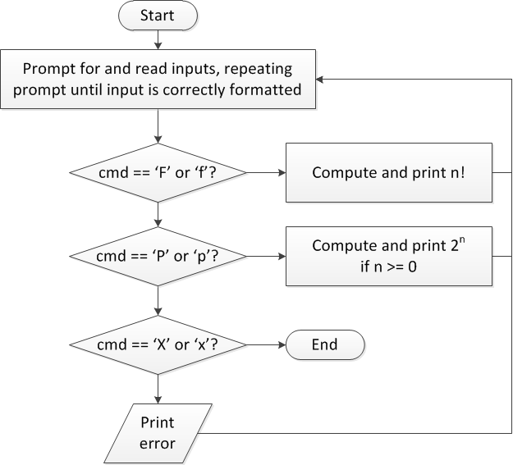
Review: overall flow

Slide 5
Review: overall flow (skeleton code)
while (1) { // Loop repeats until user enters 'X' or 'x'
/* Code to read cmd, n */
/* Evaluate cmd and perform appropriate operation */
switch (cmd) {
case 'F':
case 'f':
/* Calculate n! */
break;
case 'P':
case 'p':
/* Calculate 2^n, if n >= 0; print error otherwise */
break;
case 'X':
case 'x':
return; // Exit program
default:
printf("Invalid command %c entered\n", cmd);
}
}

Slide 6
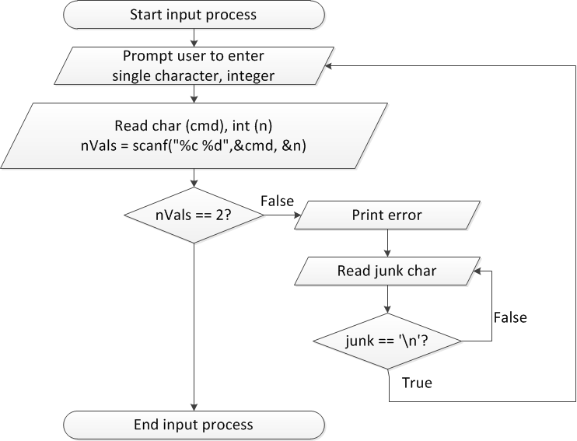
Flow charts: reading input

Slide 7
Discussion: Reading input
Loop that repeats as long as input incorrect
Loop inside that one to handle reading of remainder of line
Read character until you reach end of line
Both while/do-while loops

Slide 8
Code: Reading input
do {
printf("Enter command and integer: ");
nVals = scanf("%c %d", &cmd, &n);
// Otherwise, print error & clear line
if (nVals != 2) {
printf("Incorrectly formatted input\n“);
do {
scanf("%c", &junk);
} while (junk != '\n');
}
} while (nVals != 2);

Slide 9
Input errors
In general, may want to repeat prompt if any error occurs
Logical OR of all error conditions to continue loop
Prioritize error testing—format errors usually first
Why test inputs if they weren’t read correctly?
Example: also test for n < 0 as an error
do {
printf("Enter command and integer: ");
nVals = scanf("%c %d", &cmd, &n);
if (nVals != 2) {
// Handle error
}
else if (n < 0) { ← Test after we know no
// Handle error formatting error
}
} while ((nVals != 2) || (n < 0));

Slide 10
Iterative methods (Program 4)
Repeat calculation until correct value reached
“Correctness” defined as:
Difference between old, new value <= max error
Max error == .000001 in Prog. 4
General process:
newVal = <initial value>;
do {
oldVal = newVal;
newVal = <equation based on oldVal>;
} while (fabs(newVal – oldVal) > max_err);
You can’t use <math.h>, so you’ll need your own way of computing absolute value (fabs())

Slide 11
Final notes
Next time
For loops
Return exams (Wednesday or Friday)
Reminders:
Program 4 due 10/11
TA office hours: T 11-1, Ball 328
May add additional hours as term goes on

