Slide 1
EECE.2160 ECE Application Programming
Instructors:
Dr. Michael Geiger
Fall 2016
Lecture 13:
For loops

Slide 2
Lecture outline
Announcements/reminders
Program 4 due 10/11
TA office hours: T 11-1, Ball 328
May add additional hours as term goes on
No office hours next Tuesday (Mon schedule on Tue)
Exams to be returned Friday
Today’s lecture
Program 4 review
For loops

Slide 3
Review: Input errors
In general, may want to repeat prompt if any error occurs
Logical OR of all error conditions to continue loop
Prioritize error testing—format errors usually first
Why test inputs if they weren’t read correctly?
Example: also test for n < 0 as an error
do {
printf("Enter command and integer: ");
nVals = scanf("%c %d", &cmd, &n);
if (nVals != 2) {
// Handle error
}
else if (n < 0) { ← Test after we know no
// Handle error formatting error
}
} while ((nVals != 2) || (n < 0));

Slide 4
Review: Iterative methods (Program 4)
Repeat calculation until correct value reached
“Correctness” defined as:
Difference between old, new value <= max error
Max error == .000001 in Prog. 4
General process:
newVal = <initial value>;
do {
oldVal = newVal;
newVal = <equation based on oldVal>;
} while (fabs(newVal – oldVal) > max_err);
You can’t use <math.h>, so you’ll need your own way of computing absolute value (fabs())

Slide 5
Justifying for loops
Common loop structure
Initialize variable
Loop until that variable reaches certain limit
At end of each iteration, change variable by fixed amount
Example: squares program
i = 0;
while (i <= 10) {
iSquared = i * i;
printf("%2d%10d\n", i, iSquared);
i = i + 1;
}

Slide 6
for loops
for loops include all three aspects in one construct
Form:
for (<init var>; <test>; <change var>)
<statements>
<init var> is basic assignment
<test> same type of condition as if, while
<change var> change variable by fixed amount
Example: for (i = 0; i < 20; i++)
… You may be wondering what i++ means

Slide 7
Changing variables
Can do operation + assignment w/one operator
Simply adding/subtracting 1:
x++ → x = x + 1 (post-increment)
x-- → x = x – 1 (post-decrement)
++x → x = x + 1 (pre-increment)
--x → x = x – 1 (pre-decrement)
Augmented assignment: change variable by amount other than 1
x += y → x = x + y
x -= y → x = x – y
x *= y → x = x * y
x /= y → x = x / y

Slide 8
Pre- vs. post-increment/decrement
Pre-increment/decrement: perform increment/ decrement, then evaluate expression
Post-increment/decrement: evaluate expression, then perform increment/decrement
Example: what does the following print?
int n = 5;
printf(“n = %d\n”, ++n);
printf(“Now, n = %d\n”, n++);
printf(“Finally, n = %d\n”, n);

Slide 9
Example soln.
int n = 5;
printf(“n = %d\n”, ++n);
printf(“Now, n = %d\n”, n++);
printf(“Finally, n = %d\n”, n);
Output:
n = 6 (n pre-incremented)
Now, n = 6 (n post-incremented)
Finally, n = 7 (Shows effect of n++)

Slide 10
Simple usage of for loop
Common sequence of code:
x=0; while (x<12) { printf("%d ",x); x++; }
Output:
0 1 2 3 4 5 6 7 8 9 10 11

Slide 11
Intro to for loops
Common sequence of code:
x=0; while (x<12) { printf("%d ",x); x++; }
Equivalent for construct
for (x=0 ; x<12 ; x++ ) { printf("%d ",x); }
Initial value
Test condition
Body of loop (may be 0, 1, or several statements)
End of loop change

Slide 12
Repetition with for loop
Rewriting squares program with loop
int main() {
int i; // Number to square
int iSquared; // Square of the number
printf(" i i^2\n"); // Column headings
// Compute and display the squares of numbers 0 to 10
for (i = 0; i <= 10; i++) { // Loop until i > 10
iSquared = i * i;
printf("%2d%10d\n", i, iSquared);
}
return 0;
}

Slide 13
Repetition with for loop (cont.)
Generalizing program:
int main() {
int i; // Number to square
int iSquared; // Square of the number
int iStart; // Initial value
int iStop; // Last value
int iStep; // Increment
printf(“Enter start, stop, and increment: “);
scanf(“%d %d %d”, &iStart, &iStop, &iStep);
printf(" i i^2\n"); // Column headings
// Compute and display the squares of numbers iStart to iStop
// with increment iStep
for (i = iStart; i <= iStop; i += iStep) {
iSquared = i * i;
printf("%2d%10d\n", i, iSquared);
}
return 0;
}

Slide 14
Example: for loops
What does each of the following print?
for (i=5; i<40; i+=8) { printf("%d ", i); }
for (i=10; i<=100; i=i+10) { if (i%20) printf("%d ", i); }
for (i=-5; i<-10; i--) { printf("%d ", i); }
for (i=5; i<10; i+=i%2) { printf("%d ", i++); }

Slide 15
Example solution
What does each of the following print?
for (i=5; i<40; i+=8) { printf("%d ", i); }
OUTPUT: 5 13 21 29 37
for (i=10; i<=100; i=i+10) { if (i%20) printf("%d ", i); }
OUTPUT: 10 30 50 70 90
for (i=-5; i<-10; i--) { printf("%d ", i); }
OUTPUT: No output
for (i=5; i<10; i+=i%2) { printf("%d ", i++); }
OUTPUT: 5 6 8

Slide 16
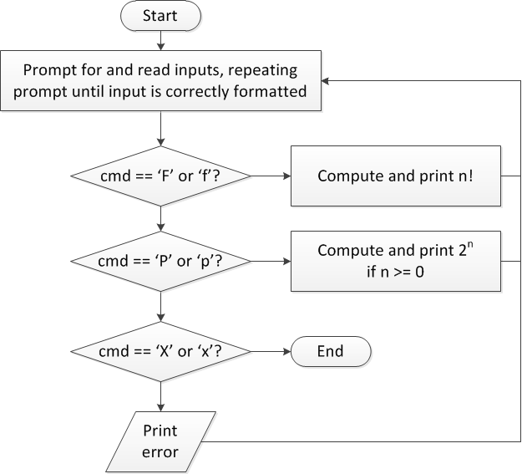
Finishing PE2: overall flow (review)

Slide 17
Finishing PE2: next steps
Write flowcharts for
Computing n!
Computing 2^{n} if n >= 0
Complete code

Slide 18
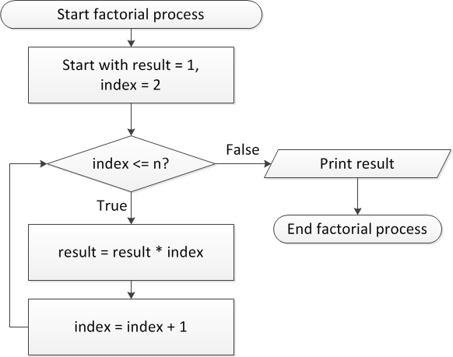
Flow charts: Calculating n!

Slide 19
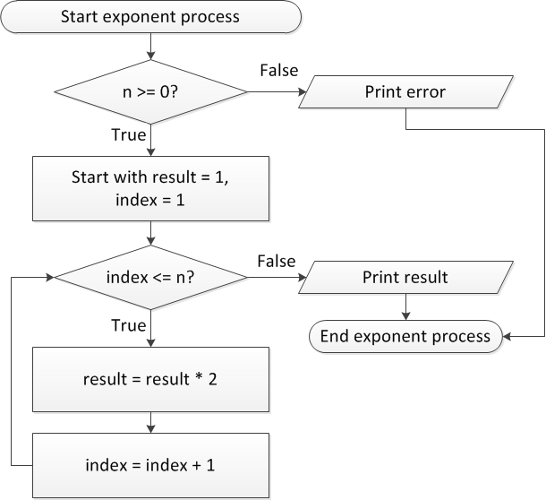
Flow charts: Calculating 2^{n}

Slide 20
Discussion: Factorial/2^{n}
Loop for each process covers fixed range of values
Use for loop
Can declare single variable to hold both results, since only one will be calculated

Slide 21
Code: factorial
result = 1;
for (i = n; i > 1; i--) {
result *= i;
}
printf("%d! = %d\n", n, result);
Slightly different approach than flow chart
Counts down instead of counting up
No benefit to doing one over the other

Slide 22
Code: 2^{n}
if (n < 0)
printf("Error: bad n value\n");
else {
result = 1;
for (i = 0; i < n; i++) {
result *= 2;
}
printf("2^%d = %d\n", n, result);
}

Slide 23
Final notes
Next time
Functions
Return exams
Reminders:
Program 4 due 10/11
TA office hours: T 11-1, Ball 328
May add additional hours as term goes on
No office hours next Tuesday (Mon schedule on Tue)

