Slide 1
EECE.3170 Microprocessor Systems Design I
Instructor: Dr. Michael Geiger
Summer 2016
Lecture 9:
PIC microcontroller intro

Slide 2
Lecture outline
Announcements/reminders
HW 4 due 1:00 PM Thursday, 6/9
Exam 2: Monday, 6/13
Will again be allowed one 8.5” x 11” note sheet, calculator
Instruction list provided
Today’s lecture:
PIC microcontroller intro

Slide 3
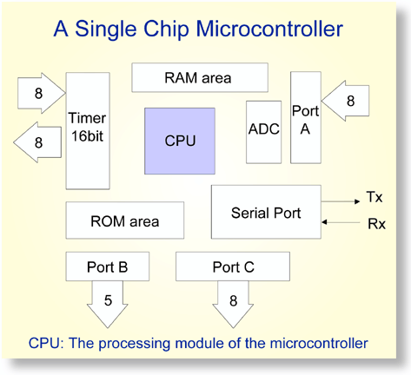
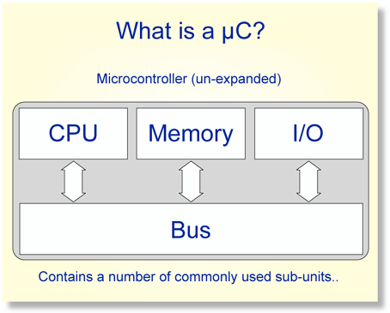
Overview of Microcontrollers
Basically, a microcontroller is a device which integrates a number of the components of a microprocessor system onto a single microchip.
Reference: http://mic.unn.ac.uk/miclearning/modules/micros/ch1/micro01notes.html#1.4

Slide 4
Microcontroller features
Processor
Usually general-purpose but can be app-specific
On-chip memory
Often RAM for data, EEPROM/Flash for code
Integrated peripherals
Common peripherals
Parallel I/O port(s)
Clock generator(s)
Timers/event counters
Special-purpose devices such as:
Analog-to-digital converter (sensor inputs)
Mixed signal components
Serial port + other serial interfaces (SPI, USB)
Ethernet

Slide 5
Microcontroller features
Benefits
Typically low-power/low-cost
Target for embedded applications
Easily programmable
Simple ISAs (RISC processors)
Use of development kits simplifies process
Limitations
Small storage space (registers, memory)
Restricted instruction set
May be required to multiplex pins
Not typically used for high performance

Slide 6
PIC microcontrollers
Manufactured by Microchip Technology
High performance/low cost for embedded applications
Work strictly with 8-bit data*
*unless you’re using one of the newer 16- or 32-bit ones
Varying complexity, characterized by
Interfaces supported
SPI, I²C, Ethernet, etc.
Number of instructions
Anywhere from ~35 to ~80
Amount of internal memory available
Internal modules
Capture, compare, timers, etc.

Slide 7
PIC16F1829
Mid-range PIC microcontroller
49 different instructions
Interrupt capability
Direct, indirect, relative addressing mode
Low Power
650nA @ 32KHz, 1.8V
Peripheral Features
Up to 17 I/O pins with individual direction control
10-bit A/D converter
8/16-bit timer/counters
Special Microcontroller Features
Internal/external oscillator
Power saving sleep mode
High Endurance Flash/EEPROM cell

Slide 8
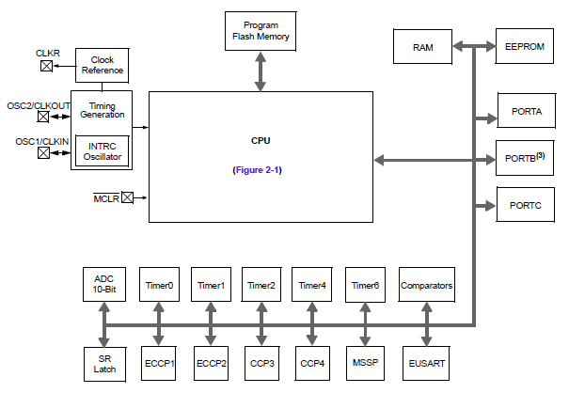
PIC16F1829 Block Diagram

Slide 9
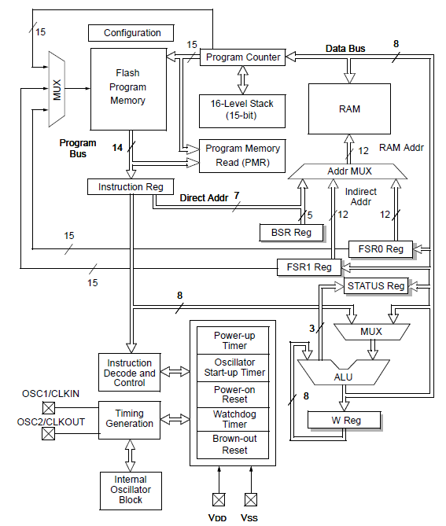
PIC16F1829 CPU Block Diagram

Slide 10
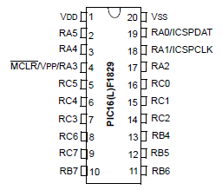
PIC16F1829 Pinout
20 pins
Mostly I/O ports A/B/C
Some pins multiplexed for in circuit debug (ICD)

Slide 11
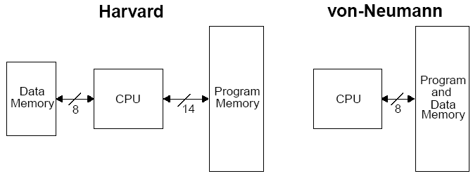
Harvard vs Von Neumann
Organization of program and data memory
PIC MCU technically “modified Harvard architecture”

Slide 12
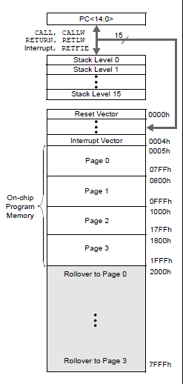
Program Memory Space
15-bit program counter to address 32K locations
Each location is 14-bit wide (instructions are 14 bits long)
RESET vector is 0000h
When the CPU is reset, its PC is automatically cleared to zero.
Interrupt Vector is 0004h
0004h is automatically loaded into the program counter when an interrupt occurs
Vector → address of code to be executed for given interrupt

Slide 13
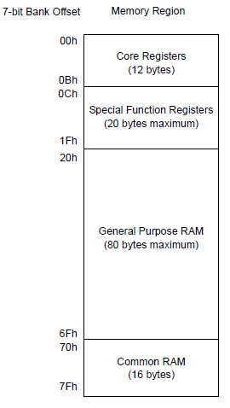
Data Memory Map
Core registers
Affect basic operation of device
Shared across all banks
Special function registers (SFRs)
Control peripheral operations
General purpose registers/RAM (GPRs)
Data storage/scratch pad operations
Common RAM
Same 16 bytes accessible in all banks

Slide 14
Core registers
WREG, the working register
To move values from one register to another register, the value must pass through the W register.
FSR0/FSR1, File Select Register
Indirect data memory addressing pointer
INDF0/INDF1
accessing INDF accesses the location pointed by IRP+FSR
PC, the Program Counter, PCL/PCLATH
BSR, Bank Select Register
Selects which bank of memory is actually being accessed

Slide 15
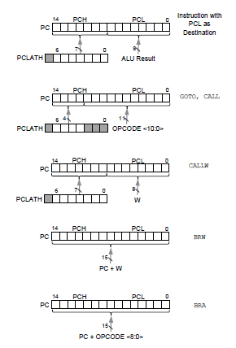
PCL and PCLATH
PC: Program Counter, 15 bits
PCL (02h): 8 bits, the lower 8 bits of PC
PCLATH (0Ah): PC Latch, provides the upper 7 bits of PC when PCL is written
Can change by
Writing PCL directly
Jump (GOTO)
Calling function (CALL, CALLW)
Relative branches (BRA/BRW)

Slide 16

STATUS register
STATUS
NOT_TO: Time Out bit, reset status bit
NOT_PD: Power-Down bit, reset status bit
Z: Zero bit ~ ZF in x86
DC: Digital Carry bit ~ AF in x86
C: Carry bit ~ CF in x86 (note: for subtraction, borrow is opposite)

Slide 17
Stack
16-level deep x 15-bit wide hardware stack
The stack space is not part of either program or data space
The PC is “PUSHed” onto the stack when a CALL instruction is executed, or an interrupt causes a branch.
The stack is “POPed” in the event of a RETURN, RETLW or a RETFIE instruction execution.
However, NO PUSH or POP instructions !
The stack operates as a circular buffer:
After the stack has been PUSHed 16 times, the 17th push overwrites the value that was stored from the first push.
Can track stack overflow/underflow to handle such conitions

Slide 18
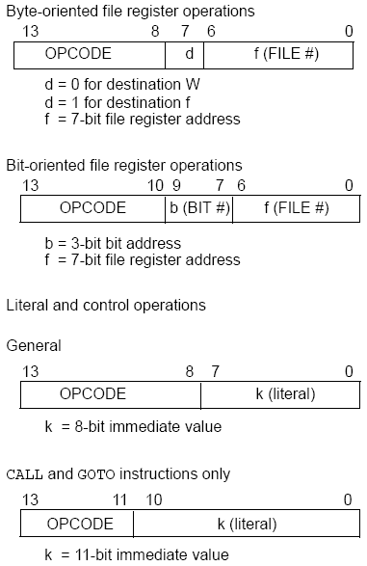
PIC16F1829 Instructions
49 instructions
Each instruction is 14 bits
Byte-oriented OPCODE f, F(W)
Source f: name of a SFR or a RAM variable
Destination F(W):
F if the destination is to be the same as the source register
W if the destination is to be the working register
Bit-oriented OPCODE f, b
Bit address b (0≤b≤7)
Literal and control OPCODE k
Literal value k

Slide 19
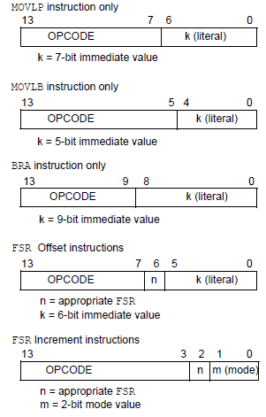
PIC16F1829 Instructions (cont.)
MOVLP/MOVLB: move literal to PCL/BSR
BRA: Relative branch
FSR instructions used in indirect addressing

Slide 20
RAM variables
Memory variable: symbolic name to refer to space in memory (GPRs)
Usable space on 16F1829: offsets 0x20–0x7F
Once declared, use symbolic name, not address
Example PIC syntax (cblock/endc):
cblock 0x20 ; cblock directive needs starting
; address
var1 ; var1 = byte at 0x20
var2 ; var2 = byte at 0x21
var3 ; var3 = byte at 0x22
endc ; End of variable block

Slide 21
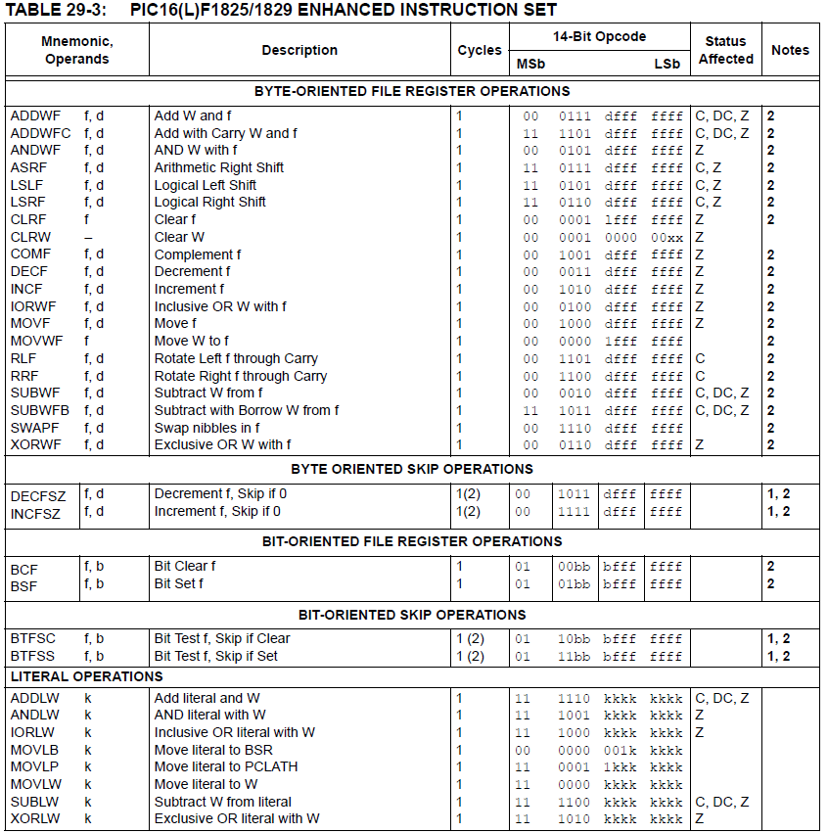

Slide 22
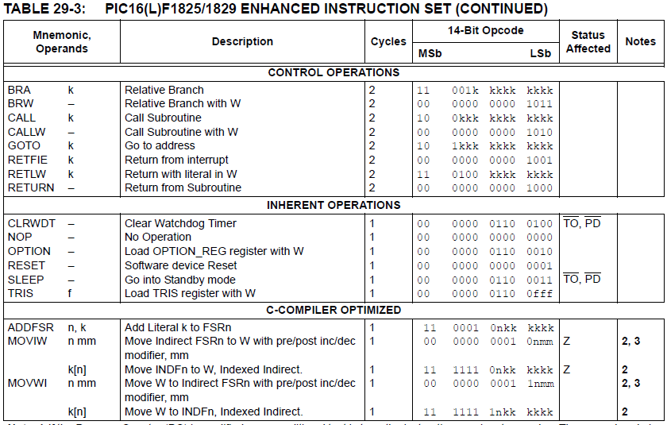

Slide 23
Clear/Move
clrw ; Clear W register
clrf f ; Clear f register
movlw k ; move literal value k to W
movwf f ; move W to f
movf f, F(W) ; move f to F or W
swapf f, F(W) ; swap nibbles of f, putting result in F or W
STATUS bits:
clrw, clrf, movf: Z
movlw, movwf, swapf: none
Examples:
clrf TEMP1 ;Clear variable TEMP1
movlw 5 ;load 5 into W
movwf TEMP1 ;move W into TEMP1
movwf TEMP1, F ;Incorrect Syntax
movf TEMP1, W ;move TEMP1 into W ;
movf TEMP1, TEMP2 ;Incorrect Syntax
swapf TEMP1, F ;Swap 4-bit nibbles of TEMP1
swapf TEMP1, W ;Move TEMP1 to W, swap nibbles, leave TEMP1 unchanged

Slide 24
Single Bit Manipulation
bcf f,b
Operation: Clear bit b of register f, where b=0 to 7
bsf f,b
Operation: Set bit b of register f, where b=0 to 7
STATUS bits:
none
Examples:
bcf PORTB, 0 ;Clear bit 0 off PORTB
bsf STATUS, C ;Set the Carry bit

Slide 25
Example
Show the values of all changed registers after the following sequence
cblock 0x30
x
y
endc
clrw
movwf x
movlw 0xFE
movwf y
swapf y, F
bcf y, 3
bsf x, 3
movf y, W

Slide 26
Example solution
clrw → W = 0x00
movwf x → x = W = 0x00
movlw 0xFE → W = 0xFE
movwf y → y = W = 0xFE
swapf y, F → Swap nibbles of y → y = 0xEF
bcf y, 3 → Clear bit 3 of y = 1110 1111₂
→ y = 1110 0111₂ = 0xE7
bsf x, 3 → Set bit 3 of x
→ x = 0000 1000₂ = 0x08
movf y, W → W = y = 0xE7

Slide 27
Increment/Decrement/ Complement
incf f, F(W) ; increment f, putting result in F or W
decf f, F(W) ;decrement f, putting result in F or W
comf f, F(W) ;complement f, putting result in F or W
STATUS bits:
Z
Examples:
incf TEMP1, F ;Increment TEMP1
incf TEMP1, W ;W <- TEMP1+1; TEMP1 unchanged
decf TEMP1, F ;Decrement TEMP1
comf TEMP1, F ;Change 0s and 1s to 1s and 0s

Slide 28
Addition/Subtraction
addlw k ;add literal value k into W
addwf f, F(W) ;add w and f, putting result in F or W
sublw k ;subtract W from literal value k, putting
;result in W
subwf f, F(W) ;subtract W from f, putting result in F or W
STATUS bits:
C, DC, Z
Examples:
addlw 5 ; W <= 5+W
addwf TEMP1, F ; TEMP1 <- TEMP1+W
sublw 5 ; W <= 5-W (not W <= W-5 )
subwf TEMP1, F ; TEMP1 <= TEMP1 - W

Slide 29
Example
Show the values of all changed registers after the following sequence
cblock 0x20
varA
varB
varC
endc
clrf varA
clrf varB
clrf varC
incf varA, W
sublw 0x0F
addwf varB, F
decf varB, F
comf varB, W
subwf varC, F

Slide 30
Example solution
clrf varA → varA = 0
clrf varB → varB = 0
clrf varC → varC = 0
incf varA, W → W = varA + 1 = 1
sublw 0x0F → W = 0x0F – W = 0x0F – 1
= 0x0E
addwf varB, F → varB = varB + W = 0x0E
decf varB, F → varB = varB – 1 = 0x0D
comf varB, W → W= ~varB = ~0x0D = 0xF2
subwf varC, F → varC = varC – W = 0x0E

Slide 31
Final notes
Next time:
Start discussing PIC instruction set
Reminders:
HW 4 due 1:00 PM Thursday, 6/9
Exam 2: Monday, 6/13
Will again be allowed one 8.5” x 11” note sheet, calculator
Instruction list provided

