Slide 1
EECE.2160 ECE Application Programming
Instructors:
Dr. Michael Geiger
Fall 2016
Lecture 10:
PE2: Loops and conditionals

Slide 2
Lecture outline
Announcements/reminders
Program 3 due 9/28
Late penalties capped at -1 from 9/29 through 10/3
Exam 1: Friday, 9/30
Will be allowed one double-sided 8.5” x 11” note sheet
No calculators or other electronic devices allowed
Review
While/do-while loops
Today’s lecture
PE2: Conditionals and while loops

Slide 3
Review: while/do-while loops
Used for repetition of code
while (<expression>)
<statement> ← loop body
do { <statements> } while ( <expression> );

Slide 4
Today’s program should:
Prompt user to enter an input character and an integer, n.
If not correctly formatted, print error, clear line, and repeat
Depending on the character entered, do the following:
‘F’ or ‘f’: Compute and print the factorial of n, n!
For example, if the user enters F 5, print 5! = 120
‘P’ or ‘p’: Compute 2^{n}, but only if n >= 0.
For example, if the user enters p 2, print 2^2 = 4
Print an error if n < 0.
‘X’ or ‘x’: Exit the program
In all other cases, print an error:
For example: Invalid command Z entered
If the user enters any command other than ‘X’ or ‘x’, return to the initial prompt and repeat the program.
Will cover parts in red in another lecture

Slide 5
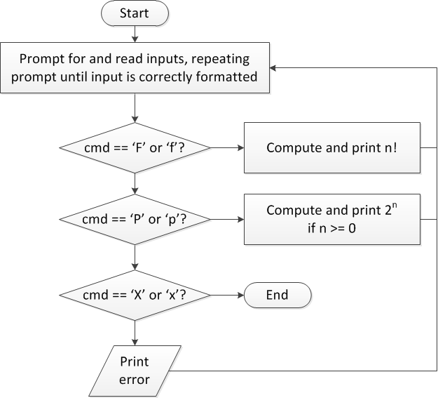
Flow charts: overall flow

Slide 6
Discussion: Overall flow
Whole program contains loop
Repeats process until user enters ‘X’ or ‘x’
Use while or do-while—unknown # of iterations
Since exit condition ends program, infinite loop
Testing cmd: switch statement
Checking equality of cmd to constant values
Exiting program: return statement
Use return at any point to end current function (including main)

Slide 7
Code: overall flow (skeleton code)
while (1) { // Loop repeats until user enters 'X' or 'x'
/* Code to read cmd, n */
/* Evaluate cmd and perform appropriate operation */
switch (cmd) {
case 'F':
case 'f':
/* Calculate n! */
break;
case 'P':
case 'p':
/* Calculate 2^n, if n >= 0; print error otherwise */
break;
case 'X':
case 'x':
return; // Exit program
default:
printf("Invalid command %c entered\n", cmd);
}
}

Slide 8
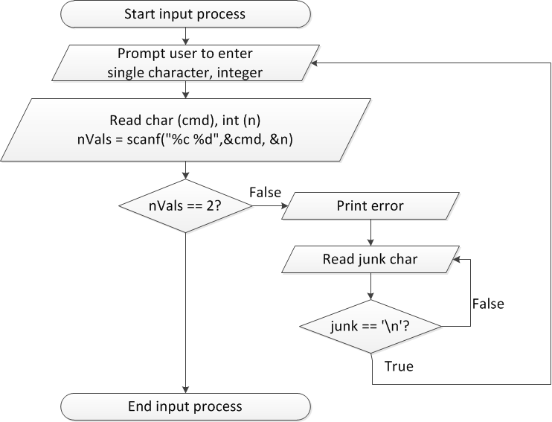
Flow charts: reading input

Slide 9
Discussion: Reading input
Loop that repeats as long as input incorrect
Loop inside that one to handle reading of remainder of line
Read character until you reach end of line
Both while/do-while loops

Slide 10
Code: Reading input
do {
printf("Enter command and integer: ");
nVals = scanf("%c %d", &cmd, &n);
// Otherwise, print error & clear line
if (nVals != 2) {
printf("Incorrectly formatted input\n“);
do {
scanf("%c", &junk);
} while (junk != '\n');
}
} while (nVals != 2);

Slide 11
Input errors
In general, may want to repeat prompt if any error occurs
Logical OR of all error conditions to continue loop
Prioritize error testing—format errors usually first
Why test inputs if they weren’t read correctly?
Example: also test for n < 0 as an error
do {
printf("Enter command and integer: ");
nVals = scanf("%c %d", &cmd, &n);
if (nVals != 2) {
// Handle error
}
else if (n < 0) { ← Test after we know no
// Handle error formatting error
}
} while ((nVals != 2) || (n < 0));

Slide 12
Next step
Write flowcharts for
Computing n!
Computing 2^{n} if n >= 0
Complete code
Will cover these steps after we discuss for loops

Slide 13
Iterative methods (Program 4)
Repeat calculation until correct value reached
“Correctness” defined as:
Difference between old, new value <= max error
Max error == .000001 in Prog. 4
General process:
newVal = <initial value>;
do {
oldVal = newVal;
newVal = <equation based on oldVal>;
} while (fabs(newVal – oldVal) > max_err);
You can’t use <math.h>, so you’ll need your own way of computing absolute value (fabs())

Slide 14
Final notes
Next time
Exam 1 Preview
Reminders:
Program 3 due 9/28
Late penalties capped at -1 from 9/29 through 10/3
Exam 1: Friday, 9/30
Will be allowed one double-sided 8.5” x 11” note sheet
No calculators or other electronic devices allowed

