Slide 1
EECE.3170 Microprocessor Systems Design I
Instructor: Dr. Michael Geiger
Summer 2016
Lecture 2:
x86 intro
Assembly basics
Data transfer instructions

Slide 2
Lecture outline
Announcements/reminders
Sign up for the course discussion group on Piazza
HW 1 due 1:00 PM, 5/19
Bring hard copies to class or leave in envelope on office door
E-mail electronic submissions to Dr. Geiger
Please attach only a single file (archives not accepted)
Include your name in some way in the file name (i.e., mgeiger_hw1.docx)
Exam 3: 6/23 instead of 6/27
Time fixed in SiS—no more time conflict with Signals
Review
Data types
Alignment and endianness
Today’s lecture
Addressing modes
x86 introduction
x86 memory accesses
Data transfer instructions

Slide 3
Review: ISA, storage
Instruction set architecture (cont.)
Operands: the data being operated on
How are the bits interpreted? (int, FP, signed/unsigned)
What size are they? (byte, word, etc.)
How do we reference operands?
Data storage
Registers
Small, fast set of on-chip storage (primarily for speed)
Referenced by name
Memory
Larger, slower set of storage (primarily for capacity)
Organized as hierarchy …
… but programmer references single range of addresses
Memory issues
Aligned data: address divisible by number of bytes
Endianness: 80x86 data is little endian

Slide 4
Addressing modes
Addressing modes: ways of specifying operand location
Where are operands stored? (3 location types)
Registers → register addressing
Provide name of register; value read from register
Memory
Provide address in memory; value read from that location
Several modes for specifying memory address
In the instruction → immediate addressing

Slide 5
Memory addressing
Instructions accessing memory generate effective address (EA)
Address calculated as part of instruction
EA can be used as
Actual memory address in a simple memory system
Address within a particular segment in a segmented memory architecture
Effective address calculations can involve
A constant value
One or more values stored in registers
Some combination of register and constant

Slide 6
General memory addressing modes
Memory direct addressing
EA = constant value encoded in instruction
Register indirect addressing
EA = value stored in register
Base + displacement addressing
EA = constant displacement + base register(s)
Can have variations of this mode based on number and type of registers
Scaled addressing
EA = base + (scale * index)
Used for array addressing

Slide 7
x86 intro
“x86” → family of general purpose Intel processors
Starts with 8086 processor (1978)
Used (w/extensions) in current processors
Supports use of 8, 16, 32, or 64 bit data
“IA-32”: x86 for 32-bit processors (80386 and later)
“x86-64”: x86 with 64-bit extensions (AMD, Intel, VIA)
“IA-64”: old name for Itanium server architecture (not extension of x86)
Allows both register and memory operands
Segmented or flat memory architecture
Real and protected mode operation
Protected mode supports virtual memory

Slide 8
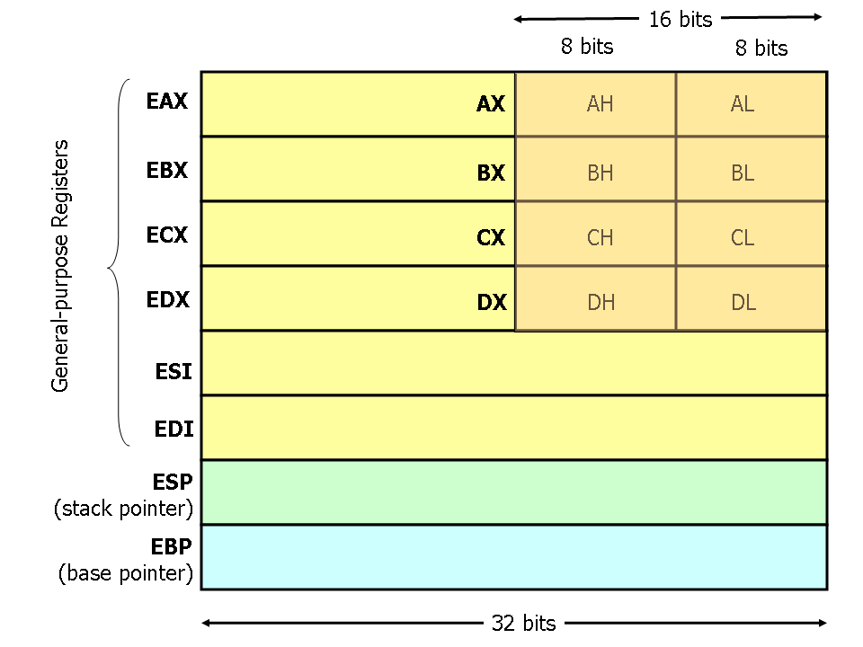
Register Set
Nine 32-bit registers
Data registers- EAX, EBX, ECX, EDX, can be used as 32, 16 or 8bit
Pointer registers- EBP, ESP
Index registers- ESI, EDI
Instruction pointer- EIP (not shown)
Flags (status) register-EFLAGS (not shown)
Source: http://www.cs.virginia.edu/~evans/
cs216/guides/x86.html

Slide 9
Register Set
64-bit extensions added with Pentium 4
Data/pointer/index/IP/ flag register extended to 64 bits
For example:
RAX = 64-bit register A
RSP = 64-bit stack pointer
8 additional data registers (R8-R15)

Slide 10
General Purpose Data Registers
Four general purpose data registers
Accumulator (A) register
Base (B) register
Count (C) register
Data (D) register
Can hold 8-bit, 16-bit, or 32-bit data
AH/AL = high and low byte value
AX = word value
EAX = double word value
General uses:
Hold data such as source or destination operands for most operations—ADD, AND, SHL
Hold address pointers for accessing memory
Some also have dedicated special uses
C—count for loop,
B—table look-up translations, base address
D—indirect I/O and string I/O

Slide 11
Pointer/Index Registers
Two pointer registers (32-/16-bit versions)
Stack pointer register (ESP/SP)
Points to top of stack
Base pointer register (EBP/BP)
Points to fixed location within current stack frame
Two index registers
Source index (ESI/SI)
Destination index (EDI/DI)
Typically used in memory addressing

Slide 12
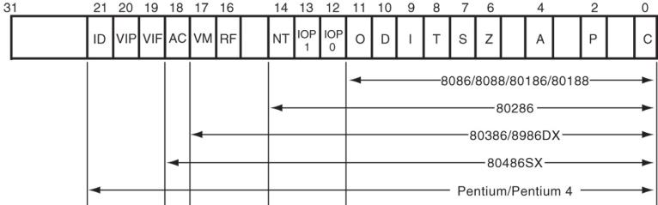
Flags Register
32-bit register holding single bit status and control information
9 active flags in real mode
Two categories
Status flags: conditions resulting from instruction
Most instructions update status
Used as test conditions
Control flags: control processor functions
Used by software to turn on/off operating capabilities

Slide 13
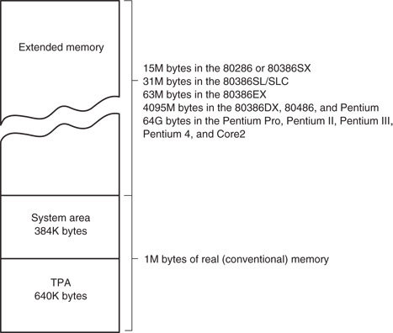
x86 memory spaces
x86 architecture implements independent memory and input/output (not shown) address spaces
Memory address space
1 MB “real” memory
System + transient program area (TPA)
Extended memory size dependent on processor
Input/output address space- 65,536 bytes long (64KB)

Slide 14
x86 memory modes
Two general modes of access
Real mode (DOS)
Protected mode (Windows)
Two memory models
Segmented memory model
Flat memory model
We’ll use this model

Slide 15
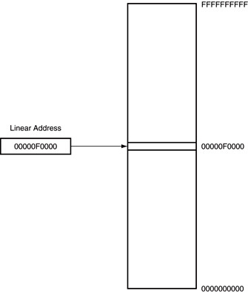
Flat mode addressing
No segmentation
Entire address space active
Address generated by instruction = linear address being accessed
Generates 40-bit external address

Slide 16
x86 addressing modes
Addresses in x86 instructions enclosed by brackets
Addressing modes: all examples of general addressing modes discussed earlier
Direct addressing
EA = constant value
Example: MOV AX, [0100H]
Register indirect addressing
EA = value stored in register
Example: MOV [EDI], AX
Base-plus-index addressing
EA = sum of two registers
Example: MOV AX, [EBX+ESI]

Slide 17
x86 addressing modes (cont.)
Register relative addressing
EA = register + constant
Examples:
MOV CL, [EBX+4]
MOV AX, ARRAY[EBX] ARRAY is constant memory location
Base relative-plus-index addressing
EA = base register + index register + constant
Example: MOV AX, 10H[ESI][EBX] -or-
MOV AX, [10H+SI+BX]
Scaled-index addressing
EA = register + (scaling factor * second register)
Often useful for array accesses
Scaling factor = element size (2, 4, 8 bytes)
Example: MOV EDX, [EAX + 4*EBX]

Slide 18
Example
Compute the address for the memory operand in each of the following instructions.
You do not need to specify what data is transferred
The register contents and variables are as follows:
(ESI) = 00000100₁₆
(EDI) = 00000200₁₆
(EBX) = 00000300₁₆
MOV [EBX+0400h], CX
MOV [EDI+2*EBX], AH
MOV [EBX+EDI+0400h], AL

Slide 19
Example solutions
Memory operand in: MOV [EBX+0400h], CX
Addr = value in EBX + 0400h
= 00000300h + 0400h = 00000700h
Memory operand in: MOV [EDI+2*EBX], AH
Addr = value in EDI + 2 * value in EBX
= 00000200h + 2 * 00000300h
= 00000200h + 00000600h
Memory operand in MOV [EBX+EDI+0400h], AL
Addr = EBX + EDI + 0400h
= 00000300H + 00000200H + 0400h = 00000900h

Slide 20
Instruction Assembly Notation
Each instruction is represented by a mnemonic that describes its operation—called its operation code (opcode)
MOV = move (data transfer)
ADD = add (arithmetic)
AND = logical AND (logic)
JMP = unconditional jump (control transfer)
Operands are the other parts of an assembly language instructions
Identify whether the elements of data to be processed are in registers or memory
Source operand– location of one operand to be processed
Destination operand—location of the other operand to be processed and the location of the result

Slide 21
Assembly Language Statements
General structure of an assembly language statement
LABEL: INSTRUCTION ;COMMENT
Label—address identifier for the statement
Instruction—the operation to be performed
Comment—documents the purpose of the statement
Example:
START: MOV AX, BX ; Copy BX into AX
Other examples:
INC SI ;Update pointer
ADD AX, BX
Few instructions have a label—usually marks a jump to point
Not all instructions need a comment

Slide 22
x86 memory accesses
# bytes from memory usually = # bytes in register
Example: MOV AX, [100H]
AX is 16-bit register → move word from address 100H to AX
Sometimes necessary to specify size
Use “<size> PTR”: BYTE PTR, WORD PTR, DWORD PTR
Example: MOVZX EAX, BYTE PTR [100H]
Take byte from memory
Zero-extend data to 32 bits and store in EAX
Remember, x86 uses little-endian data

Slide 23
Data transfer instructions
MOV
MOVSX
MOVZX
XCHG
LEA
Additional data transfer instructions (covered later, if at all)
PUSH/POP (stack transfers)
INS/OUTS (I/O)
MOVS/LODS/STOS (string instructions)
BSWAP (switch from little endian to big endian)
XLAT (table lookup)
CMOV (conditional move)

Slide 24
MOV
Used to copy data between
Registers
Registers/memory
Immediate value (source only) to register/memory
Format: MOV D, S
Operation: (D) = (S)
Restrictions
Immediate value can only be used as source

Slide 25
MOV examples
Assume: AX = 0100H, CS = 3000H,
(100H) = 00H, (101H) = FFH
MOV BL, AL
BL = AL = 00H
MOV DX, CS
DX = CS = 3000H
MOV CX, [100H]
CX = word starting at 100H = FF00H

Slide 26
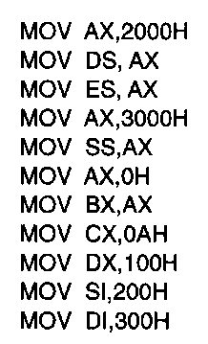
Usage of Move Instruction
Example—Initialization of internal registers with immediate data and address information
What is the final state of all affected registers?

Slide 27
Usage of Move Instruction (soln)
MOV AX, 2000H → AX = 2000H
MOV DS, AX → DS = AX = 2000H
MOV ES, AX → ES = AX = 2000H
MOV AX, 3000H → AX = 3000H
MOV SS, AX → SS = 3000H
MOV AX, 0H → AX = 0000H
MOV BX, AX → BX = AX = 0000H
MOV CX, 0AH → CX = 000AH
MOV DX, 100H → DX = 0100H
MOV SI, 200H → SI = 0200H
MOV DI, 300H → DI = 0300H

Slide 28
MOVSX/MOVZX
Move and extend data (fill upper bits with 0/1)
ZX → zero extend
SX → sign extend → copy MSB of source
Format: MOVZX D, S
MOVSX D, S
Operation: lower bits of D = S
upper bits of D = 0 (MOVZX) or
upper bits of D = MSB of S (MOVSX)
Restrictions
Only register/memory operands (no immediates)
Source must contain fewer bits than destination
If memory operand used, size must be specified

Slide 29
MOVSX/MOVZX examples
Assume: AX = 0100H, DX = 8100H,
(100H) = 00H, (101H) = FFH
What are the results of the following instructions?
MOVSX EBX, AX
MOVSX EBX, DX
MOVZX EBX, DX
MOVSX EBX, BYTE PTR [100H]
MOVSX EBX, WORD PTR [100H]

Slide 30
MOVSX/MOVZX examples (soln)
Assume: AX = 0100H, DX = 8100H, (100H) = 00H, (101H) = FFH
What are the results of the following instructions?
MOVSX EBX, AX
EBX = AX sign-extended = 00000100H (orig. value underlined)
MOVSX EBX, DX
EBX = DX sign-extended = FFFF8100H
MOVZX EBX, DX
EBX = DX zero-extended = 00008100H
MOVSX EBX, BYTE PTR [100H]
EBX = byte at 100h sign-extended = 00000000H
MOVSX EBX, WORD PTR [100H]
EBX = word at 100h sign-extended = FFFFFF00H

Slide 31
XCHG
Swap contents of source and destination
Format: XCHG D, S
Operation: (D) = (S)
(S) = (D)
Restrictions:
Memory operand can only be used as destination

Slide 32
LEA
Perform effective address computation and store result in register
Format: LEA D, EA
Operation: D = EA
Example: LEA SI, [10H + DI]

Slide 33
Example
Given the initial memory contents at left, show the results of the following instruction sequence:
MOV EAX, 528000h
MOV EBX, [EAX+2]
XCHG BL, BH
LEA EDX, [EAX+8]
MOV ECX, [EDX-3]
 | Lo |  |  | Hi
0x528000 | 50 | 88 | 31 | A3
0x528004 | B2 | FF | 0F | 7D
0x528008 | 07 | D0 | BE | 22
0x52800C | 11 | 96 | 00 | 14

Slide 34
Solution
MOV EAX, 528000h
EAX = 528000h
MOV EBX, [EAX+2]
EBX = DWORD at 528002h = FFB2A331h
XCHG BL, BH
Swap BL and BH → EBX = FFB231A3h
LEA EDX, [EAX+8]
EDX = EAX+8 = 528008h
MOV ECX, [EDX-3]
ECX = DWORD at 528005h = 077D0FFFh

Slide 35
Final notes
Next time:
Arithmetic instructions
Reminders:
Sign up for the course discussion group on Piazza
HW 1 due 1:00 PM, 5/19
Bring hard copies to class or leave in envelope on office door
E-mail electronic submissions to Dr. Geiger
Please attach only a single file (archives not accepted)
Include your name in some way in the file name (i.e., mgeiger_hw1.docx)
Exam 3: 6/23 instead of 6/27
Time fixed in SiS—no more time conflict with Signals

