Slide 1
EECE.3170 Microprocessor Systems Design I
Instructor: Dr. Michael Geiger
Summer 2016
Lecture 13:
Continue with PIC example programs:
Interrupts
Analog to digital conversion

Slide 2
Lecture outline
Announcements/reminders
HW 5 due 1:00 PM, Monday, 6/20
HW 6 due 1:00 PM, Thursday, 6/23
PICkit-based programming exercise
Encouraged to work in groups (maximum of 3 students)
Submissions received by 11:59 PM on Wednesday, 6/22 will earn an extra 10%
Must return PICkit by end of exam on Thursday, 6/23
Exam 3: Thursday, 6/23
Will again be allowed one 8.5” x 11” note sheet, calculator
Instruction list to be provided
Review:
PICkit basics
Delay
Timer module
Today’s lecture:
Interrupts
Analog to digital

Slide 3
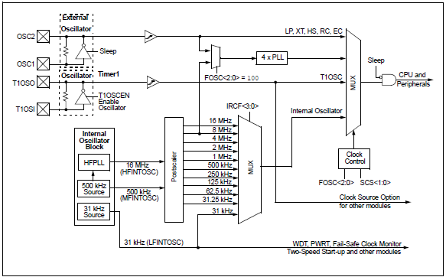
Review: clock sources

Slide 4
Review: Timer module
Internal timers common in microcontrollers
Used to generate delays, measure time between events, or count event occurrences
Typical interrupts for
Timer overflow (common for generating delay)
Timer compare (also for generating delay—stop when timer reaches certain value)
Capture (what value does timer have when event occurs?)
Typical timer configurations
Run at particular speed relative to system clock (prescaled)
Increment every time external event occurs
PIC 16F1829 has 5 timers (four 8 bit, one 16 bit)

Slide 5
Rotate with timer-based delay (asm) (1/2)
Start:
;Setup main init
banksel OSCCON ;bank1
movlw b'00111000’ ;set cpu clock speed to 500KHz
movwf OSCCON
;Configure the LEDs
banksel TRISC ;bank1
clrf TRISC ;make all of PORTC an output
banksel LATC ;bank2
movlw b'00001000‘ ;start with DS4 lit
movwf LATC
;Setup Timer0
banksel OPTION_REG ;bank1
;1:256 prescaler for a delay of:
; (insruction-cycle * 256-counts)*prescaler =
; ((8uS * 256)*256) =~ 524mS
movlw b'00000111’
movwf OPTION_REG

Slide 6
Rotate with timer-based delay (asm) (2/2)
MainLoop:
btfss INTCON, TMR0IF ;did TMR0 roll over yet?
bra $-1 ;wait until TMR0 overflows
bcf INTCON, TMR0IF ;clear flag in software
;rotate the LEDs
banksel LATC ;bank2
lsrf LATC, f
btfsc STATUS,C ;did bit rotate into carry?
bsf LATC,3 ;yes, light DS4 back up
bra MainLoop ;continue forever
end

Slide 7
Rotate with timer-based delay (C)
void main(void) {
OSCCON = 0b00111000; //500KHz clock speed
TRISC = 0; //all LED pins are outputs
LATC = 0;
//1:256 prescaler for a delay of: (instruction-cycle * 256
// counts)*prescaler = ((8uS * 256)*256) =~ 524mS
OPTION_REG = 0b00000111;
LATCbits.LATC4 = 1; //start with DS4 lit
while (1) {
//PIC can do work here, but this program just waits for flag
while (!INTCONbits.TMR0IF) continue;
INTCONbits.T0IF = 0; //flag MUST be cleared in software
LATC >> = 1; //rotate the LEDs
if (STATUSbits.C) //when last LED is lit, restart pattern
LATCbits.LATC3 = 1;
}
}

Slide 8
Review: Interrupts
PIC controllers allow internal and external interrupts
Single interrupt service routine
Must determine interrupt cause, then handle
Code addresses handled slightly differently
Processor goes to address 0 on reset, 4 on interrupt
Reset “vector”: jump to start of main program
Interrupt “vector”: jump to start of ISR
Interrupt setup
Enable device-specific interrupts first
Enable global interrupts (GIE bit on PIC16F1829)
Interrupt handling
Determine which device caused interrupt
Clear device-specific interrupt flag
Execute code to actually process interrupt, then retfie

Slide 9
PIC Interrupts
PIC controllers allow both internal and external interrupts
Single interrupt service routine
Must determine interrupt cause, then handle
Code addresses handled slightly differently
Processor goes to address 0 on reset, 4 on interrupt
Reset “vector”: jump to start of main program
Interrupt “vector”: jump to start of ISR
Code from program:
Org 0x0 ;Reset Vector starts at 0x0000
bra Start ;main code execution
Org 0x0004 ;Interrupt Vector starts at
; address 0x0004
goto ISR

Slide 10
Interrupt setup
Need to enable necessary interrupts
GIE bit in INTCON register: global interrupt enable
Timer 0 “rolls over” (goes from 255 to 0)
Set TMR0IE bit in INTCON
Switch is pressed (pin RA2 goes from high to low)
Interrupt on negative edge change in port A, pin 2
IOCIF flag in INTCON: general enable for interrupt on change
Bit 2 in IOCAN register: negative edge interrupt for port A, pin 2
Flags set when interrupt occurs
TMR0IF in INTCON for Timer 0 interrupt
Bit 2 of IOCAF register for switch
IOCAF → checking for interrupt on change in port A
Software must clear flags, or interrupts repeatedly occur

Slide 11
Rotate with interrupts (asm): Setup (1/3)
#define SWITCH PORTA, 2 ;pin where SW1 is connected
#define PULL_UPS ;if this is uncommented, JP5 can be pulled out
#define LED_RIGHT 0xFF ;keep track of LED direction
#define LED_LEFT 0x00
cblock 0x70 ;shared memory accessible from all banks
Direction
Delay1
endc
Org 0x0 ;Reset Vector starts at 0x0000
bra Start ;main code execution
Org 0x0004 ;Interrupt Vector starts at address 0x0004
goto ISR
Start:
banksel OSCCON ;bank1
movlw b'00111000' ;set cpu clock speed FO 500KHz
movwf OSCCON
bsf TRISA, RA2 ;switch as input
banksel ANSELA ;bank3
bcf ANSELA, RA2 ;digital
;can reference pins by position or name

Slide 12
Rotate with interrupts (asm): Setup (2/3)
;Configure the LEDs
banksel TRISC ;bank1
clrf TRISC ;make all of PORTC an output
banksel LATC ;bank2
movlw b'00001000' ;start with DS4 lit
;Setup Timer0 as the delay
banksel OPTION_REG ;bank1
movlw b'00000111' ;1:256 prescaler for a delay of 524mS
movwf OPTION_REG
bsf INTCON, TMR0IE ;enable the rollover interrupt to occur
;Setup interrupt-on-change for the switch
bsf INTCON, IOCIE ;set global IOC enable flag
banksel IOCAN ;bank7
bsf IOCAN, IOCAN2 ;when SW1 is pressed, enter the ISR
bsf INTCON, GIE ;must set GIE to allow any interrupt

Slide 13
Rotate with interrupts (asm): Setup (3/3)
#ifdef PULL_UPS ;set up pull up resistors
banksel WPUA ;bank4
bsf WPUA, 2 ;enable pull-up for switch
banksel OPTION_REG ;bank1
;enable (clear) the global weak pull-up bit
bcf OPTION_REG, NOT_WPUEN
#endif
movlw LED_RIGHT ; LEDs start moving
movwf Direction ; to right
;Clear the RAM
clrf Delay1

Slide 14
Rotate with interrupts (asm): Main loop, debounce, rotate LEDs
MainLoop:
bra MainLoop ; Main program doesn’t have to wait for timer
Debounce: ; Delay for ~5 mS
movlw d'209' ;(1/(500KHz/4))*209*3 = 5.016mS
movwf Delay1
DebounceLoop:
decfsz Delay1, f
bra DebounceLoop
return
RotateRight:
lsrf LATC, f ;logical shift right
btfsc STATUS,C ;did the bit rotate into the carry?
bsf LATC,3 ;yes, put it into bit 3.
retfie
RotateLeft:
lslf LATC, f ;logical shift left
btfsc LATC, 4 ;did it rotate out of the LED display?
bsf LATC, 0 ;yes, put in bit 0
retfie

Slide 15
Rotate with interrupts (asm): ISR (1/2)
ISR:
banksel IOCAF ;bank7
btfsc IOCAF, 2 ;check the interrupt-on-change flag
bra Service_SW1 ;switch was pressed
bra Service_TMR0 ;Timer0 overflowed
Service_SW1:
; Clear flag without changing other IOCAF bits
movlw 0xFF
xorwf IOCAF, w
andwf IOCAF, f ;clearing this will also clear INTCON, IOCIF bit
call Debounce ;delay for 5ms and check switch again
banksel PORTA ;bank0
btfsc SWITCH ;is it still held down?
retfie ;nope, exit the ISR back to the main code
movlw 0xFF
xorwf Direction, f ;toggle direction state and save it back
retfie ;return to main code

Slide 16
Rotate with interrupts (asm): ISR (2/2)
Service_TMR0:
bcf INTCON, T0IF ; clear flag
banksel LATC
movlw LED_RIGHT ; check dir
subwf Direction, w
btfsc STATUS, Z
bra RotateRight
bra RotateLeft
end ;end code generation

Slide 17
Rotate with interrupts (C): defines
#include <htc.h> //PIC hardware mapping
#define _XTAL_FREQ 500000 //Used by the XC8 delay_ms(x) macro
#define DOWN 0
#define UP 1
#define SWITCH PORTAbits.RA2
#define LED_RIGHT 1
#define LED_LEFT 0
#define PULL_UPS
//config bits that are part-specific for the PIC16F1829
__CONFIG(FOSC_INTOSC & WDTE_OFF & PWRTE_OFF & MCLRE_OFF & CP_OFF & CPD_OFF & BOREN_ON & CLKOUTEN_OFF & IESO_OFF & FCMEN_OFF);
__CONFIG(WRT_OFF & PLLEN_OFF & STVREN_OFF & LVP_OFF);

Slide 18
Rotate with interrupts (C): main (1/2)
unsigned char _direction; //a global variable
void main(void) {
//general init
OSCCON = 0b00111000; //500KHz clock speed
TRISC = 0; //all LED pins are outputs
LATC = 0; //init LEDs in OFF state
LATCbits.LATC3 = 1; //DS4 is lit
_direction = LED_RIGHT; //LEDs rotating R to L
//setup switch (SW1)
TRISAbits.TRISA2 = 1; //switch as input
ANSELAbits.ANSA2 = 0; //digital switch
//by using internal resistors, you eliminate external pull-up/down resistor
#ifdef PULL_UPS
WPUA2 = 1; //enable weak pull-up for switch
nWPUEN = 0; //enable global weak pull-up bit
#endif

Slide 19
Rotate with interrupts (C): main (2/2)
//setup TIMER0 as the delay
//1:256 prescaler for a delay of: (insruction-cycle * 256-counts)*prescaler = ((8uS * 256)*256) =~ 524mS
OPTION_REG = 0b00000111; //setup TIMER0
INTCONbits.TMR0IE = 1; //enable the TMR0 rollover interrupt
//setup interrupt on change for the switch
INTCONbits.IOCIE = 1; //enable interrupt on change global
IOCANbits.IOCAN2 = 1; //when SW1 is pressed, enter the ISR
GIE = 1; //enable global interupts
while (1) {
continue; //can spend rest of time doing something critical here
}
}

Slide 20
Rotate with interrupts (C): ISR
void interrupt ISR(void) {
if (IOCAF) { //SW1 was just pressed
IOCAF = 0; //must clear the flag in software
__delay_ms(5); //debounce by waiting and seeing if still held down
if (SWITCH == DOWN) {
_direction ^= 1; //change directions
}
}
if (INTCONbits.T0IF) {
INTCONbits.T0IF = 0;
if (_direction == LED_RIGHT) {
LATC >> = 1; //rotate right
if (STATUSbits.C == 1) //when the last LED is lit, restart the pattern
LATCbits.LATC3 = 1;
} else{
LATC << = 1; //rotate left
if (LATCbits.LATC4 == 1) //when the last LED is lit, restart the pattern
LATCbits.LATC0 = 1;
}
}
}

Slide 21
Analog to digital converter
10 bits of resolution
ADC value = (V / V_{REF}) * 1023
11 analog input channels
Split across ports A, B, and C
Can be referenced to V_{DD} or external reference
Key registers
ANSELx: Determines if pin(s) on port x are configured as analog or digital
ADCON0/ADCON1: Configuration registers
ADRESH/ADRESL: High/low bits of ADC result
ADC can generate interrupt when done
Set PEIE (peripheral interrupt enable) in INTCON
Set ADIE (analog to digital interrupt enable) in PIE1
When interrupt occurs, ADIF = 1 in PIR1 (must be cleared)

Slide 22
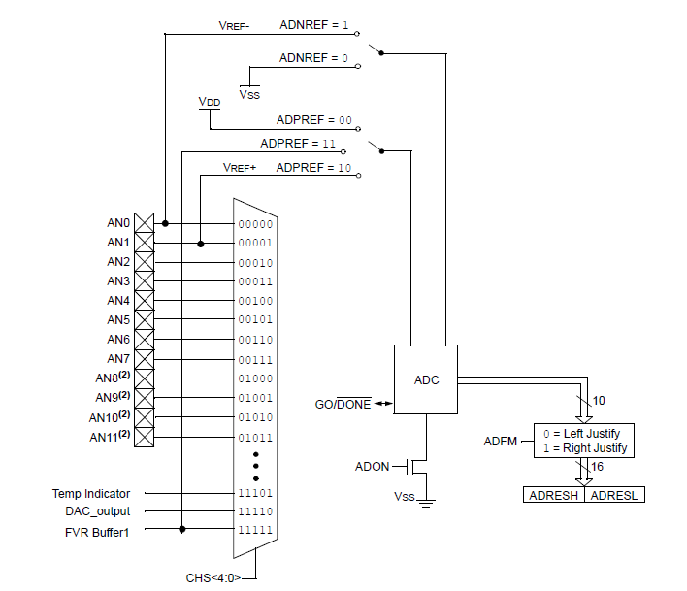
ADC block diagram

Slide 23
ADCON0
CHS <4:0>: channel select
GO/DONE’: start/end conversion
Explicitly set to 1 to start conversion
ADC will clear when conversion is done
ADON: Turns ADC on/off

Slide 24
ADCON1
ADFM: Result format
ADFM = 0 → right justified (ADRESL holds low 8 bits of result; upper 6 bits of ADRESH = 0)
ADFM = 1 → left justified (ADRESH holds upper 8 bits of result; lower 6 bits of ADRESL = 0)
ADCS<2:0>: Conversion clock select
Divide system clock by factor between 2 and 64
Or, select dedicated RC oscillator
ADNREF: Negative reference voltage
V_{SS} or negative reference input
ADPREF: Positive reference voltage
V_{DD}, positive reference input, or internal fixed voltage reference

Slide 25
ADC setup
In assembly (a2d.asm)
;already in bank1
bsf TRISA, 4 ;Pot.connected to RA4
movlw b'00001101‘ ;select RA4 as ADC source
movwf ADCON0 ; & enable (actually AN3)
movlw b'00010000‘ ;left justified, Fosc/8
movwf ADCON1 ; speed, vref is Vdd
banksel ANSELA ;bank3
bsf ANSELA, 4 ;analog for ADC
In C (a2d.c)
TRISAbits.TRISA4 = 1; //Pot. connected to RA4
ANSELAbits.ANSA4 = 1; //analog
ADCON0 = 0b00001101; //select RA4 as source of ADC
// and enable module (AN3)
ADCON1 = 0b00010000; //left justified, FOSC/8
// ref is Vdd

Slide 26
ADC access in assembly (a2d.asm)
Read ADC; put upper 4 bits on LEDs
;Start the ADC
nop ;required ADC delay
banksel ADCON0
bsf ADCON0, GO ;start the ADC
btfsc ADCON0, GO ;this bit will be cleared when
; the conversion is complete
goto $-1 ;keep checking until GO clear
;Grab Results and write to the LEDs
swapf ADRESH, w ;Get top 4 MSbs
banksel LATC
movwf LATC ;move into the LEDs

Slide 27
ADC access in C (a2d.c)
while (1) {
__delay_us(5); //wait for ADC
// charging cap to
// settle
GO = 1;
//wait for conversion to finish
while (GO) continue;
//grab the top 4 MSbs
LATC = (ADRESH >> 4);
}

Slide 28
Using ADC to determine delay (asm) (1/4)
MainLoop:
call A2d ;get the ADC result
;top 8 MSbs are now in the working register
movwf Delay2 ;move result to outer delay loop
;if ADC result is zero, load in a value of '1' or
; else delay loop will decrement starting at 255
call CheckIfZero
call DelayLoop ;delay next LED turning ON
call Rotate ;rotate the LEDs
bra MainLoop ;do this forever

Slide 29
Using ADC to determine delay (asm) (2/4)
CheckIfZero:
movlw d'0‘ ;load wreg with '0'
xorwf Delay2, w ;XOR wreg with the ADC
; result and save in wreg
btfss STATUS, Z ;if ADC result is NOT '0', ; simply return to MainLoop
return ;return to MainLoop
;ADC result IS '0'. Load delay routine with '1'
; to avoid decrementing a rollover value of 255
movlw d'1'
movwf Delay2 ;move into delay location
return ;return to MainLoop

Slide 30
Using ADC to determine delay (asm) (3/4)
A2d:
;Start the ADC
nop ;required ADC delay
banksel ADCON0
bsf ADCON0, GO ;start the ADC
btfsc ADCON0, GO ;this bit cleared when
; conversion complete
goto $-1 ; check until GO clear
movf ADRESH, w ;Get the top 8 MSbs
return

Slide 31
Using ADC to determine delay (asm) (4/4)
DelayLoop:
;Delay amount determined by ADC
decfsz Delay1,f ;will always be
; decrementing 255
goto DelayLoop
decfsz Delay2,f ;Delay2 = 8 MSBs
; from ADC
goto DelayLoop
return

Slide 32
Using ADC to determine delay (C)
while (1) {
delay = adc(); //grab the top 8 MSbs
__delay_ms(5); //delay for AT LEAST 5ms
//decrement the 8 MSbs of the ADC and delay 2ms
// for each
while (delay-- != 0)
__delay_ms(2);
//shift to the right to light up the next LED
LATC >> = 1;
//when the last LED is lit, restart the pattern
if(STATUSbits.C)
LATCbits.LATC3 = 1;
}

Slide 33
Final notes
Next time:
Practice problems
Exam 3 Preview
Reminders:
HW 5 due 1:00 PM, Monday, 6/20
HW 6 due 1:00 PM, Thursday, 6/23
PICkit-based programming exercise
Encouraged to work in groups (maximum of 3 students)
Submissions received by 11:59 PM on Wednesday, 6/22 will earn an extra 10%
Must return PICkit by end of exam on Thursday, 6/23
Exam 3: Thursday, 6/23
Will again be allowed one 8.5” x 11” note sheet, calculator
Instruction list to be provided

