Slide 1
EECE.3170 Microprocessor Systems Design I
Instructor: Dr. Michael Geiger
Fall 2016
Lecture 10:
Rotate, bit test, and bit scan instructions

Slide 2
Lecture outline
Announcements/reminders
HW 3 due Wednesday at 2:00 PM
No late submissions—solution to be posted that day
Exam 1: Friday, 9/30
Allowed calculator, one double-sided 8.5” x 11” note sheet
Will be given list of instructions covered so far
Review
Logical instructions
Shift instructions
Today’s lecture
Rotate instructions
Bit test/scan instructions

Slide 3
Review: Logical instructions
Logical instructions (AND/OR/XOR/NOT)
Basic shift instructions
Move value by <amt> bits; add 0s to left or right
CF = last bit shifted out
SHL <src>, <amt>: Move <src> to left
SAL exactly the same
SHR <src>, <amt>: Move <src> to right
Arithmetic right shift
Move value right by <amt> bits
Copy sign bit to fill remaining bits
CF = last bit shifted out
SAR <src>, <amt>

Slide 4
Rotate instructions
Difference between rotates and shifts
Shifts discard bits that are shifted out
Rotates take bits that are shifted out and use them to fill vacated bits
Rotate instruction format: <op> D, <shamt>
Destination may be register/memory
<shamt>: shift amount
May be immediate or register CL
All rotate instructions store last bit shifted out in carry flag (CF)

Slide 5
ROR / ROL / RCR / RCL
ROR: rotate right
Shift (D) to right by <shamt> bits
<shamt> LS bits are moved to MS bits
ROL: rotate left
Shift (D) to left by <shamt> bits
<shamt> MS bits are moved to LS bits
RCR: rotate right through carry
Treat (CF) as extra LS bit
Shift (D,CF) to right by <shamt> bits
<shamt> LS bits (from (D,CF)) are moved to MS bits
RCL: rotate left through carry
Treat (CF) as extra MS bit
Shift (CF,D) to left by <shamt> bits
<shamt> MS bits (from (CF,D)) are moved to LS bits

Slide 6
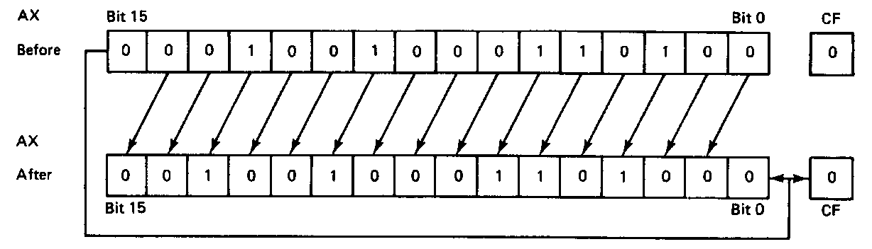
ROL example
ROL AX,1
Before execution
Dest = (AX) = 0x1234 = 0001 0010 0011 0100₂
Count = 1, CF = 0
Operation
The value in all bits of AX are rotated left one bit position
Value rotated out of the MSB is reloaded at LSB
Value rotated out of MSB copied to carry flag
After execution
Dest = (AX) = 0x2468 = 0010010001101000₂
CF = 0

Slide 7
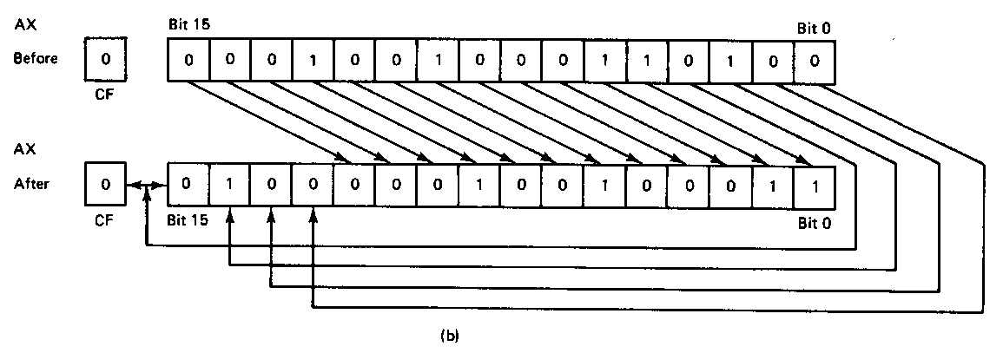
ROR example
ROR AX,CL
Before execution
Dest = (AX) = 0x1234 = 0001 0010 0011 0100₂
Count = 0x04, CF = 0
Operation
The value in all bits of AX are rotated right four bit positions
Values rotated out of the LSB are reloaded at MSB
Values rotated out of MSB copied to carry flag
After execution
Dest = (AX) = 0x4123 = 0100000100100011₂
CF = 0
Note position of hex characters in AX have been rearranged

Slide 8
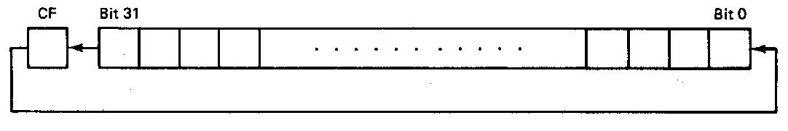
RCL example
RCL BX,CL
Before execution
Dest = (BX) = 0x1234 = 0001 0010 0011 0100₂
Count = 0x04, CF = 0
Operation
The value in all bits of AX are shifted left four bit positions
Emptied MSBs are rotated through the carry bit back into the LSB
Last value rotated out of MSB retained in carry flag
First rotate loads prior value of CF at the LSB
After execution
Dest = (BX) = 0x2340 = 0010 0011 0100 0000₂
CF = 1

Slide 9
Rotate example
Given AL = 0x43, CL = 0x04, and CF = 0, show the state of AL after each instruction in the sequence below:
ROR AL, 2
ROL AL, CL
RCR AL, 3
RCL AL, 4

Slide 10
Solution
Initially, AL = 0x43 = 01000011₂
ROR AL, 2
AL = 01000011 rotated right by 2
= 11010000 = 0xD0
CF = last bit rotated in = 1
ROL AL, CL
AL = 11010000 rotated left by 4
= 00001101 = 0x0D
CF = last bit rotated in = 1

Slide 11
Solution (cont.)
RCR AL, 3
(AL,CF) = 00001101 1 rotated right by 3
= 01100001 1
CF = 1, AL = 01100001₂ = 0x61
RCL AL, 4
(CF,AL) = 1 01100001 rotated left by 4
= 0 00011011
CF = 0, AL = 00011011₂ = 0x1B

Slide 12
Bit Test Instructions
BT → Bit test
BTR → Bit test and reset
BTS → Bit test and set
BTC → Bit test and complement
Format of bit test instruction: BT(x) D,S
(S) → index that selects the position of the bit tested
(D) → Holds value tested
Operation:
Enables programmer to test bit in a value in register or memory
All → Save the value of the selected bit in the CF
BT → Leaves selected bit unchanged
BTR → Clears the bit (bit = 0)
BTS → Sets the bit (bit = 1)
BTC → Complements the bit (bit = ~bit)

Slide 13
Bit Test Instructions
Example:
BTC BX,7
Before execution
(BX) = 0x03F0 = 0000 0011 1111 0000₂
After Execution
(CF) = bit 7 of BX = 1
(BX) = 0x0370 = 0000 0011 0111 0000₂

Slide 14
Bit Scan Instructions
BSF → Bit scan forward
BSR → Bit scan reverse
Format of bit scan instructions: BS(x) D,S
(S) → Holds value for which bits are tested to be 0
(D) → Index of first bit that tests as non-zero
Operation:
Enable programmer to test value to determine if all bits are 0
BSF → Scans bits starting from bit 0
Set ZF = 0 if all bits are found to be zero
Sets ZF = 1 when first 1 bit detected and places index of that bit into destination
BSR → Scans bits starting from MSB
Set ZF = 0 if all bits are found to be zero
Sets ZF = 1 when first 1 bit detected and places index of that bit into destination
Example:
BSF ESI,EDX → 32-bits of EDX scanned starting from B₀
If EDX = 0x00000000 → ZF = 0 (all bits zero)
If EDX = 0x00000001 → ESI = 0x00000000, ZF = 1 (bit 0 is 1)
If EDX = 0x00003000 → ESI = 0x0000000C, ZF = 1 (bit 12 is first bit set to 1)

Slide 15
Example
Given initial state shown in handout
List all changed registers/memory locations and their values, as well as CF
Instructions
BT WORD PTR [0x21102], 4
BTC WORD PTR [0x21110], 1
BTS WORD PTR [0x21104], 1
BSF CX, WORD PTR [0x2110E]
BSR DX, WORD PTR [0x21109]

Slide 16
Example solution
BT WORD PTR [0x21102], 4
Word at 0x21102 = 0x1010
= 0001 0000 0001 0000
CF = bit 4 = 1
BTC WORD PTR [21110h], 1
Word at 0x21110 = 0x001E
= 0000 0000 0001 1110
CF = bit 1 = 1
Complement bit 1
Word at 0x21110 = 0000 0000 0001 1100 = 0x001C

Slide 17
Example solution (cont.)
BTS WORD PTR [0x21104], 1
Word at 0x21104 = 0x0189 = 0000 0001 1000 1001
CF = bit 1 = 0
Set bit 1
Word at 21110 = 0000 0001 1000 1011 = 0x018B
BSF CX, WORD PTR [0x2110E]
Word at 0x2110E = 0x00FF = 0000 0000 1111 1111
Word is not zero → ZF = 1
First non-zero bit (starting from bit 0) is bit 0
→ CX = 0x0000
BSR DX, WORD PTR [0x21109]
Word at 0x2110E = 0x0000 = 0000 0000 0000 0000
Word is zero → ZF = 0
DX unchanged

Slide 18
Final notes
Next time:
Exam 1 Preview
Reminders:
HW 3 due Wednesday at 2:00 PM
No late submissions—solution to be posted that day
Exam 1: Friday, 9/30
Allowed calculator, one double-sided 8.5” x 11” note sheet
Will be given list of instructions covered so far

