Slide 1
16.317 Microprocessor Systems Design I
Instructor: Dr. Michael Geiger
Fall 2015
Lecture 30:
Continue with PIC example programs:
Interrupts

Slide 2
Lecture outline
Announcements/reminders
HW 5, 6 to be posted
HW 5: Problem set
HW 6: PIC programs (groups of 2 or 3)
Review: working with PICkit
Assembler/MPLAB basics
Use of MPLAB IDE
Today’s lecture: different ways of managing delay
Instruction count-based delay loop
Timer-based delay loop
Timer interrupt

Slide 3
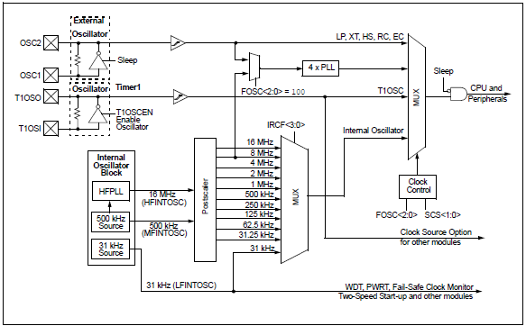
Review: clock sources

Slide 4
Review: Timer module
Internal timers common in microcontrollers
Used to generate delays, measure time between events, or count event occurrences
Typical interrupts for
Timer overflow (common for generating delay)
Timer compare (also for generating delay—stop when timer reaches certain value)
Capture (what value does timer have when event occurs?)
Typical timer configurations
Run at particular speed relative to system clock (prescaled)
Increment every time external event occurs
PIC 16F1829 has 5 timers (four 8 bit, one 16 bit)

Slide 5
Rotate with timer-based delay (asm) (1/2)
Start:
;Setup main init
banksel OSCCON ;bank1
movlw b'00111000’ ;set cpu clock speed to 500KHz
movwf OSCCON
;Configure the LEDs
banksel TRISC ;bank1
clrf TRISC ;make all of PORTC an output
banksel LATC ;bank2
movlw b'00001000‘ ;start with DS4 lit
movwf LATC
;Setup Timer0
banksel OPTION_REG ;bank1
;1:256 prescaler for a delay of:
; (insruction-cycle * 256-counts)*prescaler =
; ((8uS * 256)*256) =~ 524mS
movlw b'00000111’
movwf OPTION_REG

Slide 6
Rotate with timer-based delay (asm) (2/2)
MainLoop:
btfss INTCON, TMR0IF ;did TMR0 roll over yet?
bra $-1 ;wait until TMR0 overflows
bcf INTCON, TMR0IF ;clear flag in software
;rotate the LEDs
banksel LATC ;bank2
lsrf LATC, f
btfsc STATUS,C ;did bit rotate into carry?
bsf LATC,3 ;yes, light DS4 back up
bra MainLoop ;continue forever
end

Slide 7
Rotate with timer-based delay (C)
void main(void) {
OSCCON = 0b00111000; //500KHz clock speed
TRISC = 0; //all LED pins are outputs
LATC = 0;
//1:256 prescaler for a delay of: (instruction-cycle * 256
// counts)*prescaler = ((8uS * 256)*256) =~ 524mS
OPTION_REG = 0b00000111;
LATCbits.LATC4 = 1; //start with DS4 lit
while (1) {
//PIC can do work here, but this program just waits for flag
while (!INTCONbits.TMR0IF) continue;
INTCONbits.T0IF = 0; //flag MUST be cleared in software
LATC >> = 1; //rotate the LEDs
if (STATUSbits.C) //when last LED is lit, restart pattern
LATCbits.LATC3 = 1;
}
}

Slide 8
Exceptions
Exception: unexpected event altering normal program flow
Often result of an error
Can occur in HW or SW
HW exceptions often handled by OS
Will signal running program to stop
Examples: divide by 0, system reset, invalid address accessed, breakpoint
Some programming languages (Java, C++, C#) have software exceptions for program-related events
Application-level try/catch blocks—attempt code that may fail and “catch” exception if that occurs
Exceptions are typically synchronous events
Occur in the course of executing a single instruction

Slide 9
Interrupts
Interrupt: CPU signal that external event has occurred
Usually generated by external hardware
Signals processor to interact with peripheral
Example: key pressed on keyboard, printer reading from memory, timer completing
Can be generated by specific instructions
x86 INT, INTO, BOUND instructions
Interrupts sometimes seen as subset of exceptions
Interrupts typically asynchronous events
HW signals can be generated at any time
Current instruction completes before interrupt is handled

Slide 10
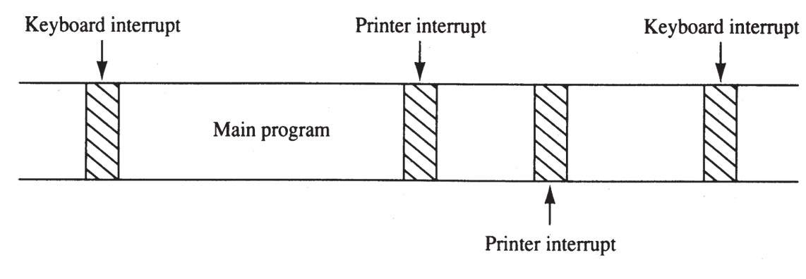
Interrupt timeline
Shows time dedicated to two potential recurring interrupts + main program
Interrupt service routines (ISRs) kept relatively short
Functions used to handle interrupts

Slide 11
General interrupt processing
Decide whether or not to service
Steps for doing so are processor-dependent
If servicing:
Complete current instruction
Save PC (or IP)
Need to know where to return after servicing interrupt
ISR is like a function, but you don’t explicitly call it
Save processor state
Registers, condition codes
Jump to start of ISR
Actually handle interrupt
Return from interrupt

Slide 12
Vectors
Interrupt/exception vector: starting address of service routine
On x86 processors, composed of both segment and instruction pointer
Typically stored in vector table
Often in lowest memory range (start at address 0)
Some vectors dedicated to specific exceptions/interrupts
Examples: divide by 0, page fault, alignment error
Range allowed for user-defined interrupts as well

Slide 13
PIC Interrupts
PIC controllers allow both internal and external interrupts
Single interrupt service routine
Must determine interrupt cause, then handle
Code addresses handled slightly differently
Processor goes to address 0 on reset, 4 on interrupt
Reset “vector”: jump to start of main program
Interrupt “vector”: jump to start of ISR
Code from program:
Org 0x0 ;Reset Vector starts at 0x0000
bra Start ;main code execution
Org 0x0004 ;Interrupt Vector starts at
; address 0x0004
goto ISR

Slide 14
Interrupt setup
Need to enable necessary interrupts
GIE bit in INTCON register: global interrupt enable
Timer 0 “rolls over” (goes from 255 to 0)
Set TMR0IE bit in INTCON
Switch is pressed (pin RA2 goes from high to low)
Interrupt on negative edge change in port A, pin 2
IOCIF flag in INTCON: general enable for interrupt on change
Bit 2 in IOCAN register: negative edge interrupt for port A, pin 2
Flags set when interrupt occurs
TMR0IF in INTCON for Timer 0 interrupt
Bit 2 of IOCAF register for switch
IOCAF → checking for interrupt on change in port A
Software must clear flags, or interrupts repeatedly occur

Slide 15
Rotate with interrupts (asm): Setup (1/3)
#define SWITCH PORTA, 2 ;pin where SW1 is connected
#define PULL_UPS ;if this is uncommented, JP5 can be pulled out
#define LED_RIGHT 0xFF ;keep track of LED direction
#define LED_LEFT 0x00
cblock 0x70 ;shared memory accessible from all banks
Direction
Delay1
endc
Org 0x0 ;Reset Vector starts at 0x0000
bra Start ;main code execution
Org 0x0004 ;Interrupt Vector starts at address 0x0004
goto ISR
Start:
banksel OSCCON ;bank1
movlw b'00111000' ;set cpu clock speed FO 500KHz
movwf OSCCON
bsf TRISA, RA2 ;switch as input
banksel ANSELA ;bank3
bcf ANSELA, RA2 ;digital
;can reference pins by position or name

Slide 16
Rotate with interrupts (asm): Setup (2/3)
;Configure the LEDs
banksel TRISC ;bank1
clrf TRISC ;make all of PORTC an output
banksel LATC ;bank2
movlw b'00001000' ;start with DS4 lit
;Setup Timer0 as the delay
banksel OPTION_REG ;bank1
movlw b'00000111' ;1:256 prescaler for a delay of 524mS
movwf OPTION_REG
bsf INTCON, TMR0IE ;enable the rollover interrupt to occur
;Setup interrupt-on-change for the switch
bsf INTCON, IOCIE ;set global IOC enable flag
banksel IOCAN ;bank7
bsf IOCAN, IOCAN2 ;when SW1 is pressed, enter the ISR
bsf INTCON, GIE ;must set GIE to allow any interrupt

Slide 17
Rotate with interrupts (asm): Setup (3/3)
#ifdef PULL_UPS ;set up pull up resistors
banksel WPUA ;bank4
bsf WPUA, 2 ;enable pull-up for switch
banksel OPTION_REG ;bank1
;enable (clear) the global weak pull-up bit
bcf OPTION_REG, NOT_WPUEN
#endif
movlw LED_RIGHT ; LEDs start moving
movwf Direction ; to right
;Clear the RAM
clrf Delay1

Slide 18
Rotate with interrupts (asm): Main loop, debounce, rotate LEDs
MainLoop:
bra MainLoop ; Main program doesn’t have to wait for timer
Debounce: ; Delay for ~5 mS
movlw d'209' ;(1/(500KHz/4))*209*3 = 5.016mS
movwf Delay1
DebounceLoop:
decfsz Delay1, f
bra DebounceLoop
return
RotateRight:
lsrf LATC, f ;logical shift right
btfsc STATUS,C ;did the bit rotate into the carry?
bsf LATC,3 ;yes, put it into bit 3.
retfie
RotateLeft:
lslf LATC, f ;logical shift left
btfsc LATC, 4 ;did it rotate out of the LED display?
bsf LATC, 0 ;yes, put in bit 0
retfie

Slide 19
Rotate with interrupts (asm): ISR (1/2)
ISR:
banksel IOCAF ;bank7
btfsc IOCAF, 2 ;check the interrupt-on-change flag
bra Service_SW1 ;switch was pressed
bra Service_TMR0 ;Timer0 overflowed
Service_SW1:
; Clear flag without changing other IOCAF bits
movlw 0xFF
xorwf IOCAF, w
andwf IOCAF, f ;clearing this will also clear INTCON, IOCIF bit
call Debounce ;delay for 5ms and check switch again
banksel PORTA ;bank0
btfsc SWITCH ;is it still held down?
retfie ;nope, exit the ISR back to the main code
movlw 0xFF
xorwf Direction, f ;toggle direction state and save it back
retfie ;return to main code

Slide 20
Rotate with interrupts (asm): ISR (2/2)
Service_TMR0:
bcf INTCON, T0IF ; clear flag
banksel LATC
movlw LED_RIGHT ; check dir
subwf Direction, w
btfsc STATUS, Z
bra RotateRight
bra RotateLeft
end ;end code generation

Slide 21
Rotate with interrupts (C): defines
#include <htc.h> //PIC hardware mapping
#define _XTAL_FREQ 500000 //Used by the XC8 delay_ms(x) macro
#define DOWN 0
#define UP 1
#define SWITCH PORTAbits.RA2
#define LED_RIGHT 1
#define LED_LEFT 0
#define PULL_UPS
//config bits that are part-specific for the PIC16F1829
__CONFIG(FOSC_INTOSC & WDTE_OFF & PWRTE_OFF & MCLRE_OFF & CP_OFF & CPD_OFF & BOREN_ON & CLKOUTEN_OFF & IESO_OFF & FCMEN_OFF);
__CONFIG(WRT_OFF & PLLEN_OFF & STVREN_OFF & LVP_OFF);

Slide 22
Rotate with interrupts (C): main (1/2)
unsigned char _direction; //a global variable
void main(void) {
//general init
OSCCON = 0b00111000; //500KHz clock speed
TRISC = 0; //all LED pins are outputs
LATC = 0; //init LEDs in OFF state
LATCbits.LATC3 = 1; //DS4 is lit
_direction = LED_RIGHT; //LEDs rotating R to L
//setup switch (SW1)
TRISAbits.TRISA2 = 1; //switch as input
ANSELAbits.ANSA2 = 0; //digital switch
//by using internal resistors, you eliminate external pull-up/down resistor
#ifdef PULL_UPS
WPUA2 = 1; //enable weak pull-up for switch
nWPUEN = 0; //enable global weak pull-up bit
#endif

Slide 23
Rotate with interrupts (C): main (2/2)
//setup TIMER0 as the delay
//1:256 prescaler for a delay of: (insruction-cycle * 256-counts)*prescaler = ((8uS * 256)*256) =~ 524mS
OPTION_REG = 0b00000111; //setup TIMER0
INTCONbits.TMR0IE = 1; //enable the TMR0 rollover interrupt
//setup interrupt on change for the switch
INTCONbits.IOCIE = 1; //enable interrupt on change global
IOCANbits.IOCAN2 = 1; //when SW1 is pressed, enter the ISR
GIE = 1; //enable global interupts
while (1) {
continue; //can spend rest of time doing something critical here
}
}

Slide 24
Rotate with interrupts (C): ISR
void interrupt ISR(void) {
if (IOCAF) { //SW1 was just pressed
IOCAF = 0; //must clear the flag in software
__delay_ms(5); //debounce by waiting and seeing if still held down
if (SWITCH == DOWN) {
_direction ^= 1; //change directions
}
}
if (INTCONbits.T0IF) {
INTCONbits.T0IF = 0;
if (_direction == LED_RIGHT) {
LATC >> = 1; //rotate right
if (STATUSbits.C == 1) //when the last LED is lit, restart the pattern
LATCbits.LATC3 = 1;
} else{
LATC << = 1; //rotate left
if (LATCbits.LATC4 == 1) //when the last LED is lit, restart the pattern
LATCbits.LATC0 = 1;
}
}
}

Slide 25
Final notes
Next time:
Continue PIC programming
Reminders:
HW 5, 6 to be posted
HW 5: Problem set
HW 6: PIC programs (groups of 2 or 3)

