Slide 1
16.317 Microprocessor Systems Design I
Instructor: Dr. Michael Geiger
Fall 2015
Lecture 4:
x86 intro

Slide 2
Lecture outline
Announcements/reminders
Sign up for the course discussion group on Piazza
HW 1 to be posted; due 2:00 PM, 9/18
Review
Alignment and endianness
Today’s lecture
Addressing modes
x86 introduction
x86 memory accesses

Slide 3
Review: data storage
Registers
Small, fast set of on-chip storage (primarily for speed)
Referenced by name
Memory
Larger, slower set of storage (primarily for capacity)
Organized as hierarchy …
… but programmer references single range of addresses
Memory issues
Aligned data: address divisible by number of bytes
Endianness: 80x86 data is little endian

Slide 4
Addressing modes
Addressing modes: ways of specifying operand location
Where are operands stored? (3 location types)
Registers → register addressing
Provide name of register; value read from register
Memory
Provide address in memory; value read from that location
Several modes for specifying memory address
In the instruction → immediate addressing

Slide 5
Memory addressing
Instructions accessing memory generate effective address (EA)
Address calculated as part of instruction
EA can be used as
Actual memory address in a simple memory system
Address within a particular segment in a segmented memory architecture
Effective address calculations can involve
A constant value
One or more values stored in registers
Some combination of register and constant

Slide 6
General memory addressing modes
Memory direct addressing
EA = constant value encoded in instruction
Register indirect addressing
EA = value stored in register
Base + displacement addressing
EA = constant displacement + base register(s)
Can have variations of this mode based on number and type of registers
Scaled addressing
EA = base + (scale * index)
Used for array addressing

Slide 7
x86 intro
“x86” → family of Intel processors
Starts with 8086 processor (1978)
Used (w/extensions) in current processors
General purpose processor
Supports use of 8, 16, 32, or 64 bit data
Allows both register and memory operands
Segmented or flat memory architecture
Real and protected mode operation
Protected mode supports virtual memory

Slide 8
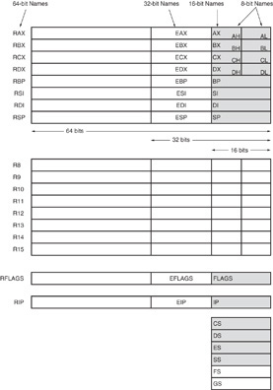
Register Set
Nine 32-bit registers
(4) Data registers- EAX, EBX, ECX, EDX, can be used as 32, 16 or 8bit
(2) Pointer registers- EBP, ESP
(2) Index registers- ESI, EDI
(1) Instruction pointer- EIP
Six 16-bit registers
(6) Segment registers- CS, DS, SS, ES, FS, GS
Flags (status) register-EFLAGS

Slide 9
Register Set
64-bit extensions
Added with Pentium 4
Data/pointer/index/IP/ flag register extended to 64 bits
For example:
RAX = 64-bit register A
RSP = 64-bit stack pointer
8 additional data registers (R8-R15)

Slide 10
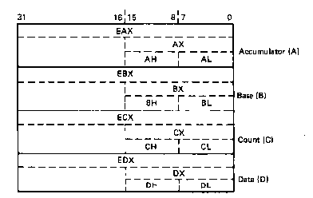
General Purpose Data Registers
Four general purpose data registers
Accumulator (A) register
Base (B) register
Count (C) register
Data (D) register
Can hold 8-bit, 16-bit, or 32-bit data
AH/AL = high and low byte value
AX = word value
EAX = double word value
General uses:
Hold data such as source or destination operands for most operations—ADD, AND, SHL
Hold address pointers for accessing memory
Some also have dedicated special uses
C—count for loop,
B—table look-up translations, base address
D—indirect I/O and string I/O

Slide 11
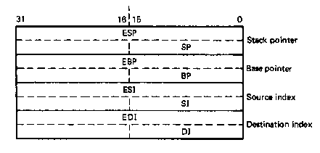
Pointer Registers
Two pointer registers
Stack pointer register
ESP = 32-bit extended stack pointer
SP = 16-bit stack pointer
Points to top of stack
Base pointer register
EBP = 32-bit extended base pointer
BP = 16-bit base pointer
Points to fixed location within current stack frame

Slide 12
Index Registers
Source index register
ESI = 32-bit source index register
SI = 16-bit source index register
Destination index registers
EDI = 32-bit destination index register
DI = 16-bit destination index register
Typically used to access source and destination operands

Slide 13
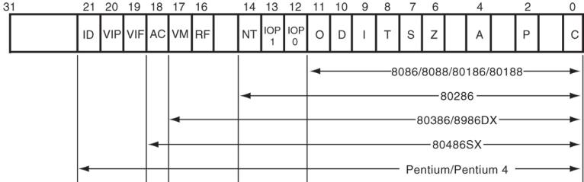
Flags Register
32-bit register holding single bit status and control information
9 active flags in real mode
Two categories
Status flags: conditions resulting from instruction
Most instructions update status
Used as test conditions
Control flags: control processor functions
Used by software to turn on/off operating capabilities

Slide 14
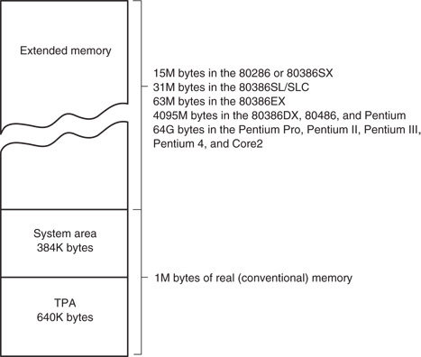
x86 memory spaces
x86 architecture implements independent memory and input/output (not shown) address spaces
Memory address space
1 MB “real” memory
System + transient program area (TPA)
Extended memory size dependent on processor
Input/output address space- 65,536 bytes long (64KB)

Slide 15
x86 memory modes
Two general modes of access
Real mode (DOS)
Protected mode (Windows)
Two memory models
Segmented memory model
Flat memory model
We’ll use this model

Slide 16
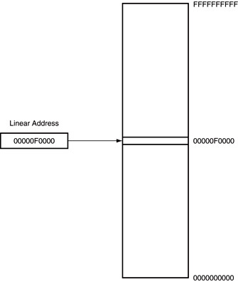
Flat mode addressing
No segmentation
Entire address space active
Address generated by instruction = linear address being accessed
Generates 40-bit external address

Slide 17
x86 addressing modes
Addresses in x86 instructions enclosed by brackets
Addressing modes: all examples of general addressing modes discussed earlier
Direct addressing
EA = constant value
Example: MOV AX, [0100H]
Register indirect addressing
EA = value stored in register
Example: MOV [EDI], AX
Base-plus-index addressing
EA = sum of two registers
Example: MOV AX, [EBX+ESI]

Slide 18
x86 addressing modes (cont.)
Register relative addressing
EA = register + constant
Examples:
MOV CL, [EBX+4]
MOV AX, ARRAY[EBX] ARRAY is constant memory location
Base relative-plus-index addressing
EA = base register + index register + constant
Example: MOV AX, 10H[ESI][EBX] -or-
MOV AX, [10H+SI+BX]
Scaled-index addressing
EA = register + (scaling factor * second register)
Often useful for array accesses
Scaling factor = element size (2, 4, 8 bytes)
Example: MOV EDX, [EAX + 4*EBX]

Slide 19
Example
Compute the address for the memory operand in each of the following instructions.
You do not need to specify what data is transferred
The register contents and variables are as follows:
(ESI) = 00000100₁₆
(EDI) = 00000200₁₆
(EBX) = 00000300₁₆
MOV [EBX+0400h], CX
MOV [EDI+2*EBX], AH
MOV [EBX+EDI+0400h], AL

Slide 20
Example solutions
Memory operand in: MOV [EBX+0400h], CX
Addr = value in EBX + 0400h
= 00000300h + 0400h = 00000700h
Memory operand in: MOV [EDI+2*EBX], AH
Addr = value in EDI + 2 * value in EBX
= 00000200h + 2 * 00000300h
= 00000200h + 00000600h
Memory operand in MOV [EBX+EDI+0400h], AL
Addr = EBX + EDI + 0400h
= 00000300H + 00000200H + 0400h = 00000900h

Slide 21
Final notes
Next time:
Assembly basics
Data transfer instructions
Reminders:
Sign up for the course discussion group on Piazza
HW 1 to be posted; due 2:00 PM, 9/18

