Slide 1
EECE.2160 ECE Application Programming
Instructor:
Dr. Michael Geiger
Summer 2016
Lecture 7:
Pointers & pointer arguments
PE3: Functions

Slide 2
Lecture outline
Announcements/reminders
Program 5 due 6/6
Review
Functions
Today’s lecture
Pointers
Pointer arguments
PE3: Functions

Slide 3
Review: functions
Used to break programs into smaller pieces
Useful when code sequences repeated
Functions have:
An optional return value
A name
Optional arguments
Must be prototyped or written completely prior to use
Preferred method: prototypes in header file, function definitions in one source file, main function in separate source file
We’ve discussed arguments passed by value:
Copy of argument is sent to function
Arguments cannot be modified outside function

Slide 4
Justifying pass by address
May want the ability to “return” multiple values from function
Functions can only return at most one value
Functions can take multiple arguments ...
... but, as we’ve discussed so far, passing by value just copies arguments
No way to change arguments and have change reflected outside of function
Solution uses pointers

Slide 5
Pointers
Pointer: address of a variable
Can get address of existing object using &
Can get value of existing pointer using *
Pointer declaration:
<base type>* <pointer name>
Base type determines how reference is interpreted
Be careful when declaring multiple pointers
Be sure to initialize pointer before use

Slide 6
Pointer example
int *iPtr, i=6;
double *dPtr, d=1.25;
iPtr
dPtr
i
d
6
1.25

Slide 7
Pointer assignment
The assignment operator (=) is defined for pointers of the same base type.
The right operand of the assignment operator can be any expression that evaluates to the same type as the left operand.
Example:
int x, *xp, *ip;
xp = &x;
ip = xp;
x
xp
ip

Slide 8
Pointer arguments
Passing pointer gives ability to modify data at that address
In prototype/definition—argument has pointer type
For example: int f(int *addr_x);
When calling function, can pass explicit pointer or use address operator (&<var>)
Examples:
int x = 3;
int y = 2;
int *xPtr = &x;
int result1, result2;
result1 = f(xPtr);
result2 = f(&y);

Slide 9
Functions - pass by address
#include <stdio.h> #include <math.h> void get_r_theta(double a, double b, double *adr_r, double *adr_th); void main() { double x,y,r,th; printf("Enter x, y components of vector: "); scanf("%lf %lf",&x,&y); get_r_theta(x,y,&r,&th); printf("Vector with x=%lf and y=%lf has r=%lf, theta=%lf\n",x,y,r,th); }
void get_r_theta(double a, double b, double *adr_r, double *adr_th) { double sum; sum = pow(a,2)+pow(b,2); //or a*a+b*b; *adr_r = sqrt(sum); *adr_th = atan2(b,a); }
x
4600
y
4608
r
4610
th
4618

Slide 10
Functions - pass by address
#include <stdio.h> #include <math.h> void get_r_theta(double a, double b, double *adr_r, double *adr_th); void main() { double x,y,r,th; printf("Enter x, y components of vector: "); scanf("%lf %lf",&x,&y); // user enters 3,4 get_r_theta(x,y,&r,&th); printf("Vector with x=%lf and y=%lf has r=%lf, theta=%lf\n",x,y,r,th); }
void get_r_theta(double a, double b, double *adr_r, double *adr_th) { double sum; sum = pow(a,2)+pow(b,2); //or a*a+b*b; *adr_r = sqrt(sum); *adr_th = atan2(b,a); }
x
3.0
4600
y
4.0
4608
r
?
4610
th
?
4618

Slide 11
Functions - pass by address
#include <stdio.h> #include <math.h> void get_r_theta(double a, double b, double *adr_r, double *adr_th); void main() { double x,y,r,th; printf("Enter x, y components of vector: "); scanf("%lf %lf",&x,&y); // user enters 3,4 get_r_theta(x,y,&r,&th); printf("Vector with x=%lf and y=%lf has r=%lf, theta=%lf\n",x,y,r,th); }
void get_r_theta(double a, double b, double *adr_r, double *adr_th) { double sum; sum = pow(a,2)+pow(b,2); //or a*a+b*b; *adr_r = sqrt(sum); *adr_th = atan2(b,a); }
x
3.0
4600
y
4.0
4608
r
4610
th
4618
a
3.0
7380
b
4.0
7385
adr_r
4610
7388
adr_th
4618
738c
sum
7380

Slide 12
Functions - pass by address
#include <stdio.h> #include <math.h> void get_r_theta(double a, double b, double *adr_r, double *adr_th); void main() { double x,y,r,th; printf("Enter x, y components of vector: "); scanf("%lf %lf",&x,&y); // user enters 3,4 get_r_theta(x,y,&r,&th); printf("Vector with x=%lf and y=%lf has r=%lf, theta=%lf\n",x,y,r,th); }
void get_r_theta(double a, double b, double *adr_r, double *adr_th) { double sum; sum = pow(a,2)+pow(b,2); //or a*a+b*b; *adr_r = sqrt(sum); *adr_th = atan2(b,a); }
x
3.0
4600
y
4.0
4608
r
?
4610
th
?
4618
a
3.0
7380
b
4.0
7385
adr_r
4610
7388
adr_th
4618
738c
sum
25.0
7380

Slide 13
Functions - pass by address
#include <stdio.h> #include <math.h> void get_r_theta(double a, double b, double *adr_r, double *adr_th); void main() { double x,y,r,th; printf("Enter x, y components of vector: "); scanf("%lf %lf",&x,&y); // user enters 3,4 get_r_theta(x,y,&r,&th); printf("Vector with x=%lf and y=%lf has r=%lf, theta=%lf\n",x,y,r,th); }
void get_r_theta(double a, double b, double *adr_r, double *adr_th) { double sum; sum = pow(a,2)+pow(b,2); //or a*a+b*b; *adr_r = sqrt(sum); *adr_th = atan2(b,a); }
x
3.0
4600
y
4.0
4608
r
5.0
4610
th
?
4618
a
3.0
7380
b
4.0
7385
adr_r
4610
7388
adr_th
4618
738c
sum
25.0
7380

Slide 14
Functions - pass by address
#include <stdio.h> #include <math.h> void get_r_theta(double a, double b, double *adr_r, double *adr_th); void main() { double x,y,r,th; printf("Enter x, y components of vector: "); scanf("%lf %lf",&x,&y); // user enters 3,4 get_r_theta(x,y,&r,&th); printf("Vector with x=%lf and y=%lf has r=%lf, theta=%lf\n",x,y,r,th); }
void get_r_theta(double a, double b, double *adr_r, double *adr_th) { double sum; sum = pow(a,2)+pow(b,2); //or a*a+b*b; *adr_r = sqrt(sum); *adr_th = atan2(b,a); }
x
3.0
4600
y
4.0
4608
r
5.0
4610
th
36.87
4618
a
3.0
7380
b
4.0
7388
adr_r
4610
7390
adr_th
4618
7394
sum
25.0
7398

Slide 15
Functions - pass by address
#include <stdio.h> #include <math.h> void get_r_theta(double a, double b, double *adr_r, double *adr_th); void main() { double x,y,r,th; printf("Enter x, y components of vector: "); scanf("%lf %lf",&x,&y); // user enters 3,4 get_r_theta(x,y,&r,&th); printf("Vector with x=%lf and y=%lf has r=%lf, theta=%lf\n",x,y,r,th); }
void get_r_theta(double a, double b, double *adr_r, double *adr_th) { double sum; sum = pow(a,2)+pow(b,2); //or a*a+b*b; *adr_r = sqrt(sum); *adr_th = atan2(b,a); }
x
3.0
4600
y
4.0
4608
r
5.0
4610
th
36.87
4618

Slide 16
Example: pointer arguments
What does the following print?
int f(int *a, int *b);
int main() {
int x = 1;
int y = 2;
int result1, result2, result3;
result1 = f(&x, &y);
result2 = f(&y, &result1);
result3 = f(&result1, &result2);
printf("x = %d, y = %d\n", x, y);
printf("Result 1: %d\n", result1);
printf("Result 2: %d\n", result2);
printf("Result 3: %d\n", result3);
return 0;
}
int f(int *a, int *b)
{
int copyB = *b;
while (*a > 1) {
*b += copyB;
(*a)--;
}
return *b;
}

Slide 17
Example solution
After first call to function
x = 1, y = 2, result1 = 2
After second call to function
y = 1, result1 = 4, result2 = 4
After third call to function
result1 = 1, result2 = 16, result3 = 16
Final output
x = 1, y = 1
Result 1: 1
Result 2: 16
Result 3: 16

Slide 18
Example: writing functions with pointers
Write a function that:
Given two integer arguments, x and y, store the quotient and remainder of x / y into locations specified by arguments q and r, respectively.
Uses pointers to swap the values of two double-precision variables

Slide 19
Example solution
Given two integer arguments, x and y, store the quotient and remainder of x / y into locations specified by arguments q and r, respectively.
void divQR(int x, int y,
int *q, int *r)
{
*q = x / y;
*r = x % y;
}

Slide 20
Example solution (cont.)
Use pointers to swap the values of two double-precision variables
void swap(double *a, double *b)
{
double temp;
temp = *a;
*a = *b;
*b = temp;
}

Slide 21
PE3: Change problem
Given any amount of change under $2.00, determine and print out the minimum number of coins required to make that amount of change.
Available coins are Halves (half dollars), Quarters, Dimes, Nickels, and Pennies.

Slide 22
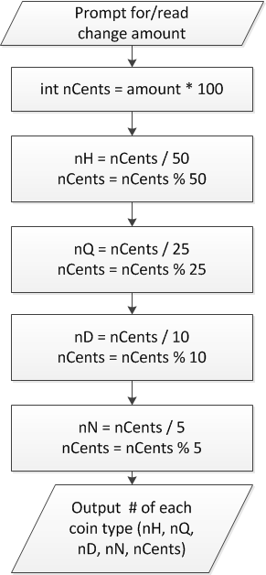
Flowchart
Treat change amount as integer (nCents)
Can now use division & modulus
nCents = # pennies after previous four coin types have been taken out

Slide 23
When to use functions
Find a particular step or series of steps being repeated in your code
If code is exactly the same, you need no arguments
If one or more values change, but actual calculations are the same, values can be function arguments
If function modifies:
1 variable: just return it
2+ variables: use pointer argument(s)
Reassess change example
Steps for creating change are extremely similar
What changes each time?
How should we use those values in a function?
Inputs, outputs, variables … ?

Slide 24
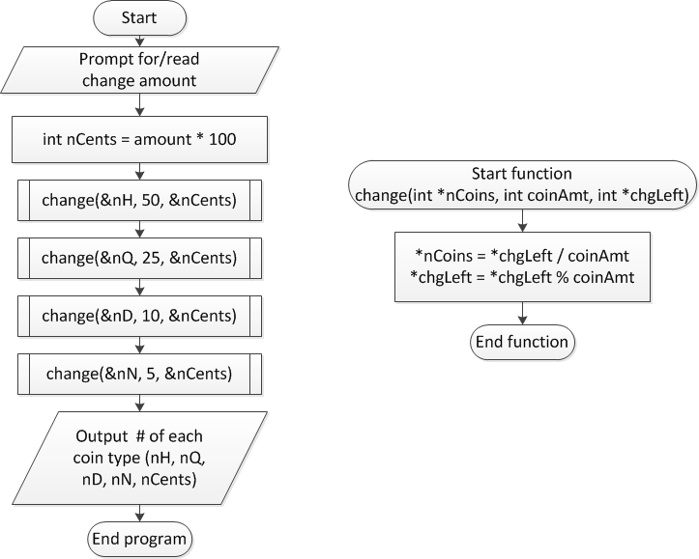
Overall flowchart

Slide 25
Final notes
Next time
Arrays
Reminders:
Program 5 due 6/6

