Slide 1
EECE.3170 Microprocessor Systems Design I
Instructor: Dr. Michael Geiger
Summer 2016
Lecture 7:
Subroutines
HLL → assembly

Slide 2
Lecture outline
Announcements/reminders
HW 3 due 1:00 PM, 6/6
Review
Conditional execution
Jump/loop instructions
Today’s lecture
Subroutines
Stack details
HLL → assembly

Slide 3
Review: conditional instructions
Conditional move
Move performed only if condition is true
SETcc D
Sets single byte destination to 1 (01H) if condition true; all 0s (00H) if condition false
Can be used to build up complex conditions

Slide 4
Review: jump, loop
Two general types of jump
Unconditional: JMP <target>
Always go to target address
Conditional: Jcc <target>
Go to target address if condition true
Loop instructions
Combines CX decrement with JNZ test
May add additional required condition
LOOPE/LOOPZ: loop if ((CX != 0) && (ZF == 1))
LOOPNE/LOOPNZ: loop if (CX != 0) && (ZF == 0))

Slide 5
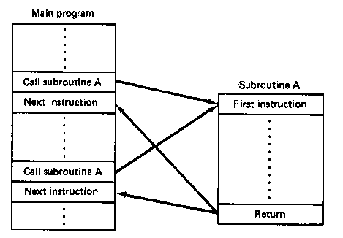
Subroutines
Subroutine: special program segment that can be “called” from any point in program
Implements HLL functions/procedures
Written to perform operation that must be repeated in program
Actual subroutine code only written once

Slide 6
Subroutine operation
When called, address of next instruction saved
State may need to be saved before call
Parameters can be passed
Control of program transferred to subroutine
After subroutine finished, return instruction goes back to saved address

Slide 7
x86 subroutines
Specify starting point with pseudo-op
<name> PROC
May save state/allocate variables at start
If so, will restore at end of subroutine
Last instruction returns to saved address
Always RET
Pseudo-op after RET indicates routine end
<name> ENDP

Slide 8
Subroutine example
SQUARE PROC
PUSH AX ; Save AX to stack
MOV AL, BL ; Copy BL to AL
IMUL BL ; AX = BL * AL
; = original BL squared
MOV BX, AX ; Copy result to BX
POP AX ; Restore AX
RET
SQUARE ENDP

Slide 9
Call/return
Calling subroutine: CALL <proc>
Address of next instruction saved on stack
Either IP or EIP (instruction pointer)
When function ends, use return instruction (RET)
Jumps to saved return address (IP/EIP)

Slide 10
Example
Assuming AX = 2 and BX = 4, show the results of the following sequence:
Assume the addresses of the first three instructions are 0005, 0008, and 0009, respectively
CALL SUM
RET ; End main function
SUM PROC NEAR
MOV DX, AX
ADD DX, BX
RET
SUM ENDP

Slide 11
Example results
CALL SUM
RET ; End main function
SUM PROC NEAR
MOV DX, AX DX = AX = 2
ADD DX, BX DX = DX + BX = 2 + 4 = 6
RET
SUM ENDP

Slide 12
Saving state
May need to save state before routine starts
Overwritten registers (that aren’t return values)
Flags
Placing data on stack: PUSH
Store data “above” current TOS; decrement SP
Stack grows toward lower addresses
New SP points to start of data just stored
Basic PUSH stores word or double word
Directly storing flags: PUSHF
Storing all 16-/32-bit general purpose registers: PUSHA/PUSHAD

Slide 14
Restoring state
Removing data from TOS: POP
Data removed from TOS; SP incremented
Basic POP removes word/double word
Directly removing flags: POPF
Removing all 16-/32-bit general purpose registers: POPA/POPAD
POP instructions generally executed in reverse order of corresponding PUSH instructions

Slide 15
Revisiting subroutine example
SQUARE PROC NEAR
PUSH AX ; Save AX to stack
MOV AL, BL ; Copy BL to AL
IMUL BL ; AL = BL * AL
; = original BL squared
MOV BX, AX ; Copy result to BX
POP AX ; Restore AX
RET
SQUARE ENDP

Slide 16
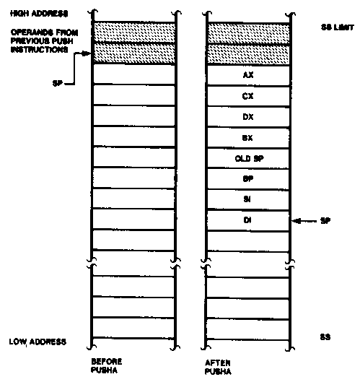
Push All and Pop All Operations

Slide 17
Stack examples
Assume initial state shown in handout
What is the resulting stack state of each of the following sequences?
PUSH BX
PUSH AX
PUSH EBX
PUSH EAX
PUSHA

Slide 18
Solution
What is the resulting stack state of each of the following sequences?
PUSH BX
PUSH AX
4 bytes pushed to stack, so SP decremented by 4 → ESP = 00001FFCH
AX is at top of stack; BX is below that
PUSH EBX
PUSH EAX
8 bytes pushed to stack, so SP decremented by 8 → ESP = 00001FF8H
EAX is at top of stack; EBX is below that
PUSHA
8 words = 16 bytes pushed to stack, so SP decremented by 16 → ESP = 00001FF0H
As shown in slide 13, DI is at top of stack, followed by SI, BP, old SP, BX, DX, CX, and AX

Slide 19
HLL → assembly
Given some brief examples already; want to think about common HLL concepts and their assembly counterparts
Compiling HLL to assembly
Data accesses
Stack usage with function calls
Conditional statements (if-then-else)
Loops

Slide 20
Sample program
int X[10], Y[10]; // integer arrays
int i, j; // index variables
for (i = 0; i < 10; i++) { // outer loop
X[i] = i * 2; // set X[i]
for (j = 0; j < 10; j++) { // inner loop
if (j < 5) // set Y[j]
Y[j] = X[i] + j; // based on
else // value of j
Y[j] = X[i] – j;
}
}

Slide 21
Data representations
Program references four pieces of data
Two integer arrays: X[10], Y[10]
Two integer index variables: i, j
Compilers must account for:
Data size: is variable a double word, word, or byte?
Characters (char) are always 8 bits → 1 byte
Other types system-dependent
In x86, integers (int) are 32 bits → 4 bytes → double word
Short integers (short) are 16 bits → 2 bytes → word
Data location: where is data allocated?
Depends on how it’s allocated …
If writing assembly by hand, static data → directly allocated in memory
If compiled code or function call, allocated on stack
Variables declared inside functions, function arguments

Slide 22
Static data accesses
Global declarations in high-level program
Stored in data segment
Offset into data segment declared as symbol
Example (from testfile2.asm)
mov eax, DWORD PTR _c

Slide 23
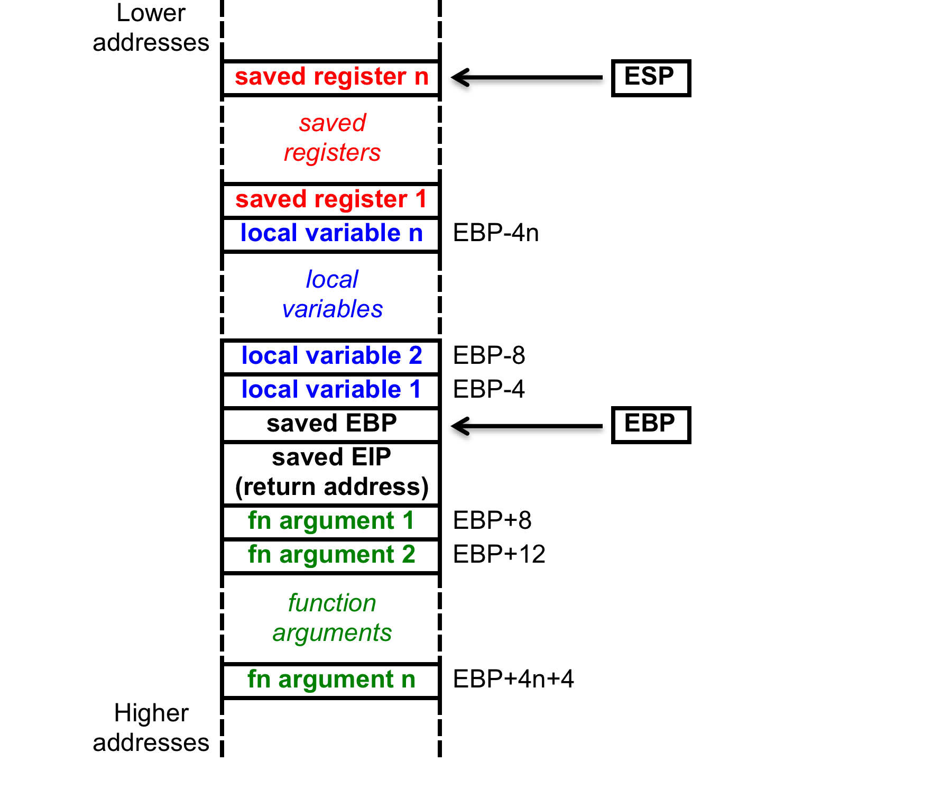
Stack accesses
On function call
SP or ESP: points to current top of stack
Lowest address in current stack frame
BP or EBP: used to reference data within frame
Arguments
Local variables

Slide 24
Stack accesses (cont.)
Arguments start at offset 8 from EBP
Local variables start at offset -4 from EBP
Starting offset of each variable can be defined as symbol
Ex. (testfile1.asm) _j$ = -120; size = 4
_i$ = -108; size = 4
_Y$ = -96; size = 40
_X$ = -48; size = 40
mov DWORD PTR _i$[ebp], 0
→ sets i = 0

Slide 25
Final notes
Next time:
More on HLL → assembly
Announcements/reminders
HW 3 due 1:00 PM, 6/6

