Slide 1
EECE.2160 ECE Application Programming
Instructors:
Dr. Michael Geiger & Dr. Peilong Li
Spring 2017
Lecture 13:
For loops

Slide 2
Lecture outline
Announcements/reminders
Program 4 due 2/24
Regrade deadline for P1-P3 to be determined …
… but don’t let that stop you from submitting regrades!
Just remember to e-mail Dr. Geiger when you do
Today’s lecture
For loops

Slide 3
Justifying for loops
Common loop structure
Initialize variable
Loop until that variable reaches certain limit
At end of each iteration, change variable by fixed amount
Example: squares program
i = 0;
while (i <= 10) {
iSquared = i * i;
printf("%2d%10d\n", i, iSquared);
i = i + 1;
}

Slide 4
for loops
for loops include all three aspects in one construct
Form:
for (<init var>; <test>; <change var>)
<statements>
<init var> is basic assignment
<test> same type of condition as if, while
<change var> change variable by fixed amount
Example: for (i = 0; i < 20; i++)
… You may be wondering what i++ means

Slide 5
Changing variables
Can do operation + assignment w/one operator
Simply adding/subtracting 1:
x++ → x = x + 1 (post-increment)
x-- → x = x – 1 (post-decrement)
++x → x = x + 1 (pre-increment)
--x → x = x – 1 (pre-decrement)
Augmented assignment: change variable by amount other than 1
x += y → x = x + y
x -= y → x = x – y
x *= y → x = x * y
x /= y → x = x / y

Slide 6
Pre- vs. post-increment/decrement
Pre-increment/decrement: perform increment/ decrement, then evaluate expression
Post-increment/decrement: evaluate expression, then perform increment/decrement
Example: what does the following print?
int n = 5;
printf(“n = %d\n”, ++n);
printf(“Now, n = %d\n”, n++);
printf(“Finally, n = %d\n”, n);

Slide 7
Example soln.
int n = 5;
printf(“n = %d\n”, ++n);
printf(“Now, n = %d\n”, n++);
printf(“Finally, n = %d\n”, n);
Output:
n = 6 (n pre-incremented)
Now, n = 6 (n post-incremented)
Finally, n = 7 (Shows effect of n++)

Slide 8
Simple usage of for loop
Common sequence of code:
x=0; while (x<12) { printf("%d ",x); x++; }
Output:
0 1 2 3 4 5 6 7 8 9 10 11

Slide 9
Intro to for loops
Common sequence of code:
x=0; while (x<12) { printf("%d ",x); x++; }
Equivalent for construct
for (x=0 ; x<12 ; x++ ) { printf("%d ",x); }
Initial value
Test condition
Body of loop (may be 0, 1, or several statements)
End of loop change

Slide 10
Repetition with for loop
Rewriting squares program with loop
int main() {
int i; // Number to square
int iSquared; // Square of the number
printf(" i i^2\n"); // Column headings
// Compute and display the squares of numbers 0 to 10
for (i = 0; i <= 10; i++) { // Loop until i > 10
iSquared = i * i;
printf("%2d%10d\n", i, iSquared);
}
return 0;
}

Slide 11
Repetition with for loop (cont.)
Generalizing program:
int main() {
int i; // Number to square
int iSquared; // Square of the number
int iStart; // Initial value
int iStop; // Last value
int iStep; // Increment
printf(“Enter start, stop, and increment: “);
scanf(“%d %d %d”, &iStart, &iStop, &iStep);
printf(" i i^2\n"); // Column headings
// Compute and display the squares of numbers iStart to iStop
// with increment iStep
for (i = iStart; i <= iStop; i += iStep) {
iSquared = i * i;
printf("%2d%10d\n", i, iSquared);
}
return 0;
}

Slide 12
Example: for loops
What does each of the following print?
for (i=5; i<40; i+=8) { printf("%d ", i); }
for (i=10; i<=100; i=i+10) { if (i%20) printf("%d ", i); }
for (i=-5; i<-10; i--) { printf("%d ", i); }
for (i=5; i<10; i+=i%2) { printf("%d ", i++); }

Slide 13
Example solution
What does each of the following print?
for (i=5; i<40; i+=8) { printf("%d ", i); }
OUTPUT: 5 13 21 29 37
for (i=10; i<=100; i=i+10) { if (i%20) printf("%d ", i); }
OUTPUT: 10 30 50 70 90
for (i=-5; i<-10; i--) { printf("%d ", i); }
OUTPUT: No output
for (i=5; i<10; i+=i%2) { printf("%d ", i++); }
OUTPUT: 5 6 8

Slide 14
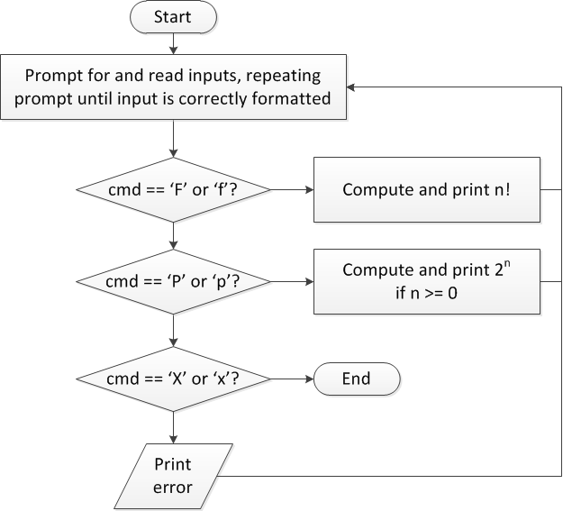
Finishing PE2: overall flow (review)

Slide 15
Finishing PE2: next steps
Write flowcharts for
Computing n!
Computing 2^{n} if n >= 0
Complete code

Slide 16
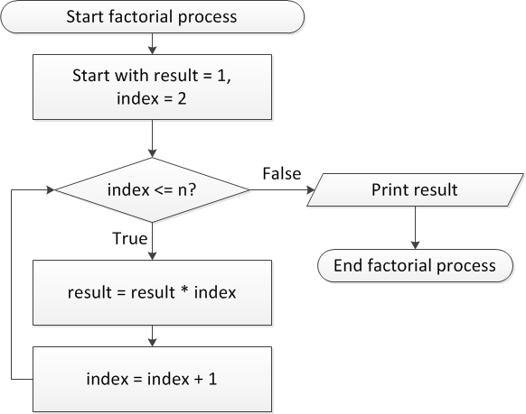
Flow charts: Calculating n!

Slide 17
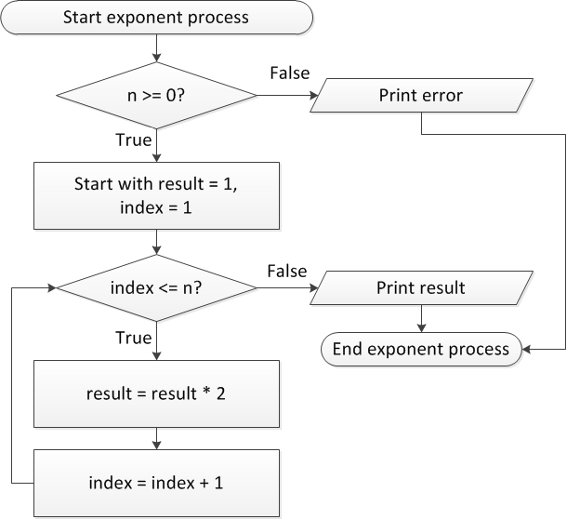
Flow charts: Calculating 2^{n}

Slide 18
Discussion: Factorial/2^{n}
Loop for each process covers fixed range of values
Use for loop
Can declare single variable to hold both results, since only one will be calculated

Slide 19
Code: factorial
result = 1;
for (i = n; i > 1; i--) {
result *= i;
}
printf("%d! = %d\n", n, result);
Slightly different approach than flow chart
Counts down instead of counting up
No benefit to doing one over the other

Slide 20
Code: 2^{n}
if (n < 0)
printf("Error: bad n value\n");
else {
result = 1;
for (i = 0; i < n; i++) {
result *= 2;
}
printf("2^%d = %d\n", n, result);
}

Slide 21
Final notes
Next time
Functions
Return exams
Reminders:
Program 4 due 2/24
Regrade deadline for P1-P3 to be determined …
… but don’t let that stop you from submitting regrades!
Just remember to e-mail Dr. Geiger when you do

