Slide 1
16.317 Microprocessor Systems Design I
Instructor: Dr. Michael Geiger
Fall 2015
Lecture 21:
PIC instruction set (continued)

Slide 2
Lecture outline
Announcements/reminders
HW 4 posted; due 10/30
Wednesday, November 4: Exam 2
Will be allowed one double-sized 8.5” x 11” note sheet, calculator
Instruction list to be provided
Advising starts Monday
Review
PIC instruction set basics
Data transfers
Bit manipulation instructions
Today’s lecture
Arithmetic instructions
Logical instructions
Shift/rotate instructions

Slide 3
Review: PIC instructions
Four typical instruction formats (+ few special purpose)
Upper bits of all hold opcode
Byte-oriented includes 1 bit destination, 7 bit direct address
Bit-oriented includes 3 bit position (0-7), 7 bit direct address
Literal/control includes 8 bit literal
CALL/GOTO includes 11 bit literal
Variable declarations
cblock <start_address>: start of variable declarations
All names between cblock/endc directives assigned to consecutive bytes starting at <start_address>

Slide 4
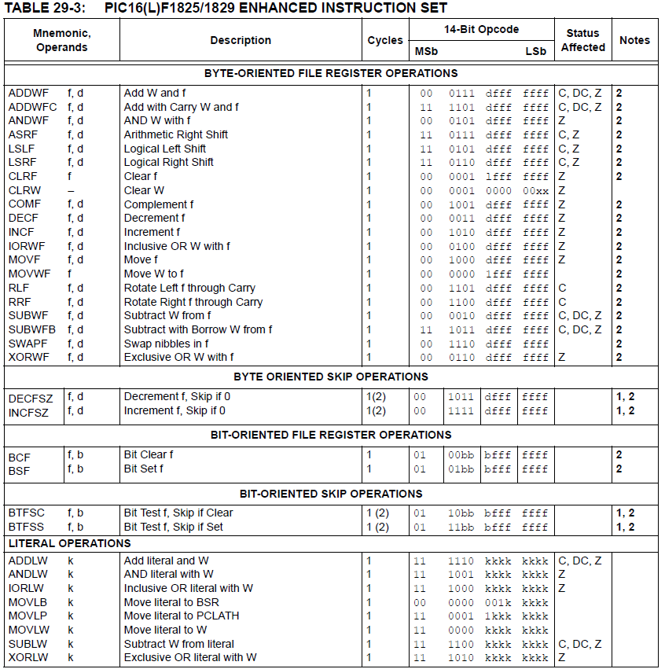

Slide 5
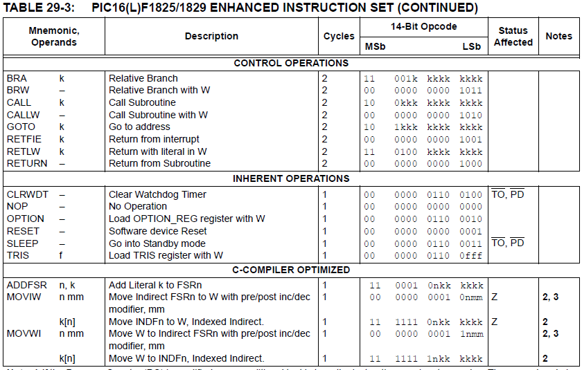

Slide 6
Review: PIC instructions (cont.)
Clearing register: clrw/clrf
Moving values: movlw/movwf/movf
Swap nibbles: swapf
Single bit manipulation: bsf/bcf

Slide 7
Increment/Decrement/ Complement
incf f, F(W) ; increment f, putting result in F or W
decf f, F(W) ;decrement f, putting result in F or W
comf f, F(W) ;complement f, putting result in F or W
STATUS bits:
Z
Examples:
incf TEMP1, F ;Increment TEMP1
incf TEMP1, W ;W <- TEMP1+1; TEMP1 unchanged
decf TEMP1, F ;Decrement TEMP1
comf TEMP1, F ;Change 0s and 1s to 1s and 0s

Slide 8
Addition/Subtraction
addlw k ;add literal value k into W
addwf f, F(W) ;add w and f, putting result in F or W
addwfc f, F(W) ;add w, f, and C, putting result in F or W
sublw k ;subtract W from literal value k, putting
;result in W
subwf f, F(W) ;subtract W from f, putting result in F or W
subwfb f, F(W) ;subtract f – W – (~C), putting result in F or W
STATUS bits:
C, DC, Z
Examples:
addlw 5 ; W = 5+W
addwf TEMP1, F ; TEMP1 = TEMP1+W
sublw 5 ; W = 5-W (not W = W-5 )
subwf TEMP1, F ; TEMP1 = TEMP1 - W

Slide 9
Example
Show the values of all changed registers after the following sequence
cblock 0x20
varA
varB
varC
endc
clrf varA
clrf varB
clrf varC
incf varA, W
sublw 0x0F
addwf varB, F
decf varB, F
comf varB, W
subwf varC, F

Slide 10
Example solution
clrf varA → varA = 0
clrf varB → varB = 0
clrf varC → varC = 0
incf varA, W → W = varA + 1 = 1
sublw 0x0F → W = 0x0F – W = 0x0F – 1
= 0x0E
addwf varB, F → varB = varB + W = 0x0E
decf varB, F → varB = varB – 1 = 0x0D
comf varB, W → W= ~varB = ~0x0D = 0xF2
subwf varC, F → varC = varC – W = 0x0E

Slide 11
Multi-bit Manipulation
andlw k ; AND literal value k into W
andwf f, F(W) ; AND W with f, putting result in F or W
iorlw k ; Inclusive-OR literal value k into W
iorwf f, F(W) ; Inclusive-OR W with f, putting result in F or W
xorlw k ; Exclusive-OR literal value k into W
xorwf f, F(W) ; Exclusive-OR W with f, putting result in F or W
Examples:
andlw B’00000111’ ;force upper 5 bits of W to zero
andwf TEMP1, F ;TEMP1 <- TEMP1 AND W
andwf TEMP1, W ;W <- TEMP1 AND W
iorlw B’00000111’ ;force lower 3 bits of W to one
iorwf TEMP1, F ;TEMP1 <- TEMP1 OR W
xorlw B’00000111’ ;complement lower 3 bits of W
xorwf TEMP1, W ;W <- TEMP1 XOR W
STATUS bits:
Z

Slide 12
Shift/Rotate
asrf f, F(W) ; copy f into F or W; shift F or W right one bit, keeping
; sign intact; shift LSB into C
lsrf f, F(W) ; copy f into F or W; shift F or W right one bit, shifting
; 0 into MSB; shift LSB into C
lslf f, F(W) ; copy f into F or W; shift F or W left one bit, shifting
; 0 into LSB; shift MSB into C
rlf f, F(W) ; copy f into F or W; rotate F or W left through
; the carry bit
rrf f, F(W) ; copy f into F or W; rotate F or W right through
; the carry bit
STATUS bits:
C

Slide 13
Final notes
Next time:
Continue with PIC instruction set
Reminders:
HW 4 posted; due 10/30
Wednesday, November 4: Exam 2
Will be allowed one double-sized 8.5” x 11” note sheet, calculator
Instruction list to be provided
Advising starts Monday

